Slide 1


MANJUFACTURING INDUSTRIES
INTRODUCTION
SUBJECT : GEOGRAPHY
CHAPTER NUMBER: 06 (Session-1)
CHAPTER NAME : MANUFACTURING INDUSTRIES

Slide 2
What we expect to learn?
Student will be able to apprise the importance of manufacturing industries in economic growth.
Student will be familiarized with industries contribution to national growth.
They will be able to analyse various factors responsible for the location of manufacturing industries.
Learners will be sensitized about human impacts on environment.
Awareness regarding conservation of resource
Building Righteous Conduct

Slide 3
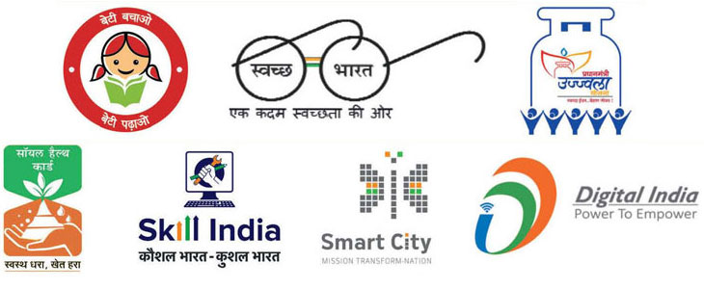
What is your view on PM Modi’s Dream Project?

Slide 4
Lets know more about you-
Lets start thinking?
Which is your favourite brand of Car?
Which brand’s clothes do you like wearing?
Ever wondered, how are they produced…..
So many products, at the same time…How?

Slide 5
INTRODUCTION
MANUFACTURING : Process of converting the raw material into a finished good is called manufacturing. This adds value to the good and it becomes of greater use to humans.
People employed in the secondary activities manufacture the primary materials into finished goods.
The economic strength of a country is measured by the development of manufacturing industries

Slide 6
Lets check these video :-
https://www.youtube.com/watch?v=J9NyrbzULw8 MANUFACTURING
https://www.youtube.com/watch?v=QHgNoSYlhYs COTTON MANUFACTURING

Slide 7
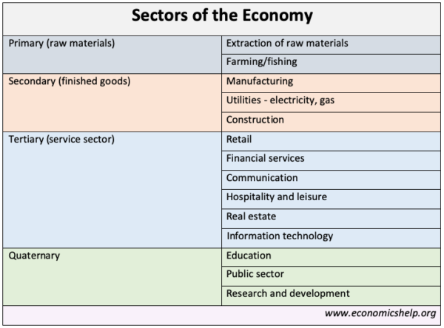

Slide 8
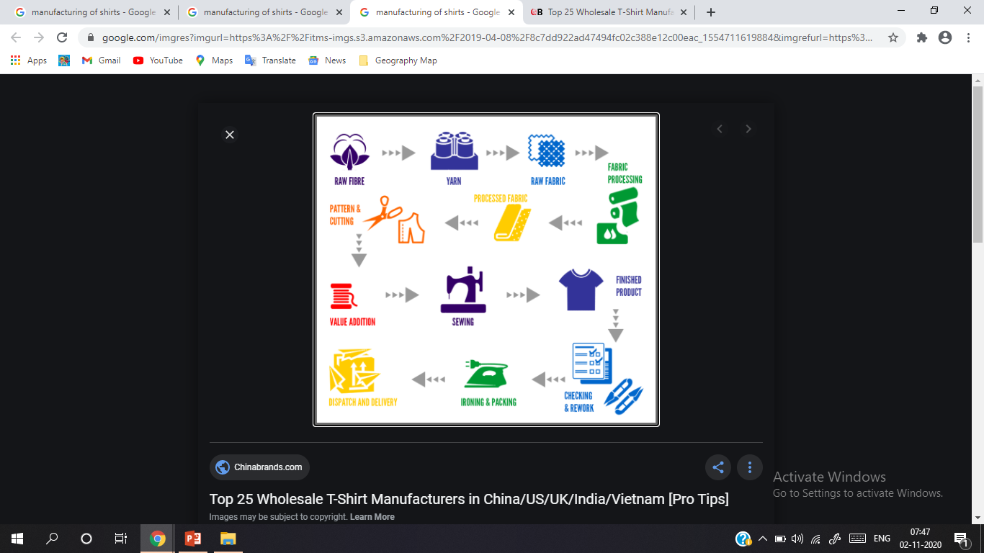

Slide 9
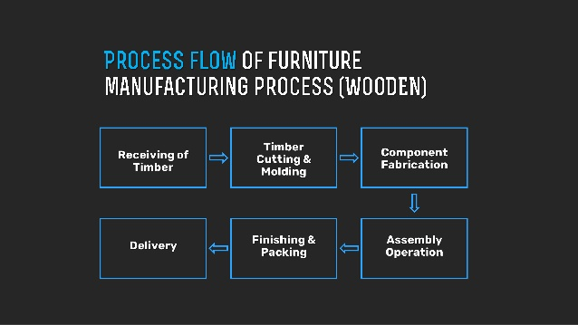

Slide 10
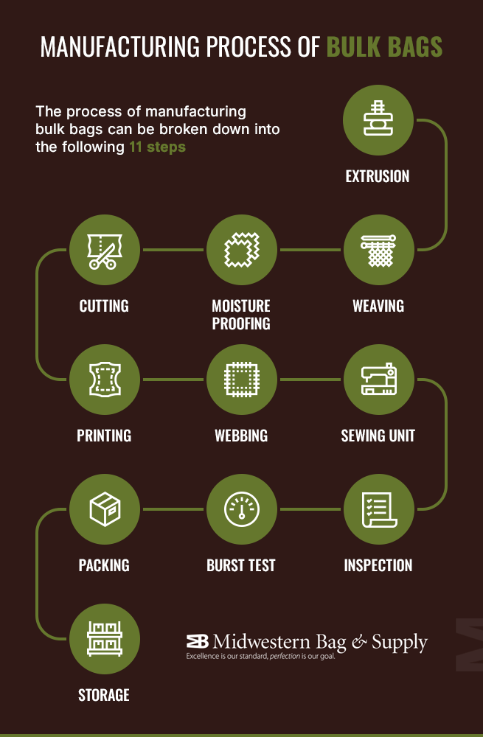

Slide 11
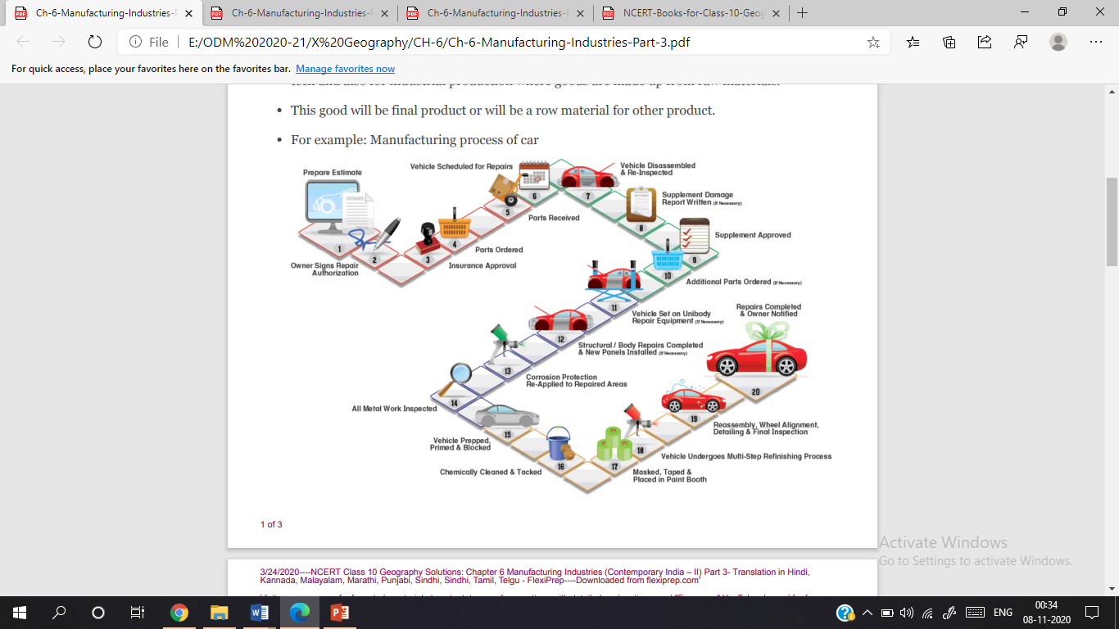

Slide 12
IMPORTANCE OF MANUFACTURING
1. INCREASE OF EMPLOYMENT | 9. SPECIALIZATION
2. INCREASE IN GNP | 10. STRONG DEFENCE
3. RAISE IN LIVING STANDARDS | 11. MARKET EXPANSION
4. INCREASE IN GOVERNMNET REVENUE | 12. AGRICULTURAL DEVELOPMENT
5. INCREASE IN SOCIAL WELFARE | 13. UTILIZATION OF RAW MATERIAL
6. INCREASE IN INVESTMENT | 14. RESOURCE DEVELOPMENT
7. MULTI SECTOR DEVELOPMENT | 15. FOREIGN EXCHANGE
8. FAVAOURABLE EXPORTS, IMPROVEMENT IN BALANCE OF PAYMENTS | 16. ECONOMIC STABILITY

Slide 13
CONTRIBUTION OF INDUSTRY TO NATIONAL ECONOMY
Over the last two decades, the share of manufacturing sector has stagnated to 17 per cent of the GDP, which is required to be increased.
The trend of growth rate in manufacturing over the last decade is around 7 per cent per annum.
Desired growth rate is 12 per cent per annum.
The National Manufacturing Competitiveness Council (NMCC) has been set up with the objective to improve productivity of industries .

Slide 14
CONTRIBUTION OF INDUSTRY TO NATIONAL ECONOMY
a) substantial increase in GDP . b)Industries generates employment . c)Industrial sector adds to country's growth and choices for consumers. d)It ensure foreign exchange. e) It improves country's infrastructure.

Slide 15
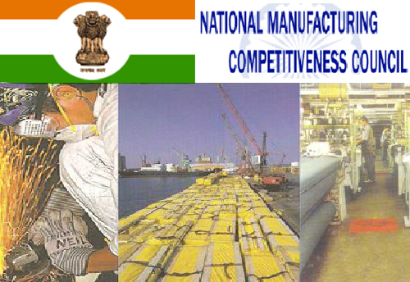

Slide 16
National Manufacturing Competitiveness Council (NMCC)
The National Manufacturing Competitiveness Council (NMCC) has been set up by the Government to provide a continuing forum for policy dialogue to energies and sustain the growth of manufacturing industries in India.
The Office of the National Manufacturing Competitiveness Council is a subordinate office under the Department of Industrial Policy and Promotion.
Details information is provided on the National Manufacturing Policy, national policy for manufacturing, national manufacturing competitiveness programmes, skill development and events etc.
Food processing, textiles and garments, engineering, consumer goods, pharmaceuticals, capital goods, leather and IT hardware are among the priority items specifically mentioned in the Common Minimum Programme

Slide 17
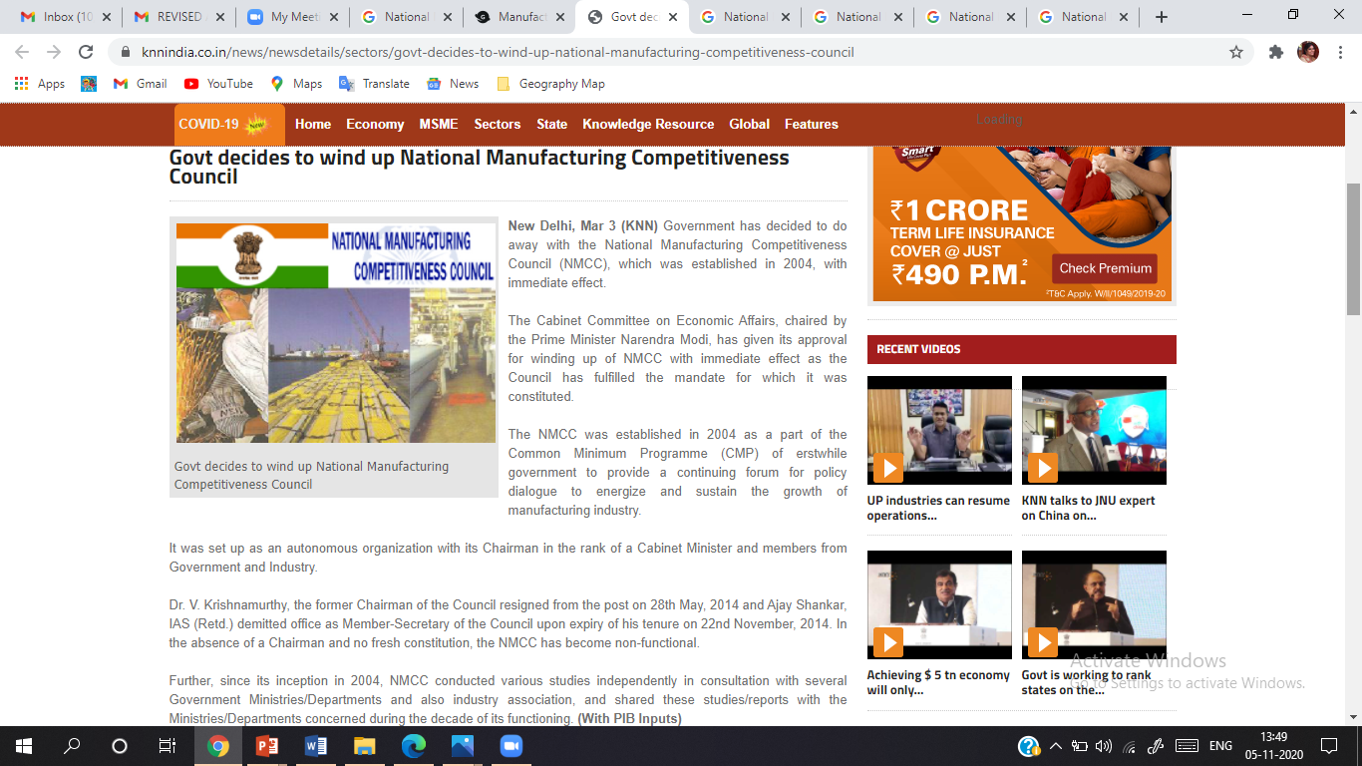
Current Government’s stand on NMCC.
#NewspaperClip

Slide 18
RECAPITULATION
Importance of Industry
Co-relation between Manufacturing and Agriculture
Contribution of Industry in Indian Economy
NMCC

Slide 19
HOME ASSIGNMENT
What is manufacturing?
What do you understand by secondary sector? Give few examples of secondary activities.
“The economic strength of a country is measured by the development of manufacturing industries.” Justify. Qs- 1, 2 and 7 of the Worksheet

Slide 20
THANKING YOU
ODM EDUCATIONAL GROUP

Slide 21
MANJUFACTURING INDUSTRIES
INTRODUCTION
SUBJECT : GEOGRAPHY
CHAPTER NUMBER: 06 (Session-2)
CHAPTER NAME : MANUFACTURING INDUSTRIES

Slide 22
What we expect to learn?
Student will be able to know about various factors that affect the location of an industry.
Student will be familiarized with industrial Market Linkage.
They will be able to analyse various classification of industries.
Learners will understand key role of raw materials.
They will be able to differentiate between various types of industries.
This will help in building righteous conduct about resources.

Slide 23


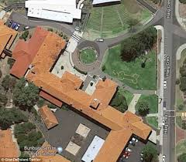
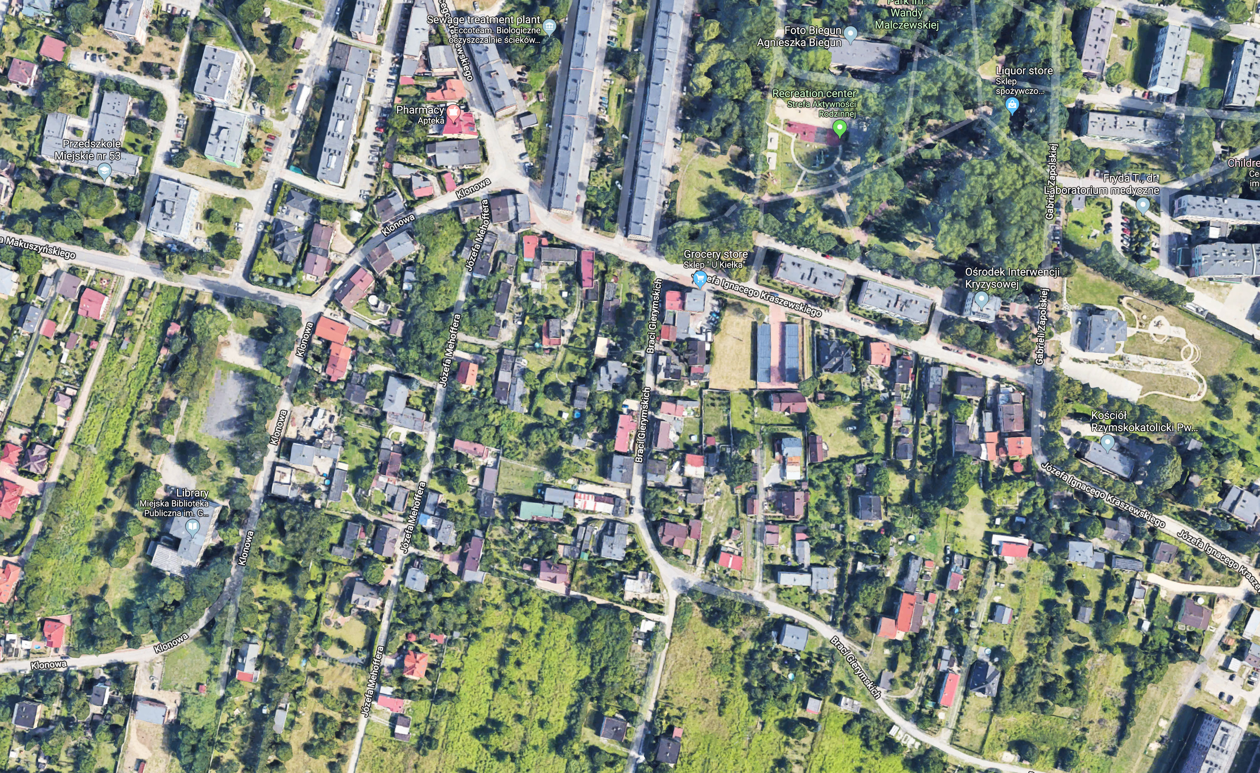
What is your view on following pictures :-

Slide 24
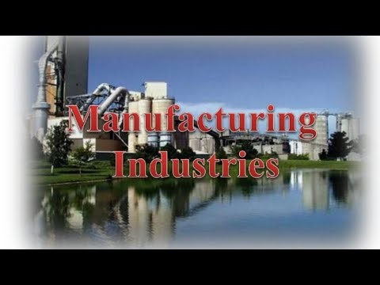

Lets check this video on Industrial Location :-
https://www.youtube.com/watch?v=0MmyQcA5z2c

Slide 25
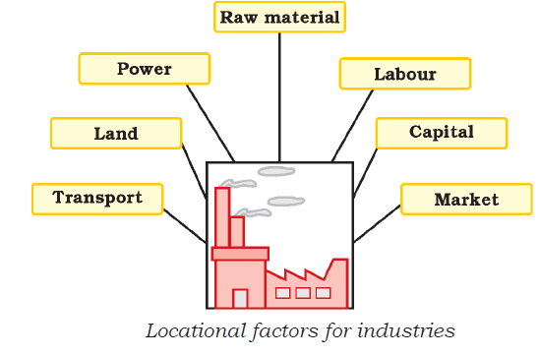

INDUSTRIAL LOCATION

Slide 26
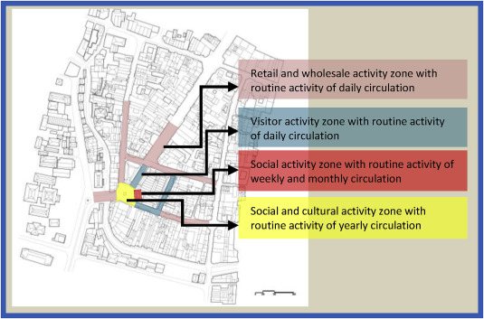
Industrial locations are complex in nature.
AGGLOMERATION ECONOMIES
Industrially developed urban centers are usually surrounded by a huge agricultural rural hinterland.

Slide 27
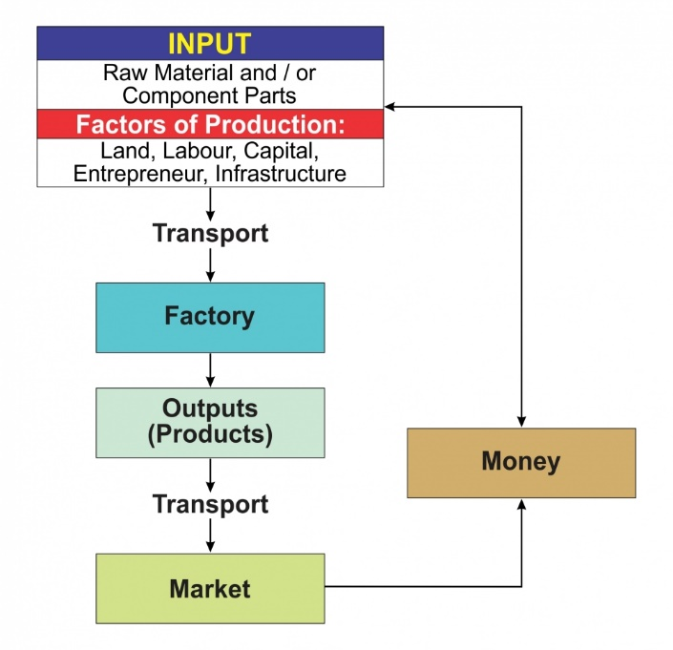
Industry Market Linkage

Slide 28
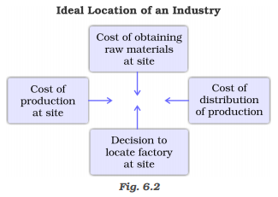
Ideal Location of Industry

Slide 29
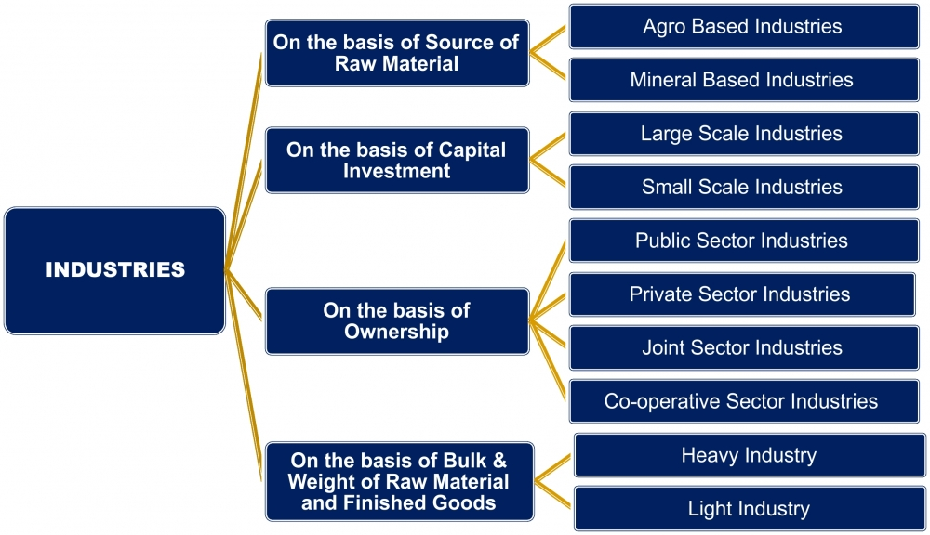
Classification of Industries

Slide 30
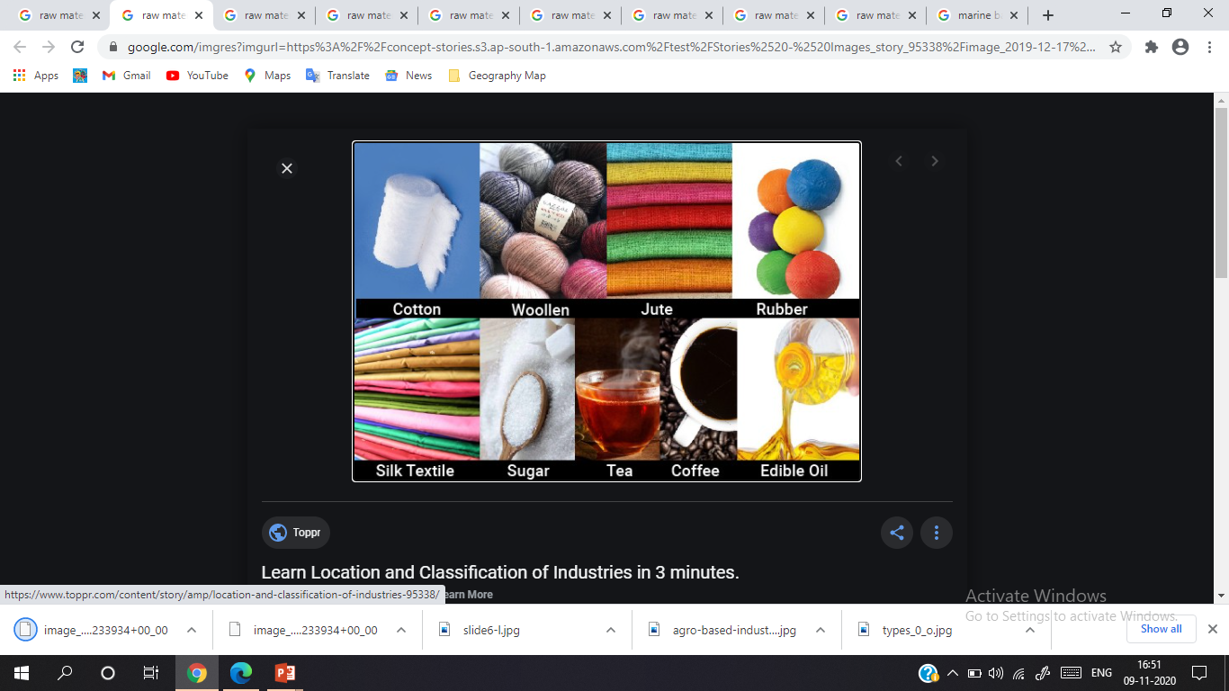
Agro-Based Industry

Slide 31
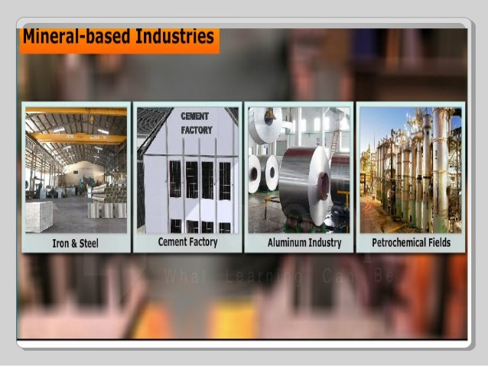

Slide 32
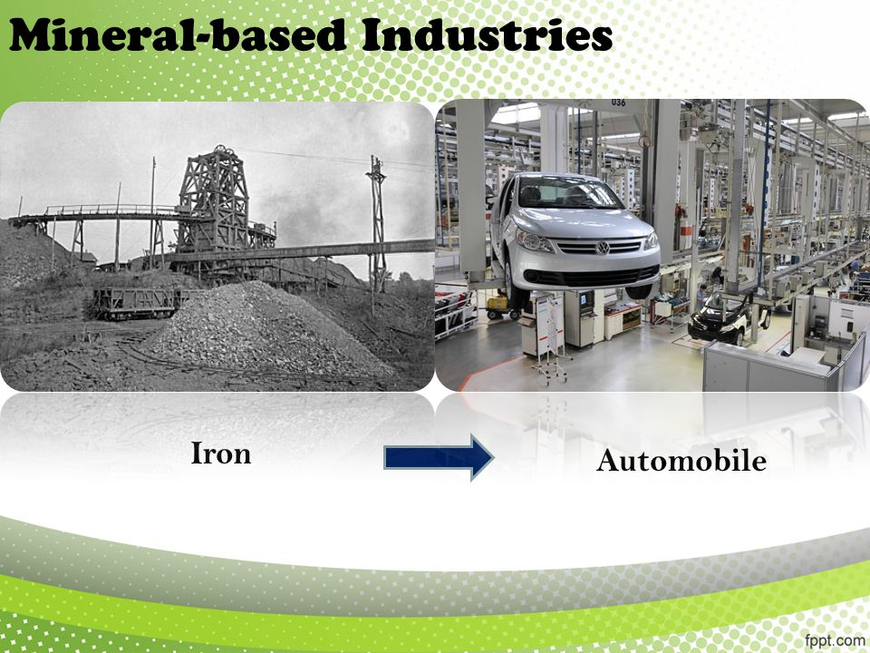

Slide 33
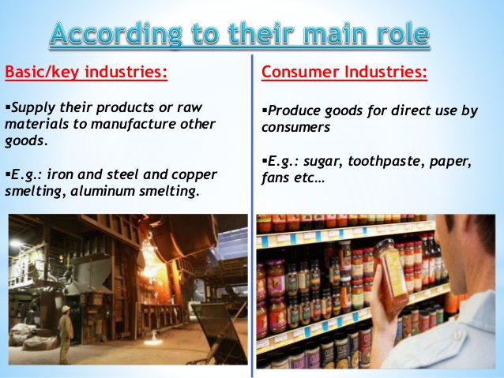
On the basis of their MAIN ROLE

Slide 34
RECAPITULATION
Industrial Location is based on various factors.
Industry-Market Linkage prime importance for manufacturing industry.
Ideal Location of Industry based on least cost.
Classification of Industries: - has various basis of category
On the basis of raw materials: - Agro-based, mineral-based
On the basis of main role:- Basic and consumer Industry

Slide 35
HOME ASSIGNMENT
Name three human factors that affect the location of industries. (1)
Give a diagram to depict industry and market linkage. (3)
Explain the classification of industries on the basis of raw materials with example. (5) (Worksheet Q.No.2, 4 and 5)

Slide 36
THANKING YOU
ODM EDUCATIONAL GROUP

Slide 37
MANJUFACTURING INDUSTRIES
INTRODUCTION
SUBJECT : GEOGRAPHY
CHAPTER NUMBER: 06 (Session-3)
CHAPTER NAME : MANUFACTURING INDUSTRIES

Slide 38
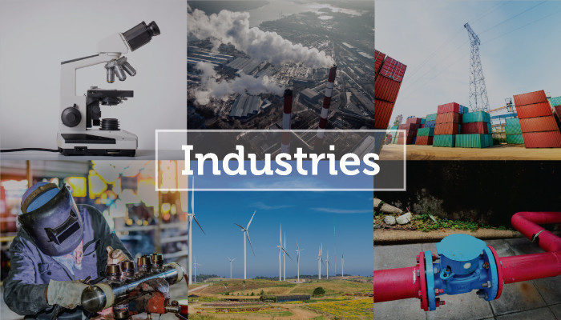

Slide 39
What we expect to learn?
Students will be able to classify the industries on the basis of their use specific to capital investment, ownership, bulk and weight of raw materials.
They will be able to differentiate between large scale industries, small scale industries, private-public-joint or co-operative sector industries.
They will understand importance of resources and its planned utilization.
They will be constructive towards conservation of resources.
This will help them to establish relationship between natural resources and types of industries.

Slide 40
Think the things around us :-
?
Have you been to any market or manufacturing site ?
What’s your favourite toy, do you know how its manufactured?
Name few Product people cannot imagine a life without, now-a-days?

Slide 41
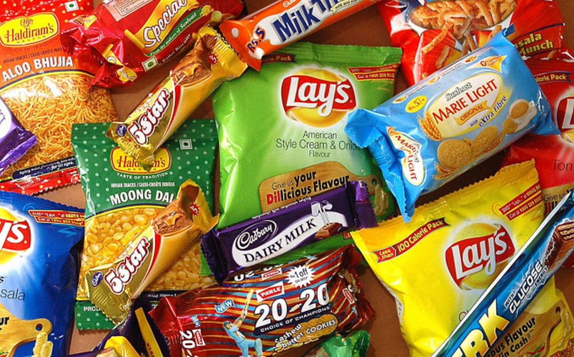
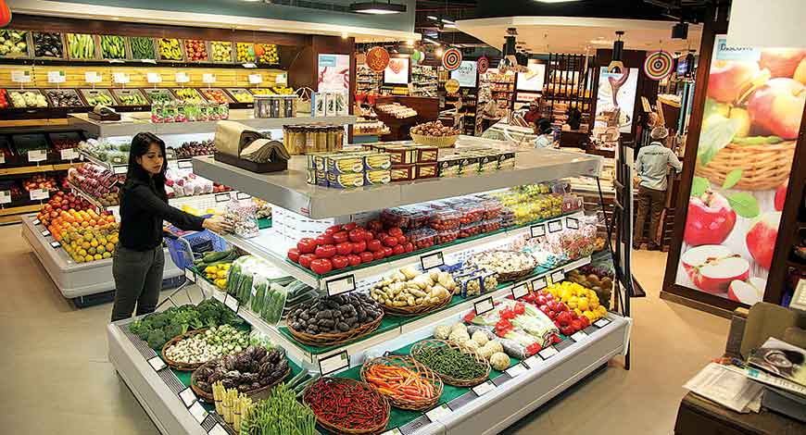
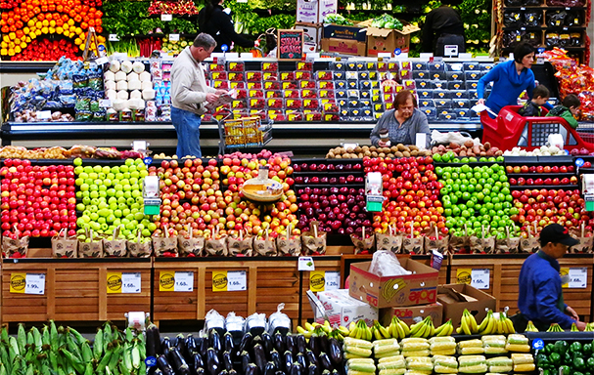

Can you guess their origin ?

Slide 42
CONTENT
Classification of Industries
On the basis of SIZE (Capital Investment)
On the basis of OWNERSHIP
On the basis of BULK AND WEIGHT OF THE RAW MATERIAL

Slide 43

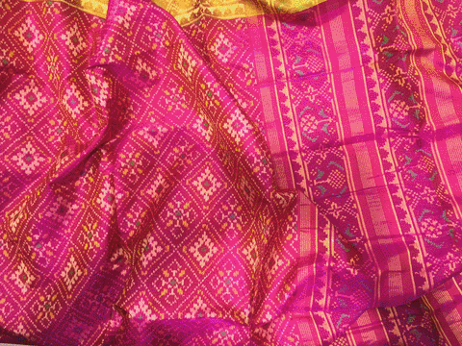
Small Scale Industries:
These industries use lesser amount of capital and technology.
They hire skilled labour.
Use machines
Obtain raw material from outside.
Produce more in terms of volume
Sell through traders in markets.
Works under private sector.
Ex- Silk-weaving, Garments production, food-leather units, chemical manufacturing, furniture-fittings, Automobile components etc.

Slide 44
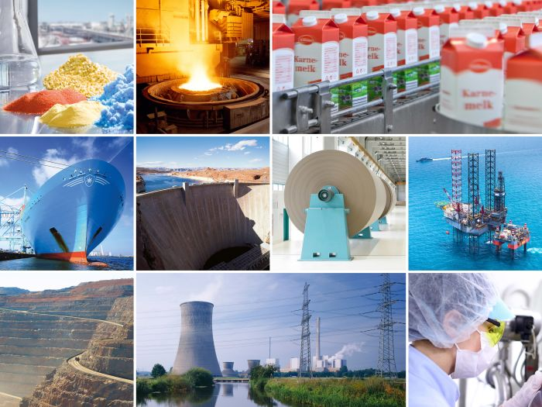

Slide 45
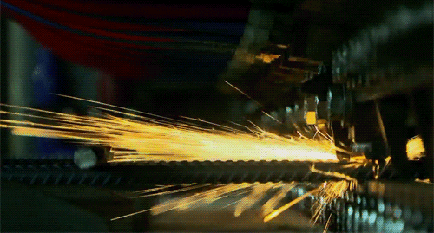
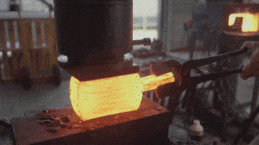
Large Scale Industries:
Large scale industries produce large volumes of products.
The investment of capital is higher.
Technology is superior.
Employ huge number of workers.
Production is on a mass scale and in voluminous.
For example: Iron-Steel, Petrochemicals, Textile, Production of automobiles- aircraft, railway coach, ship building, cement and heavy machinery etc.
After independence, India gave emphasis to this sector for development.

Slide 46
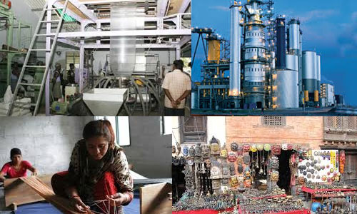
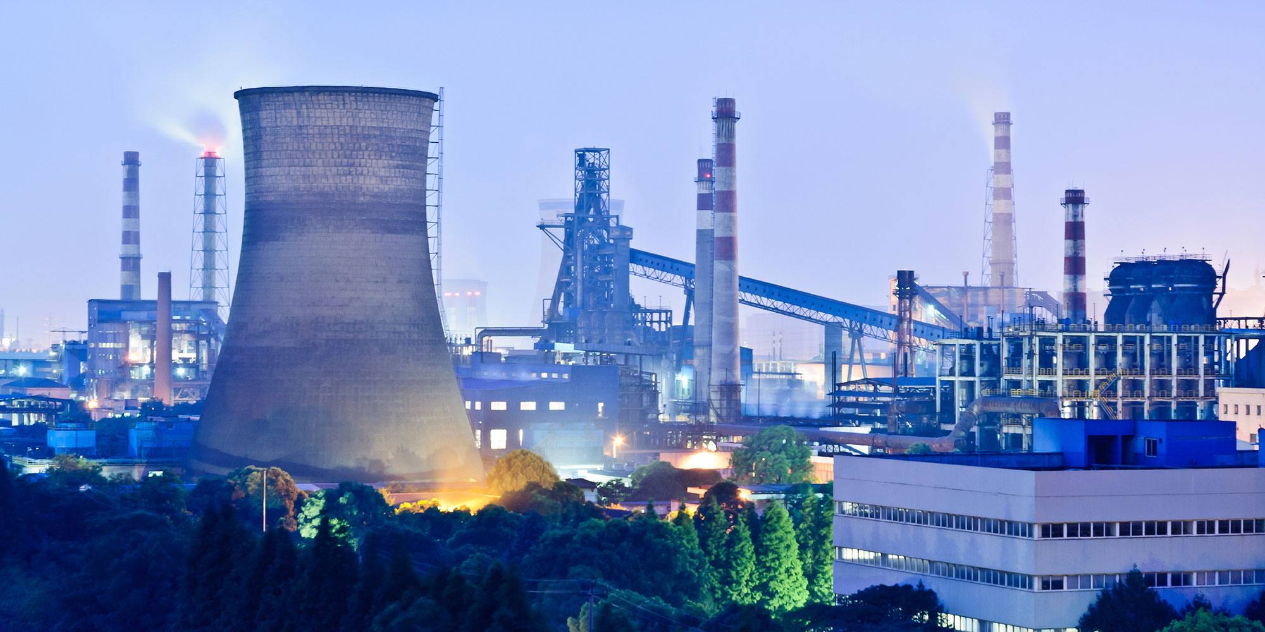
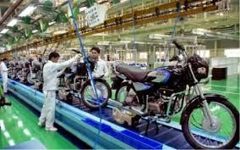

Slide 47
On the basis of ownership
Ownership: On the basis of ownership, industries can be classified into the following sectors:
Public sector industries are owned and operated by the government. For example, Hindustan Aeronautics Limited and Steel Authority of India Limited, BHEL, SAIL etc.
Private Sector Industries are owned and operated by individuals or a group of individuals. For example, Bharat Heavy Electrical Ltd., Indian Oil Cooperation, –TISCO, Bajaj Auto Ltd., Dabur Industries.
Joint Sector Industries are owned and operated by the state and individuals or a group of individuals. For example Maruti Udyog Limited. Oil India Ltd. (OIL) is jointly owned by public and private sector.

Slide 48
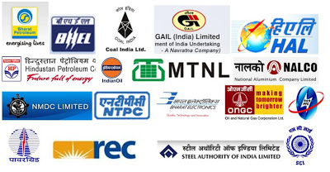

PUBLIC INDUSTRIES
PRIVATE INDUSTRY

Slide 49
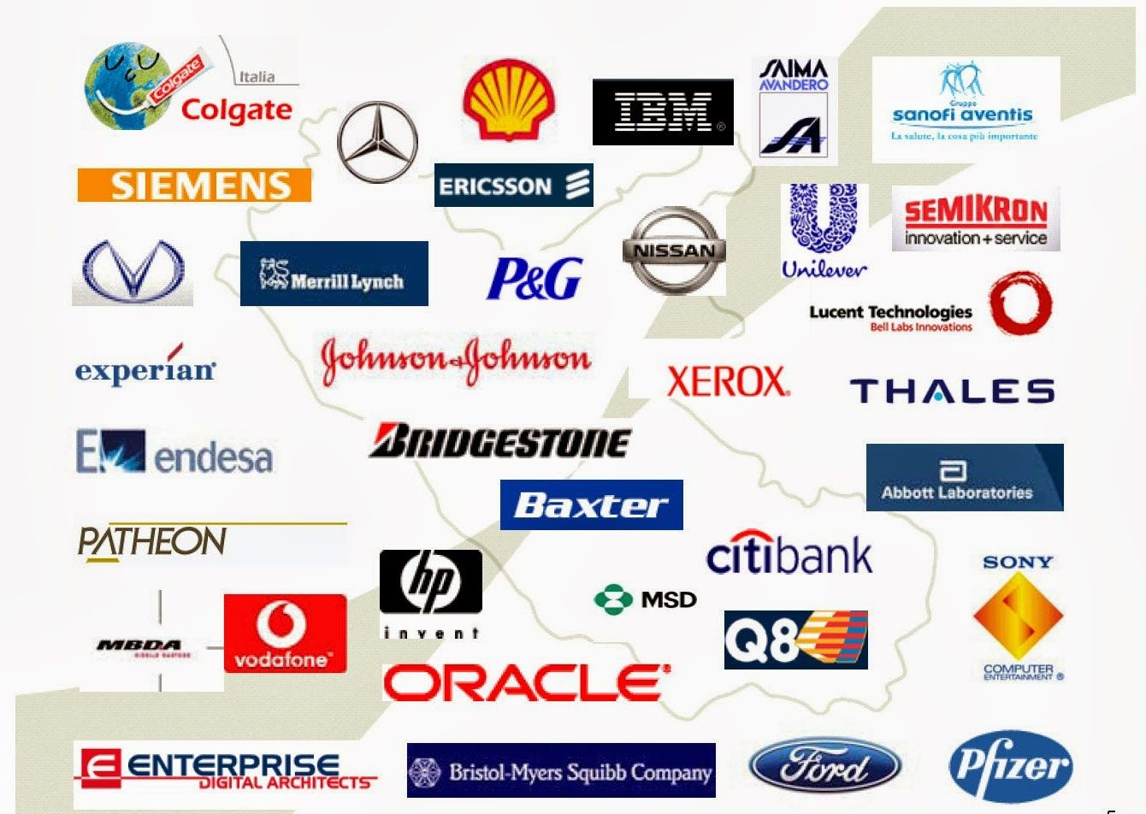
JOINT SECTOR INDUSTRIES

Slide 50
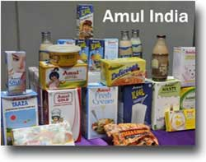
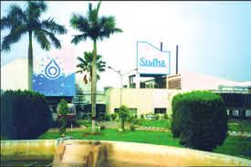
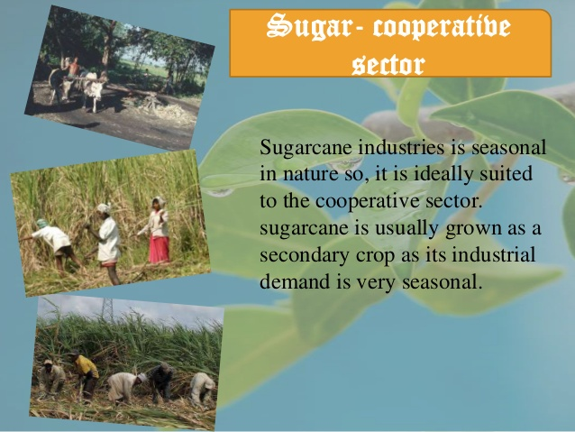
Cooperative Sector Industries: These industries are owned and operated by the producers or suppliers of raw materials, workers or both.
For example: AMUL (Anand Milk Union Limited, Cooperative Producers), KRIBHCO (Krishak Bharati Cooperative Limited), Sudha Dairy and West Bengal State Co-operative Bank Ltd.
Sugar industry in Maharashtra, the coir industry in Kerala. They process the raw material to add value and earn more profit. Aims community welfare.

Slide 51
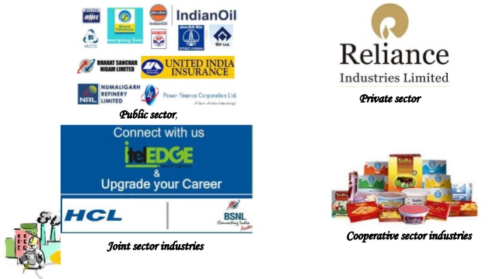

Slide 52
Based on the bulk and weight of raw material and finished goods:
• Heavy industries such as iron and steel
• Light industries that use light raw materials and produce light goods such as electrical industry
ACTIVITY :-
Classify the following into two groups on the basis of bulk and weight of raw material and finished goods. (i) Oil (vi) Sewing Machines (ii) Knitting needles (vii) Shipbuilding (iii) Brassware (viii) Electric Bulbs (iv) Fuse wires (ix) Paint brushes (v) Watches (x) Automobiles

Slide 53
RECAPITULATION
Classification of Industries
On the basis of SIZE (Capital Investment)
On the basis of OWNERSHIP
On the basis of BULK AND WEIGHT OF THE RAW MATERIAL

Slide 54
HOME ASSIGNMENT
Which of the following industries is not a heavy industry? (1) (a) Cotton textile (b) Cement (c) Iron and Steel (d) Ship building Name the classification of industries on the basis of bulk and weight. (2) Distinguish between large scale and small scale industry. (3) How can we classify industries on the basis of capital investment? Explain with example. (5) (WS Q.NO.- 2,3,5,7)

Slide 55
THANKING YOU
ODM EDUCATIONAL GROUP

Slide 56
MANJUFACTURING INDUSTRIES
INTRODUCTION
SUBJECT : GEOGRAPHY
CHAPTER NUMBER: 06 (Session-4)
CHAPTER NAME : MANUFACTURING INDUSTRIES

Slide 58
What we expect to learn?
Students will be able to understand agro-based industries specific to Cotton, Jute and Sugar Industry.
They will be able to know the importance of textile industry of our country.
This will build their conscious about country and its resources.
They will understand importance of resources and its planned utilization.
They will be constructive towards conservation of resources.

Slide 59

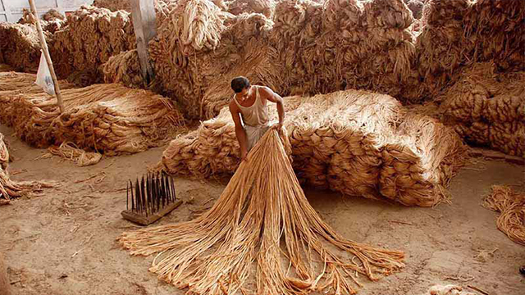

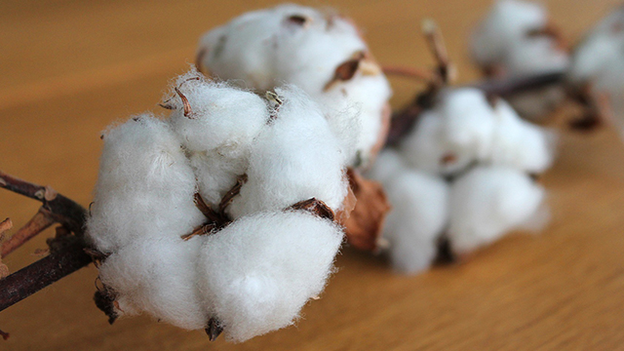
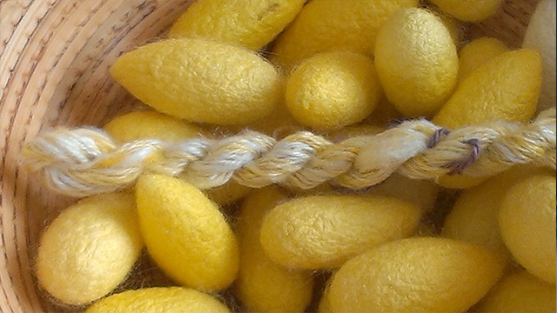
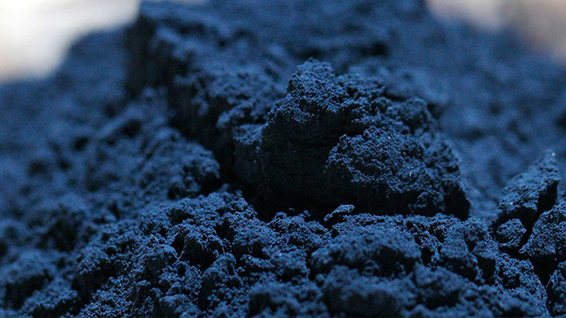
Let’s check out:-

Slide 60
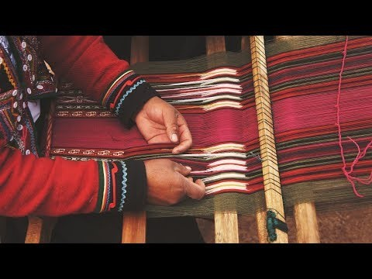
https://www.youtube.com/watch?v=s6LUwesvpyw INDIAN TEXTILE INDUSTRY

Slide 61
Agro Based Industries Cotton, jute, silk, Woollen textiles, sugar and edible oil, tea, coffee etc. industry are based on agricultural raw materials.

Slide 62

Textile Industry:
The textile industry’s industrial production- 14%
2nd largest employment generation
It contributes 4 per cent towards GDP.
It is the self-reliant industry.

Slide 63
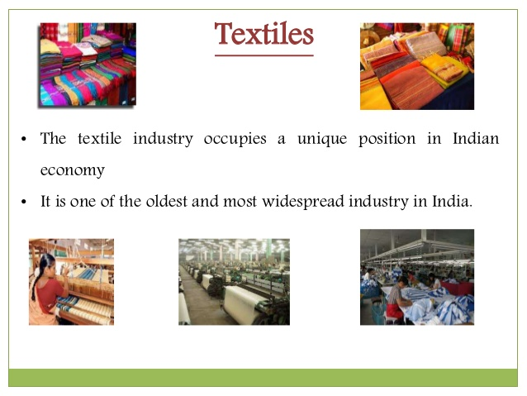

Slide 64
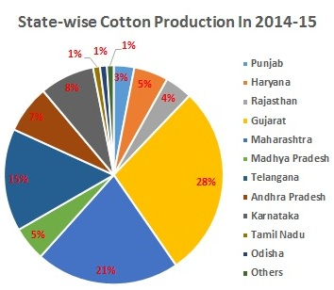
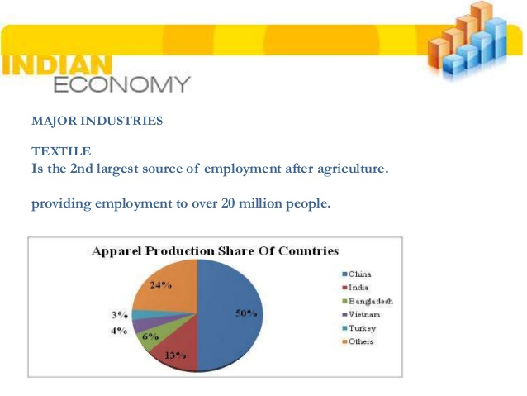

Slide 65

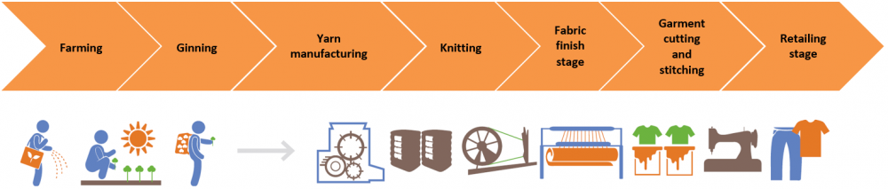
Value Addition in the Textile Industry

Slide 66
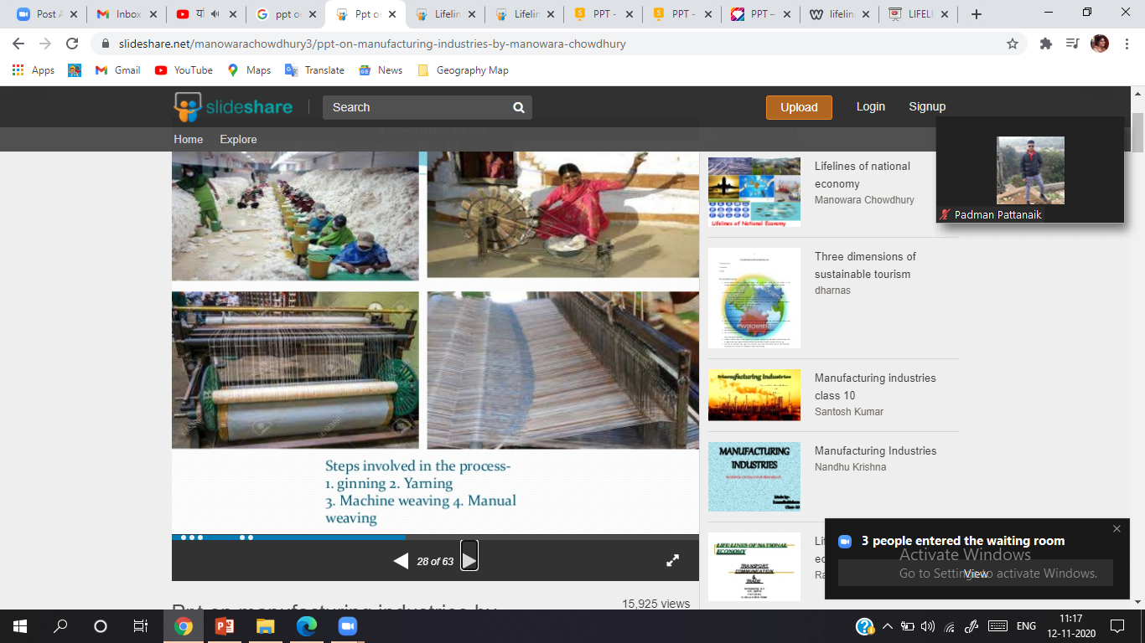
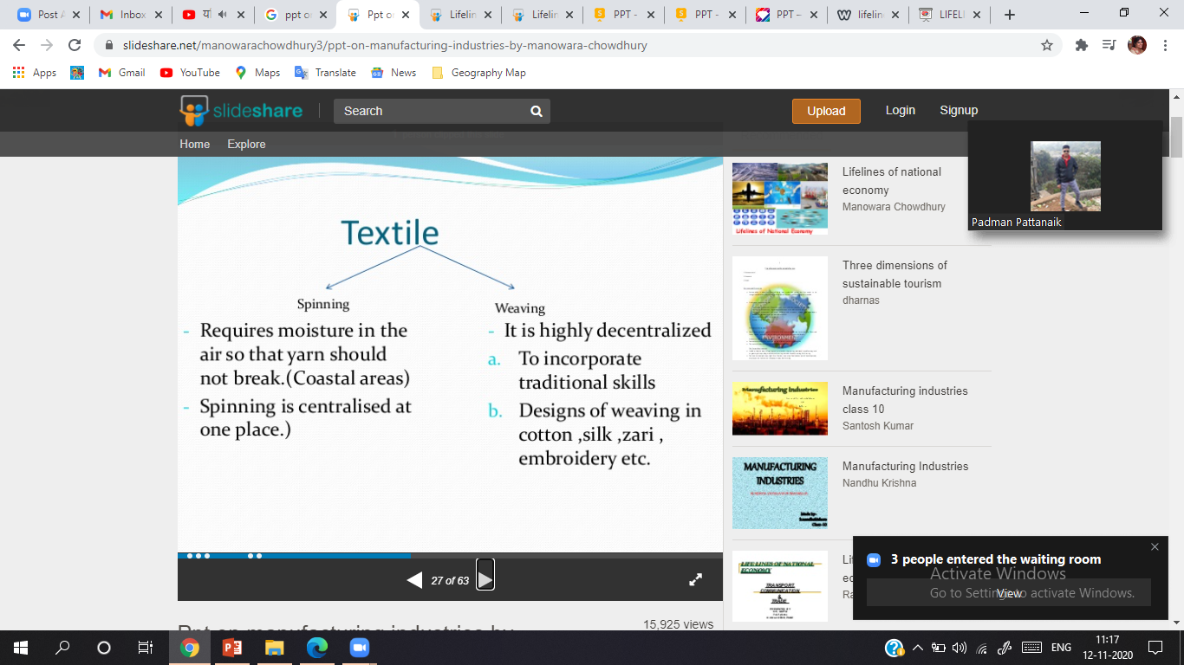

Slide 67
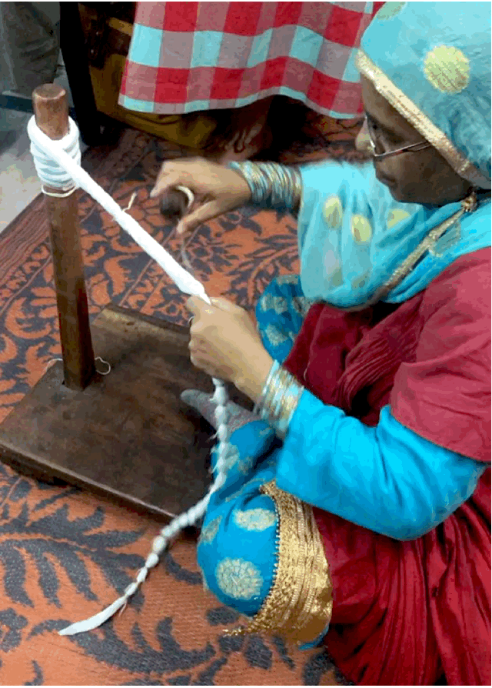

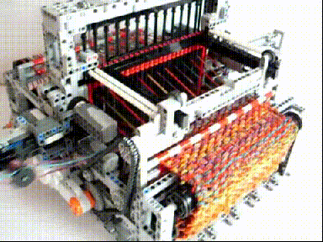
Cotton Textiles
Cotton Textiles: Handloom-Powerlooms
The first successful textile mill was established in Mumbai in 1854.
India exports yarn to Japan.
Importers of cotton goods from India are U.S.A., U.K., Russia, France, East European countries, Nepal, Singapore, Sri Lanka, and African countries.

Slide 68

Concentration of cotton textile industry -the cotton growing belt of Maharashtra and Gujarat.
Favourable conditions
Challenges

Slide 69
JUTE TEXTILES
India is the largest producer of raw jute and jute goods and stands at second place as an exporter after Bangladesh.
Located in West Bengal, mainly along the banks of the Hugli river, in a narrow belt (98 km long and 3 km wide).
The first jute mill was set up near Kolkata in 1859 at Rishra.
Factors responsible for their location in the Hugli basin.
Challenges of Jute Textile Industry
Solutions

Slide 70

Jute Production

Slide 71



Slide 72


Slide 73
SUGAR INDUSTRY
India stands second as a world producer of sugar but occupies the first place in the production of gur and khandsari.
The raw material used in this industry is bulky, and in haulage its sucrose content reduces.
Difference between North and South sugar mills.
Major challenges:-
The seasonal nature of the industry.
Old and inefficient methods of production.
Transport delay in reaching cane to factories.
The need to maximize the use of baggase.

Slide 74

Sugar Manufacturing

Slide 75
RECAPITULATION
Agro-based Industry
Cotton Industry
Jute Industry
Sugar Industry

Slide 76
HOME ASSIGNMENT
To which one of the following countries does India export jute goods? (1) (a) Japan (b) China (c) USA (d) France Why did Mahatma Gandhi lay emphasis on spinning yarn and weaving khadi? (3) State three conditions that resulted in expansion of sugar industry in the Southern States. (3) Suggest five ways by which agriculture in India has been modernized with the development and expansion of industry. (5) (WS Q.NO.- 4,7,9,10)

Slide 77
THANKING YOU
ODM EDUCATIONAL GROUP

Slide 78
MANJUFACTURING INDUSTRIES
INTRODUCTION
SUBJECT : GEOGRAPHY
CHAPTER NUMBER: 06 (Session-5)
CHAPTER NAME : MANUFACTURING INDUSTRIES

Slide 80
What we expect to learn?
Students will be able to understand mineral-based industries specific to Iron and Steel Industry, Aluminium, Chemical, Fertilizer and Cement Industry.
They will be able to know the importance of mineral based industry.
This will build their conscious about country and its resources.
They will understand importance of resources and its planned utilization.
They will be constructive towards conservation of resources.

Slide 81
CONTENT
Mineral Based Industries
Iron – Steel Industry
Aluminium Industry
Chemical Industry
Fertilizer Industry
Cement Industry
Automobile Industry
Information Technology and Electronic Industry

Slide 82
Mineral based industry
Industries that use minerals and metals as raw materials are called mineral based industries.
Iron and Steel Industry
The iron and steel Industry is the basic industry since all the other industries—heavy, medium and light, depend on it for their machinery.
Steel is needed to manufacture a variety of engineering goods, construction material, defence, medical, telephonic, scientific equipment and a variety of consumer goods.

Slide 83




Iron and Steel Industry

Slide 84




STEEL MANUFACTURING

Slide 85





STEEL MANUFACTURING

Slide 86


Slide 87
1870-Bengal Iron Works Company established its plant in West Bengal.
1974, The Steel Authority of India Limited (SAIL) was established.
Indian ranked at the 4th position in the production of crude steel (85 million tones) in the world during 2014 after China, Japan and USA.
China is the largest producer and also the world’s largest consumer of steel.
Chotanagpur plateau region has the maximum concentration of iron and steel industries.
Favourable Conditions
Challenges of Iron and Steel Industry

Slide 88


Slide 89



Slide 90

INTEGRATED AND MINI STEEL PLANTS IN INDIA

Slide 91


Aluminium Smelting
Aluminium smelting is the second most important metallurgical industry in India.
It is light, resistant to corrosion, a good conductor of heat, malleable and becomes strong when it is mixed with other metals.
It is used to manufacture aircraft, utensils and wires.

Slide 92




Slide 93



Slide 94


Slide 95

CHEMICAL INDUSTRY:
Chemical industry is the one of the oldest industry of India(3% GDP).
It includes petrochemical, fertilizers, paints and varnishes, gases, soap, perfumes, toiletries and pharmaceuticals.
It is the third largest in Asia and occupies the twelfth place in the world in term of its size.
Inorganic chemicals
Organic chemicals
The chemical industry is its own largest consumer.

Slide 96
Organic chemicals include petrochemicals (synthetic fibres, synthetic rubber) plastics, dye-stuffs, drugs and pharmaceuticals.
Organic chemical plants are located near oil refineries or petrochemical plants
Inorganic chemicals include sulphuric acid (used to manufacture fertilisers, synthetic fibres, plastics, adhesives, paints, dyes stuffs), nitric acid, alkalies, soda ash (used to make glass, soaps and detergents, paper) and caustic soda.

Slide 97


Slide 98


Slide 99


FERTILIZER INDUSTRY:
India today is the 3rd largest producer of nitrogenous fertilizers in the world only behind china and USA.
Potash is entirely imported.
Fertilizer Corporation of India, cooperative sector at Hazira in Gujarat.
Green Revolution resulted in the expansion of this industry.
Major Producers :- Gujarat, Tamil Nadu, Uttar Pradesh, Punjab and Kerala.
Other:- Andhra Pradesh, Orissa, Rajasthan, Bihar, Maharashtra, Assam, West Bengal, Goa, Delhi, Madhya Pradesh and Karnataka.

Slide 100


Slide 101



Slide 102

CEMENT INDUSTRY:
The production of cement was started in 1904 at the Madras (Chennai).
Indian Cement Company was laid in 1914, Gujarat
Decontrol of price and distribution since 1989 (policy reforms)
Cement is essential for construction activity such as building houses, factories, bridges, roads, airports, dams and for other commercial establishments.
This industry requires bulky and heavy raw materials like limestone, silica, alumina and gypsum. Coal and electric power are needed apart from rail transportation.
Market:- East Asia, Middle East, Africa and South Asia

Slide 103



Slide 104


Slide 105
Automobile Industry
Automobiles provide vehicle for quick transport of good services and passengers.
Trucks, buses, cars, motor cycles, scooters, three-wheelers and multi-utility vehicles are manufactured in India at various centers.
The liberalization, the coming in of new and contemporary models stimulated the demand for vehicles in the market. Foreign Direct Investment brought in new technology and aligned the industry with global developments.
There are 15 manufacturers of passenger cars and multi-utility vehicles, 9 of commercial vehicles, 14 of the two and three-wheelers.
The industry is located around Delhi, Gurgaon, Mumbai, Pune, Chennai, Kolkata, Lucknow, Indore, Hyderabad, Jamshedpur and Bangalore.

Slide 106



Slide 107
Information Technology and Electronics Industry
Bangalore-the electronic capital of India.
Important centers for electronic goods are Mumbai, Delhi, Hyderabad, Pune, Chennai, Kolkata, Lucknow and Coimbatore.
18 software technology parks provide single window service and high data communication facility to software experts.
A major impact of this industry-Employment generation. It is encouraging to know that 30 per cent of the people employed in this sector are women.
This industry has been a major foreign exchange earner in the last two or three years because of its fast growing Business Processes Outsourcing (BPO) sector.
The continuing growth in the hardware and software is the key to the success of IT industry in India

Slide 108

https://www.youtube.com/watch?v=0qach-F3Xvw

Slide 109
RECAPITULATION
Mineral Based Industries
Iron – Steel Industry
Aluminium Industry
Chemical Industry
Fertilizer Industry
Cement Industry

Slide 110
HOME ASSIGNMENT
To which one of the following countries does India export jute goods? (1) (a) Japan (b) China (c) USA (d) France Why did Mahatma Gandhi lay emphasis on spinning yarn and weaving khadi? (3) State three conditions that resulted in expansion of sugar industry in the Southern States. (3) Suggest five ways by which agriculture in India has been modernized with the development and expansion of industry. (5) (WS Q.NO.- 4,7,9,10)

Slide 111
THANKING YOU
ODM EDUCATIONAL GROUP

Slide 112
MANUFACTURING INDUSTRIES
INTRODUCTION
SUBJECT : GEOGRAPHY
CHAPTER NUMBER: 06 (Session-6)
CHAPTER NAME : MANUFACTURING INDUSTRIES

Slide 114
Learning Outcomes
Students will be able to understand Automobile Industry, Information Technology and Electronics Industry.
They will be able to know the importance of mineral based industry.
This will build their conscious about country and its resources.
They will understand importance of resources and its planned utilization.
They will be constructive towards conservation of resources.

Slide 115

CONTENT
Automobile Industry
Information Technology
Electronic Industry

Slide 116





Let’s Identify

Slide 117

AUTOMOBILE INDUSTRY
Automobiles :Trucks, buses, cars, motor cycles, scooters, three-wheelers and multi-utility vehicles.
Liberalization, the coming in of new and contemporary models stimulated the demand for vehicles in the market.
Foreign Direct Investment brought in new technology and aligned the industry with global developments.
The industry is located around Delhi, Gurgaon, Mumbai, Pune, Chennai, Kolkata, Lucknow, Indore, Hyderabad, Jamshedpur and Bangalore.
Automobile industry has given employment to 13 million peoples roughly and gives 6% to the GDP of India.

Slide 118

Have a glance :-

Slide 119



INFORMATION TECHNOLOGY (IT):
Information technology industry deals in the storage, processing and distribution of information.
IT hubs in metropolitan centers of India are Mumbai, Pune, New Delhi, Hyderabad, Kolkata, Lucknow, Coimbatore and Chennai.
IT sector provides jobs to maximum population in service sector. It is encouraging to know that 30 per cent of the people employed in this sector are women.
This industry has been a major foreign exchange earner in the last two or three years because of its fast growing Business Processes Outsourcing (BPO) sector.

Slide 120

Information Industry

Slide 121

Software Technology Parks provide single window service and high data communication facility to software experts.

Slide 122


Electronic Industry
Bengaluru is known as ‘Silicon Plateau’. It has emerged as the electronic capital of India.
The electronics industry covers a wide range of products from transistor sets to television, telephones, cellular telecom, pagers, telephone exchange, radars, computers and many other equipment's required by the telecommunication industry.

Slide 123

Electronic Industry

Slide 124
RECAPITULATION
Automobile Industry
Information Technology
Electronic Industry

Slide 125
HOME ASSIGNMENT
To which one of the following countries does India export jute goods? (1) (a) Japan (b) China (c) USA (d) France Why did Mahatma Gandhi lay emphasis on spinning yarn and weaving khadi? (3) State three conditions that resulted in expansion of sugar industry in the Southern States. (3) Suggest five ways by which agriculture in India has been modernized with the development and expansion of industry. (5) (WS Q.NO.- 4,7,9,10)

Slide 126
THANKING YOU
ODM EDUCATIONAL GROUP

Slide 127
MANUFACTURING INDUSTRIES
INTRODUCTION
SUBJECT : GEOGRAPHY
CHAPTER NUMBER: 06 (Session-6)
CHAPTER NAME : MANUFACTURING INDUSTRIES

Slide 129
Learning Outcomes :-
Students will be able to analyse impact of industries on man and know the steps taken to check environmental degradation.
They will understand importance of resources and its planned utilization.
They will be constructive towards conservation of resources building critical thinking.
Students will be able to analyse the factors responsible for environmental degradation.
This helps in sensitizing learner about the importance of environment pollution.
Students will be able to explain measures to control environmental degradation and be a problem solver and take part in decision making.

Slide 130

CONTENT
Industrial Pollution and Environmental Degradation
Air pollution
Water pollution
Thermal pollution
Noise pollution
Control of Environmental Degradation
NTPC

Slide 131

Have a glance :-

Slide 132

Industrial Pollution and Environmental Degradation
Air pollution

Slide 133

Water pollution

Slide 134


THERMAL POLLUTION of water occurs when hot water from factories and thermal plants is drained into rivers and ponds before cooling.
NOISE POLLUTION not only results in irritation and anger, it can also cause hearing impairment, increased heart rate and blood pressure among other physiological effects. Unwanted sound is an irritant and a source of stress.

Slide 135


Control of Environmental Degradation

Slide 136
Control of Environmental Degradation
Every liter of waste water discharged by our industry pollutes eight times the quantity of freshwater.
Q. How can the industrial pollution of fresh water be reduced?
Minimizing use water for processing by reusing and recycling it in two or more successive stages
Harvesting of rainwater to meet water requirements
Treating hot water and effluents before releasing them in rivers and ponds.

Slide 137
NTPC shows the way
Optimum utilization of equipment adopting latest techniques and upgrading existing equipment.
Minimizing waste generation by maximizing ash utilization.
Providing green belts for nurturing ecological balance and addressing the question of special purpose vehicles for afforestation.
Reducing environmental pollution through ash pond management, ash water recycling system and liquid waste management.
Ecological monitoring, reviews and online database management for all its power stations.

Slide 138
RECAPITULATION
Industrial Pollution and Environmental Degradation
Air pollution
Water pollution
Thermal pollution
Noise pollution
Control of Environmental Degradation
NTPC

Slide 139
HOME ASSIGNMENT
To which one of the following countries does India export jute goods? (1) (a) Japan (b) China (c) USA (d) France Why did Mahatma Gandhi lay emphasis on spinning yarn and weaving khadi? (3) State three conditions that resulted in expansion of sugar industry in the Southern States. (3) Suggest five ways by which agriculture in India has been modernized with the development and expansion of industry. (5) (WS Q.NO.- 4,7,9,10)

Slide 140
THANKING YOU
ODM EDUCATIONAL GROUP

