Slide 1


FOREST AND WILDLIFE
INTRODUCTION
SUBJECT : GEOGRAPHY
CHAPTER NUMBER: 02
CHAPTER NAME : FOREST AND WILDLIFE

Slide 2
CONTENTS
Biodiversity or Biological diversity
Classification of Biodiversity (IUCN)
Conservation of Forest and Wildlife in India
Community and Conservation
TO BE ASSESSED ONLY IN PERIODIC TEST

Slide 3
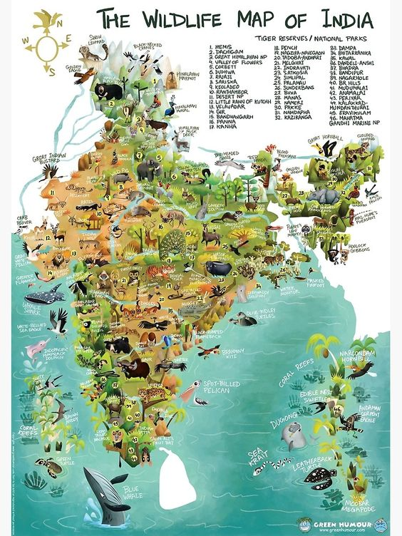
BIODIVERSITY IN INDIA
India is very rich in biological diversity.
India has nearly 8% of the total number of species found in the world (1.6million).
About 81,000 species of fauna [animals] and 47,000 species of flora [plants] are found in India.
About 15,000 flowering species are endemic (indigenous) to India.
India is famous for rhino, elephant, tiger, lion, monkey, snakes, peacock etc.

Slide 4

At least 10 per cent of India’s recorded wild flora and 20 per cent of its mammals are on the threatened list.
No one can say how many species may have already been lost. Today, we only talk of the larger and more visible animals and plants that have become extinct but what about smaller animals like insects and plants?

Slide 5
CLASSIFICATION OF SPECIES
The International Union for Conservation of Nature (IUCN)
Headquarters: Gland, Switzerland
CEO: Bruno Oberle (Swiss Biologist and Environmental Scientist)
(13 JULY 2020- continuing)
Founder: Julian Huxley
Founded: 5 October 1948, France
The International Union for Conservation of Nature and Natural Resources (IUCN) has classified plants and animals in order of existence.

Slide 6
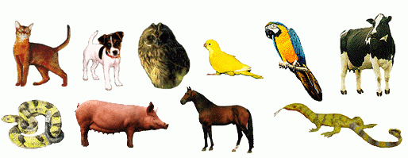
Normal Species: This includes species whose population levels are considered to be normal for their survival, such as cattle, sal, pine, rodents, etc. They are thus, called the normal species.

Slide 7
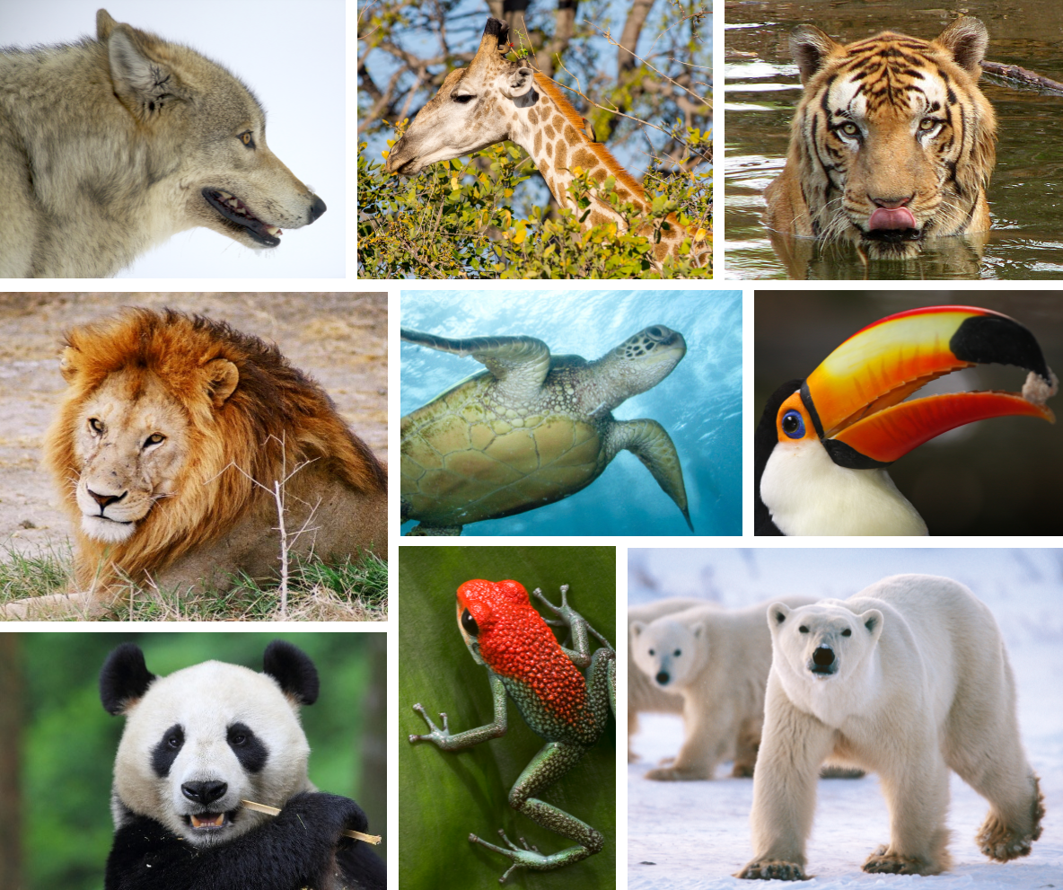
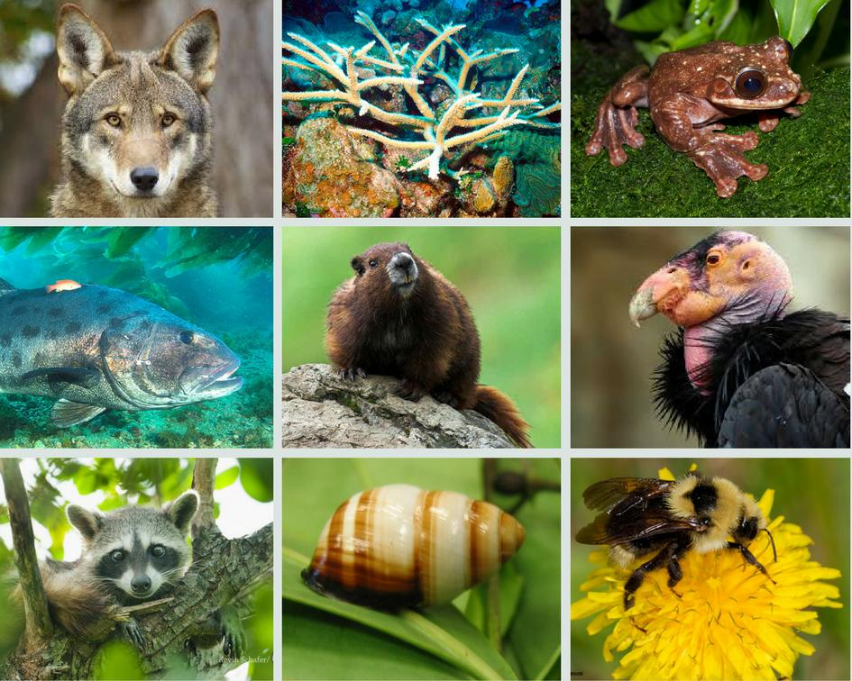
Endangered Species: This includes species which are in danger of extinction, hence called the endangered species. For example, black buck, crocodile, Indian wild ass etc.

Slide 8
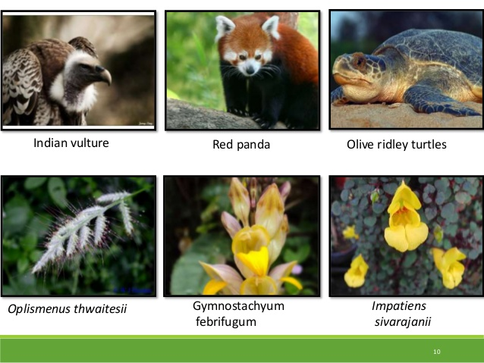

Slide 9
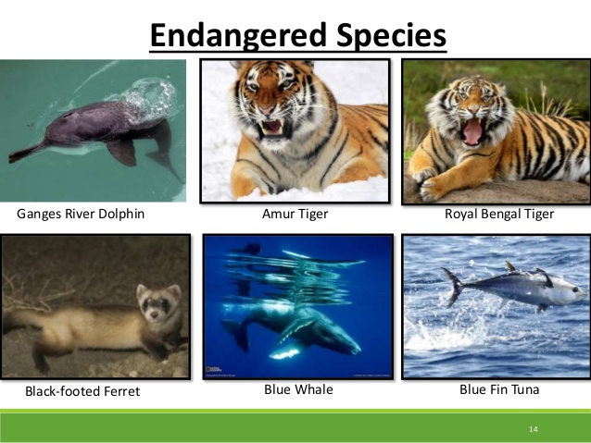

Slide 10
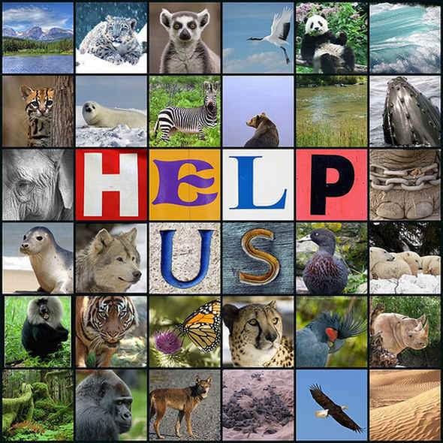
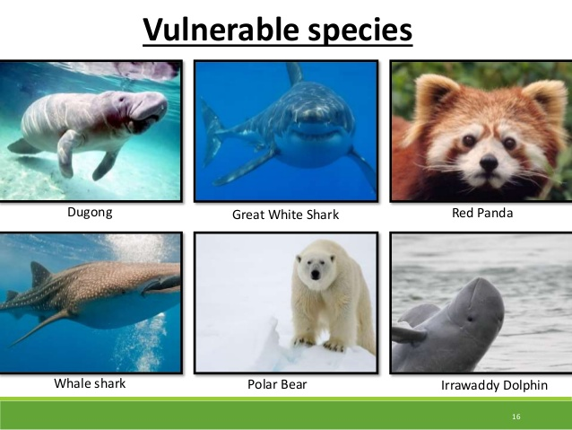
Vulnerable Species: This includes species whose population has declined to levels from where it is likely to move into the endangered category in the near future. For examples, blue sheep, Asiatic elephant, Gangetic dolphin, etc.

Slide 11
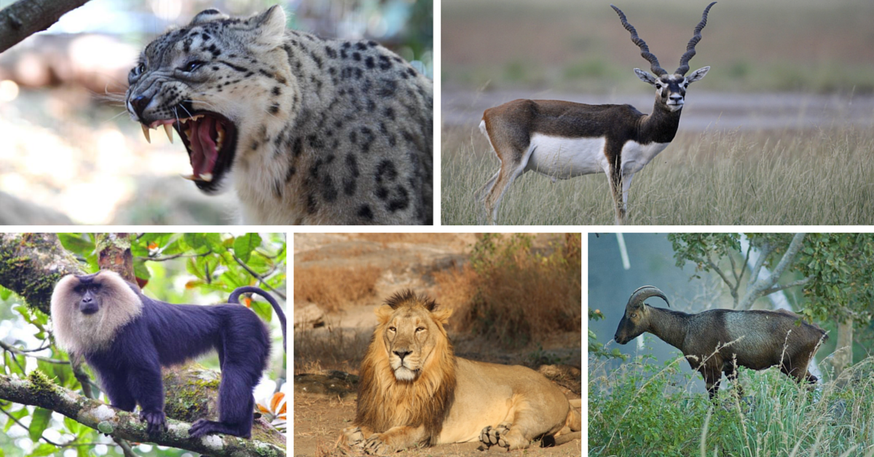
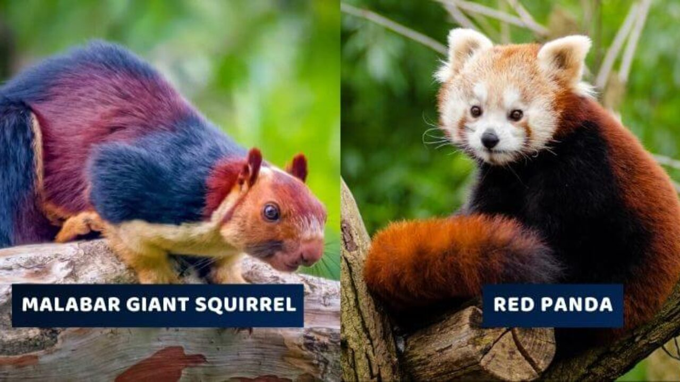
Rare Species: This includes species with a small population. They might move into the endangered or vulnerable category if right measures aren’t taken. For example, Himalayan brown bear, wild Asiatic buffalo, desert fox, and hornbill, etc.

Slide 12
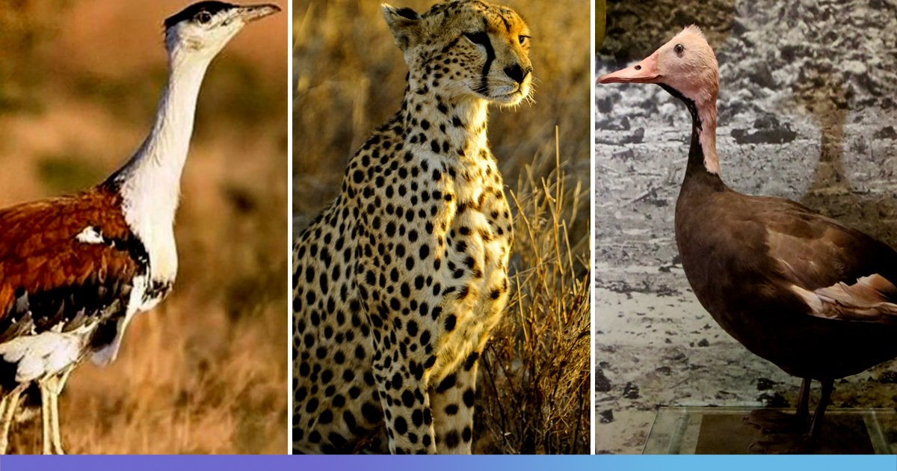
Extinct Species: This includes species which are not found after searches of known or likely areas where they may occur. For example, the Asiatic cheetah, pink head duck etc.

Slide 13
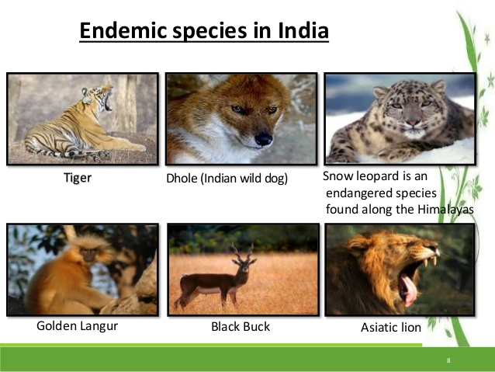
Endemic Species: This includes species which are only found in some particular areas that are usually isolated by natural or geographical barriers. For example, Andaman Teal, Nicobar pigeon, Andaman wild pig, Mithun in Arunachal Pradesh.

Slide 14
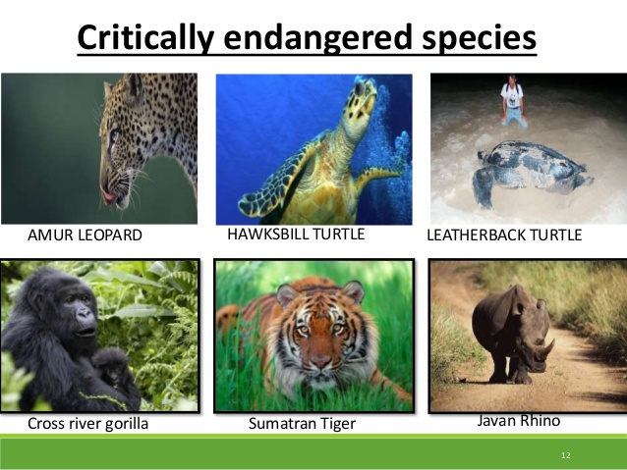

Slide 15
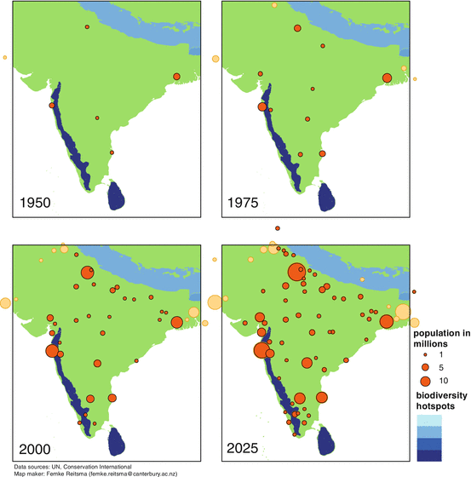
REASONS FOR A DECLINE IN INDIA’S BIODIVERSITY
Over-exploitation
Forest fires
Hunting
Habitat destruction
Poisoning
Poaching
Environmental Pollution

Slide 16
CAUSES OF DEPLETION OF THE FLORA AND FAUNA
Shifting cultivation
Deforestation, illegal cutting of trees, and forest fire.
Construction of dam, road, railways in the forest.
Pollution and global warming leading to climatic change.
Increasing human population pressure on the forest resources.(Over-population)
Mining
Large-scale development projects
Grazing and fuel-wood collection

Slide 17
Home Assignment
1.What do you understand by the terms critical species. Give example.
2. What is IUCN?
3. Why do we need international organizations to come up for ecological reconstruction?

Slide 18
THANKING YOU
ODM EDUCATIONAL GROUP

