Slide 1


FOREST AND WILDLIFE
INTRODUCTION
SUBJECT : GEOGRAPHY
CHAPTER NUMBER: 02
CHAPTER NAME : FOREST AND WILDLIFE

Slide 2
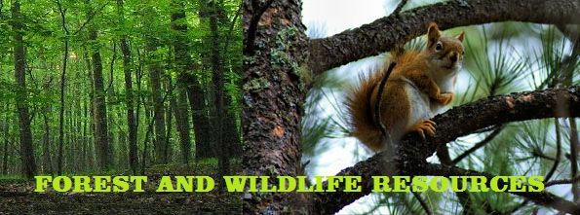

Slide 3

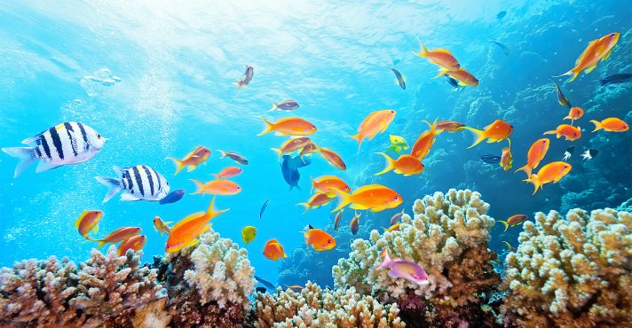

Slide 4
CONTENTS
Biodiversity or Biological diversity
Classification of Biodiversity (IUCN)
Conservation of Forest and Wildlife in India
Community and Conservation
TO BE ASSESSED ONLY IN PERIODIC TEST

Slide 5
WE SHARE THIS PLANET WITH MILLIONS OF OTHER LIVING BEINGS,starting from micro-organisms and bacteria, lichens to banyan trees, elephants and blue whales. This entire habitat that we live in has immense BIODIVERSITY.

Slide 6
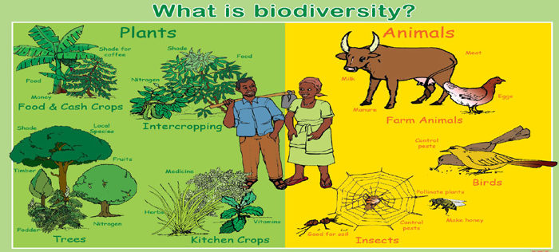

Slide 7
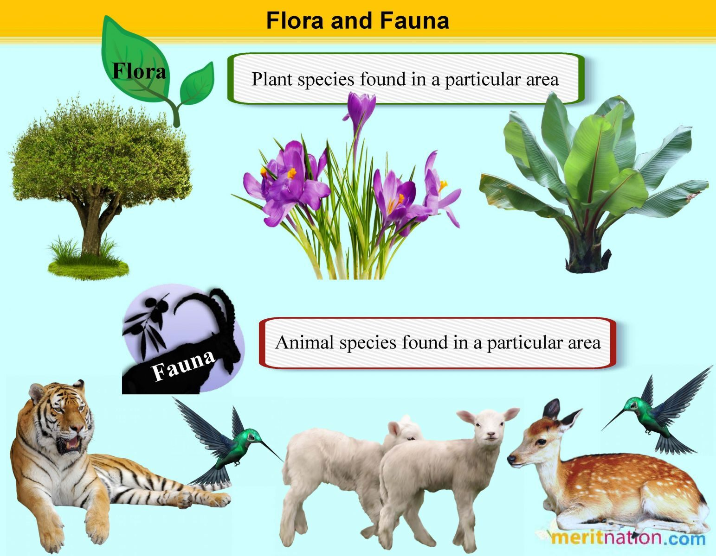

Slide 8
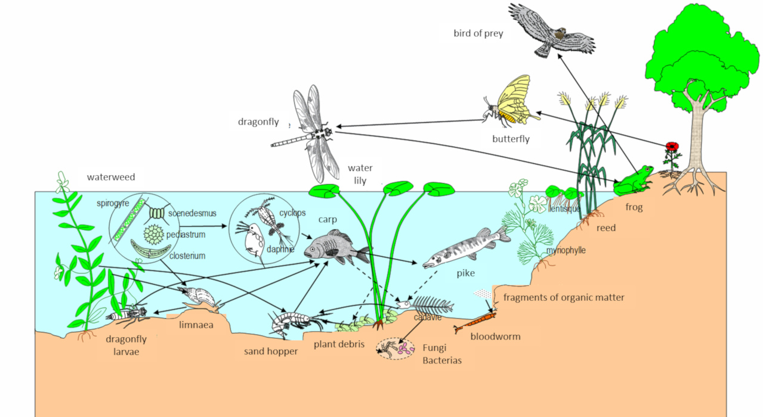
We humans along with all living organisms form a complex web of ecological system in which we are only a part and very much dependent on this system for our own existence.
The plants, animals and micro-organisms re-create the quality of the air we breathe, the water we drink and the soil that produces our food without which we cannot survive.
Forests play a key role in the ecological system as these are also the primary producers on which all other living beings depend.

Slide 9
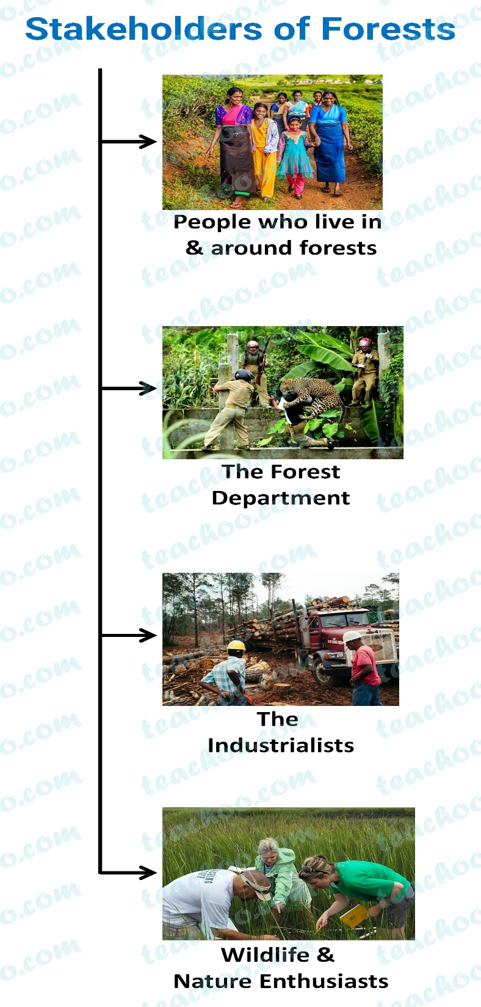
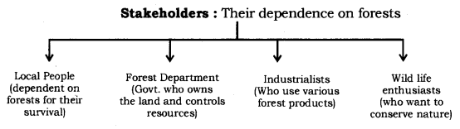
Biodiversity or Biological Diversity is immensely rich in wildlife and cultivated species, diverse in form and function but closely integrated in a system through multiple network of interdependencies.

Slide 10
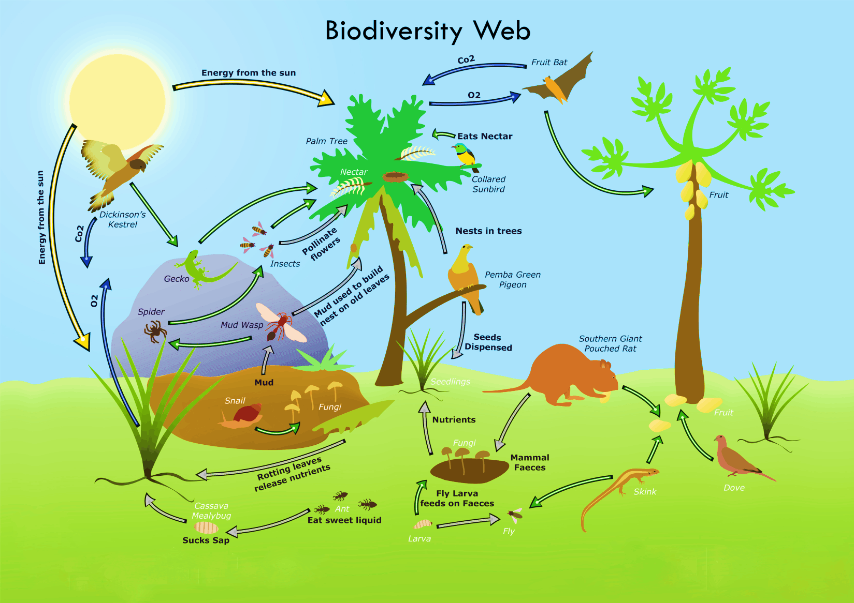

Slide 11
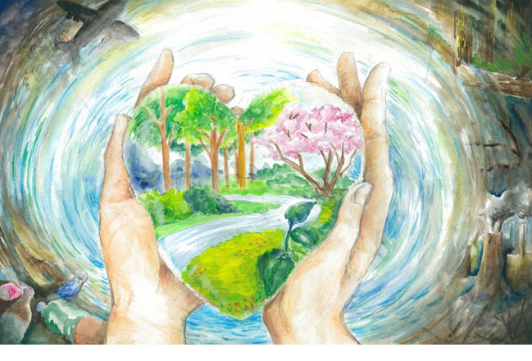
ACTIVITY :-
Draw a POSTER in your copy showing the harmonious relationship between human beings and nature.

Slide 12
Home Assignment
1. What is biodiversity?
2. Explain the importance of biodiversity in environment.
3. Who all are the stakeholders of biodiversity?

Slide 13
THANKING YOU
ODM EDUCATIONAL GROUP

