Slide 1

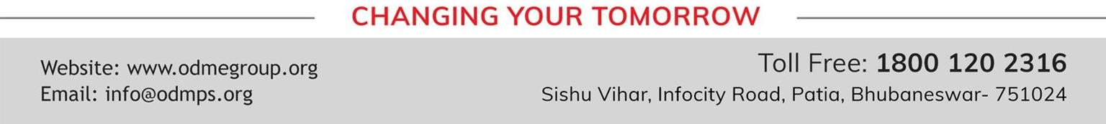
WELCOME TO THE NEW AGE CLASSROOM
SOCIAL SCIENCE
SUBJECT : CIVICS
CHAPTER NUMBER: 01
CHAPTER NAME : POWER SHARING
TOPIC: 3. SRI LANKA: CASE – STUDY

Slide 2

LEARNING OUTCOMES
The Pupil will be able to:-
Comprehend the topic taught in last class
Understand different ethnic composition of Sri Lanka.
Analyze the importance of Diversity.
Appreciate, respect the identity of others.
Identify the location of Sri Lanka.

Slide 3



Slide 4
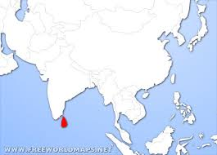
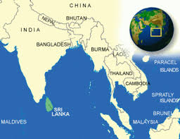

Slide 5
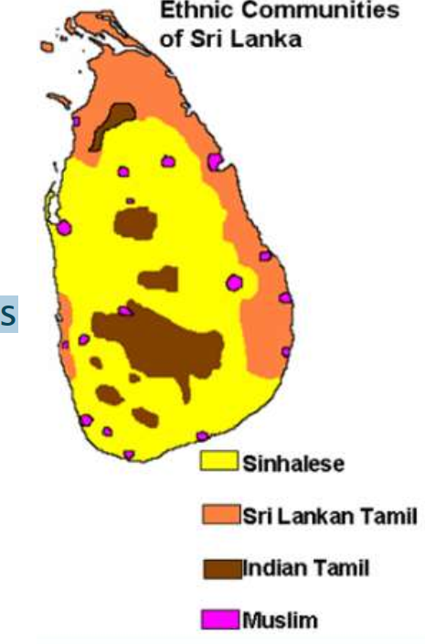
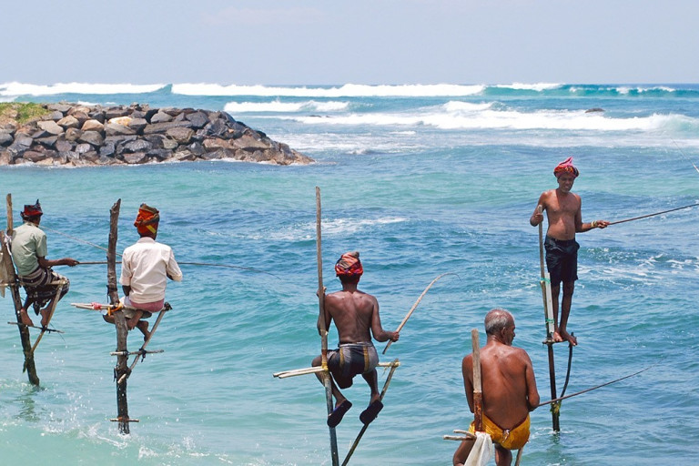

Slide 6
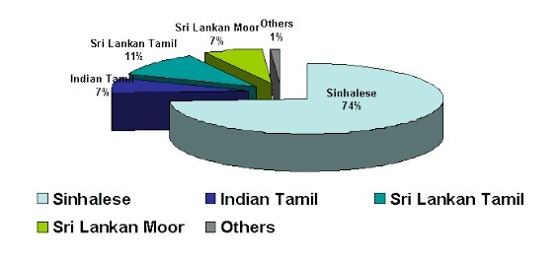
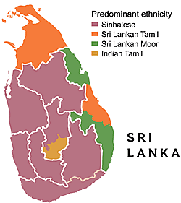


Slide 7
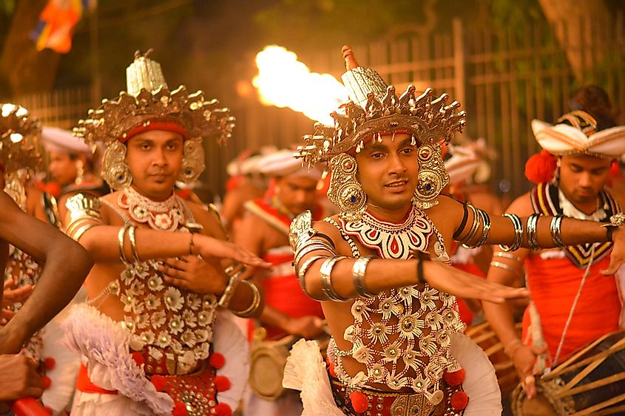
Poya Festival (full moon)

Slide 8



இலங்கை

Slide 9

VIDEO LINK FOR SRI LANKA-CASE STUDY
https://youtu.be/dj2j7N1Atq4

Slide 10
THANKING YOU
ODM EDUCATIONAL GROUP

