Slide 1


WELCOME TO THE NEW AGE CLASSROOM
SOCIAL SCIENCE
SUBJECT : CIVICS
CHAPTER NUMBER: 01
CHAPTER NAME : POWER SHARING
TOPIC: 2. POWER SHARING- DIFFERENT FORMS AND BELGIUM: CASE– STUDY

Slide 2

LEARNING OUTCOMES
The Pupil will be able to:-
Comprehend the topic taught in last class
Understand different forms of power sharing.
Analyze the importance of each forms of power sharing.
Identify the difference between different forms of power sharing.
Appreciate, respect the power sharing process in Belgium
Identify the location of Belgium.

Slide 3
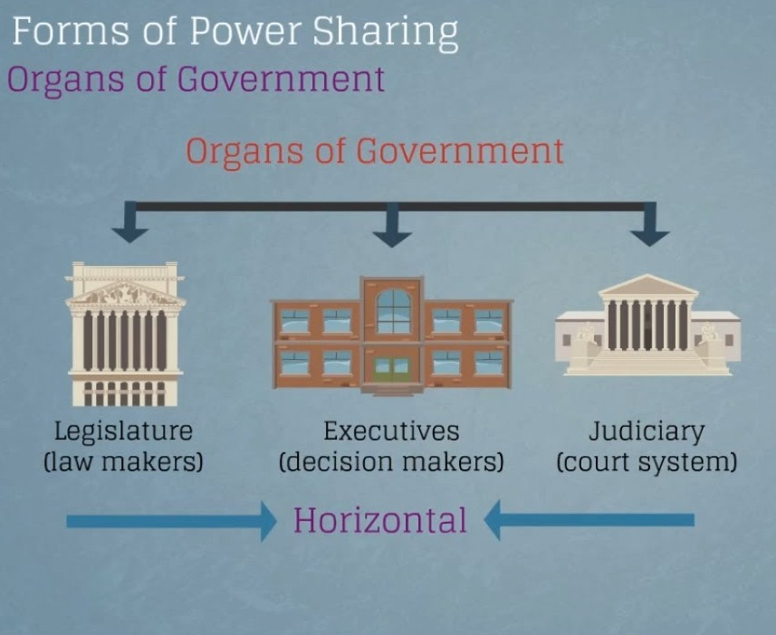

Slide 4


Slide 5


Slide 6
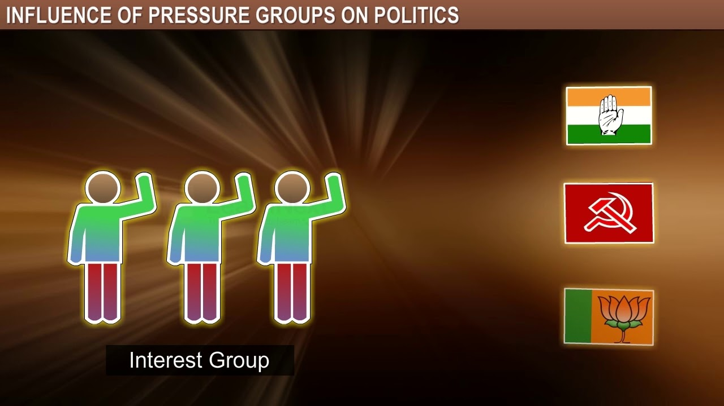

Slide 7



Slide 8
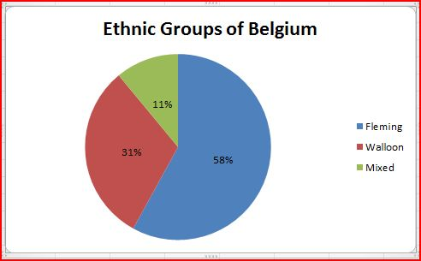
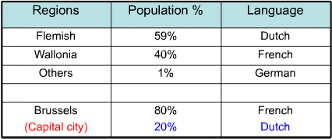

Slide 9
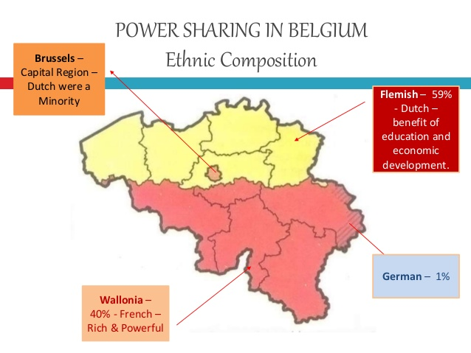

Slide 10

VIDEO LINK FOR BELGIUM-CASE STUDY
https://youtu.be/wLPBvAMQ5Xg

Slide 11
THANKING YOU
ODM EDUCATIONAL GROUP

