Slide 1


VOCATION
STD-VII
SUBJECT : ENGLISH
PERIOD NUMBER:1
CHAPTER NAME : VOCATION

Slide 2

EXPECTED LEARNING OUTCOMES
GENERAL OBJECTIVES
Understand and appreciate poetry as a literary art form
Analyze the various elements of poetry, such as diction, tone, form, genre, imagery, figures of speech, symbolism, theme, etc.
Recognize the rhythms, metrics and other musical aspects of poetry
Develop their critical thinking skills
Develop their own creativity which will help to enhance writing skills
SPECIFIC LEARNING OBJECTIVES
Analyse the poem and understand its central theme
Relate the theme of the poem to his/her personal life
Analyse the structure of the poem
Interpret the tone and mood of the poem

Slide 3
Introduction
Vocation by Rabindranath Tagore is a long poem in which a young and innocent child expresses his desires without knowing the harsh reality of the world. However, on the other hand, the poem also highlights the treatment of children by their parents and teachers.

Slide 4
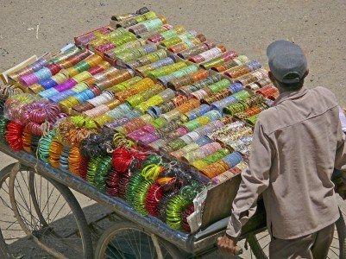
Stanzas-1,2,3
Everyday on his way to school, he sees a hawker selling bangles. He seems to choose any road he likes. He has no fixed time even of returning home. The child wishes that he were a hawker!

Slide 5
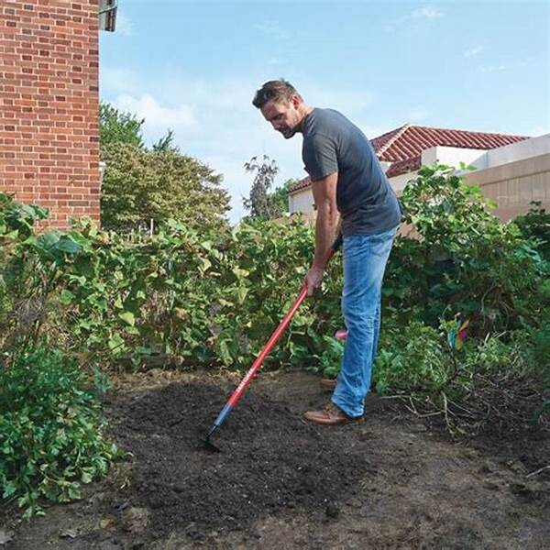
Stanzas-4,5,6
From the gate of his house, he sees the gardener digging the ground and soiling his clothes. No one asks him not to dig ground or not to soil his clothes. He is so free that the child aspires to be a gardener.

Slide 6

Stanzas-7,8
At night, through the open window of his room, he sees the watchman moving up and down the lane. No one tells the watchman that it is night and he must go to bed. The child wishes to be a watchman.

Slide 7
Thank You

