Slide 1


GRAMMAR
STD-VIII
SUBJECT : ENGLISH
CHAPTER NUMBER: 8
PERIOD NUMBER : 2
CHAPTER NAME :VERB PHRASE

Slide 2
EXPECTED LEARNING OUTCOMES
GENERAL OBJECTIVES Understand the basics of grammar Being acquainted with the chapter and its tenets Understanding the idea Appreciate the beauty of grammar and use in day to day life Developing LSRW Skills
SPECIFIC OBJECTIVES/ EXTENDED OBJECTIVES develop your knowledge of expanded verb phrases understand how verb phrases can improve clarity of writing have a greater understanding of how to use verb phrases.

Slide 3
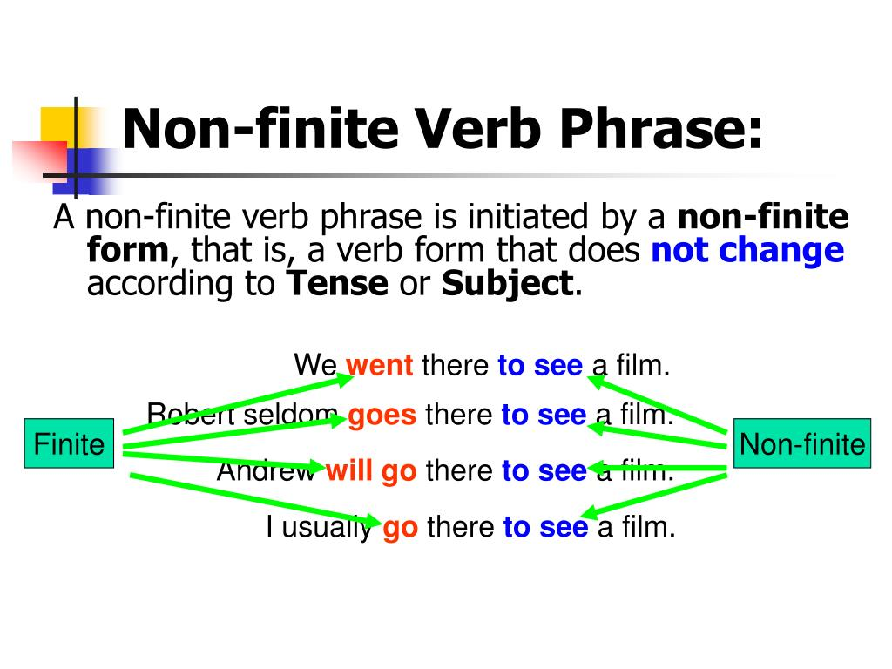
Kinds of Verb Phrases
Finite Verb Phrases
Non Finite Verb Phrases

Slide 4
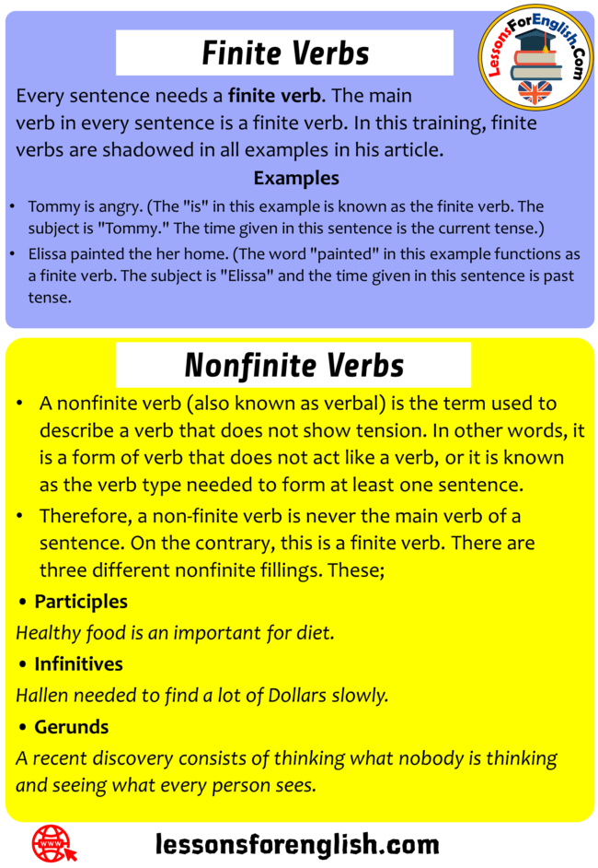
Finite Verb Phrase
Finite Verb as head word.
The main verb in every sentence is a finite verb.
A verb phrase is said to be finite if there is only one verb phrase in a sentence. The head verb, which is categorized as finite, can either be in the present or past tense.

Slide 5
Non Finite Verb Phrase
This kind of verb phrase has the head verb as an infinitive, participle, and can even be a gerund.
Non finite is never the main verb of a sentence.
HW- Exercise - 6 (Page -61)

Slide 6
THANK YOU
ODM EDUCATIONAL GROUP

