Slide 1


Valoday and me
(Leo Tolstoy)
SUBJECT : (English)
CHAPTER NUMBER: 1
CHAPTER NAME :Valodya and me

Slide 2
Learning Objectives
Students will be able to:
Analyse the behaviour and attitude of two characters in the story;
Explain the interpersonal relationships between siblings;
Recognise the importance of forgiveness in relationships and inculcate it in daily behaviour;
Identify noun clauses and define their functions;
Record significant experiences in a diary or a learning journal.

Slide 3
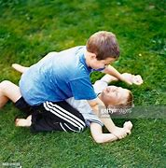
In a Nutshell
Both brothers had a fight over the broken scent bottles.
Valodya being elder and more responsible, took the initiative of asking the narrator for forgiveness.
The narrator realised then that his brother understood him and was touched. Both the brothers shook hands and embraced each other.

Slide 4
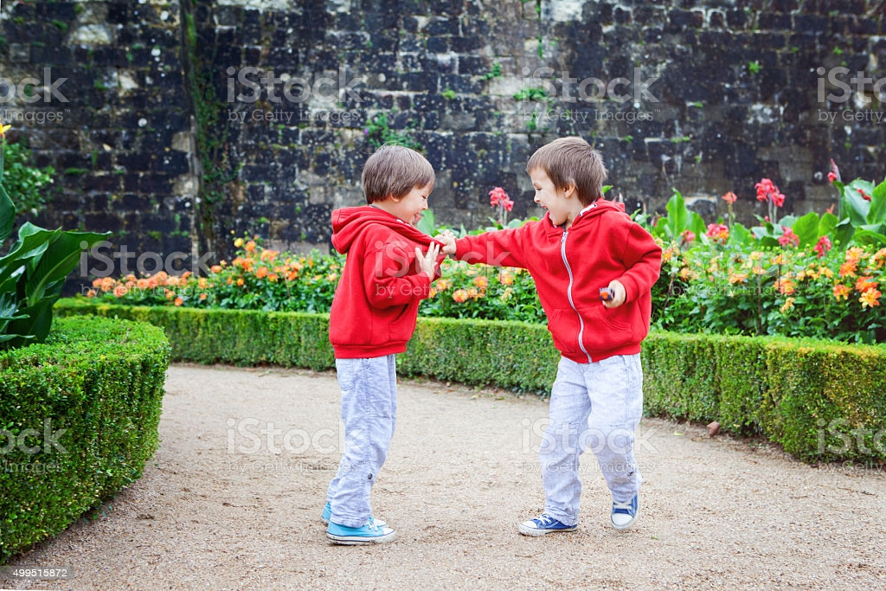

Slide 5
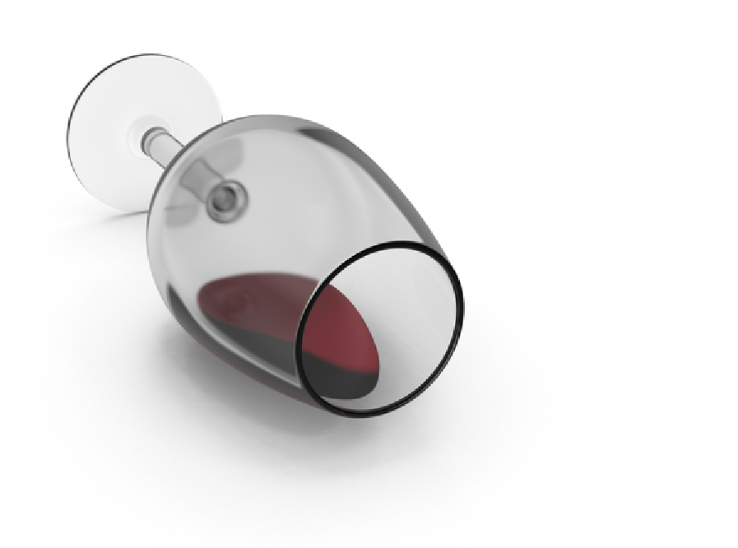
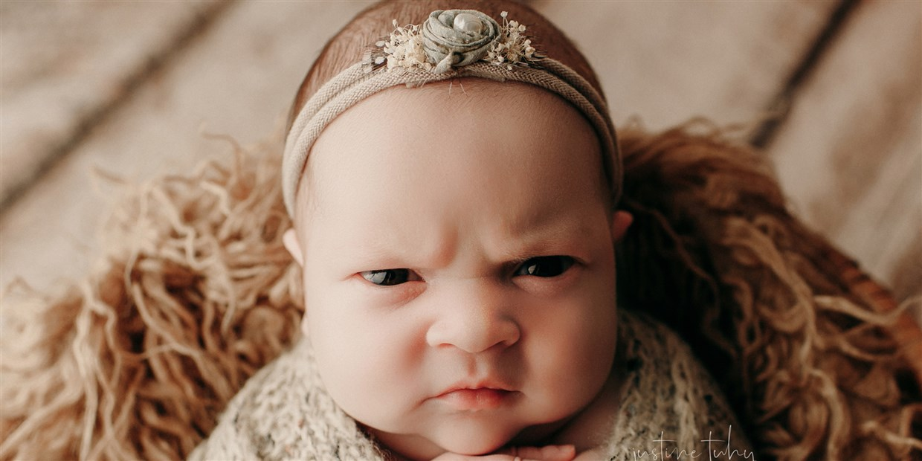
Difficult words:
jerking : raising shoulder
inherit: derive genetically from one's parents or ancestors.
brat : a child who behaves badly.
beside myself : loosing control
tipped it over: cause it to fall.
scowl: angry face
irresistible : too attractive and tempting to be resisted
pathos: sadness

Slide 6

Questions:
Describe the incident that made Valodya angry with his brother.
2. How did the narrator feel when Valodya asked for forgiveness?

Slide 7
THANKING YOU
ODM EDUCATIONAL GROUP

