Slide 1


Valoday and me
(Leo Tolstoy)
SUBJECT : (English)
CHAPTER NUMBER: 1
CHAPTER NAME :Valoday and me

Slide 2
Learning Objectives
Students will be able to:
Analyse the behaviour and attitude of two characters in the story;
Explain the interpersonal relationships between siblings;
Recognise the importance of forgiveness in relationships and inculcate it in daily behaviour;
Identify noun clauses and define their functions;
Record significant experiences in a diary or a learning journal.

Slide 3
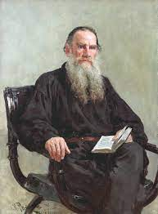
About author
Russian novelist and moral philosopher
Leo Tolstoy was born on September 9, 1828, in the Tula Province of Russia.
His mother died when he was two years old, whereupon his father's distant cousin Tatyana Ergolsky took charge of the children.
Tolstoy was educated at home by German and French tutors.

Slide 4
In a Nutshell:
He was impulsive and ...... I did not feel in the least like smiling.
Valodya was interested in many different hobbies. He would be curious to decorate his table, collecting them from every room of the house.
He also had a secret habit of reading novels and would read them all day and all night. Narrator was impressed with his brother for his hobbies and passion, however, was too proud to imitate them.

Slide 5
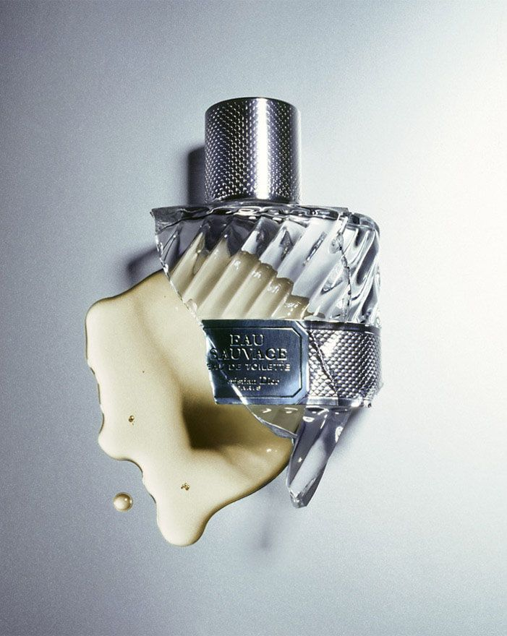
One day, Narrator accidentally broke an empty bright colored little scent bottle which was kept on the table in Valodya’s room.
Valodya treasured the bottle greatly. He knew how important that bottle was for his brother, but he pretended to smile to show him that he was not bothered. Instead of feeling sorry, he behaved casually.

Slide 6
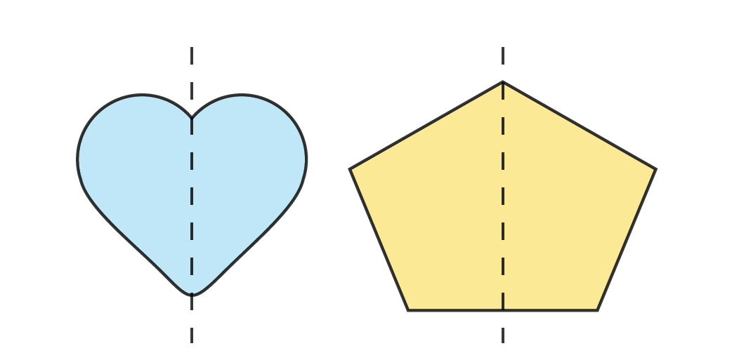
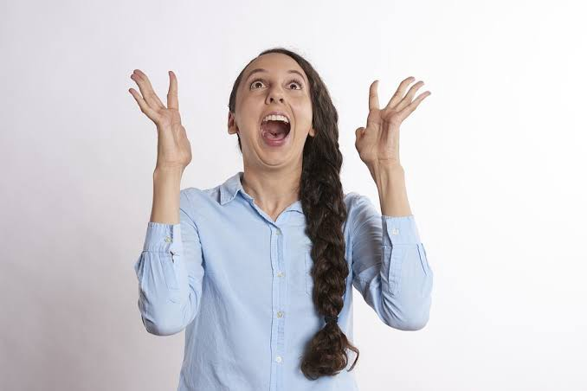
Difficult words:
impulsive : doing things or tending to do things suddenly and without careful thought
enthusiasm: strong excitement of feeling
curious : eager to know or learn something.
mania: madness
on the sly : secretly.
at its high: highest level
symmetry : balance in arrangement
retort : to reply

Slide 7

Questions:
What are Valodya’s hobbies?
What impressed the narrator?

Slide 8
THANKING YOU
ODM EDUCATIONAL GROUP

