Slide 1


Valoday and me
(Leo Tolstoy)
SUBJECT : (English)
CHAPTER NUMBER: 1
CHAPTER NAME :Valoday and me

Slide 2
Learning Objectives
Students will be able to:
Analyze the behavior and attitude of two characters in the story;
Explain the interpersonal relationships between siblings;
Recognize the importance of forgiveness in relationships and inculcate it in daily behavior;
Identify noun clauses and define their functions;
Record significant experiences in a diary or a learning journal.

Slide 3
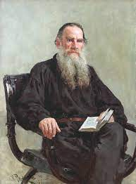
About author
Russian novelist and moral philosopher
Leo Tolstoy was born on September 9, 1828, in the Tula Province of Russia.
His mother died when he was two years old, whereupon his father's distant cousin Tatyana Ergolsky took charge of the children.
Tolstoy was educated at home by German and French tutors.

Slide 4
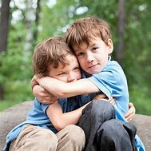
Theme of the story
It is a story about two brothers, their relationship with each other characterised by feelings of love, jealousy, etc. and a change that comes in their behaviour towards the end.

Slide 5
Summary:
Vadolya and narrator grew up together in a happy environment.
They grew up like friends studying and playing together despite their age difference. But after a few years Narrator started developing a complex.
He compared himself with his brother and felt he was nowhere compared to Vadolya in terms of age, interests, ability and even studies.
He felt Vadolya was proud because he believed he was better. He was also unhappy when Valodya was given a linen shirt.

Slide 6
Difficult words:
distinction : difference or contrast between similar things or people
no companion for him : not similar
vanity: pride, ego
anguish : here, mental suffering
torment: torture
sensitiveness : easily hurt emotionally

Slide 7

Questions:
Describe the relationship between Valodya and the narrator.
What made the narrator jealous of Valodya?

Slide 8
THANKING YOU
ODM EDUCATIONAL GROUP

