Slide 1


NATURAL NUMBERS AND WHOLE NUMBERS
SUBJECT : MATHEMATICS
CHAPTER NUMBER: 05
CHAPTER NAME : NATURAL NUMBERS AND WHOLE NUMBERS
SUB TOPIC: Natural Number System and Whole Number System
PERIOD NO:1

Slide 2

Learning outcomes
Students will be able to define and differentiate natural number and whole numbers.
Students will be able to apply properties of Natural numbers.
Students will be able to apply properties of Whole numbers.

Slide 3
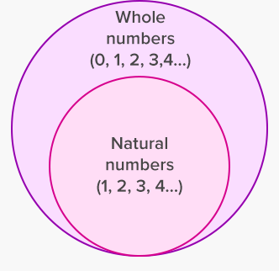
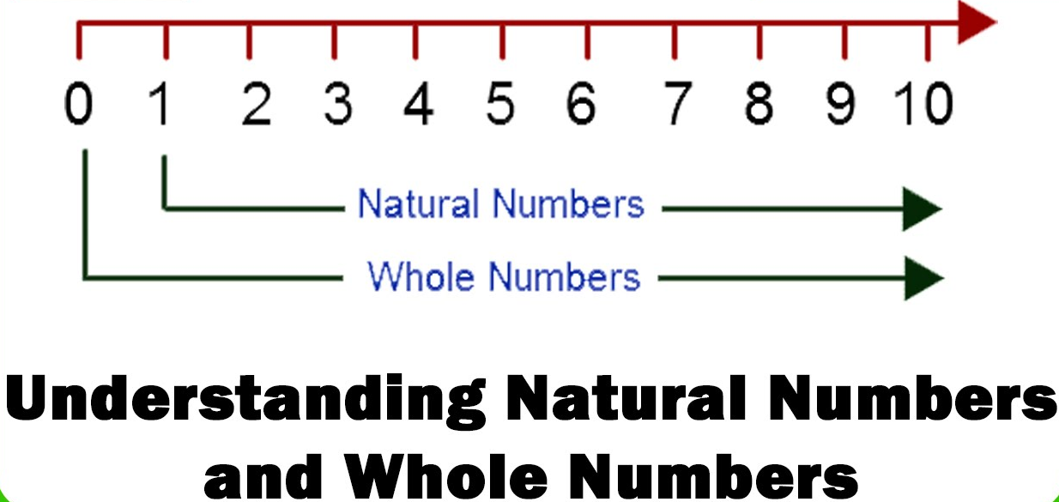
Natural Numbers and Whole Numbers

Slide 4
Natural Numbers and Whole Numbers
Natural numbers and whole numbers will be explained using a video.
https://www.youtube.com/watch?v=-L94qb6RXwc(4.49)

Slide 5
Properties of Addition of Natural Numbers and Whole Numbers
Properties of addition of whole numbers will be explained with the help of a video
https://www.youtube.com/watch?v=m0YAJe_NDeM

Slide 6
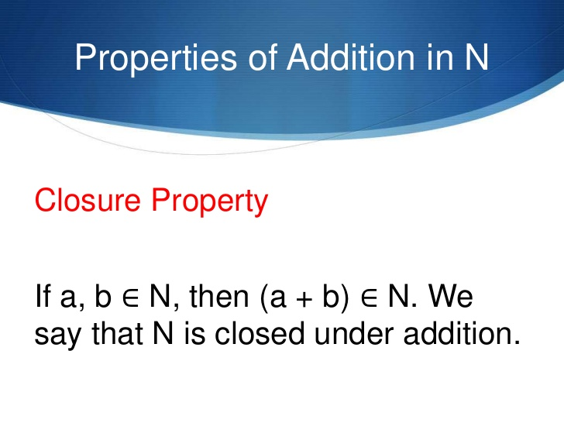

Slide 7
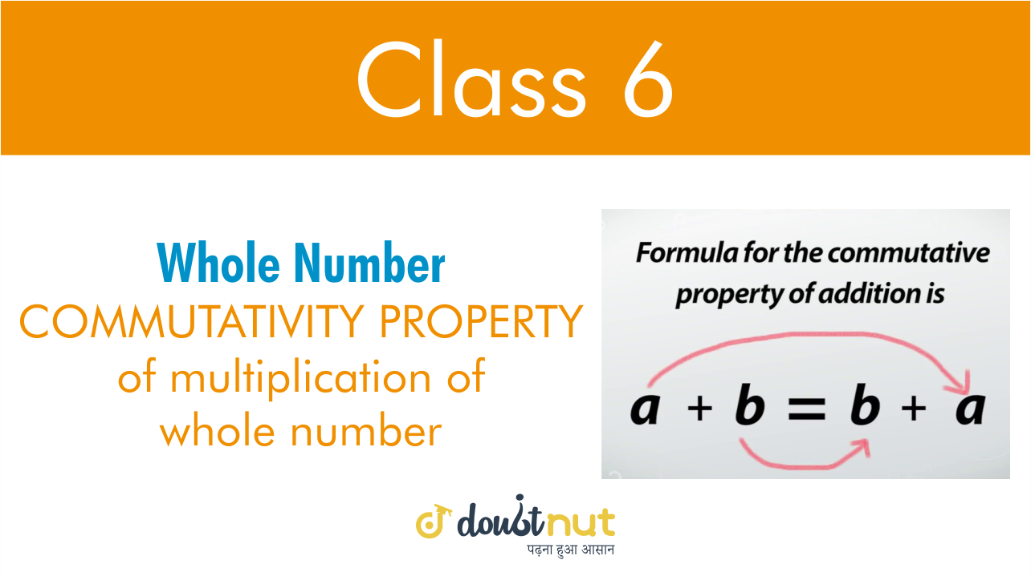
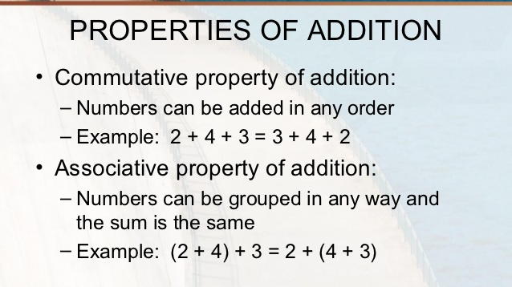

Slide 8
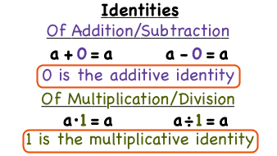
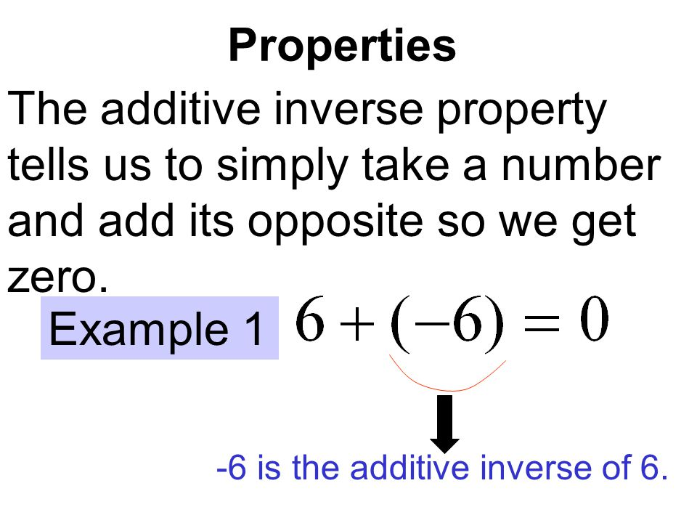

Slide 9
Evaluation Question
1. Fill in the blanks : (i) Smallest natural number is ………….. (ii) Smallest whole number is ………… (iii) Largest natural number is ………… (iv) Largest whole number is ……….. (v) All natural numbers are …………
Solution:
(i) Smallest natural number is 1
(ii) Smallest whole number is 0
(iii) Largest natural number is not possible
(iv) Largest whole number is not possible
(v) All natural numbers are whole numbers

Slide 10
Evaluation Question
4. Fill in the blanks : (i) 54 + 234 = 234 + ………… (ii) 332 + 497 = ………… + 332 (iii) 286 + 0 = ……….. Solution:
(i) 54 + 234 = 234 + 54
(ii) 332 + 497 = 497 + 332
(iii) 286 + 0 = 286

Slide 11
Evaluation Question
5. By re-arranging the given numbers, evaluate: (i) 237 + 308 + 163 (ii) 162 + 253 +338 + 47 Solution:
(i) 237 + 308 + 163
= (237 + 163) + 308 (by associative law)
= 400 + 308
= 708
(ii) 162 + 253 + 338 + 47
= (162 + 338) + (253 + 47) (by associative law)
= 500 + 300
= 800

Slide 12
Evaluation Question
7. Which property of addition is satisfied by: (i) 8 + 7 = 15 (ii) 3+ (5 + 4) = (3 + 5)+ 4 (iii) 8 x (8 + 0) = 8 x 8 + 8 x 0 (iv) (7 + 6) x 10 = 7 x 10 + 6 x 10 (v) (15 – 12) x 18 = 15 x 18 – 12 x 18
Solution:
(i) 8 + 7 = 15
The property used as closure property satisfied by 15
(ii) 3 + (5 + 4) = (3 + 5) + 4
3 + (5 + 4) = 3 + 9 = 12 and
(3 + 5) + 4 = 8 + 4 = 12
The property used as Associative law of addition satisfied by 12

Slide 13
Evaluation Question
(iii) 8 x (8 + 0) = 8 x 8 + 8 x 0
8 × (8 + 0) = 8 × 8= 64 and
8 × 8 + 8 × 0 = 64 + 0= 64
The property used as Distributive of multiplication over addition satisfied by 64
(iv) (7 + 6) × 10 = 7 × 10 + 6 × 10
(7 + 6) × 10 = 13 × 10= 130 and
7 × 10 + 6 × 10 = 70 + 60= 130
The property used as Distributive property over addition satisfied by 130
(v) (15 – 12) x 18 = 15 x 18 – 12 x 18
(15 – 12) × 18 = 3 × 18= 54 and
15 × 18 – 12 × 18 = 270 – 216= 54
The property used is Distributive over subtraction satisfied by 54

Slide 14
Additional Homework
Q1. Starting from the least even natural number, state the sum of the first four even numbers
Q2. Subtract the successor of 99 from the predecessor of 201.
HW
Ex.5.A

Slide 15
THANKING YOU
ODM EDUCATIONAL GROUP

