Slide 1


NATURAL NUMBERS AND WHOLE NUMBERS
SUBJECT : MATHEMATICS
CHAPTER NUMBER: 05
CHAPTER NAME : NATURAL NUMBERS AND WHOLE NUMBERS
SUB TOPIC: Properties of whole numbers for Multiplication
PERIOD NO: 3

Slide 2

Learning outcomes
Students will be able to solve problems related to Properties of multiplication on whole numbers.
Students will develop application skill.

Slide 3
Previous knowledge Test
1. (16 – 8) x 24 = ………….. = ………….. 16 x 24 – 8 x 24 = …….. – ……….. = ……….. Is (16 – 8) x 24 = 16 x 24 – 8 x 24? ………….. Is the type of result always true? …………. Name the property used here ………………

Slide 4
Natural Numbers and Whole Numbers Properties of multiplication of whole numbers will be explained with the help of a video https://www.youtube.com/watch?v=Doqt7bb8Gno

Slide 5
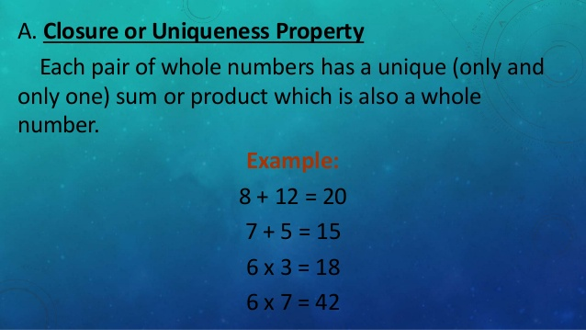

Slide 6
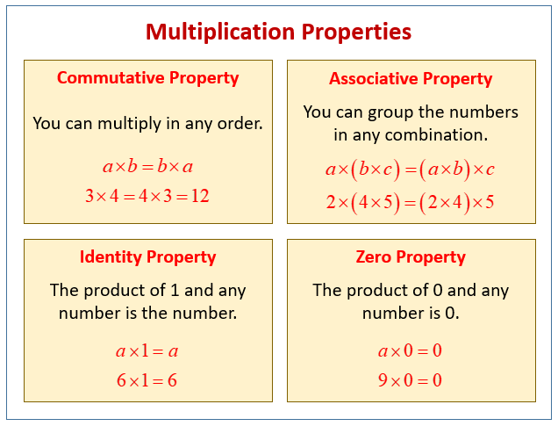

Slide 7
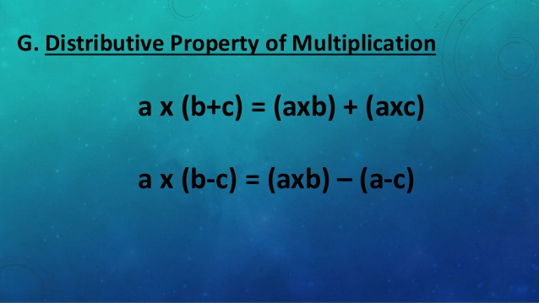

Slide 8
Evaluation Question
1. Fill in the blanks : (i) 42 x o = ………. (ii) 592 x 1 = ……….. (iii) 328 x 573 = ……….. x 328 (iv) 229 x ………… = 578 x 229 (v) 32 x 15 = 32 x 6 + 32 x 7 + 32 x ……….
(vi) 23 × 56 = 20 × 56 + ………… × 56
(vii) 83 × 54 + 83 × 16 = 83 × (……….) = 83 × ………… = ……….
(viii) 98 × 273 – 75 × 273 = (………..)× 273 = ………. × 273

Slide 9
Evaluation Question
ANS:
i) 42 × 0 = 0 (By closure property 0)
(ii) 592 × 1 = 592 (By closure property 1)
(iii) 328 × 573 = 573 × 328 (By commutative law of multiplication)
(iv) 229 × 578 = 578 × 229 (By commutative law of multiplication)
(v) 32 × 15 = 32 × 6 + 32 × 7 + 32 × 2 (By distributive law of multiplication)
(vi) 23 × 56 = 20 × 56 + 3 × 56 (By distributive law of multiplication)
(vii) 83 × 54 + 83 × 16 = 83 × (54 + 16) = 83 × 70 = 5810
(viii) 98 × 273 – 75 × 273 = (98 – 75) × 273 = 23 × 273

Slide 10
Evaluation Question
2.By re-arranging the given numbers, evaluate : (i) 2 x 487 x 50 (ii) 25 x 444 x 4 (iii) 225 x 20 x 50 x 4
Solution:
(i) 2 × 487 × 50 = (2 × 50) × 487
= 100 × 487= 48700
(ii) 25 × 444 × 4= (25 × 4) × 444
= 100 × 444
= 44400
(iii) 225 × 20 × 50 × 4
(225 × 4) × (20 × 50) = 900 ×1000
= 900000

Slide 11
Evaluation Question
3.Use distributive law to evaluate: (i) 984 x 102 (ii) 385 x 1004 (iii) 446 x 10002
Solution:
(i) 984 × 102 = 984 × (100 + 2)
= 984 × 100 + 984 × 2
= 98400 + 1968 = 100, 368
(ii) 385 × 1004= 385 × (1000 + 4)
= 385 × 1000 + 385 × 4
= 385000 + 1540 = 386540
(iii) 446 × 10002 = 446 × (10000 + 2)
= 446 × 10000 + 446 × 2
= 4460000 + 892 = 4460892

Slide 12
Evaluation Question
4. Evaluate using properties: (i) 548 x 98 (ii) 924 x 988 (iii) 3023 x 723
Solution:
(i) 548 × 98 = (500 + 40 + 8) × 98
= 500 × 98 + 40 × 98 + 8 × 98
= 49000 + 3920 + 784= 53704
(ii) 924 × 988 = (900 + 20 + 4) × 988
= 900 × 988 + 20 × 988 + 4 × 988
= 889200 + 19760 + 3952 = 912912
(iii) 3023 × 723 = (3000 + 20 + 3) × 723
= 3000 × 723 + 20 × 723 + 3 × 723
= 2169000 + 14460 + 2169 = 2185629

Slide 13
Evaluation Question
5. Evaluate using properties : (i) 679 x 8 + 679 x 2 (ii) 284 x 12 – 284 x 2 (iii) 55873 x 94 + 55873 x 6 (iv) 7984 x 15 – 7984 x 5 (v) 8324 x 1945 – 8324 x 945
(vi) 3333 × 987 + 13 × 3333
Solution:
(i) 679 × 8 + 679 × 2= 679 × (8 + 2)
= 679 × 10 = 6790
(ii) 284 × 12 – 284 × 2= 284 × (12 – 2)
= 284 × 10= 2840

Slide 14
Evaluation Question
(iii) 55873 × 94 + 55873 × 6
= 55873 × (94 + 6)
= 55873 × 100= 5587300
(iv)7984 × 15 – 7984 × 5
= 7984 × (15 – 5)
= 7984 × 10= 79840
V) 8324 × 1945 – 8324 × 945
= 8324 × (1945 – 945)
= 8324 × 1000= 8324000
(vi) 3333 × 987 + 13 × 3333
= 3333 × (987 + 13) = 3333 × 1000
= 3333000

Slide 15
Additional Homework
1. Find the product of
i) The greatest number of three digits and smallest number of 5 digits
ii) The greatest number of 4 digits and greatest number of 5 digits.
HW
Ex.5.c Q. No.,

Slide 16
THANKING YOU
ODM EDUCATIONAL GROUP

