Slide 1


NATURAL NUMBERS AND WHOLE NUMBERS
SUBJECT : MATHEMATICS
CHAPTER NUMBER: 05
CHAPTER NAME : NATURAL NUMBERS AND WHOLE NUMBERS
SUB TOPIC: Properties of whole numbers for Subtraction
PERIOD NO: 2

Slide 2

Learning outcomes
Students will be able to solve problems based on properties of subtraction.
Student will be able to apply in real life situation.

Slide 3
Previous knowledge Test
Q1.State, True or False : (i) The sum of two odd numbers is an odd number. (ii) The sum of two odd numbers is an even number. (iii) The sum of two even numbers is an even number. (iv) The sum of two even numbers is an odd number. (v) The sum of an even number and an odd number is odd number. (vi) Every whole number is a natural number. (vii) Every natural number is a whole number. (viii) Every whole number + 0 = The whole number itself. (ix) Every whole number x 1 = The whole number itself. (x) Commutativity and associativity are properties of natural numbers and whole numbers both. (xi) Commutativity and associativity are properties of addition for natural numbers and whole numbers both. (xii) If x is a whole number then -x is also a whole number.

Slide 4
Natural Numbers and Whole Numbers Properties of subtraction of whole numbers will be explained with the help of a video https://www.youtube.com/watch?v=DzCiH_CrGv0

Slide 5
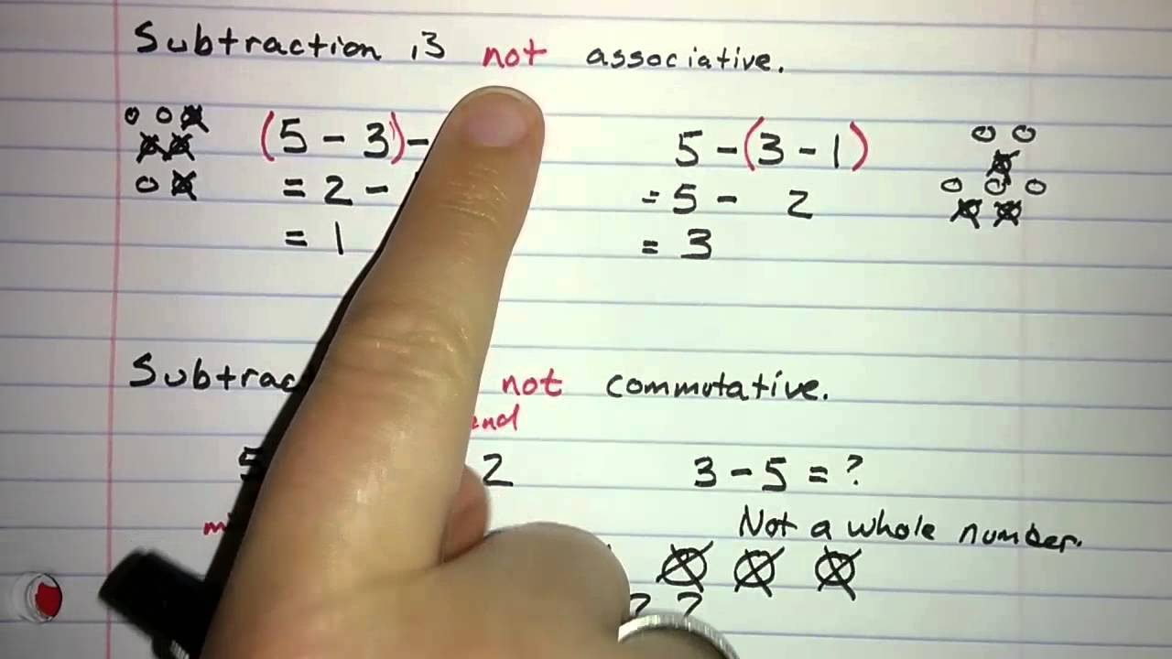

Slide 6
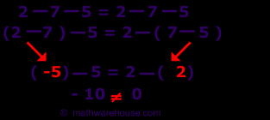

Slide 7
Evaluation Question
1. Consider two whole numbers a and b such that a is greater than b. (i) Is a – b a whole number ? Is this result always true? (ii) b-a a whole number ? Is this result always true?
Solution:
Let us take a = 2 and b = 1
(i) a – b = 2 – 1= 1
Yes, a – b is a whole number and the result will always remain true
(ii) b – a = 1 – 2= -1
No, (b – a) cannot be a whole number and this result will always remain true.

Slide 8
Evaluation Question
2. Fill in the blanks : (i) 8 – 0 = ……….. and 0 – 8 = ………. 8 – 0 ≠ 0 – 8, this shows subtraction of whole numbers is not ……….. (ii) 5 – 10 = ………., which is not a ………… => Subtraction of ……….. is not closed. (iii) 7 – 18 = ……….. and (7 – 18) – 5 = ………….. 18 – 5 = …………. and (7 – 18) – 5 = …………. Is (7 – 18) – 5 = 7 – (18 – 5) ? => Subtraction of whose numbers is not ………….
Solution:
(i) 8 – 0 = 8 and 0 – 8 = – 8
8 – 0 ≠ 0 – 8, this shows subtraction of whole numbers is not commutative
(ii) 5 – 10 = – 5, which is not a whole number
=> Subtraction of whole numbers is not closed.
(iii) 7 – 18 = – 11 and (7 – 18) – 5 = – 16
18 – 5 = 13 and (7 – 18) – 5 = – 16
Is (7 – 18) – 5 = 7 – (18 – 5) =?
No (7 – 18) – 5 ≠ 7 – (18 – 5)
=> Subtraction of whole numbers is not associative

Slide 9
Evaluation Question
3.Write the identity number, if possible for subtraction.
Solution:
It is not possible because for subtraction no identity number exists.
4.Write the inverse, if possible for subtraction of whole numbers?
Solution:
Since subtraction for every non-zero whole number does not have identity number, its inverse does not ex

Slide 10
Evaluation Question
5. 12 x (9 – 6) = ………….. = …………. 12 x 9 – 12 x 6 = …………. = ……………. Is 12 x (9 – 6) = 12 x 9 – 12 x 6? …………. Is this type of result always true? …………… Name the property used here …………..
Solution:
12 × (9 – 6) = 12 × 3 = 36
12 × 9 – 12 × 6 = 108 – 72 = 36
Is 12 × (9 – 6) = 12 × 9 – 12 × 6? Yes
Is this type of result always true? Yes
Name the property used here Distributive property

Slide 11
Additional Homework
1. (i) 229 x ....... = 578 × 229
(ii) 32 x 15 = 32 x 6 + 32 x 7 + 32 x ....
(iii) 23 x 56 = 20 x 56 + ........ x 56
2. By re-arranging the given numbers, evaluate :
i)2 x 487 x 50
ii)25 x 444 x 4
iii)225 x 20 x 50 x 4
HW
Ex.5.B

Slide 12
THANKING YOU
ODM EDUCATIONAL GROUP

