Slide 1


ESTIMATION
SUBJECT : MATHEMATICS
CHAPTER NUMBER: 02
CHAPTER NAME : NUMBER SYSTEM
SUB TOPIC: Problem solving based on Estimation of Numbers
PERIOD NO:3

Slide 2

Learning outcomes
*Student will be able to estimate the quotient.
*Student will be able do approximation.
*Student will be able to apply approximation in real life situation

Slide 3

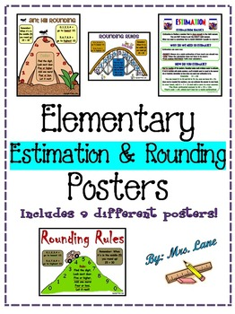
Problem solving based on Estimation of Numbers

Slide 4
Previous Knowledge Test
1..Estimate the sums by rounding off to the nearest thousands
i)7789+569
ii)8976+43565.
2. Give a rough estimate (by rounding off to nearest hundreds) and also a closer estimate (by rounding off to nearest tens) :
(a) 439 + 334 + 4,317
(b) 1,08,734 – 47,599
(c) 8325 – 491
(d) 4, 89,348 – 48,365

Slide 5
Estimation of quotient will be explained with the help of a video.
https://www.youtube.com/watch?v=dQcF0Q2WcfE

Slide 6
Problem solving based on Estimation of Numbers
Q.1. Estimate the following by converting each of them to nearest ten
i. 484/42
ii. 198/24
Solutions:
i) 484 ÷ 42
484 ÷42 is approximately (to the nearest 10) equal to
480 ÷ 40 = 12
ii) 198 ÷ 24
198 ÷ 24 is approximately (to the nearest 10) equal to
200 ÷ 20 = 10

Slide 7
Q7Estimate each of the following products by rounding off each number to the nearest ten : (i) 49 x 52 Solution: (i) 49 to the nearest ten = 50 and 52 to the nearest ten = 50 ∴Required product = (50 × 50) = 2500
Evaluation Questions

Slide 8
Evaluation Questions
8. Estimate each of the following products by rounding off each number to the nearest hundred : (i) 477 x 213
Solution (i) 477 x 213
477 to the nearest hundred = 500 and
213 to the nearest hundred = 200
∴Required product = (500 × 200)
= 100000

Slide 9
Evaluation Questions
10. Estimate each of the following quotients by converting each number to the nearest ten: (i) 87 ÷ 28
(ii) 84 ÷ 23
Solutions
(i) 87 ÷ 28
87 ÷ 28 is approximately (to the nearest 10) equal to
90 ÷ 30 = 3
(ii) 84 ÷ 23
84 ÷ 23 is approximately (to the nearest 10) equal to
80 ÷ 20 = 4

Slide 10

Home assignment
AHA
Q1. Find the estimated sum of 4,380 and 18,765 to the nearest thousand.
Q2.Estimate the quotient by rounding off to nearest ten
a)283/7 b)314/6 c)6217/7
d) 2758/96 e)4423/21
HW
EX 2.B Q.NO. 9

Slide 11
THANKING YOU
ODM EDUCATIONAL GROUP

