Slide 1


ESTIMATION
SUBJECT : MATHEMATICS
CHAPTER NUMBER: 02
CHAPTER NAME : ESTIMATION
SUB TOPIC: Estimation of Numbers
PERIOD NO :2

Slide 2

Learning outcomes
*Students will be able to estimate the sum.
*Student will be able to estimate the difference
*Student will be able to estimate the product

Slide 3
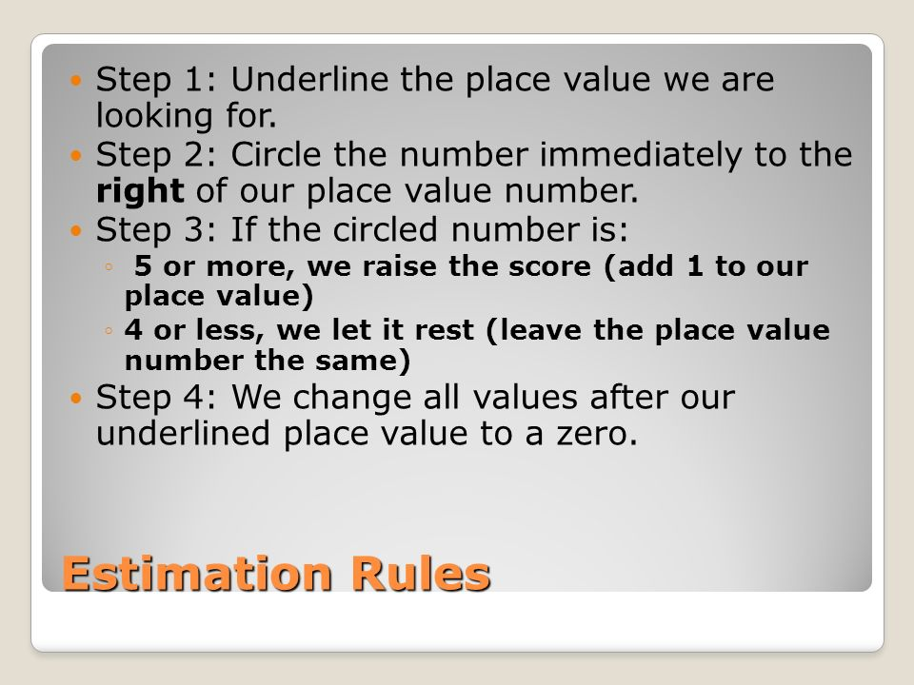
RULES OF ESTIMATION

Slide 4
Previous Knowledge Test
1. When rounded off to nearest thousands, the number 85642 is
(a) 85600 (b) 85700 (c) 85000 (d) 86000
2. State true or false
i)The number 85764 rounded off to nearest hundreds is written as 85700.
ii) Estimated sum of 7826 and 12469 rounded off to hundreds is 20,000.
10. Find the largest number formed by the digits 4, 3,0, 9. Round it off to the nearest thousand.

Slide 5
Estimation of the sum, difference and product will be explained with the help of a video https://www.youtube.com/watch?v=sAGbKRcSlis

Slide 6
Estimation of Numbers
Q1.Estimate the following
i)sum of 76 and 62 to its nearest ten.
ii)6352-2086 to its nearest hundred.
iii)74X67 to nearest ten.
Solution:
(i) 76 to the nearest ten is 80
62 to the nearest ten is 60
Sum of these numbers = 80 + 60
= 140
∴Required sum = 140
ii) 6352 to the nearest hundred = 6400 and
2086 to the nearest hundred = 2100
∴Required difference = (6400 – 2100)
= 4300
iii) ) 74 to the nearest ten = 70 and
67 to the nearest ten = 70
∴Required product = (70 × 70)
= 4900

Slide 7
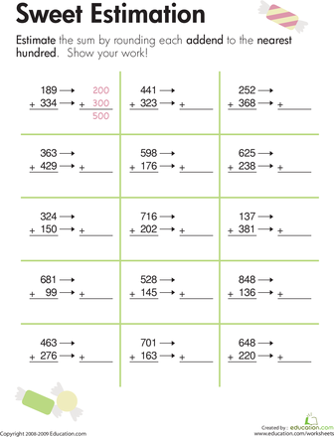
Lets Estimate

Slide 8
Evaluation Questions
1.Estimate the sum of each pair of numbers to the nearest ten :
(i) 67 and 44
(ii) 34 and 87
Solution:
(i) 67 to the nearest ten is 70
44 to the nearest ten is 40
Sum of these numbers = 70 + 40=110
∴Required sum = 110
(ii) 34 to the nearest ten is 30
87 to the nearest ten is 90
Sum of these numbers = 30 + 90=120

Slide 9
Evaluation Questions
2.Estimate the sum of each pair of numbers to the nearest hundred:
(i) 336 and 782
(iii) 270 and 495
Solution:
(i) 336 to the nearest hundred is 300 and 782 to the nearest hundred is 800
Sum of these numbers = (300 + 800)
= 1100
∴Required sum = 1100
(iii) 270 to the nearest hundred is 300 and 495 to the nearest hundred is 500
Sum of these numbers = (300 + 500)= 800
∴Required sum = 800

Slide 10
Evaluation Questions
5.Estimate each difference to the nearest hundred:
(i) 769 – 314
(ii) 856 – 687
Solution:
(i) 769 to the nearest hundred = 800 and
314 to the nearest hundred = 300
∴Required difference = (800 – 300)
= 500
(ii) 856 to the nearest hundred = 900 and
687 to the nearest hundred = 700
∴Required difference = (900 – 700)
= 200

Slide 11

Home assignment
AHA
Q1. The largest number formed by the digits 4, 3,0, 9, rounded off to the nearest thousand is ………………
Q2.The sum of my digits is 12. When rounded off to the nearest hundred. I am 500. Rounding to the nearest 10 makes me 530. What am I ?
Q3. Estimate the following products to the nearest ten:
(a) 578 × 161 (b) 5281 × 3491 (c) 1291 × 592 (d) 9250 × 29
HW
EX.2B. Q.NO.4

Slide 12
THANKING YOU
ODM EDUCATIONAL GROUP

