Slide 1


ESTIMATION
INTRODUCTION
SUBJECT : MATHEMATICS
CHAPTER NUMBER: 02
CHAPTER NAME : ESTIMATION
SUB TOPIC: Introduction, Rounding off Numbers to Nearest Ten, Hundred and Thousand
PERIOD NO:1

Slide 2

Learning outcomes
*Students will be able to round off given number to nearest ten.
*Students will be able to round off given number to nearest hundred.
*Students will be able to round off given number to nearest thousand.
*Students will be able to solve problems based on rounding off.

Slide 3
Rounding off to nearest 10, 100,1000 will be explained with the help of a video.
https://www.youtube.com/watch?v=jvp0mtr1kFM

Slide 4
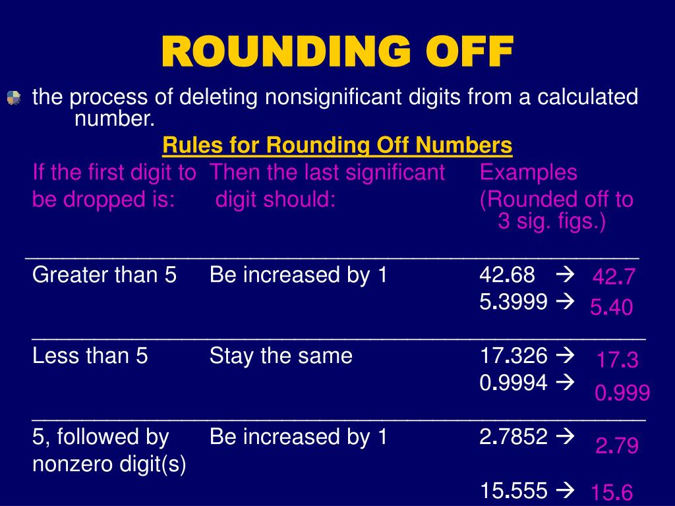
ROUNDING OFF TO NEAREST TEN ,HUNDRED AND THOUSAND

Slide 5
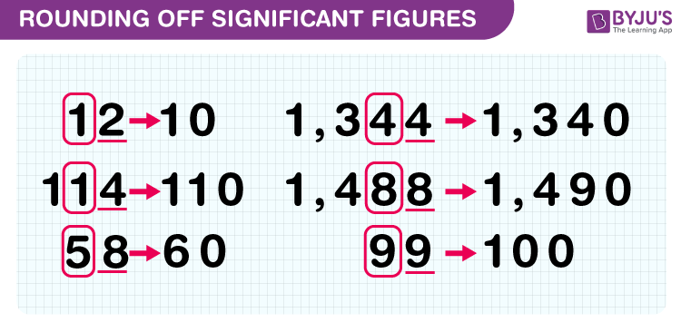
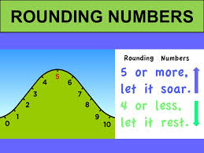
LETS KNOW ABOUT ROUNDING OFF NUMBERS

Slide 6
ROUNDING OFF TO NEAREST TEN ,HUNDRED AND THOUSAND
Q1.Round off
i) 62and 87 to nearest ten
ii) 748 and 2667 to nearest hundred
iii) 6475 and 6732 to nearest thousand
Solution:
62 to the nearest ten is 60
87 to the nearest ten is 90
(ii) 748 to the nearest hundred is 700
2667 to the nearest hundred is 2700
(iii) 6475 to the nearest thousand is 6000
6732 to the nearest thousand is 7000

Slide 7
Evaluation Questions
1. Round off each of the following to the nearest ten:
ii)265 v)6294
Solution:
If the ones place digit is less than 5, replace ones digit by 0, and keep the other digit as the same
And if the digit at ones place is 5 or more than 5, increase tens digit by 1 and replace ones digit by 0
(ii) 265 to the nearest ten is 270
(v) 6294 to the nearest ten is 6290

Slide 8
Evaluation Questions
Q2. Round off each of the following to the nearest hundred:
(ii) 784
(v) 6388
Solution:
If the digit at tens place is less than 5, replace each one of tens and ones digits by 0 and keep the other digits as the same
If the tens digit is 5 or more than 5, increase the hundreds digit by 1 and replace each of tens and ones digit by 0
(ii) 784 to the nearest hundred is 800
(v) 6388 to the nearest hundred is 6400

Slide 9
Evaluation Questions
3. Round off each of the following to the nearest thousand:
(iii) 25352
(v) 9248
Solution:
Observe the hundreds digit of the given number
If the hundreds digit is less than 5, replace each one of hundreds, tens, and ones digits by 0 and keep the other digits as same
If hundreds digit is 5 or more than 5 in the given number, increase thousand digit by 1 and replace each other digit on its right by 0
(iii) 25352 to the nearest thousand is 25000
(v) 9248 to the nearest thousand is 9000

Slide 10
Home assignment
Q1.When rounded off to nearest thousands, the number 85642 is (a)85600(b)85700 (c) 85000 (d) 86000
Q2. The greatest number which on rounding off to nearest thousands gives 5000, is (a) 5001 (b) 5559 (c) 5999 (d) 5499
HW
EX 1A. Q.NO.4

Slide 11
THANKING YOU
ODM EDUCATIONAL GROUP

