Slide 1


SIMPLE LINEAR EQUATIONS
SUBJECT : MATHEMATICS
CHAPTER NUMBER: 22
CHAPTER NAME:SIMPLE LINEAR EQUATIONS
SUB TOPIC:Solving a Linear Equation Using Transposition.
PERIOD NO:2

Slide 2

Learning outcomes
Students will be able to do transposition of positive and negative terms.
Students will be able to solve linear equations using transposition.

Slide 3
SIMPLE LINEAR EQUATIONS Previous Knowledge Test
1. Solve:
(i) x – 3 = 2 (ii) m – 2 = – 5
(iii) b – 5 = 7 (iv) a – 2.5 = – 4
(v) y – 3 (1 / 2) = 6

Slide 4
SIMPLE LINEAR EQUATIONS
Solving linear equation by using transposition will be explained with the help of a video.
https://www.youtube.com/watch?v=gQTkxcriXk0(5.45)

Slide 5
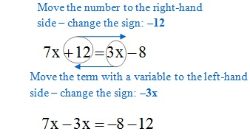
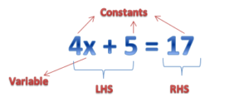
SIMPLE LINEAR EQUATIONS

Slide 6
Evaluation Question EXERCISE 22 B
1. Solve:
(i) 2x + 5 = 17 (ii) 3y – 2 = 1
(iii) 5p + 4 = 29 (iv) 4a – 3 = – 27
(v) 2z + 3 = – 19
2. Solve:
(i) x / 3 – 5 = 2 (ii) y / 2 – 3 = 8
(iii) z / 7 + 1 = 2 (1 / 2) (iv) a / 2.4 – 5 = 2.4
(v) b / 1.6 + 3 = – 2.5
3. Solve:
(i) – 8m – 2 = – 10 (ii) 4x + 2x = 3 + 5
(iii) 4x – x + 5 = 8 (iv) 6x + 2 = 2x + 10
(v) 18 – (2a – 12) = 8a

Slide 7
Evaluation Question
1.Solution:
(i) 2x + 5 = 17
2x = 17 – 5
2x = 12
x = 12 / 2
x = 6
(ii) 3y – 2 = 1
3y = 1 + 2
3y = 3
y = 3 / 3
y = 1
(iii) 5p + 4 = 29
5p = 29 – 4
5p = 25
p = 25 / 5 or p = 5

Slide 8
Evaluation Question
2. Solution:(i) x / 3 – 5 = 2
x / 3 = 2 + 5
x / 3 = 7
x = 7 × 3
x = 21
(ii) y / 2 – 3 = 8
y / 2 = 8 + 3
y / 2 = 11
y = 11 × 2
y = 22
Hence, the value of y = 22

Slide 9
Evaluation Question
3.Solution:(i) – 8m – 2 = – 10
– 8m = – 10 + 2
– 8m = – 8
m = – 8 / – 8
m = 1
Therefore, the value of m = 1
(ii) 4x + 2x = 3 + 5
6x = 8
x = 8 / 6
x = 4 / 3

Slide 10
Additional Homework
Solve the following:
1. x/2 + x/5 = 14
2. x/3 – x/4 = 2
HW
Ex.22 B

Slide 11
THANKING YOU
ODM EDUCATIONAL GROUP

