Slide 1


SIMPLE LINEAR EQUATIONS
SUBJECT : MATHEMATICS
CHAPTER NUMBER: 22
CHAPTER NAME:SIMPLE LINEAR EQUATIONS
SUB TOPIC:Basic Concepts, Solving a Linear Equation.
PERIOD NO:1

Slide 2

Learning outcomes
Students will be able to solve linear equations of the form x+a=b, x-a=b.
Students will be able to solve linear equation of the form ax=b.

Slide 3
SIMPLE LINEAR EQUATIONS
Solving linear equations will be taught with the help of a video.
https://www.youtube.com/watch?v=tHm3X_Ta_iE(11.05)

Slide 4
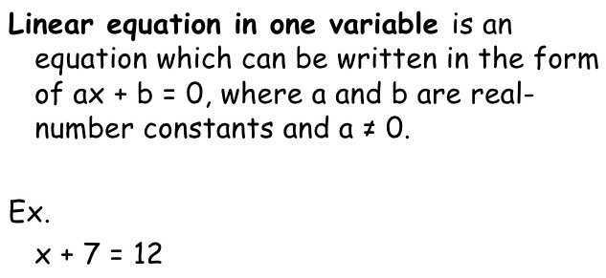
SIMPLE LINEAR EQUATIONS
.

Slide 5
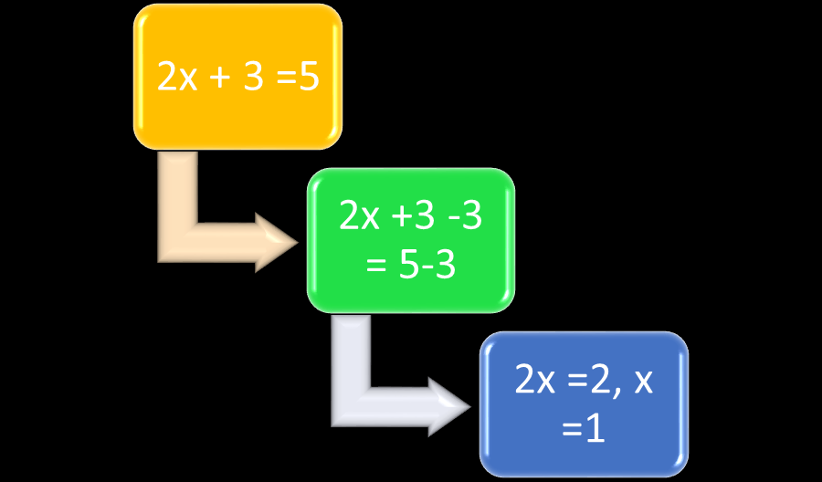
SIMPLE LINEAR EQUATIONS

Slide 6
Evaluation Question EXERCISE 22A
1. Solve:
(i) x + 2 = 6 (ii) x + 6 = 2
(iii) y + 8 = 5 (iv) x + 4 = – 3
(v) y + 2 = – 8
Solution:
(i) x + 2 = 6
x = 6 – 2
x = 4
Hence, the value of x for x + 2 is 4
(ii) x + 6 = 2
x = 2 – 6
x = – 4
Hence, the value of x for x + 6 = 2 is – 4

Slide 7
Evaluation Question EXERCISE 22 A
2. Solve:
(i) x – 3 = 2 (ii) m – 2 = – 5
(iii) b – 5 = 7 (iv) a – 2.5 = – 4
(v) y – 3 (1 / 2) = 6
Solution:
(i) x – 3 = 2
x = 2 + 3
x = 5
Therefore, the value of x for x – 3 = 2 is 5
(ii) m – 2 = – 5
m = – 5 + 2
m = – 3
Therefore, the value of m for m – 2 = – 5 is – 3

Slide 8
Evaluation Question EXERCISE 22 A
3. Solve:
(i) 3x = 12 (ii) 2y = 9
(iii) 5z = 8.5 (iv) 2.5m = 7.5
(v) 3.2p = 16
Solution:
(i) 3x = 12
x = 12 / 3
x = 4
Hence, the value of x for 3x = 12 is 4
(ii) 2y = 9
y = 9 / 2
y = 4.5
Hence, the value of y for 2y = 9 is 4.5

Slide 9
Evaluation Question EXERCISE 22
4. Solve:
(i) x / 2 = 5 (ii) y / 3 = – 2
(iii) a / 5 = – 15 (iv) z / 4 = 3 (1 / 4)
(v) m / 6 = 2 (1 / 2)
Solution:
(i) x / 2 = 5
x = 5 × 2
x = 10
Hence, the value of x for x / 2 = 5 is 10
(ii) y / 3 = – 2
y = – 2 × 3
y = – 6
Hence, the value of y for y / 3 = – 2 is – 6
(iii) a / 5 = – 15
a = – 15 × 5
We get,
a = – 75
Hence, the value of a for a / 5 = – 15 is – 75
(iv) z / 4 = 3 (1 / 4)
This can be written as,
z / 4 = 13 / 4
z = 13 / 4 × 4
We get,
z = 13
Hence, the value of z for z / 4 = 3 (1 / 4) is 13
(v) m / 6 = 2 (1 / 2)
This can be written as,
m / 6 = 5 / 2
m = 5 / 2 × 6
m = 5 × 3
We get,
m = 15
Hence, the value of m for m / 6 = 2 (1 / 2) is 15
5. Solve:
(i) – 2x = 8
(ii) – 3.5y = 14
(iii) – 5z = 4
(iv) – 5 = a + 3
(v) 2 = p + 5
Solution:
(i) – 2x = 8
x = – 8 / 2
We get,
x = – 4
Therefore, the value of x for – 2x = 8 is – 4
(ii) – 3.5y = 14
y = – 14 / 3. 5
We get,
y = – 4
Therefore, the value of y for – 3.5y = 14 is – 4
(iii) – 5z = 4
z = – 4 / 5
We get,
z = – 0.8
Therefore, the value of z for – 5z = 4 is – 0.8
(iv) – 5 = a + 3
– 5 – 3 = a
On calculating, we get
a = – 8
Therefore, the value of a for – 5 = a + 3 is – 8
(v) 2 = p + 5
2 – 5 = p
We get,
p = – 3
Therefore, the value of p for 2 = p + 5 is – 3

Slide 10
Evaluation Question EXERCISE 22
5. Solve:
(i) – 2x = 8 (ii) – 3.5y = 14
(iii) – 5z = 4 (iv) – 5 = a + 3 (v) 2 = p + 5
Solution:
(i) – 2x = 8
x = – 8 / 2
x = – 4
Therefore, the value of x for – 2x = 8 is – 4
(ii) – 3.5y = 14
y = – 14 / 3. 5
y = – 4
Therefore, the value of y for – 3.5y = 14 is – 4

Slide 11
Evaluation Question EXERCISE 22
(iii) – 5z = 4
z = – 4 / 5
z = – 0.8
Therefore, the value of z for – 5z = 4 is – 0.8
(iv) – 5 = a + 3
– 5 – 3 = a
a = – 8
Therefore, the value of a for – 5 = a + 3 is – 8
(v) 2 = p + 5
2 – 5 = p
p = – 3
Therefore, the value of p for 2 = p + 5 is – 3

Slide 12
Additional Homework
1. Solve the following
(i) 4a – 3 = – 27
(ii) 2z + 3 = – 19
HW
Ex. 22A

Slide 13
THANKING YOU
ODM EDUCATIONAL GROUP

