Slide 1


FRAMING ALGEBRAIC EXRESSIONS
SUBJECT : MATHEMATICS
CHAPTER NUMBER: 21
CHAPTER NAME:FRAMING ALGEBRAIC EXPRESSIONS.
SUB TOPIC:Framing Algebraic Expressions.
PERIOD NO:1

Slide 2

Learning outcomes
Students will be able to frame algebraic expressions.
Students will be able to convert real life situations into algebraic expressions.

Slide 3
FRAMING ALGEBRAIC EXPRESSIONS
Concept of framing algebraic expression will be explained using a video.
https://www.youtube.com/watch?v=lxHM4i4kwoQ(12.5)

Slide 4
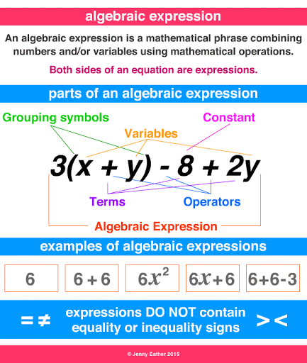
FRAMING ALGEBRAIC EXPRESSIONS

Slide 5
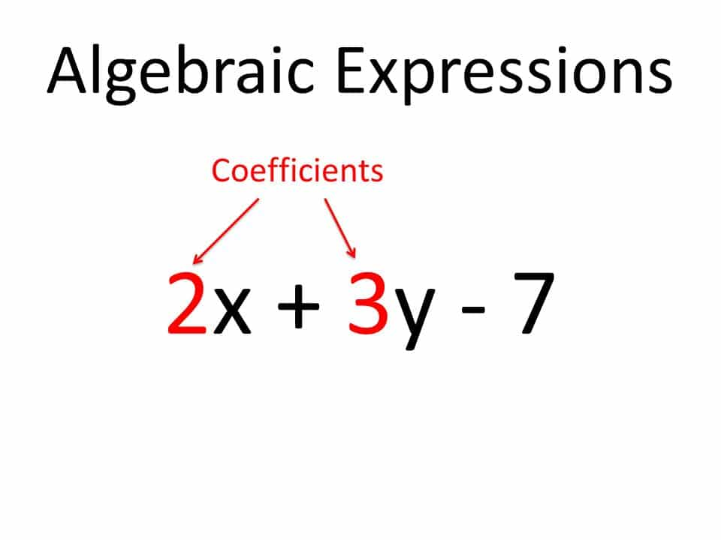
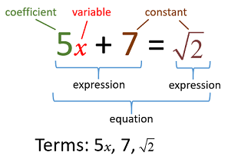
FRAMING ALGEBRAIC EXPRESSIONS

Slide 6
Evaluation Question EXERCISE 21
1. Write in the form of an algebraic expression:
Perimeter (P) of a rectangle is two times the sum of its length (l) and its breadth (b).
(ii) Perimeter (P) of a square is four times its side.
(iii) Area of a square is square of its side.
(iv) Surface area of a cube is six times the square of its edge.
Solution: (i) Let us assume the length be l, breadth be b and perimeter be P. Then the algebraic expression for the given statement is written as,
P = 2 (l + b)
(ii) Let us assume the side be s and perimeter be P. Then the algebraic expression for the given statement is written as,
P = 4s

Slide 7
Evaluation Question
2. Express each of the following as an algebraic expression:
(i) The sum of x and y minus m.
(ii) The product of x and y divided by m.
(iii) The subtraction of 5m from 3n and then adding 9p to it.
(iv) The product of 12, x, y and z minus the product of 5, m and n.
(v) Sum of p and 2r – s minus sum of a and 3n + 4x.
Solution:
(i)The algebraic expression for the given sentence is given below
x + y – m
(ii) The algebraic expression for the given sentence is given below
xy / m

Slide 8
Evaluation Question
3. Construct a formula for the following:
Total wages (Rs W) of a man whose basic wage is (Rs B) for t hours week plus (Rs R) per hour, if he works a total of T hours.
Solution:
The wages for t hours is Rs B.
The wages for overtime is R(T – t)
Hence, the total wages is calculated as given below,
W = B + R(T – t)
4. If x = 4, evaluate:
3x + 8 (ii) x² – 2x (iii) x² / 2
5. If m = 6, evaluate:
(i) 5m – 6 (ii) 2m² + 3m (iii) (2m)²

Slide 9
Evaluation Question
Solution:
(i) 3x + 8
The value of 3x + 8 for x = 4 is calculated as below
Now, substituting x = 4 in the given equation, we get
3x + 8 = 3 × 4 + 8
= 12 + 8
= 20
Therefore, the value of 3x + 8 for x = 4 is 20
(ii) x² – 2x
The value of x² – 2x for x = 4 is calculated as below
Now, substituting x = 4 in the given equation, we get
x² – 2x = 4² – 2 × 4
= 16 – 8 = 8
Therefore, the value of x² – 2x for x = 4 is 8

Slide 10
Evaluation Question
Solution:
(iii) x² / 2
The value of x² / 2 for x =4 is calculated as below
x² / 2 = 4² / 2
= 16 / 2 = 8
Therefore, the value of x² / 2 for x = 4 is 8
5.Solution:
(i) 5m – 6
The value of 5m – 6 for m = 6 is calculated as below
Now, substituting the value of m = 6 in the given equation, we get
5m – 6 = 5 × 6 – 6
= 30 – 6 = 24
Hence, the value of 5m – 6 for m = 6 is 24

Slide 11
Evaluation Question
(ii) 2m² + 3m
The value of 2m² + 3m for m = 6 is calculated as below
Now, substituting the value of m = 6 in the given equation, we get
2m² + 3m = 2(6)² + 3(6)
= 2 × 36 + 3 × 6
= 72 + 18 = 90
Hence, the value of 2m² + 3m for m = 6 is 90
(iii) The value of (2m)² for m = 6 is calculated as below
Now, substituting the value of m = 6 in the given equation, we get
(2m)² = (2 × 6)²
= 12² = 144
Hence, the value of (2m)² for m = 6 is 144

Slide 12
Evaluation Question
6. If x = 4, evaluate:
(i) 12x + 7
(ii) 5x² + 4x
(iii) x² / 8
Solution:(i) substituting the value of x = 4 in the given equation, we get
12x + 7 = 12 × 4 + 7
= 48 + 7 = 55
Therefore, the value of 12x + 7 for x = 4 is 55
(ii) The value of 5x² + 4x for x = 4 is calculated as follows,
Substituting the value of x = 4 in the given equation, we get
5x² + 4x = 5 × 4² + 4 × 4
= 5 × 16 + 16 = 80 + 16= 96
Therefore, the value of 5x² + 4x for x = 4 is 96
(iii) x² / 8
The value of x² / 8 for x = 4 is calculated as follows,
x² / 8 = 4² / 8
We get,
= 16 / 8
= 2
Therefore, the value of x² / 8 for x = 4 is 2
7. If m = 2, evaluate:
(i) 16m – 7
(ii) 15m² – 10m
(iii) 1 / 4 × m³
Solution:
(i) 16m – 7
The value of 16m – 7 for m = 2 is calculated as below,
16m – 7 = 16 × 2 – 7
= 32 – 7
We get,
= 25
Hence, the value of 16m – 7 for m = 2 is 25
(ii) 15m² – 10m
The value of 15m² – 10m for m = 2 is calculated as below,
15m² – 10m = 15 × 2² – 10 × 2
= 15 × 4 – 20
= 60 – 20
We get,
= 40
Hence, the value of 15m² – 10m for m = 2 is 40
(iii) 1 / 4 × m³
The value of 1 / 4 × m³ for m = 2 is calculated as below,
1 / 4 × m³ = 1 / 4 × 2³
We get,
= 1 / 4 × 8
= 2
Hence, the value of 1 / 4 × m³ for m = 2 is 2
8. If x = 10, evaluate:
(i) 100x + 225
(ii) 6x² – 25x
(iii) 1 / 50 × x³
Solution:
(i) 100x + 225
The value of 100x + 225 for x = 10 is calculated as follows,
100x + 225 = 100 × 10 + 225
= 1000 + 225
We get,
= 1225
Therefore, the value of 100x + 225 for x = 10 is 1225
(ii) 6x² – 25x
The value of 6x² – 25x for x = 10 is calculated as follows,
6x² – 25x = 6 × 10² – 25 × 10
= 6 × 100 – 250
= 600 – 250
We get,
= 350
Therefore, the value of 6x² – 25x for x = 10 is 350
(iii) 1 / 50 × x³
The value of 1 / 50 × x³ for x = 10 is calculated as follows,
1 / 50 × x³ = 1 / 50 × 10³
= 1 / 50 × 1000
We get,
= 20
Therefore, the value of 1 / 50 × x³ for x = 10 is 20
9. If a = – 10, evaluate:
(i) 5a
(ii) a²
(iii) a³
Solution:
(i) 5a
The value of 5a for a = – 10 is calculated as shown below,
5a = 5 × (- 10)
We get,
= – 50
Therefore, the value of 5a for a = -10 is – 50
(ii) a²
The value of a² for a = -10 is calculated as shown below,
a² = (- 10)²
= 100
Therefore, the value of a² for a = – 10 is 100
(iii) a³
The value of a³ for a = – 10 is calculated as shown below,
a³ = (- 10)³
= – 1000
Therefore, the value of a³ for a = – 10 is – 1000

Slide 13
Evaluation Question
(iii) x² / 8
The value of x² / 8 for x = 4 is calculated as follows,
x² / 8 = 4² / 8
= 16 / 8= 2
Therefore, the value of x² / 8 for x = 4 is 2
7. If m = 2, evaluate:
(i) 16m – 7
(ii) 15m² – 10m
(iii) 1 / 4 × m³
i)Solution : The value of 16m – 7 for m = 2 is calculated as below,
16m – 7 = 16 × 2 – 7= 32 – 7= 25
Hence, the value of 16m – 7 for m = 2 is 25

Slide 14
Evaluation Question
8. If x = 10, evaluate:
(i) 100x + 225
(ii) 6x² – 25x (iii) 1 / 50 × x³
Solution:
(i)The value of 100x + 225 for x = 10 is calculated as follows,
100x + 225 = 100 × 10 + 225
= 1000 + 225= 1225
Therefore, the value of 100x + 225 for x = 10 is 1225
(ii)The value of 6x² – 25x for x = 10 is calculated as follows,
6x² – 25x = 6 × 10² – 25 × 10
= 6 × 100 – 250
= 600 – 250 = 350

Slide 15
Additional Homework
1. Fill in the blanks:
(i) 8x + 5x = …….
(ii) 8x – 5x = ……
(iii) 6xy² + 9xy² = …….
HWEx.21 Q NO 1TO 10

Slide 16
THANKING YOU
ODM EDUCATIONAL GROUP

