Slide 1


DECIMALS
SUBJECT : MATHEMATICS
CHAPTER NUMBER: 15
CHAPTER NAME : DECIMALS

Slide 2

Learning outcomes
Students will be able to solve sums based on decimal addition and subtraction.
Students will be able to apply in daily life situations.

Slide 3
https://www.youtube.com/watch?v=m0aNbQi2uzI

Slide 4
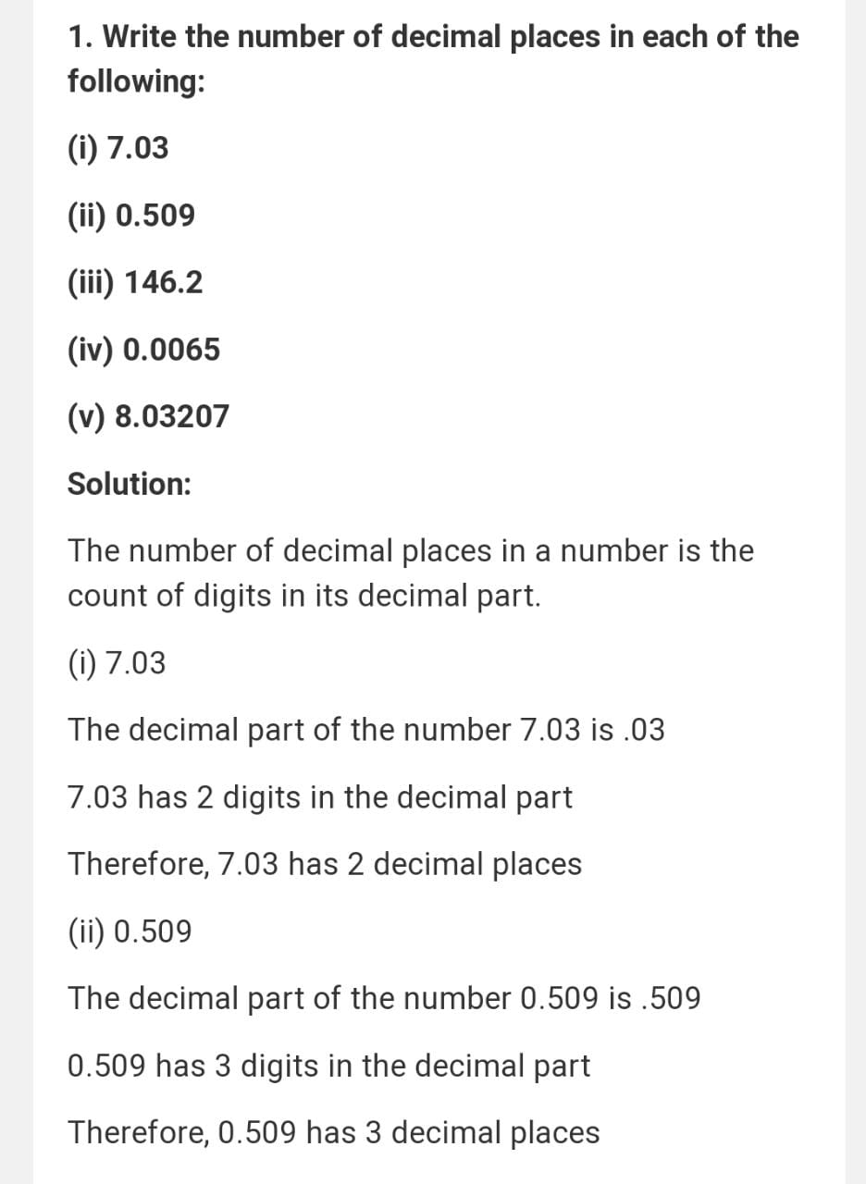

Slide 5
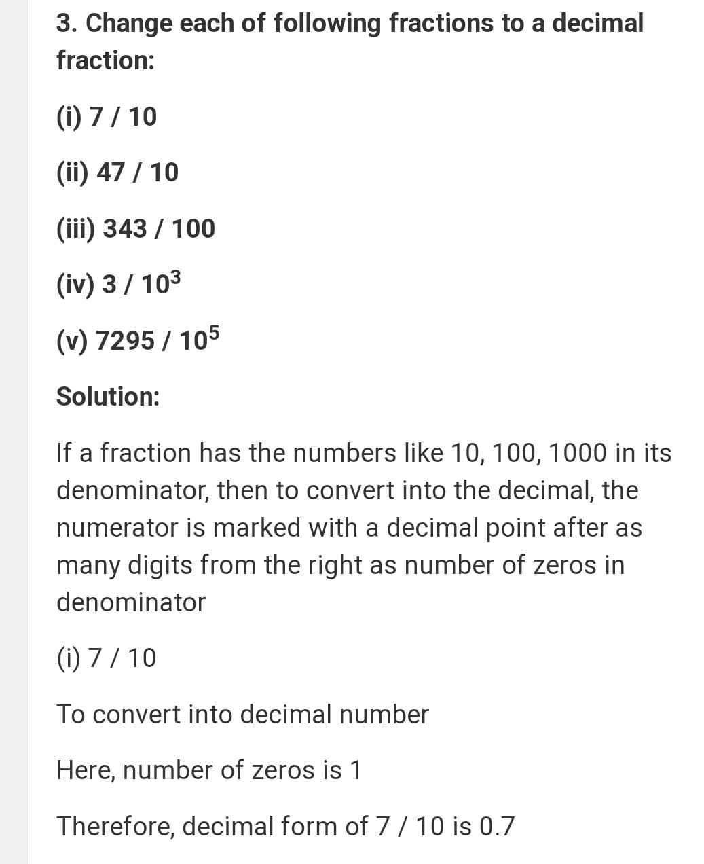

Slide 6
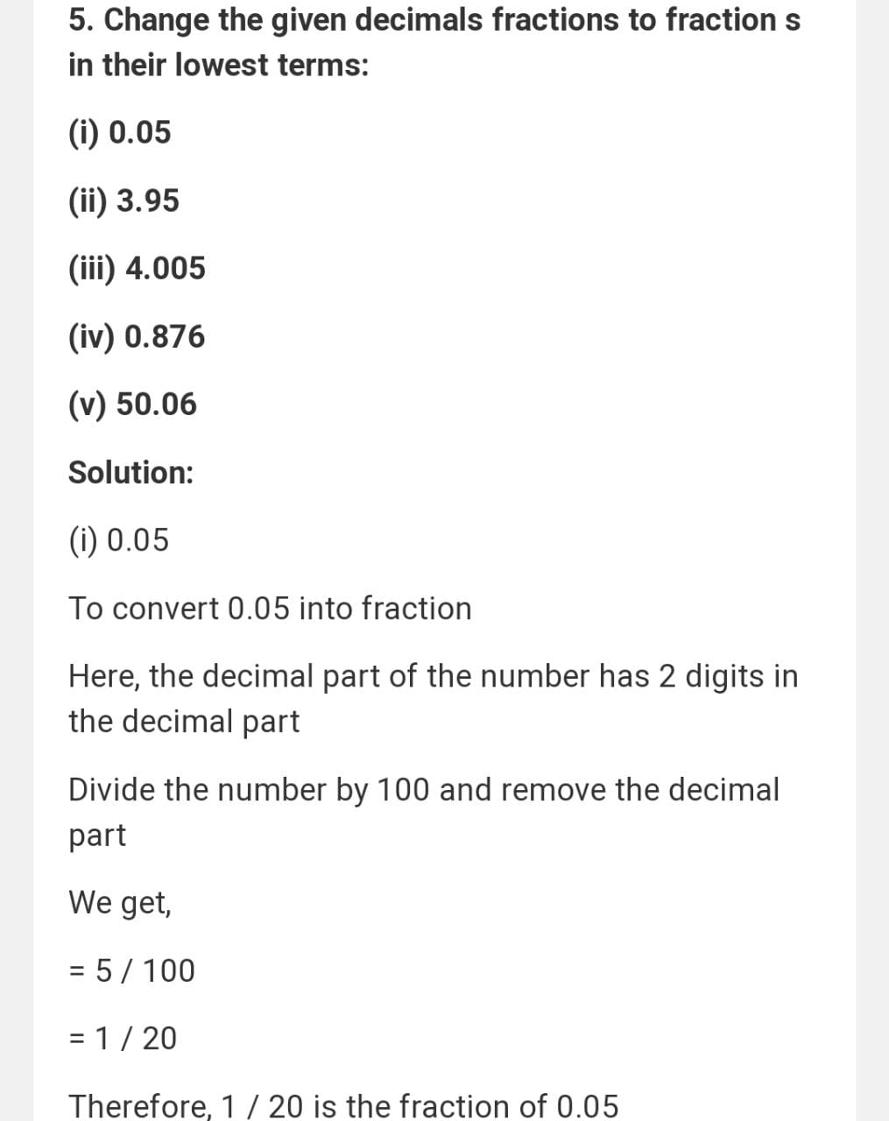

Slide 7
Additional Homework
HW
Ex15A

Slide 8
THANKING YOU
ODM EDUCATIONAL GROUP

