Slide 1


NUMBER SYSTEM
SUBJECT : MATHEMATICS
CHAPTER NUMBER: 01
CHAPTER NAME : NUMBER SYSTEM
SUB TOPIC:FORMATION OF LARGEST AND SMALLEST NUMBER
PERIOD NO :2

Slide 2

Learning outcome
Students will be able to form largest number and smallest number.
Student will be able to identify largest and smallest numbers from a group of numbers

Slide 3
Previous Knowledge Test
Q1.State the rule for comparing two given numbers.
Q2. Compare the numbers 9524420 and 9528420.
Q3. . Fill in the blanks with < or > sign:
(i) 34512 …………. 5451 (ii) 63458 ……….. 63548
(iii) 96785 ………….95793 (iv) 58934 ……….. 58943

Slide 4
Largest and smallest number formation
Largest and smallest number formation will be explained with the help of a video.
https://www.youtube.com/watch?v=-VuUUhhsUSQ

Slide 5
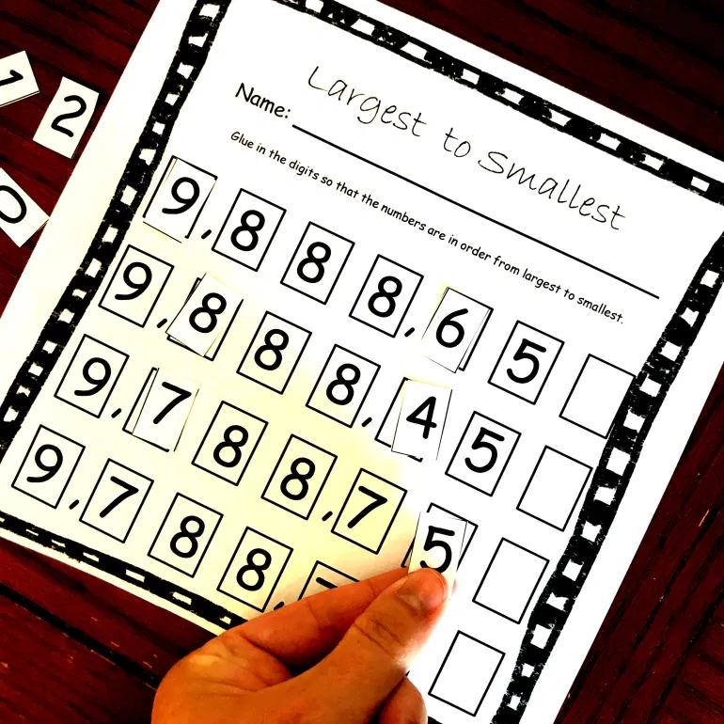
Formation of Largest and Smallest Number

Slide 6
Formation of Largest and Smallest Number
To get the smallest number, using the given digits:
the smallest digit is written at the leftmost and then the remaining digits in ascending order of their values to the right.
To get the largest number, using the given digits:
the largest digit is written at the leftmost and then the remaining digits in descending order of their values to the to the right.
A number can not
begin with 0

Slide 7
Evaluation Question
Q.7 Find the smallest and the greatest numbers in each case given below: (i) 983, 5754, 84 and 5942
Solution:
Since 84 has the least number of digits.
84 is the smallest number
5754 and 5942 have the maximum number of digits. Among these two 5942 is greater than 5754
Therefore 84 is the smallest number and 5942 is the greatest number.

Slide 8
Evaluation Questions
Q.8.Form the greatest and the smallest 4 digit numbers using the given digits without repetition (i) 3, 7, 2 and 5 (ii) 6, 1, 4 and 9
Solution:
(i) The given digits are 3, 7, 2 and 5
(a) 7532 is the greatest 4-digit number
(b) 2357 is the smallest 4-digit number
(ii) The given digits are 6, 1, 4 and 9
(a) 9641 is the greatest 4-digit number
(b) 1469 is the smallest 4-digit number

Slide 9
Evaluation Question
Q.10. Form the greatest and the smallest 4-digit numbers using any four different digits, with the condition that digit 5 is always at ten’s place.
Solution:
The greatest and the smallest 4-digit numbers using any four different digits, with the condition that digit 5 is always at ten’s place is
The greatest 4-digit number = 9857
The smallest 4-digit number = 1052

Slide 10

Additional Home assignment
Q1.Find the largest 4- digit no using any one digit twice from the digits 5,9,2 and 6.
Q2.The largest 5-digit number having three different digits is (A)98978 (B)99897 (C)99987 (D) 98799
Q3. Write the largest 5-digit number having three different digits.
Q4. Write the smallest 4-digit number and the greatest 4-digit number (without repeating a digit) from each of the following groups of four digits: (i) 4, 7, 2, 9 (ii) 3, 6, 2, 4
HW
Ex.1.AQ.No.
9,12,13

Slide 11
THANKING YOU
ODM EDUCATIONAL GROUP

