Slide 1


NUMBER SYSTEM
SUBJECT : MATHEMATICS
CHAPTER NUMBER: 01
CHAPTER NAME : NUMBER SYSTEM
SUB TOPIC: COMPARISON OF NUMBERS,COMPARING NUMBERS USING CHARTS
PERIOD NO:1

Slide 2

Learning outcome
Students will be able to compare numbers.
Students will be able to compare numbers using charts.
Students will be able to solve problems based on comparing numbers

Slide 3
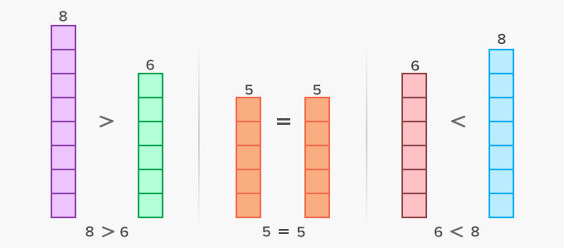
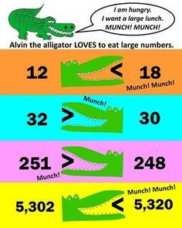
Lets know about comparing numbers

Slide 4
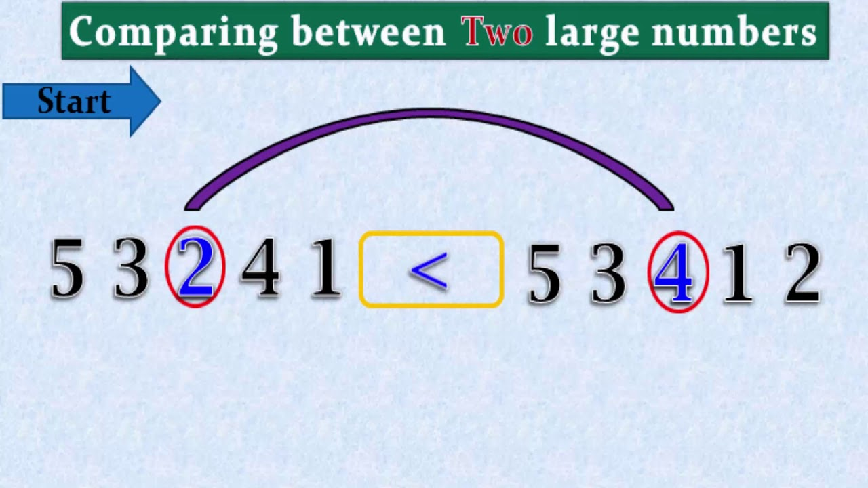
Comparing large numbers

Slide 5
Rules of Comparison Rules of comparison of numbers. https://www.youtube.com/watch?v=BEbh_cGcZmM(4.16)

Slide 6
Comparison of numbers described with the help of following video
https://www.youtube.com/watch?v=yUKcKLxYq-k&t=12s(10.16)

Slide 7
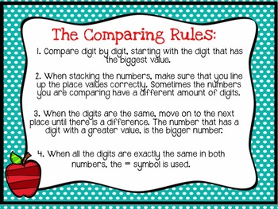
Rules of comparison of numbers

Slide 8
Compare 62,36,489 and 62,53,278 using charts
6 | 2 | 3 | 6 | 4 | 8 | 9
6 | 2 | 5 | 3 | 2 | 7 | 8
Clearly both the numbers have equal number of digits i.e. 7 digits.
At the leftmost ,both have the same digit 6.
At the second place from left ,again both have the same digit 2.
At the third place ,from the left the first number has digit 3and the second number has digit 5.
Since 3<5
6236489 < 6253278

Slide 9
Evaluation Question
Q1. Which is greater? (i) 537 or 98 (ii) 2428 or 529 (iii) 2, 59,467or 10,35,729
Solution:
(i) 537 or 98
Here 537 is a three digit number and 98 is a two digit number
∴ 537 > 98
(ii) 2428 or 529
Here 2428 is a four digit number and 529 is a three digit number
∴ 2428 > 529
(iii) 2, 59,467 or 10, 35,729
Here 10, 35,729 is a seven digit number and 2, 59,467 is a six digit number
∴ 10,35,729 > 2,59,467

Slide 10
Evaluation Question
Q.2. Which is smaller? (i) 428 or 437 (ii) 2497 or 2597 (iii) 3297 or 3596
Solution:
(i) 428 or 437
We observe that both the numbers are of three digit numbers
At the leftmost, both the number have same digit i.e. 4.
At the second place from left, the first number has 2 and the second number has 3
We know that,
2 < 3
∴ 428 is smaller than 437

Slide 11
Evaluation Question
(ii) 2497 or 2597
We observe that both the numbers are of four digit numbers.
At the leftmost, both the numbers have same digit i.e. 2
At the second place from the left, the first number has 4 and the second number has 5
We know that,
4 < 5
∴2497 is smaller than 2597

Slide 12
Evaluation Question
iii) 3297 or 3596
We observe that both the number are of four digit numbers
At the leftmost, both the numbers have same digit i.e. 3
At the second place from the left, the first number has 2 and the second number has 5
We know that,
2 < 5
3297 is smaller than 3596

Slide 13
Evaluation Question
Q3 Which is greater 380362 or 381007
Solutions
We observe that both the numbers are of 6 digits numbers
The digits are same at the leftmost and second place from left
But the digits at the third place from left are different, the first
number has 0 and the second number has 1
We know that,0 < 1
Hence, 381007 is greater than 380362

Slide 14
Additional Homework
Q1. By making suitable chart compare
4,67,58,907 and4,67,87,043
Q2.Use table form to compare numbers and write them in descending order.
5,43,567; 54,82,760; 49,78,987; 64,876 and 79,768
HW
Ex.1.A Q. No. 5

Slide 15
THANKING YOU
ODM EDUCATIONAL GROUP

