Slide 1


FUNDAMENTAL OPERATIONS
SUBJECT : MATHEMATICS
CHAPTER NUMBER:19
CHAPTER NAME :FUNDAMENTAL OPERATIONS
SUBTOPIC :More Problems on the above concepts.
PERIOD NO: 6

Slide 2

Learning outcomes
Students will be able to divide polynomial by polynomial.
Students will develop application skill.

Slide 3
PREVIOUS KNOWLEDGE TEST
1. Divide
(i) – 21m⁵n⁷ by 14m²n²
(ii) 36a⁴x⁵y⁶ by 4x²a³y²
(iii) 20x³a⁶ by 5xy

Slide 4
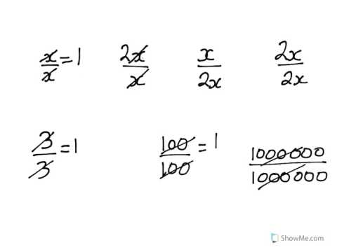
Number Line

Slide 5
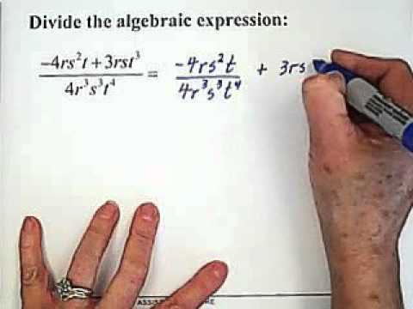
Number Line

Slide 6
Evaluation Question EX-19 D
4. Simplify:
(i) (- 15m⁵n²) / (- 3m⁵)
(ii) 35x⁴y² / – 15x²y²
(iii) (- 24x⁶y²) / (6x⁶y)
Solution:
(i) (-15m⁵n²) / (- 3m⁵) = (-15 × m⁵ × n²) / (- 3 × m⁵)
This can be written as,
= (3 × 5 × m⁵⁻⁵ × n²) / 3
= 5 × m⁰ × n² = 5 × 1 × n²
= 5n²
Hence, (-15m⁵n²) / (- 3m⁵) = 5n²

Slide 7
Evaluation Question EX-19 D
Solution: (ii) 35x⁴y² / – 15x²y²
35x⁴y² / – 15x²y² = (35 × x⁴ × y²) / (- 15 × x² × y²)
This can be written as,
= – (5 × 7 × x⁴⁻² × y²⁻²) / (3 × 5) = – (7 × x² × y⁰) / 3
= – 7x²y / 3
Hence, 35x⁴y² / – 15x²y² = – 7x²y / 3
(iii) (- 24x⁶y²) / (6x⁶y)
(- 24x⁶y²) / (6x⁶y) = (- 24 × x⁶ × y²) / (6 × x⁶ × y)
This can be written as, (- 4 × 6 × x⁶⁻⁶ × y²⁻¹) / 6
= – 4 × x⁰ × y¹ = – 4y
Hence, (- 24x⁶y²) / (6x⁶y) = – 4y

Slide 8
Evaluation Question EX-19 D
5. Divide:
(i) 9x³ – 6x² by 3x
(ii) 6m² – 16m³ + 10m⁴ by – 2m
(iii) 15x³y² + 25x²y³ – 36x⁴y⁴ by 5x²y²
(iv) 36a³x⁵ – 24a⁴x⁴ + 18a⁵x³ by – 6a³x³
Solution: (i) 9x³ – 6x² by 3x
9x³ – 6x² ÷ 3x = (9 × x³ – 6 × x²) / (3 × x)
Separating the terms, we get
= (9 × x³) / (3 × x) – (6 × x²) / (3 × x) = 3 × x³⁻¹ – 2 × x²⁻¹
= 3x² – 2x
Hence, 9x³ – 6x² ÷ 3x = 3x² – 2x

Slide 9
Evaluation Question EX-19 D
Solution: (ii) 6m² – 16m³ + 10m⁴ by – 2m
6m² – 16m³ + 10m⁴ ÷ – 2m = (6 × m²– 16 × m³ + 10 × m⁴) / – 2 × m
Separating the terms, we get
= (6 × m² / – 2 × m) – (16 × m³) / (- 2 × m) + (10 × m⁴) / (- 2 × m)
= – 3 × m²⁻¹ + 8 × m³⁻¹ – 5 × m⁴⁻¹
= – 3 × m + 8 × m² – 5 × m³
= – 3m + 8m² – 5m³
Hence, 6m² – 16m³ + 10m⁴ ÷ – 2m = – 3m + 8m² – 5m³

Slide 10
Evaluation Question EX-19 D
Solution: (iii) 15x³y² + 25x²y³ – 36x⁴y⁴ by 5x²y²
15x³y² + 25x²y³ – 36x⁴y⁴ ÷ 5x²y²
= (15x³y² + 25x²y³ – 36x⁴y⁴) / (5x²y²)
= (15 × x³ × y²) / (5 × x² × y²) + (25 × x² × y³) / (5 × x² × y²) – (36 × x⁴ × y⁴) / (5 × x² × y²)
On further calculation, we get
= 3 × x³⁻² × y²⁻² + 5 × x²⁻² × y³⁻² – (36 × x⁴⁻² × y⁴⁻²) / 5
We get,
= 3 × x¹ × y⁰ + 5 × x⁰ × y¹ – (36 × x² × y²) / 5
= 3x + 5y – (36x²y²) / 5
Hence, 15x³y² + 25x²y³ – 36x⁴y⁴ ÷ 5x²y² = 3x + 5y – (36x²y²) / 5

Slide 11
Evaluation Question EX-19 D
Solution: (iv) 36a³x⁵ – 24a⁴x⁴ + 18a⁵x³ by – 6a³x³
36a³x⁵ – 24a⁴x⁴ + 18a⁵x³ ÷ (– 6a³x³) = (36a³x⁵ – 24a⁴x⁴ + 18a⁵x³) / – 6a³x³
= (36.a³.x⁵) / (-6.a³.x³) – (24.a⁴.x⁴) / (-6.a³.x³) + (18.a⁵.x³) / (-6.a³.x³)
We get,
= – 6.x⁵⁻³ + 4.a⁴⁻³.x⁴⁻³ – 3.a⁵⁻³
= – 6x² + 4ax – 3a²
Hence, 36a³x⁵ – 24a⁴x⁴ + 18a⁵x³ ÷ (– 6a³x³) = – 6x² + 4ax – 3a²

Slide 12
Additional Homework
1. Divide:
(i) n² – 2n + 1 by n – 1
(ii) m² – 2mn + n² by m – n
HW
Ex.19 D Q. No 4 to 5

Slide 13
THANKING YOU
ODM EDUCATIONAL GROUP

