Slide 1


FUNDAMENTAL OPERATIONS
SUBJECT : MATHEMATICS
CHAPTER NUMBER:19
CHAPTER NAME :FUNDAMENTAL OPERATIONS
SUBTOPIC : Division of a Monomial by a Monomial, and Polynomial by a Monomial.
PERIOD NO: 5

Slide 2

Learning outcomes
Students will be able to divide monomial by monomial .
Students will be able to binomial by monomial

Slide 3
PREVIOUS KNOWLEDGE TEST
1. Find the product of:
(i) a + b – c and 2a – 3b (ii) 5x – 6y – 7z and 2x + 3y
(iii) 5x – 6y – 7z and 2x + 3y + z

Slide 4
Negative numbers and Integers
Students will Learn division of monomials and polynomials with the help of a video .
https://www.youtube.com/watch?v=hJ9na3B1bVo(7.24)

Slide 5
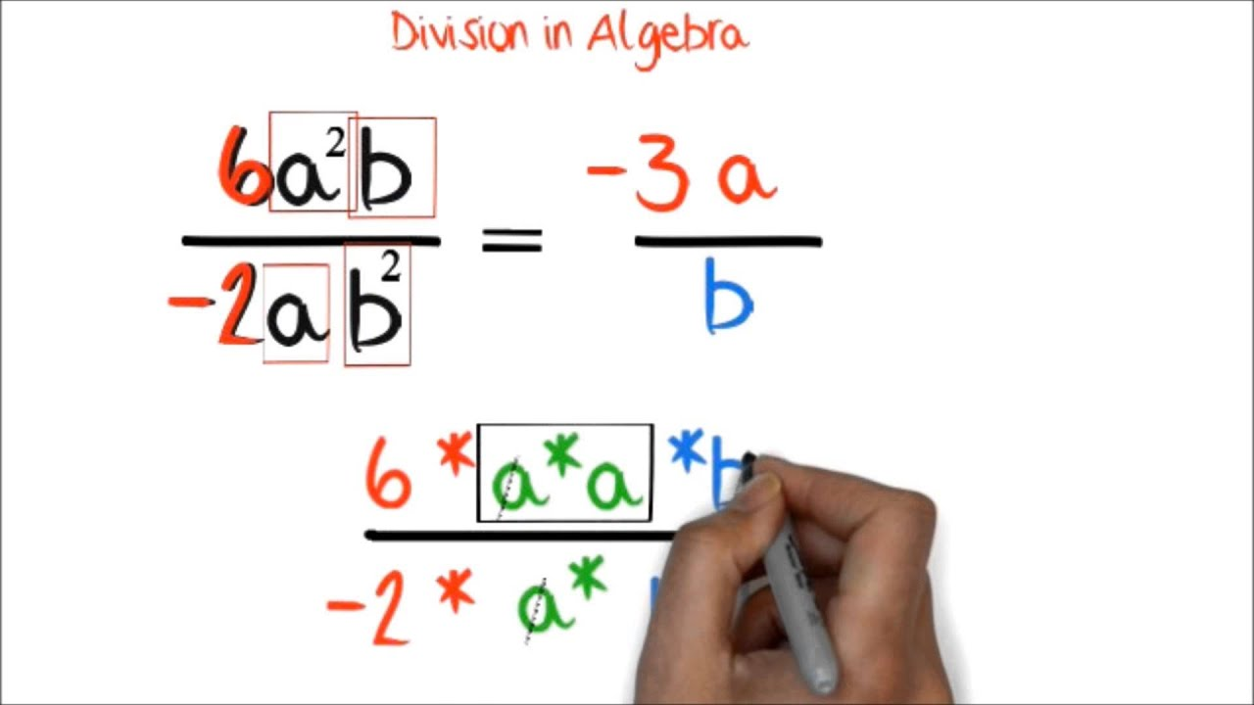
Number Line

Slide 6
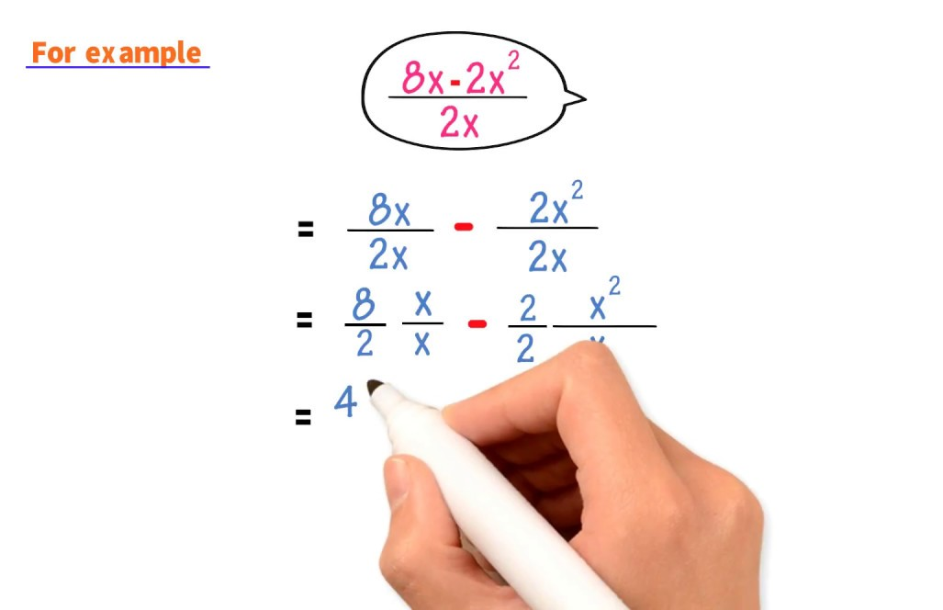
Number Line

Slide 7
Division of polynomial by monomial means dividing the polynomials which is
written as numerator by a monomial
which is written as denominator to find their quotient. For example: 4a³ – 10a² + 5a ÷ 2a Now the polynomials (4a³ – 10a² + 5a) is written as numerator and the monomial (2a)
is written as denominator.
Therefore, we get( 4a3−10a2+5a)/2a
Now we observe that there are three terms in the polynomial so,
each term of the polynomial (numerator)
is separately divided by the same monomial (denominator).
4a3/2a−10a2/2a+5a/2a=4a3/2a−10a2/2a+5a/2a Note:
The process is exactly converse of finding the L.C.M. of fractions and reducing the expression
into a single fraction.
Now we will cancel out the common factor from both numerator and denominator to simplify.
= 4a2−5a+5/2

Slide 8
Evaluation Question EX-19 D
1. Divide:
(i) 3a by a
(ii) 15x by 3x
(iii) 16m by 4
(iv) 20x² by 5x
(v) 30p² by 10p²
Solution:
(i) 3a by a
3a ÷ a
This can be written as, 3a / a = (3 × a) / a = 3
Hence, 3a ÷ a = 3

Slide 9
Evaluation Question EX-19 D
Solution: (ii) 15x by 3x
15x ÷ 3x
15x / 3x = (15 × x) / (3 × x)
This can be written as,
= (3 × 5 × x) / (3 × x) = 5
Hence, 15x ÷ 3x = 5
(iii) 16m by 4
16m ÷ 4
16m / 4 = (16 × m) / 4
This can be written as, = (4 × 4 × m) / 4
= 4m

Slide 10
Evaluation Question EX-19 D
Solution: (iv) 20x² by 5x
20x² ÷ 5x = 20x² / 5x = (20 × x²) / (5 × x)
This can be written as,
= (4 × 5 × x²⁻¹) / 5 = 4 × x
= 4x
Hence, 20x² ÷ 5x = 4x
(v) 30p² by 10p²
30p² ÷ 10p² = (30 × p²) / (10 × p²)
This can be written as, (3 × 10 × p²⁻²) / 10
= 3 × p⁰ = 3 × 1 = 3
Hence, 30p² ÷ 10p² = 3

Slide 11
Evaluation Question EX-19 D
2. Simplify:
(i) 2x⁵ ÷ x² (ii) 6a⁸ ÷ 3a³
(iii) 20xy ÷ – 5xy (iv) – 24a²b²c² ÷ 6ab
(v) – 5x²y ÷ xy²
Solution: (i) 2x⁵ ÷ x²
= (2 × x⁵) / x² = 2 × x⁵⁻²
= 2 × x³
= 2x³
Hence, 2x⁵ ÷ x² = 2x³

Slide 12
Evaluation Question EX-19 D
Solution: (ii) 6a⁸ ÷ 3a³
= (6 × a⁸) / (3 × a³)
This can be written as,
= (2 × 3 × a⁸⁻³) / 3
= 2 × a⁵ = 2a⁵
Hence, 6a⁸ ÷ 3a³ = 2a⁵
(iii) 20xy ÷ – 5xy
= (20 × x × y) / (- 5 × x × y)
This can be written as, (4 × 5) / – 5
= – 4
Hence, 20xy ÷ – 5xy = – 4

Slide 13
Evaluation Question EX-19 D
Solution: (iv) – 24a²b²c² ÷ 6ab
= (- 24 × a² × b² × c²) / (6 × a × b)
This can be written as,
= (-4 × 6 × a²⁻¹ × b²⁻¹ × c²) / 6
= – 4 × a × b × c² = – 4abc²
Hence, – 24a²b²c² ÷ 6ab = – 4abc²
(v) – 5x²y ÷ xy²
= (- 5 × x² × y) / (x × y²)
This can be written as, (- 5 × x²⁻¹) / y²⁻¹
= (- 5 × x) / y = – 5x / y
Hence, – 5x²y ÷ xy² = – 5x / y

Slide 14
Evaluation Question EX-19 D
3. Divide:
(i) (- 3m / 4) by 2m
(ii) – 15p⁶q⁸ by – 5p⁶q⁷
(iii) – 21m⁵n⁷ by 14m²n²
(iv) 36a⁴x⁵y⁶ by 4x²a³y²
(v) 20x³a⁶ by 5xy
Solution: (i) (- 3m / 4) by 2m
= – 3m / 4 ÷ 2m = – 3m / 4 × 1 / 2m
= – (3 × m) / (4 × 2 × m)
= – 3 / 8
Hence, (- 3m / 4) ÷ 2m = – 3 / 8

Slide 15
Evaluation Question EX-19 D
Solution: (ii) – 15p⁶q⁸ by – 5p⁶q⁷
– 15p⁶q⁸ ÷ – 5p⁶q⁷ = (- 15 × p⁶ × q⁸) / (- 5 × p⁶ × q⁷)
This can be written as,
= (3 × 5 × q⁸⁻⁷) / 5 = 3 × q
= 3q
Hence, – 15p⁶q⁸ ÷ – 5p⁶q⁷ = 3q
(iii) – 21m⁵n⁷ by 14m²n²
– 21m⁵n⁷ ÷ 14m²n² = (- 21 × m⁵ × n⁷) / (14 × m² × n²)
This can be written as, (- 3 × 7 × m⁵⁻² × n⁷⁻²) / (2 × 7)
= (- 3 × m³ × n⁵) / 2 = – 3m³n⁵ / 2
Hence, – 21m⁵n⁷ ÷ 14m²n² = – 3m³n⁵ / 2

Slide 16
Evaluation Question EX-19 D
Solution: (iv) 36a⁴x⁵y⁶ by 4x²a³y²
36a⁴x⁵y⁶ ÷ 4x²a³y² = (36 × a⁴ × x⁵ × y⁶) / (4 × x² × a³ × y²)
This can be written as,
= (4 × 9 × a⁴⁻³ × x⁵⁻² × y⁶⁻²) / 4
= 9 × a¹ × x³ × y⁴ = 9ax³y⁴
Hence, 36a⁴x⁵y⁶ ÷ 4x²a³y² = 9ax³y⁴
(v) 20x³a⁶ by 5xy
20x³a⁶ ÷ 5xy = (20 × x³ × a⁶) / (5 × x × y)
This can be written as,
= (4 × 5 × x³⁻¹ × a⁶) / (5 × y) = (4 × x² × a⁶) / y = 4x²a⁶ / y
Hence, 20x³a⁶ ÷ 5xy = 4x²a⁶ / y

Slide 17
Additional Homework
1. Divide:
(i) – 16ab²c by 6abc
(ii) 25x²y by – 5y²
(iii) 8x + 24 by 4
(iv) 4a² – a by – a
(v) 8m – 16 by – 8
HW
Ex.19 D Q .No 1 to 3

Slide 18
THANKING YOU
ODM EDUCATIONAL GROUP

