Slide 1


FUNDAMENTAL OPERATIONS
SUBJECT : MATHEMATICS
CHAPTER NUMBER:19
CHAPTER NAME :FUNDAMENTAL OPERATIONS
SUBTOPIC : Multiplication of Monomials
PERIOD NO: 3

Slide 2

Learning outcomes
Students will be able to multiply a monomial by a monomial.
Students will be able to multiply monomial by a binomial.

Slide 3
PREVIOUS KNOWLEDGE TEST
1.Add the following expressions:
(i) – 17x² – 2xy + 23y², – 9y² + 15x² + 7xy
and 13x² + 3y² – 4xy
(ii) – x² – 3xy + 3y² + 8, 3x² – 5y² – 3 + 4xy and – 6xy + 2x² – 2 + y²
(iii) a³ – 2b³ + a, b³ – 2a³ + b and – 2b + 2b³ – 5a + 4a³

Slide 4
Negative numbers and Integers
Students will Learn multiplication of polynomials with the help of a video .
https://www.youtube.com/watch?v=_nGv_xSAT2I(12.59)

Slide 5
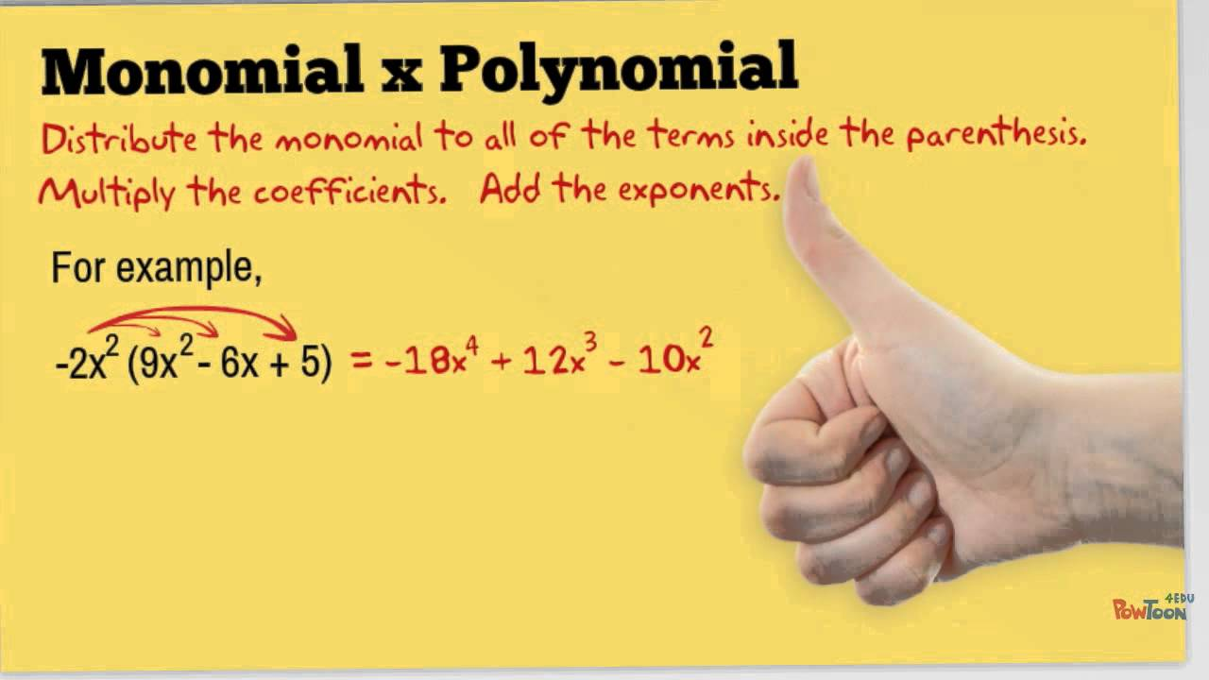

Slide 6
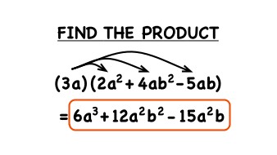
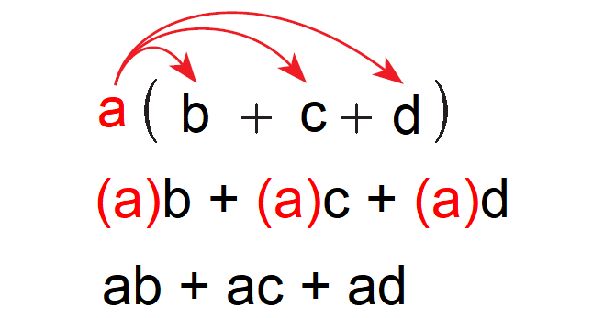

Slide 7
Evaluation Question EX-19 C
1. Fill in the blanks:
(i) 6 × 3 = ………. and 6x × 3x = …………
(ii) 6 × 3 = ……… and 6x² × 3x³ = …………
(iii) 5 × 4 = ………. and 5x × 4y = …………
(iv) 4 × 7 = …………. and 4ax × 7x = ……….
(v) 6 × 2 = …………. and 6xy × 2xy = ……….
Solution: (i) 6 × 3 = 18
Hence,6x × 3x = 6 × 3 × x × x
= 18 × x² = 18x²
Therefore, 6 × 3 = 18 and 6x × 3x = 18x²

Slide 8
Evaluation Question EX-19 C
Solution: (ii) 6 × 3 = 18
Hence, 6x² × 3x³ = 6 × 3 × x² ⁺ ³
= 18 × x⁵ = 18x⁵
Therefore, 6 × 3 = 18 and 6x² × 3x³ = 18x⁵
(iii) 5 × 4 = 20 and 5x × 4y = 5 × 4 × x × y
= 20xy
Therefore, 5 × 4 = 20 and 5x × 4y = 20xy
(iv) 4 × 7 = 28
Hence,4ax × 7x = 4 × 7 × a × x × x = 28 × a × x² = 28ax²
Therefore, 4 × 7 = 28 and 4ax × 7x = 28ax²

Slide 9
Evaluation Question EX-19 C
Solution: (v) 6 × 2 = 12
Hence, 6xy × 2xy = 6 × 2 × x¹ ⁺ ¹ × y¹ ⁺ ¹
= 12 × x² × y² = 12x²y²
Therefore, 6 × 2 = 12 and 6xy × 2xy = 12x²y²
2. Fill in the blanks:
(i) 4x × 6x × 2 = ………
(ii) 3ab × 6ax = …………
(iii) x × 2x² × 3x³ = ………
(iv) 5 × 5a³ = …………
(v) 6 × 6x² × 6x²y² = ………

Slide 10
Evaluation Question EX-19 C
Solution: (i) 4x × 6x × 2 = 4 × 6 × 2 × x × x
= 48 × x² = 48x²
Hence, 4x × 6x × 2 = 48x²
(ii) 3ab × 6ax = 3 × 6 × a × a × b × x
= 18 × a² × b × x = 18a²bx
Hence, 3ab × 6ax = 18a²bx
(iii) x × 2x² × 3x³ = 2 × 3 × x × x² × x³
= 6 × x¹ ⁺ ² ⁺ ³ = 6 × x⁶ = 6x⁶
Hence, x × 2x² × 3x³ = 6x⁶

Slide 11
Evaluation Question EX-19 C
Solution: (iv) 5 × 5a³ = 5 × 5 × a³
= 25 × a³ = 25a³
Hence, 5 × 5a³ = 25a³
(v) 6 × 6x² × 6x²y² = 6 × 6 × 6 × x² × x² × y²
= 216 × x²⁺ ² × y² = 216 × x⁴ × y² = 216x⁴y²
Hence, 6 × 6x² × 6x²y² = 216x⁴y²
3. Find the value of:
(i) 3x³ × 5x⁴
(ii) 5a² × 7a⁷
(iii) 3abc × 6ac³
(iv) a²b² × 5a³b⁴ (v) 2x²y³ × 5x³y⁴

Slide 12
Evaluation Question EX-19 C
Solution:
(i) 3x³ × 5x⁴
3x³ × 5x⁴ = 3 × 5 × x³ × x⁴
= 15 × x³ ⁺ ⁴
= 15 × x⁷ = 15x⁷
Hence, the value of 3x³ × 5x⁴ is 15x⁷
(ii) 5a² × 7a⁷
5a² × 7a⁷ = 5 × 7 × a² × a⁷
= 35 × a² ⁺ ⁷ = 35 × a⁹
= 35a⁹
Hence, the value of 5a² × 7a⁷ is 35a⁹

Slide 13
Evaluation Question EX-19 C
Solution:
(iii) 3abc × 6ac³
3abc × 6ac³ = 3 × 6 × a × a × b × c × c³
=18 × a¹⁺ ¹ × b × c¹⁺³ = 18 × a² × b × c⁴
= 18a²bc⁴
Hence, the value of 3abc × 6ac³ is 18a²bc⁴
(iv) a²b² × 5a³b⁴
a²b² × 5a³b⁴ = 5 × a² × a³ × b² × b⁴
= 5 × a²⁺³ × b²⁺⁴ = 5 × a⁵ × b⁶
= 5a⁵b⁶
Hence, the value of a²b² × 5a³b⁴ is 5a⁵b⁶

Slide 14
Evaluation Question EX-19 C
Solution:(v) 2x²y³ × 5x³y⁴
2x²y³ × 5x³y⁴ = 2 × 5 × x² × x³ × y³ × y⁴ = 10 × x²⁺³ × y³⁺⁴
= 10 × x⁵ × y⁷ = 10x⁵y⁷
Hence, the value of 2x²y³ × 5x³y⁴ is 10x⁵y⁷
4. Multiply:
(i) a + b by ab (ii) 3ab – 4b by 3ab
(iii) 2xy – 5by by 4bx (iv) 4x + 2y by 3xy
(v) 1 + 4x by x

Slide 15
Evaluation Question EX-19 C
Solution:
(i) a + b by ab
The multiplication of a + b by ab is calculated as,
(a + b) × ab = a × ab + b × ab = a¹⁺¹b + ab¹⁺¹
= a²b + ab²
Hence, (a + b) by ab = a²b + ab²
(ii) 3ab – 4b by 3ab
The multiplication of 3ab – 4b by 3ab is calculated as,
(3ab – 4b) × 3ab = 3ab × 3ab – 4b × 3ab
= 9a¹⁺¹b¹⁺¹ – 12ab¹⁺¹ = 9a²b² – 12ab²

Slide 16
Evaluation Question EX-19 C
Solution:
(iii) 2xy – 5by by 4bx
The multiplication of 2xy – 5by by 4bx is calculated as,
(2xy – 5by) × 4bx = 2xy × 4bx – 5by × 4bx
= 8bx¹⁺¹y – 20b¹⁺¹xy = 8bx²y – 20b²xy
Therefore, (2xy – 5by) by 4bx = 8bx²y – 20b²xy
(iv) 4x + 2y by 3xy
The multiplication of 4x + 2y by 3xy is calculated as,
(4x + 2y) × 3xy = 4x × 3xy + 2y × 3xy
On simplification, we get 12x¹⁺¹y + 6xy¹⁺¹ = 12x²y + 6xy²
Therefore, (4x + 2y) by 3xy = 12x²y + 6xy²

Slide 17
Evaluation Question EX-19 C
Solution:
(v) 1 + 4x by x
The multiplication of (1 + 4x) by x is calculated as,
(1 + 4x) × x = 1 × x + 4x × x
On simplification, we get
= x + 4x¹⁺¹
= x + 4x²
Therefore, (1 + 4x) by x = x + 4x²

Slide 18
Additional Homework
1. – 2x (x + y) + x²
2. b (2b – 1/b) – 2b (b – 1/b)
HW
Ex.19 C Q.NO 1 TO 4

Slide 19
THANKING YOU
ODM EDUCATIONAL GROUP

