Slide 1


FUNDAMENTAL OPERATIONS
SUBJECT : MATHEMATICS
CHAPTER NUMBER:19
CHAPTER NAME :FUNDAMENTAL OPERATIONS
SUBTOPIC : More about Addition and Subtraction.
PERIOD NO: 2

Slide 2

Learning outcomes
Students will be able to solve questions based on addition and subtraction of like terms .
Students will develop application skill.

Slide 3
PREVIOUS KNOWLEDGE TEST
1. Simplify:
(i) 2a²b² + 5ab² + 8a²b² – 3ab²
(ii) 4a + 3b – 2a – b
(iii) 2xy + 4yz + 5xy + 3yz – 6xy
(iv) ab + 15ab – 11ab – 2ab
(v) 6a² – 3b² + 2a² + 5b² – 4a²

Slide 4
FUNDAMENTAL OPERATIONS
i) 2a²b² + 5ab² + 8a²b² – 3ab²
The simplified form of the given expression is calculated as follows
2a²b² + 5ab² + 8a²b² – 3ab² = 2a²b² + 8a²b² + 5ab² – 3ab²
We get, = 10a²b² + 2ab²
Therefore, 2a²b² + 5ab² + 8a²b² – 3ab² = 10a²b² + 2ab²
(ii) 4a + 3b – 2a – b
The simplified form of the given expression is calculated as follows
4a + 3b – 2a – b = 4a – 2a + 3b – b
= 2a + 2b

Slide 5
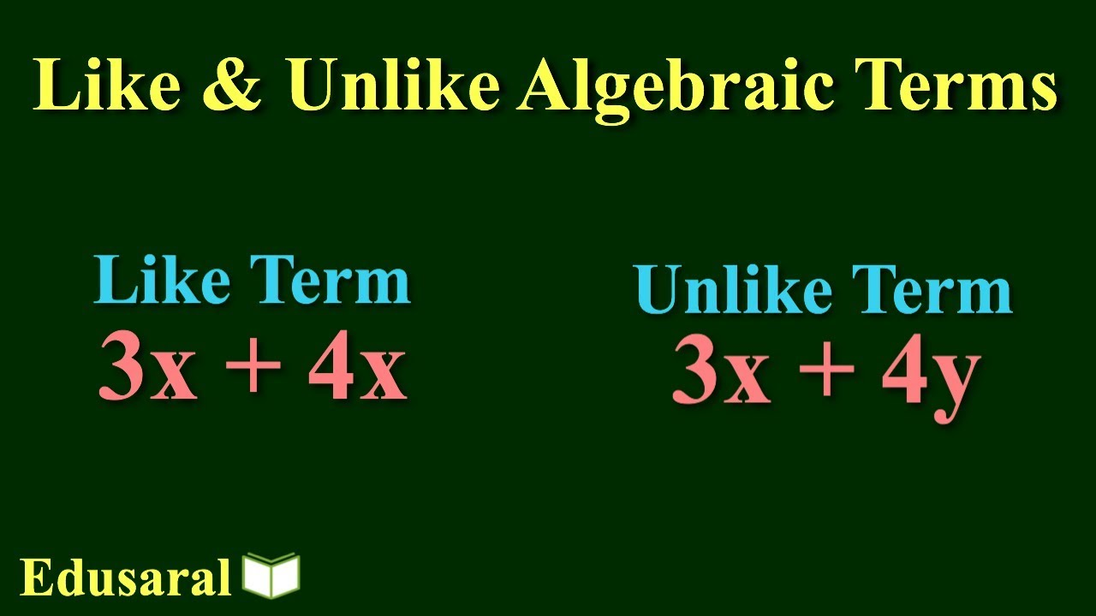
FUNDAMENTAL OPERATIONS

Slide 6
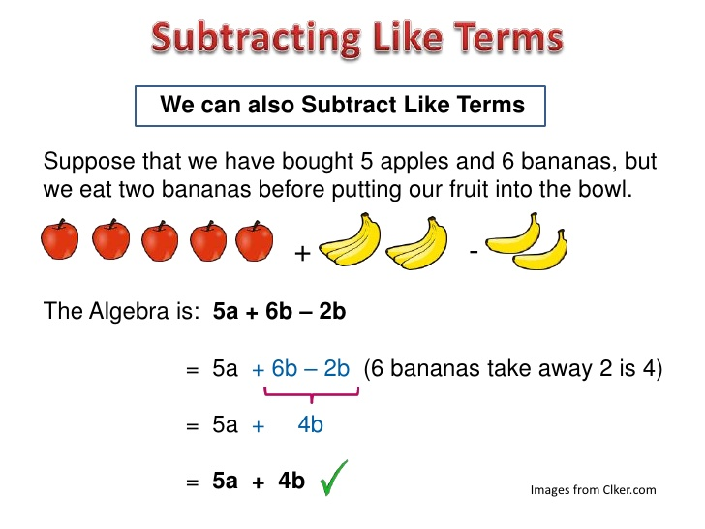
Number Line

Slide 7
Evaluation Question EX-19 B
1. Find the sum of:
(i) 3a + 4b + 7c, – 5a + 3b – 6c
and 4a – 2b – 4c
(ii) 2x² + xy – y², – x² + 2xy + 3y²
and 3x² – 10xy + 4y²
(iii) x² – x + 1, -5x² + 2x – 2
and 3x² – 3x + 1
(iv) a² – ab + bc, 2ab + bc – 2a²
and – 3bc + 3a² + ab
(v) 4x² + 7 – 3x, 4x – x² + 8 and – 10 + 5x – 2x²

Slide 8
Evaluation Question EX-19 B
Solution:
(i) 3a + 4b + 7c, – 5a + 3b – 6c and 4a – 2b – 4c
The sum of 3a + 4b + 7c, – 5a + 3b – 6c and 4a – 2b – 4c is calculated as shown below
(3a + 4b + 7c) + (-5a + 3b – 6c) + (4a – 2b – 4c)
= 3a + 4a – 5a + 4b + 3b – 2b + 7c – 6c – 4c
We get,
= 2a +5b – 3c
Hence, the sum of 3a + 4b + 7c, – 5a + 3b – 6c and 4a – 2b – 4c is 3c

Slide 9
Evaluation Question EX-19 B
Solution:
(ii) 2x² + xy – y², – x² + 2xy + 3y²
and 3x² – 10xy + 4y²
The sum of 2x² + xy – y², – x² + 2xy + 3y² and 3x² – 10xy + 4y² is calculated as shown below
(2x² + xy – y²) + (- x² + 2xy + 3y²) + (3x² – 10xy + 4y²)
= 2x² – x² + 3x² + xy + 2xy – 10xy + 3y² + 4y² – y²
We get,
= 4x² – 7xy + 6y²
Hence, the sum of 2x² + xy – y², – x² + 2xy + 3y² and 3x² – 10xy + 4y² is 4x² – 7xy + 6y²

Slide 10
Evaluation Question EX-19 B
Solution: (iii) x² – x + 1, -5x² + 2x – 2 and 3x² – 3x + 1
The sum of (x² – x + 1), (- 5x² + 2x – 2) and (3x² – 3x + 1) is calculated as shown below
(x² – x + 1) + (- 5x² + 2x – 2) + (3x² – 3x + 1)
= x² – 5x² + 3x² + 2x – x – 3x + 1 +1 – 2 = – x² – 2x
Hence, the sum of (x² – x + 1), (- 5x² + 2x – 2) and (3x² – 3x + 1) is – x² – 2x
(iv) a² – ab + bc, 2ab + bc – 2a² and – 3bc + 3a² + ab
The sum of (a² – ab + bc), (2ab + bc – 2a²) and (- 3bc + 3a² + ab) is calculated as shown below
(a² – ab + bc) + (2ab + bc – 2a²) + (- 3bc + 3a² + ab)
= a² – 2a² + 3a² + 2ab + ab – ab + bc + bc – 3bc
= 2a² +2ab – bc

Slide 11
Evaluation Question EX-19 B
Solution: (v) 4x² + 7 – 3x, 4x – x² + 8 and – 10 + 5x – 2x²
The sum of (4x² + 7 – 3x), (4x – x² + 8) and (- 10 + 5x – 2x²) is calculated as shown below
(4x² + 7 – 3x) + (4x – x² + 8) + (- 10 + 5x – 2x²)
= 4x² – x² – 2x² + 7 + 8 – 10 + 4x + 5x – 3x
= x² + 5 + 6x
Hence, the sum of (4x² + 7 – 3x), (4x – x² + 8) and (- 10 + 5x – 2x²) is x² + 5 + 6x

Slide 12
Evaluation Question EX-19 B
3. Evaluate:
(i) 3a – (a + 2b)
(ii) (5x – 3y) – (x + y)
(iii) (8a + 15b) – (3b – 7a)
(iv) (8x + 7y) – (4y – 3x)
(v) 7 – (4a – 5)
Solution: (i) 3a – (a + 2b)
The value of the given expression is calculated as below
3a – (a + 2b) = 3a – a – 2b
= 2a – 2b=2(a – b)

Slide 13
Evaluation Question EX-19 B
Solution:
(ii) (5x – 3y) – (x + y)
The value of the given expression is calculated as below
(5x – 3y) – (x + y) = 5x – x – 3y – y
= 4x – 4y
Taking 4 as common, we get 4(x – y)
(iii) (8a + 15b) – (3b – 7a)
The value of the given expression is calculated as below
(8a + 15b) – (3b – 7a) = 8a + 7a + 15b – 3b
On calculation, we get 15a + 12b

Slide 14
Evaluation Question EX-19 B
Solution: (iv) (8x + 7y) – (4y – 3x)
The value of the given expression is calculated as below
(8x + 7y) – (4y – 3x)
= 8x + 3x + 7y – 4y
On further calculation, we get
= 11x + 3y
(v) 7 – (4a – 5)
The value of the given expression is calculated as below
7 – (4a – 5) = 7 – 4a + 5
We get, 12 – 4a

Slide 15
Evaluation Question EX-19 B
4. Subtract:
(i) 5a – 3b + 2c from a – 4b – 2c
(ii) 4x – 6y + 3z from 12x + 7y – 21z
(iii) 5 – a – 4b + 4c from 5a – 7b + 2c
(iv) – 8x – 12y + 17z from x – y – z
(v) 2ab + cd – ac – 2bd from ab – 2cd + 2ac + bd
Solution:
(i) 5a – 3b + 2c from a – 4b – 2c
The value of the subtraction is calculated as follows
(a – 4b – 2c) – (5a – 3b + 2c) = a – 5a – 4b + 3b – 2c – 2c
= – 4a – b – 4c

Slide 16
Evaluation Question EX-19 B
Solution:
(ii) 4x – 6y + 3z from 12x + 7y – 21z
The value of the subtraction is calculated as follows
(12x + 7y – 21z) – (4x – 6y + 3z)
= 12x – 4x + 7y + 6y – 21z – 3z
On further calculation, we get
= 8x + 13y – 24z
(iii) 5 – a – 4b + 4c from 5a – 7b + 2c
The value of the subtraction is calculated as follows
(5a – 7b + 2c) – (5 – a – 4b + 4c) = 5a + a – 7b + 4b + 2c – 4c – 5
=6a – 3b – 2c – 5

Slide 17
Evaluation Question EX-19 B
Solution:
(iv) – 8x – 12y + 17z from x – y – z
The value of the subtraction is calculated as follows
(x – y – z) – (- 8x – 12y + 17z)
= x + 8x + 12y – y – z – 17z = 9x + 11y – 18z
(v) 2ab + cd – ac – 2bd from ab – 2cd + 2ac + bd
The value of the subtraction is calculated as follows
(ab – 2cd + 2ac + bd) – (2ab + cd – ac – 2bd)
= ab – 2ab – 2cd – cd + 2ac + ac + bd + 2bd
On calculating further, we get
= – ab – 3cd + 3ac + 3bd

Slide 18
Evaluation Question EX-19 B
5.(i) Take – ab + bc – ca from bc – ca + ab.
(ii) Take 5x + 6y – 3z from 3x + 5y – 4z.
(iii) Take (-3 / 2) p + q – r from (1 / 2)p – (1 / 3)q – (3 / 2) r
(iv) Take 1 – a + a² from a² + a + 1
Solution: (i) The value of the subtraction is calculated as,
(bc – ca + ab) – (-ab + bc – ca) = bc – bc – ca + ca + ab + ab = 2ab
Hence, (bc – ca + ab) – (-ab + bc – ca) = 2ab
(ii) The value of the subtraction is calculated as,
(3x + 5y – 4z) – (5x + 6y – 3z) = 3x – 5x + 5y – 6y – 4z + 3z
On simplification, we get – 2x – y – z
Hence, (3x + 5y – 4z) – (5x + 6y – 3z) = – 2x – y – z

Slide 19
Evaluation Question EX-19 B
Solution: (iii) The value of the subtraction is calculated as,
[(1 / 2)p – (1 / 3)q – (3 / 2) r] – [(-3 / 2) p + q – r]
= (1 / 2)p + (3 / 2)p – (1 / 3)q – q – (3 / 2)r + r
On further calculation, we get
= 2p – (4 / 3)q – (1 / 2)r
Hence, [(1 / 2)p – (1 / 3)q – (3 / 2) r] – [(-3 / 2) p + q – r] = 2p – (4 / 3)q – (1 / 2)r
(iv) The value of the subtraction is calculated as,
(a² + a + 1) – (1 – a + a²)
= a² – a² + a + a + 1 – 1
We get,= a + a = 2a

Slide 20
Evaluation Question EX-19 B
6. From the sum of x + y – 2z and 2x – y + z subtract x + y + z.
Solution:
The value of terms as per the question is calculated as follows
(x + y – 2z) + (2x – y + z) – (x + y + z)
= x + 2x – x + y – y – y – 2z – z + z
We get,
= 2x – y – 2z
Therefore, (x + y – 2z) + (2x – y + z) – (x + y + z) = 2x – y – 2z

Slide 21
Evaluation Question EX-19 B
7. From the sum of 3a – 2b + 4c and 3b – 2c subtract a – b – c.
Solution:
The value of terms as per the question is calculated as shown below
(3a – 2b + 4c) + (3b – 2c) – (a – b – c)
= 3a – 2b + 4c + 3b – 2c – a + b + c
On further calculation, we get
= 3a – a + 3b + b – 2b + 4c + c – 2c
= 2a + 2b + 3c
Hence, (3a – 2b + 4c) + (3b – 2c) – (a – b – c) = 2a + 2b + 3c

Slide 22
Evaluation Question EX-19 B
8. Subtract x – 2y – z from the sum of 3x – y + z and x + y – 3z.
Solution:
The value of terms as per the question is calculated as follows
(3x – y + z) + (x + y – 3z) – (x – 2y – z)
= 3x + x – x – y + y + 2y + z – 3z + z
We get,
= 3x + 2y – z
Therefore, (3x – y + z) + (x + y – 3z) – (x – 2y – z) = 3x + 2y – z

Slide 23
Evaluation Question EX-19 B
9. Subtract the sum of x + y and x – z from the sum of x – 2z and x + y + z
Solution:
The value of terms as per the question is calculated as follows
(x – 2z) + (x + y + z) – {(x + y) + (x – z)}
On further calculation, we get
= x + x – x –x + y – y + z + z – 2z
We get,
= 0
Therefore, (x – 2z) + (x + y + z) – {(x + y) + (x – z)} = 0

Slide 24
Evaluation Question EX-19 B
10. By how much should x + 2y – 3z be increased to get 3x?
Solution:
The terms calculated as per the question is as follows
3x – (x + 2y – 3z) = 3x – x – 2y + 3z
We get,
= 2x – 2y + 3z
11. The sum of two expressions is 5x² – 3y². If one of them is 3x² + 4xy – y², find the other.
Solution: The other expression is calculated as follows
(5x² – 3y²) – (3x² + 4xy – y²) = 5x² – 3x² – 4xy – 3y² + y²
= 2x² – 4xy – 2y²

Slide 25
Evaluation Question EX-19 B
12. The sum of two expressions is 3a² + 2ab – b². If one of them is 2a² + 3b², find the other.
Solution:
The other expression is calculated as follows
(3a² + 2ab – b²) – (2a² + 3b²)
On simplification, we get
=3a² – 2a² – b² – 3b² + 2ab
= a²– 4b² + 2ab

Slide 26
Additional Homework
1. Write the degree of each of the following polynomials:
(i) x + x²
(ii) 5x² – 7x + 2
(iii) x³ – x⁸ + x¹⁰
HW
Ex.19 B

Slide 27
THANKING YOU
ODM EDUCATIONAL GROUP

