Slide 1


FUNDAMENTAL OPERATIONS
SUBJECT : MATHEMATICS
CHAPTER NUMBER:19
CHAPTER NAME :FUNDAMENTAL OPERATIONS
SUBTOPIC : Basic Concepts, Addition and Subtraction of Like Terms and Unlike Terms
PERIOD NO: 1

Slide 2

Learning outcomes
Students will be able to identify like and unlike terms.
Students will be able to add and subtract like and unlike terms.

Slide 3
FUNDAMENTAL OPERATIONS
Like and unlike terms will be explained with the help of a video.
https://www.youtube.com/watch?v=F14ramrPMDg(5.36)

Slide 4
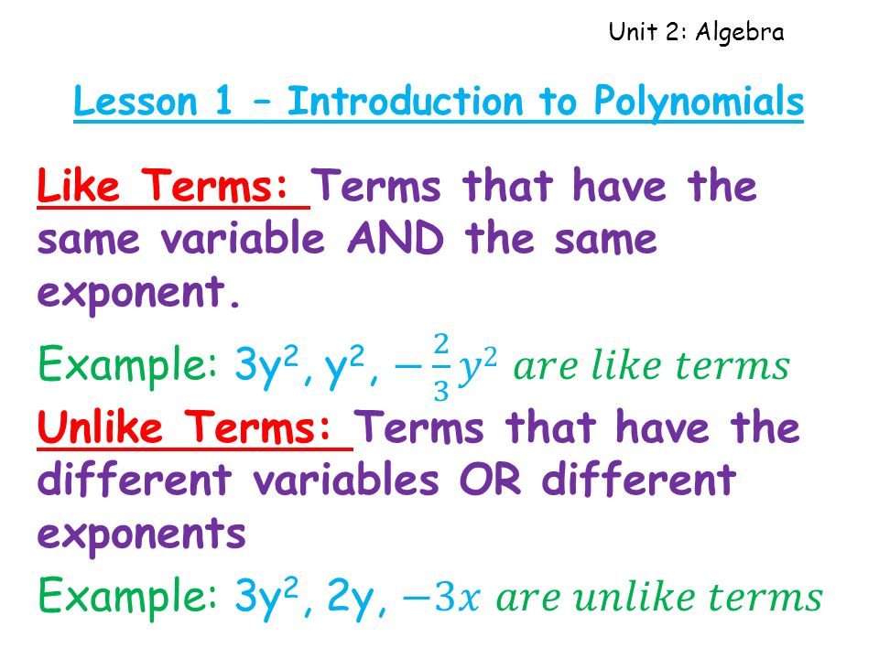
FUNDAMENTAL OPERATIONS

Slide 5
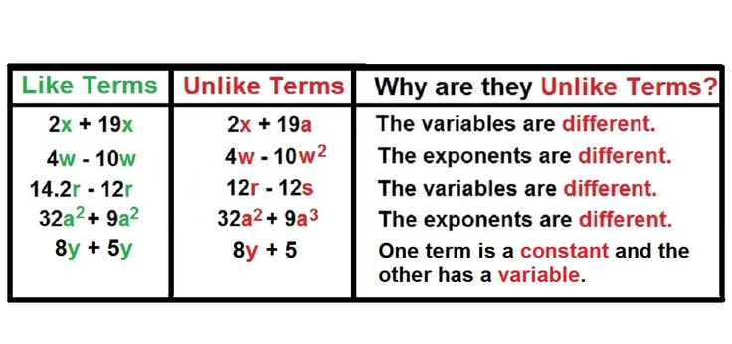
FUNDAMENTAL OPERATIONS
Students will Learn with the help of a video .

Slide 6
Evaluation Question EX-19 A
1. Fill in the blanks:
(i) 5 + 4 = …….. and 5x + 4x = ………
(ii) 12 + 18 = ……. and 12x²y + 18x²y = ……..
(iii) 7 + 16 = …….. and 7a + 16b = …….
(iv) 1 + 3 = ……. and x²y + 3xy² = ……
(v) 7 – 4 = …… and 7ab – 4ab = ………
Solution:
(i) 5 + 4 = 9 and 5x + 4x = 9x
(ii) 12 + 18 = 30 and 12x²y + 18x²y = 30x²y
(iii) 7 + 16 = 23 and 7a + 16b = 7a + 16b
(v) 7 – 4 = 3 and 7ab – 4ab = 3ab

Slide 7
Evaluation Question EX-19 A
Solution:
(iv) 1 + 3 = 4 and x²y + 3xy² = x²y + 3xy²
(v) 7 – 4 = 3 and 7ab – 4ab = 3ab
2. Fill in the blanks:
(i) The sum of -2 and -5 = ……… and the sum of -2x and -5x = ……….
(ii) The sum of 8 and -3 = ……… and the sum of 8ab and -3ab = ………….
(iii) The sum of -15 and -4 = ……… and the sum of -15x and -4y = ………..
(iv) 15 + 8 + 3 = …….. and 15x + 8y + 3x = …………
(v) 12 – 9 + 15 = ………… and 12ab – 9ab + 15ba = ……….

Slide 8
Evaluation Question EX-19 A
Solution:
(i) The sum of -2 and -5 = – 7 and the sum of -2x and -5x = – 7x
(ii) The sum of 8 and -3 = 5 and the sum of 8ab and -3ab = 5ab
(iii) The sum of -15 and -4 = – 19 and the sum of -15x and -4y = – 15x – 4y
(iv) 15 + 8 + 3 = 26 and 15x + 8y + 3x = 18x + 8y
(v) 12 – 9 + 15 = 18 and 12ab – 9ab + 15ba = 18ab
3. Add:
(i) 8xy and 3xy
(ii) 2xyz, xyz and 6xyz
(iii) 2a, 3a and 4b

Slide 9
Evaluation Question EX-19 A
3. Add:
(iv) 3x and 2y
(v) 5m, 3n and 4p
Solution:
(i) 8xy and 3xy
The addition of 8xy and 3xy is calculated as follows
8xy + 3xy = 11xy
(ii) 2xyz, xyz and 6xyz
The addition of 2xyz, xyz and 6xyz is calculated as follows
2xyz + xyz + 6xyz = 9xyz

Slide 10
Evaluation Question EX-19 A
Solution:
(iii) 2a, 3a and 4b
The addition of 2a, 3a and 4b is calculated as follows
2a + 3a + 4b = 5a + 4b
(iv) 3x and 2y
The addition of 3x and 2y is calculated as follows
3x + 2y = 3x + 2y
(v) 5m, 3n and 4p
The addition of 5m, 3n and 4p is calculated as follows
5m + 3n + 4p = 5m + 3n + 4p

Slide 11
Evaluation Question EX-19 A
4. Evaluate:
(i) 6a – a – 5a – 2a
(ii) 2b – 3b – b + 4b
(iii) 3x – 2x – 4x + 7x
(iv) 5ab + 2ab – 6ab + ab
(v) 8x – 5y – 3x + 10y
Solution:
(i) The value of given expression is calculated as below
6a – a – 5a – 2a = (6 – 1 – 5 – 2) a
We get, = (5 – 5 – 2) a = – 2a
Therefore, 6a – a – 5a – 2a = – 2a

Slide 12
Evaluation Question EX-19 A
Solution:
(ii) 2b – 3b – b + 4b
The value of given expression is calculated as below
2b – 3b – b + 4b = 2b + 4b – (3 + 1) b
We get,= 6b – 4b = 2b
Therefore, 2b – 3b – b + 4b = 2b
(iii) 3x – 2x – 4x + 7x
The given expression is calculated as below
3x – 2x – 4x + 7x = 3x + 7x – 2x – 4x = (3 + 7) x – (2 + 4) x
= 10x – 6x = 4x
Therefore, 3x – 2x – 4x + 7x = 4x

Slide 13
Evaluation Question EX-19 A
Solution:
(iv) 5ab + 2ab – 6ab + ab
The given expression is calculated as below
5ab + 2ab – 6ab + ab = 5ab + 2ab + ab – 6ab
We get, = 8ab – 6ab = 2ab
Therefore, 5ab + 2ab – 6ab + ab = 2ab
(v) 8x – 5y – 3x + 10y
The given expression is calculated as below
8x – 5y – 3x + 10y = 8x – 3x + 10y – 5y = 5x + 5y
Therefore, 8x – 5y – 3x + 10y = 5x + 5y

Slide 14
Evaluation Question EX-19 A
5. Evaluate:
(i) -7x + 9x + 2x – 2x
(ii) 5ab – 2ab – 8ab + 6ab
(iii) -8a – 3a + 12a + 13a – 6a
(iv) 19abc – 11abc – 12abc + 14abc
Solution:
(i) -7x + 9x + 2x – 2x
The value of given expression is calculated as follows
-7x + 9x + 2x – 2x = 9x + 2x – 7x – 2x = 11x – 9x
We get, = 2x
Hence, -7x + 9x + 2x – 2x = 2x

Slide 15
Evaluation Question EX-19 A
Solution:
(ii) 5ab – 2ab – 8ab + 6ab
The value of given expression is calculated as follows
5ab – 2ab – 8ab + 6ab = 5ab + 6ab – 2ab – 8ab
We get, = 11ab – 10ab = ab
Hence, 5ab – 2ab – 8ab + 6ab = ab
(iii) –8a – 3a + 12a + 13a – 6a
The value of given expression is calculated as follows
-8a – 3a + 12a + 13a – 6a = 12a + 13a – (8a + 3a + 6a)
= 25a – 17a = 8a
Hence, -8a – 3a + 12a + 13a – 6a = 8a

Slide 16
Evaluation Question EX-19 A
Solution:
(iv) 19abc – 11abc – 12abc + 14abc
The value of given expression is calculated as follows
19abc – 11abc – 12abc + 14abc = abc (19 – 11 – 12 + 14)
= abc (33 – 23) = 10abc
Hence, 19abc – 11abc – 12abc + 14abc = 10abc
6. Subtract the first term from the second:
(i) 4ab, 6ba
(ii) 4.8b, 6.8b
(iii) 3.5abc, 10.5abc
(iv) 3(1 / 2) mn, 8(1 / 2)nm
Solution:
(i) 4ab, 6ba
The subtraction of first term from the second term is calculated as below
6ba – 4ab = 2ab
(ii) 4.8b, 6.8b
The subtraction of first term from the second term is calculated as below
6.8b – 4.8b = 2b
(iii) 3.5abc, 10.5abc
The subtraction of first term from the second term is calculated as below
10.5abc – 3.5abc = 7abc
(iv) 3(1 / 2) mn, 8(1 / 2)nm
The subtraction of first term from the second term is calculated as below
8(1 / 2)nm – 3 (1 / 2) mn = (17 / 2)nm – (7 / 2)mn
We get,
= [(17mn – 7mn) / 2]
= (10 / 2)mn
= 5mn
7. Simplify:
(i) 2a²b² + 5ab² + 8a²b² – 3ab²
(ii) 4a + 3b – 2a – b
(iii) 2xy + 4yz + 5xy + 3yz – 6xy
(iv) ab + 15ab – 11ab – 2ab
(v) 6a² – 3b² + 2a² + 5b² – 4a²
Solution:
(i) 2a²b² + 5ab² + 8a²b² – 3ab²
The simplified form of the given expression is calculated as follows
2a²b² + 5ab² + 8a²b² – 3ab² = 2a²b² + 8a²b² + 5ab² – 3ab²
We get,
= 10a²b² + 2ab²
Therefore, 2a²b² + 5ab² + 8a²b² – 3ab² = 10a²b² + 2ab²
(ii) 4a + 3b – 2a – b
The simplified form of the given expression is calculated as follows
4a + 3b – 2a – b = 4a – 2a + 3b – b
= 2a + 2b
Therefore, 4a + 3b – 2a – b = 2a + 2b
(iii) 2xy + 4yz + 5xy + 3yz – 6xy
The simplified form of the given expression is calculated as follows
2xy + 4yz + 5xy + 3yz – 6xy = 2xy + 5xy – 6xy + 4yz + 3yz
= xy + 7yz
Therefore, 2xy + 4yz + 5xy + 3yz – 6xy = xy + 7yz
(iv) ab + 15ab – 11ab – 2ab
The simplified form of the given expression is calculated as follows
ab + 15ab – 11ab – 2ab = 16ab – 13ab
= 3ab
Therefore, ab + 15ab – 11ab – 2ab = 3ab
(v) 6a² – 3b² + 2a² + 5b² – 4a²
The simplified form of the given expression is calculated as follows
6a² – 3b² + 2a² + 5b² – 4a² = 6a² + 2a² – 4a² + 5b² – 3b²
We get,
= 4a² + 2b²
Therefore, 6a² – 3b² + 2a² + 5b² – 4a² = 4a² + 2b²

Slide 17
Evaluation Question EX-19 A
Solution:
(iv) 19abc – 11abc – 12abc + 14abc
The value of given expression is calculated as follows
19abc – 11abc – 12abc + 14abc = abc (19 – 11 – 12 + 14)
= abc (33 – 23) = 10abc
Hence, 19abc – 11abc – 12abc + 14abc = 10abc
6. Subtract the first term from the second:
(i) 4ab, 6ba
(ii) 4.8b, 6.8b
(iii) 3.5abc, 10.5abc
(iv) 3(1 / 2) mn, 8(1 / 2)nm

Slide 18
Evaluation Question EX-19 A
Solution:
(i) 4ab, 6ba
The subtraction of first term from the second term is calculated as below
6ba – 4ab = 2ab
(ii) 4.8b, 6.8b
The subtraction of first term from the second term is calculated as below
6.8b – 4.8b = 2b
(iii) 3.5abc, 10.5abc
The subtraction of first term from the second term is calculated as below
10.5abc – 3.5abc = 7abc

Slide 19
Evaluation Question EX-19 A
Solution: (iv) 3(1 / 2) mn, 8(1 / 2)nm
The subtraction of first term from the second term is calculated as below
8(1 / 2)nm – 3 (1 / 2) mn = (17 / 2)nm – (7 / 2)mn
We get, = [(17mn – 7mn) / 2]
= (10 / 2)mn = 5mn

Slide 20
Additional Homework
1. State whether true or false:
(i) xy and –yx are like terms.
(ii) x²y and –y²x are like terms.
(iii) a and –a are like terms.
HW
Ex.19 A

Slide 21
THANKING YOU
ODM EDUCATIONAL GROUP

