Slide 1


PERCENT
SUBJECT : MATHEMATICS
CHAPTER NUMBER: 16
CHAPTER NAME : PERCENT

Slide 2

Learning outcomes
Students will be able to convert decimal ,fraction to percentage.
Students will be able to apply percentage in real life situation.

Slide 3
https://www.youtube.com/watch?v=aldPGpTm22Q&t=219s

Slide 4
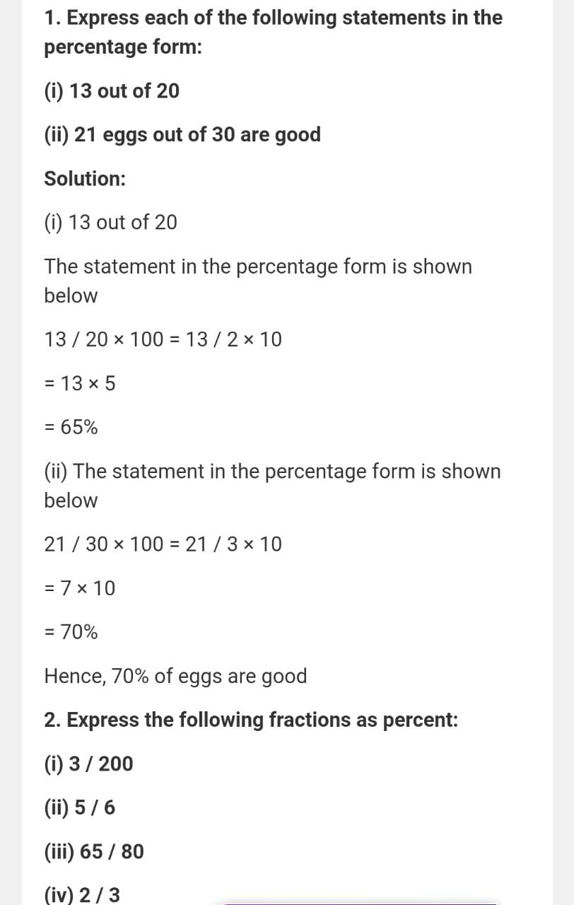

Slide 6
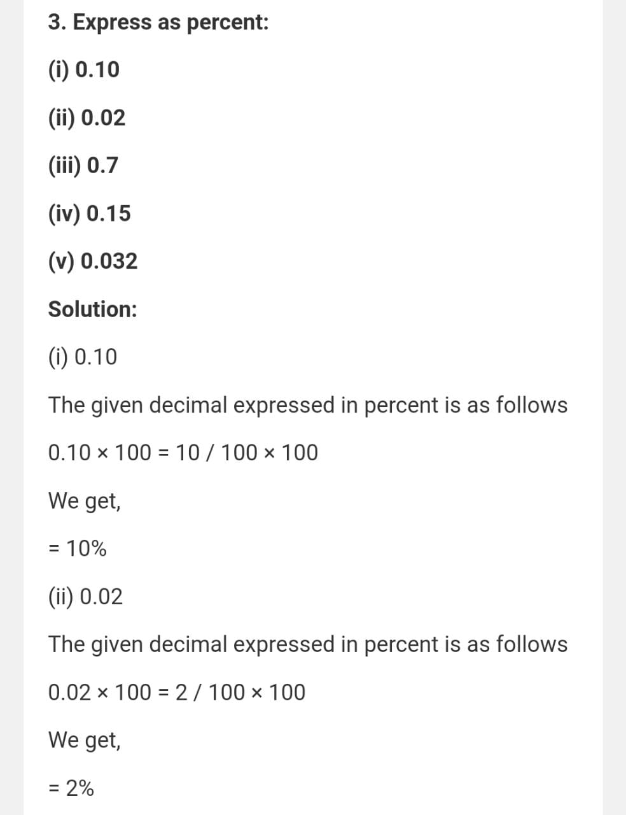

Slide 8
Additional Homework
HW
Ex.16 A

Slide 9
THANKING YOU
ODM EDUCATIONAL GROUP

