Slide 1


PROPORTION
SUBJECT : MATHEMATICS
CHAPTER NUMBER: 12
CHAPTER NAME : PROPORTION
SUB TOPIC:
PERIOD NO:2

Slide 2

Learning outcomes
Students will be able to solve problems based on proportion .
Students will be able to apply it in daily life situation problems.

Slide 3
PREVIOUS KNOWLEDGE TEST
1. The ratio of the length and the width of a school ground is 5: 2. Find the length, if the width is 40 metres.
Solution: The ratio of the length and the width of a school ground = 5: 2
The width of the school ground = 40 metre
Let the length of the school ground be x metre
Hence the length of the ground can be calculated as follows:
Ratio of length to width of a school ground = x: 40
According to the given statement
5: 2 = x: 40
⇒ 2 × x = 40 × 5 ⇒ x = (40 × 5) / 2
⇒ x = 200 / 2=100
Therefore the length of the school ground is 100 m

Slide 4
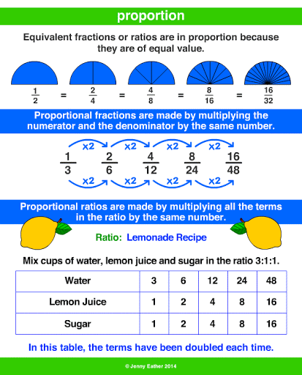
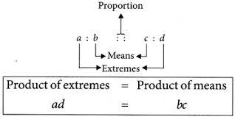
PROPORTION

Slide 5
EVALUATION QUESTIONS
8. The ratio of the sale of eggs on a Sunday and that of the whole week at a grocery shop was 2: 9. If the total value of the sale of eggs in the same week was Rs 360, find the value of the sale of eggs that Sunday.
9. The ratio of copper and zinc in an alloy is 9: 8. If the weight of zinc, in the alloy, is 9.6 kg, find the weight of copper in the alloy.
10. The ratio of the number of girls to the number of boys in a school is 2: 5. If the number of boys is 225; find:
(i) the number of girls in the school
(ii) the number of students in the school.

Slide 6
Evaluation Question
8.Solution:
Ratio of sale of eggs on a Sunday and whole week at a grocery shop = 2: 9
Total sale of eggs in the same week = Rs 360
Let the sale of eggs on Sunday be x
Hence the sale of eggs on Sunday can be calculated as follows:
2: 9 = x: 360
⇒ 9 × x = 360 × 2
⇒ x = (360 × 2) / 9
⇒ x = 720 / 9
⇒ x = 80
Therefore the value of the sale of eggs on Sunday is of Rs 80

Slide 7
Evaluation Question
9.Solution: Ratio of copper and zinc in an alloy = 9: 8
Weight of zinc in an alloy = 9.6 kg
Let x kg be the weight of copper in the alloy
Hence the weight of copper can be calculated as below
9: 8 = x: 9.6
⇒ 8 × x = 9 × 9.6
⇒ x = (9 × 9. 6) / 8
⇒ x = 86.4 / 8
⇒ x = 10.8
Therefore the weight of copper in the alloy is 10.8 kg

Slide 8
Evaluation Question
10.Solution:
Ratio of girls to the boys in a school = 2.5
Number of boys in a school = 225
(i) Let x be the number of girls in a school
Hence number of girls in a school can be calculated as follows:
2: 5 = x: 225
⇒ 5 × x = 2 × 225
⇒ x = (2 × 225) / 5
⇒ x = 450 / 5
⇒ x = 90
Therefore the number of girls in the school is 90

Slide 9
Evaluation Question
(ii) Total number of students in a school becomes
Total student = Total boys + Total girls
= 225 + 90
= 315
Therefore total number of students in the school is 315
11. In a class 1 out of every 5 students pass. If there are 225 students in all the sections of a class, find how many pass?
12.Make set of all possible proportions from the numbers 15, 18, 35 and 42

Slide 10
Evaluation Question
11.Solution:
Given
Total number of students in all the sections of a class = 225
And 1 out of every 5 students pass
So, total number of pass students can be calculated as follows:
Total student pass = 225 × 1 / 5
= 45
Therefore total pass students are 45

Slide 11
Evaluation Question
12.Solution:
Given
Numbers are 15, 18, 35 and 42
Hence the possible proportions are as follows:
(i) 15: 18:: 35: 42
(ii) 15: 35:: 18: 42
(iii) 42: 18:: 35: 15
(iv) 42: 35:: 18: 15

Slide 12
Additional Homework
HW
Ex.12A Q NO 8 TO 12

Slide 13
THANKING YOU
ODM EDUCATIONAL GROUP

