Slide 1


PROPORTION
SUBJECT : MATHEMATICS
CHAPTER NUMBER: 12
CHAPTER NAME : PROPORTION
SUB TOPIC:Basic Concepts of Proportion
PERIOD NO:1

Slide 2

Learning outcomes
Students will be able to define proportion
Students will be able to solve sums of proportion.
Students will be able to apply proportion in daily life situations.

Slide 3
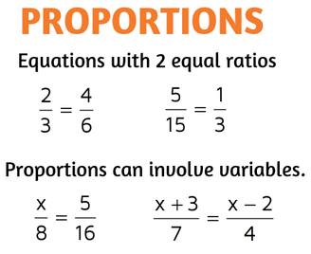
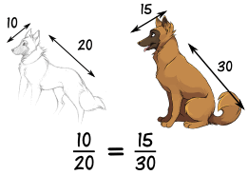
PROPORTION

Slide 4
PROPORTION
Concept of proportion will be explained using a video.
https://www.youtube.com/watch?v=-cxJMsqHH1Y(4.49)

Slide 5
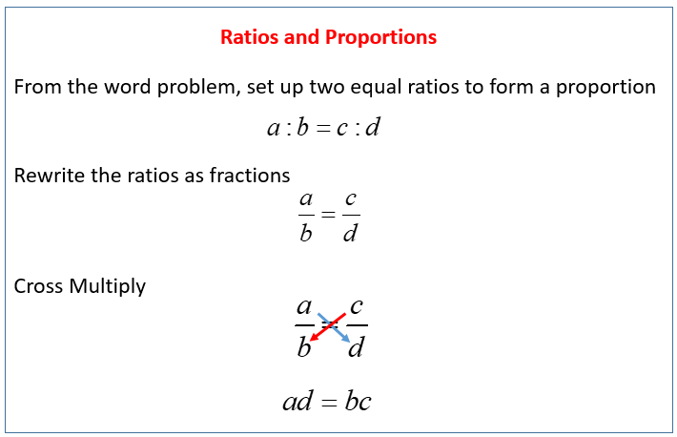
PROPORTION
Product of extreme terms = Product of means

Slide 6
Evaluation Questions Exercise 12 A
1. In each of the following, check whether or not the given ratios form a proportion: (i) 8: 16 and 12: 15
(ii) 16: 28 and 24: 42 (iii) 12 ÷ 3 and 8 ÷ 2
(iv) 25: 40 and 20: 32 (v) 15 / 18 and 10 / 12
Solution:
(i) 8: 16 and 12: 15
The above expression can be written as follows:
8: 16 = 8 / 16
= 1 / 2 and
12: 15 = 12 / 15
= 4 / 5
Since 8: 16 ≠ 12: 15
Therefore they are not in proportion

Slide 7
Evaluation Question
(ii) 16: 28 and 24: 42
The above expression can be written as follows:
16: 28 = 16 / 28
= 4 / 7 and
24: 42 = 24 / 42
= 4 / 7
Since 16: 28 = 24: 42
Therefore they form a proportion
(iii) 12 ÷ 3 and 8 ÷ 2
The above expression can be written as follows:
12 ÷ 3 = 12 / 3 = 4 and
8 ÷ 2 = 8 / 2= 4
Since 12: 3 = 8: 2
Therefore they form a proportion

Slide 8
Evaluation Question
2. Find the value of x in each of the following proportions:
(i) x: 4 = 6: 8 (ii) 14: x = 7: 9
(iii) 4: 6 = x: 18 (iv) 8: 10 = x: 25
(v) 5: 15 = 4: x
Solution:
(i) x: 4 = 6: 8
The given proportion can be calculated for the value of x as follows:
x: 4 = 6: 8
x / 4 = 6 / 8
⇒ x × 8 = 4 × 6
⇒ x = (4 × 6) / 8
⇒ x = 3
Therefore the value of x is 3

Slide 9
Evaluation Question
(ii) 14: x = 7: 9
The given proportion can be calculated for the value of x as follows:
14: x = 7: 9
14 / x = 7 / 9
⇒ x × 7 = 14 × 9
⇒ x = (14 × 9) / 7
⇒ x = 18
Therefore the value of x is 18
(iii) 4: 6 = x: 18 The given proportion can be calculated for the value of x as follows:
4 / 6 = x / 18
⇒ x × 6 = 4 × 18
⇒ x = (4 × 18) / 6
⇒ x = 12
Therefore the value of x is 12

Slide 10
Evaluation Question
3. Find the value of x so that the given four numbers are in proportion:
(i) x, 6, 10 and 15 (ii) x, 4, 15 and 30
(iii) 2, x, 10 and 25 (iv) 4, x, 6 and 18
(v) 9, 12, x and 8
Solution:
(i) x, 6, 10 and 15
The given proportion can be calculated for the value of x as follows:
x: 6: 10: 15
⇒ x ×15 = 6 × 10
⇒ x = (6 × 10) / 15
⇒ x = 60 / 15
⇒ x = 4
Therefore the value of x is 4

Slide 11
Evaluation Question
(ii) x, 4, 15 and 30
The given proportion can be calculated for the value of x as follows:
x: 4: 15: 30
⇒ x × 30 = 4 × 15
⇒ x = (4 × 15) / 30
⇒ x = 60 / 30 ⇒ x = 2
Therefore the value of x is 2
(iii) 2, x, 10 and 25
The given proportion can be calculated for the value of x as follows:
2: x: 10: 25
⇒ x × 10 = 2 × 25
⇒ x = (2 × 25) / 10
⇒ x = 50 / 10 ⇒ x = 5
Therefore the value of x is 5

Slide 12
Evaluation Question
4. The first, second and the fourth terms of a proportion are 6, 18 and 75, respectively. Find its third term
5. Find the second term of the proportion whose first, third and fourth terms are 9, 8 and 24 respectively.

Slide 13
Evaluation Question
4.Solution:
First term = 6
Second term = 18
Fourth term = 75
Third term =?
Let the third term be x
6: 18: x: 75
⇒ x × 18 = 6 × 75
⇒ x = (6 × 75) / 18
⇒ x = 25
Therefore the value of third term is 25

Slide 14
Evaluation Question
5.Solution:
Given
First term = 9
Third term = 8
Fourth term = 24
Second term =?
Let the second term be x
9: x: 8: 24
⇒ x × 8 = 9 × 24
⇒ x = (9 × 24) / 8
⇒ x = 216 / 8
⇒ x = 27

Slide 15
Homework
1. Find the fourth term of the proportion whose first, second and third terms are 18, 27 and 32 respectively.
2. The ratio of the length and the width of a school ground is 5: 2. Find the length, if the width is 40 metres.
HW
Ex.12 AQ NO1 to 6

Slide 16
THANKING YOU
ODM EDUCATIONAL GROUP

