Slide 1


RATIO
SUBJECT : MATHEMATICS
CHAPTER NUMBER: 11
CHAPTER NAME :Ratio
SUB TOPIC: Comparing the Ratio, Increase or Decrease in a Given Ratio
PERIOD NO:4

Slide 2

Learning outcomes
Students will be able to apply ratios .
Students will be able to Comparing the Ratio, Increase or Decrease in a Given Ratio .

Slide 3
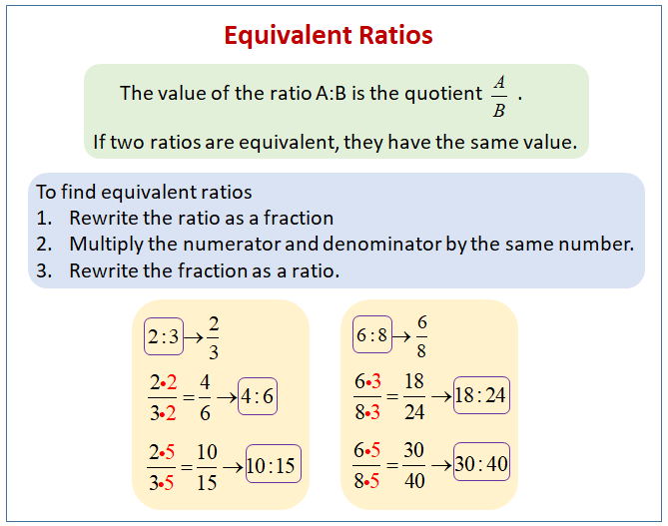
RATIO

Slide 4
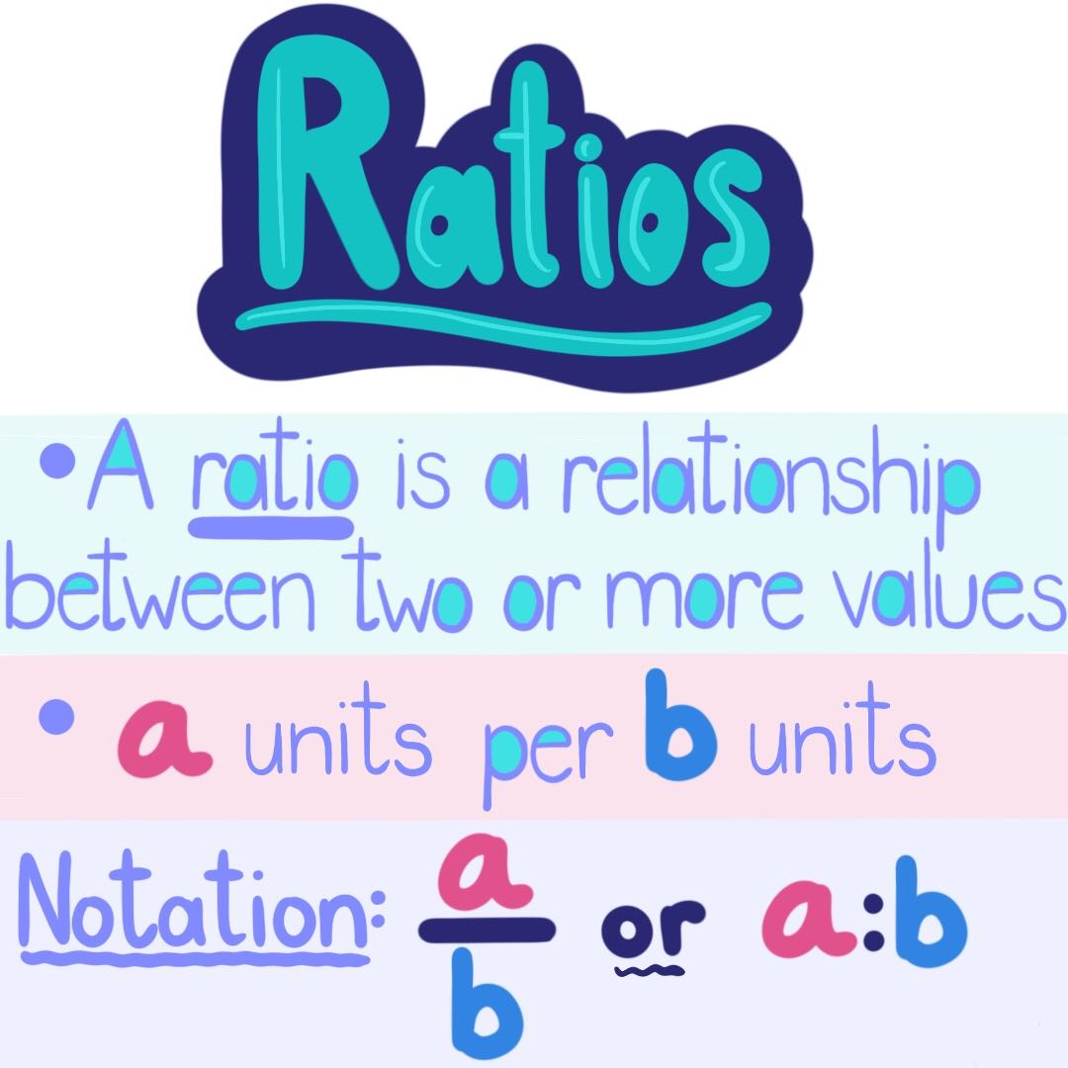

Slide 5
Evaluation Questions Exercise 11D
Which ratio is greater: (i) 8 / 15 or 5 / 9 (ii) 3 / 7 or 6 / 13
2. Which ratio is smaller:
(i) 9 / 17 or 8 / 15 (ii) 7 / 15 or 15 / 32
3. Increase 95 in the ratio 5: 8
4. Decrease 275 in the ratio 11: 7
5. Decrease 850 in the ratio 17: 6 and then increase the result in the ratio 5: 9
6. Decrease 850 in the ratio 17: 6 and then decrease the resulting number again in 4: 3
7. Increase 1200 in the ratio 2: 3 and then decrease the resulting number in the ratio 10: 3

Slide 6
Evaluation Question
1.(i)8 / 15 or 5 / 9
The above expression can be written as follows:
8 / 15 or 5 / 9= 8 × 9 or 15 × 5= 72 or 75
We know that 75 is greater than 72
Therefore 5 / 9 is greater
(ii) 3 / 7 or 6 / 13
3 / 7 or 6 / 13
⇒ 3 × 13 or 6 × 7
⇒ 39 or 42
We know that 42 is greater than 39
Therefore 6 / 13 is greater

Slide 7
Evaluation Question
2Solution:
9 / 17 or 8 / 15
⇒ 9 × 15 or 8 × 17
⇒ 135 or 136
We know that, 135 is smaller than 136
Therefore 9 / 17 is smaller
(ii) Given
7 / 15 or 15 / 32
⇒ 7 × 32 or 15 × 15
⇒ 224 or 225
We know that, 224 is smaller than 225
Therefore 7 / 15 is smaller

Slide 8
Evaluation Question
3.Solution:Ratio = 5: 8
Given quantity = 95
Hence the increased quantity can be calculated as given below
The increased quantity = 8 / 5 × given quantity= 8 / 5 × 95= 152
Therefore the increased quantity is 152
4.Solution:
Ratio = 11: 7
Given quantity = 275
Hence the decreased quantity can be calculated as given below
The decreased quantity = 7 / 11 × given quantity
= 7 / 11 × 275= 175

Slide 9
Evaluation Question
5.Solution:
Decrease in the ratio = 17: 6
Given quantity = 850
Hence the decreased quantity can be calculated as given below
The decreased quantity = 6 / 17 × given quantity= 6 / 17 × 850= 300
The quantity is increased in the ratio 5: 9
Therefore the final quantity can be calculated as given below
Final quantity = 9 / 5 × 300= 540
Thus the final quantity is 540

Slide 10
Evaluation Question
7.Solution:
Decrease in the ratio = 17: 6
Given quantity = 850
Hence the decreased quantity can be calculated as given below
The decreased quantity = 6 / 17 × given quantity= 6 / 17 × 850= 300
The quantity is decreased in the ratio of 4: 3
Therefore the final quantity can be calculated as given below
Final quantity = 3 / 4 × 300= 225
Thus the final quantity is 225

Slide 11
Evaluation Question
7.Solution:
Increase in the ratio = 2: 3
Given quantity = 1200
Hence the decreased quantity can be calculated as given below
The increased quantity = 3 / 2 × given quantity
= 3 / 2 × 1200= 1800
The quantity is decreased in the ratio 10: 3
Therefore the final quantity can be calculated as given below
Final quantity = 3 / 10 × 1800= 540
Thus the final quantity is 540

Slide 12
Evaluation Question
8. Increase 1200 in the ratio 3: 7 and then increase the resulting number again in the ratio 4: 7
9. The number 650 is decreased to 500 in the ratio a: b, find the ratio a: b
10. The number 800 is increased to 960 in the ratio a: b, find the ratio a: b

Slide 13
Evaluation Question
8.Solution:
Increase in the ratio = 3: 7
Given quantity = 1200
Hence the increased quantity can be calculated as given below
The increased quantity = 7 / 3 × given quantity
= 7 / 3 × 1200= 2800
The quantity is increased in the ratio 4: 7
Therefore the final quantity can be calculated as given below
Final quantity = 7 / 4 × 2800= 4900
Thus the final quantity is 4900

Slide 14
Evaluation Question
9.Solution:
Given quantity = 650
Decrease quantity = 500
Hence the ratio (a: b) by which 650 is decreased to 500 can be calculated as given below
Resulting ratio = 650 / 500
= 13 / 10
= 13: 10
Therefore the resulting ratio is 13: 10

Slide 15
Evaluation Question
10.Solution:
Given quantity = 800
Increase in quantity = 960
Hence the ratio (a: b) by which 800 is increased to 960 can be calculated as given beLow
Resulting ratio = 800 / 960
= 5 / 6
= 5: 6
Thus the resulting ratio is 5: 6

Slide 16
Homework
HW
Ex.11 D

Slide 17
THANKING YOU
ODM EDUCATIONAL GROUP

