Slide 1


FRACTIONS
SUBJECT : MATHEMATICS
CHAPTER NUMBER: 14
CHAPTER NAME : FRACTIONS

Slide 2

Learning outcomes
Students will be able to find like equivalent factions ,compare fractions.
Students will be add and subtract fractions.

Slide 3
https://www.youtube.com/watch?v=9yZQK4w1JUc

Slide 4
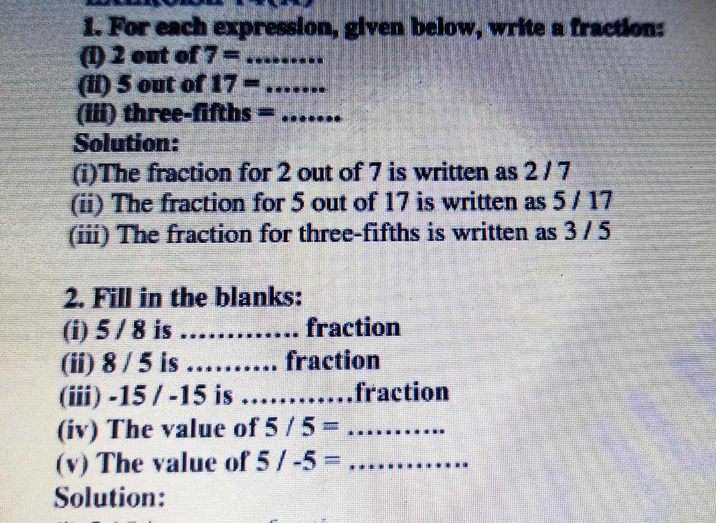

Slide 6
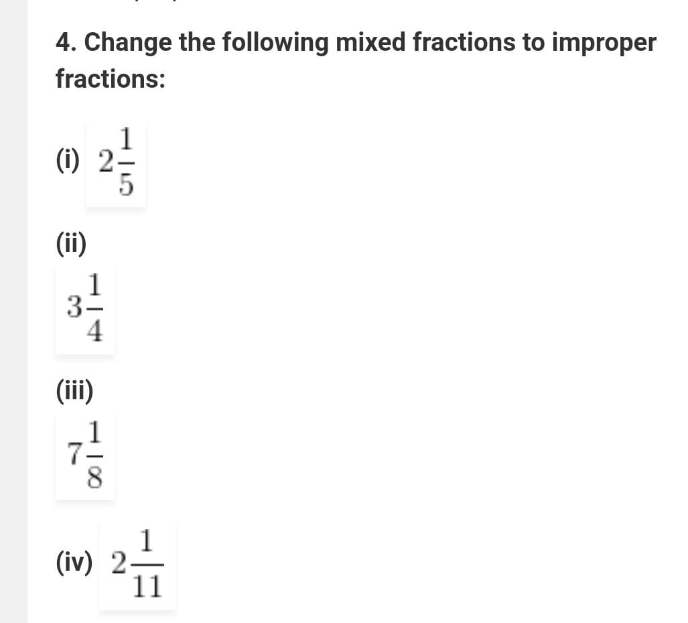

Slide 8
Additional Homework
EXERCISE 14 A
HW
Ex.13 A

Slide 9
THANKING YOU
ODM EDUCATIONAL GROUP

