Slide 1

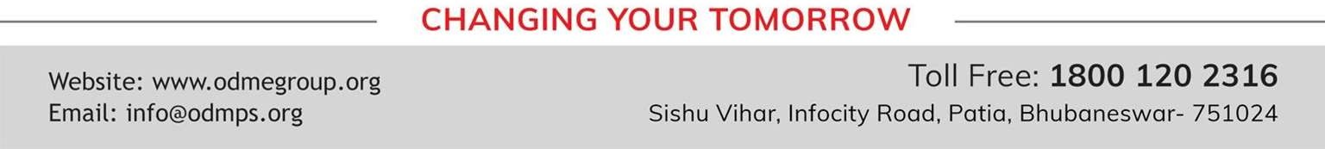
TOPIC- URINE FORMATION PERIOD- 4
CHAPTER NUMBER- 05
CHAPTER: Excretion in Humans
CLASS: VII
SUBJECT: BIOLOGY

Slide 2

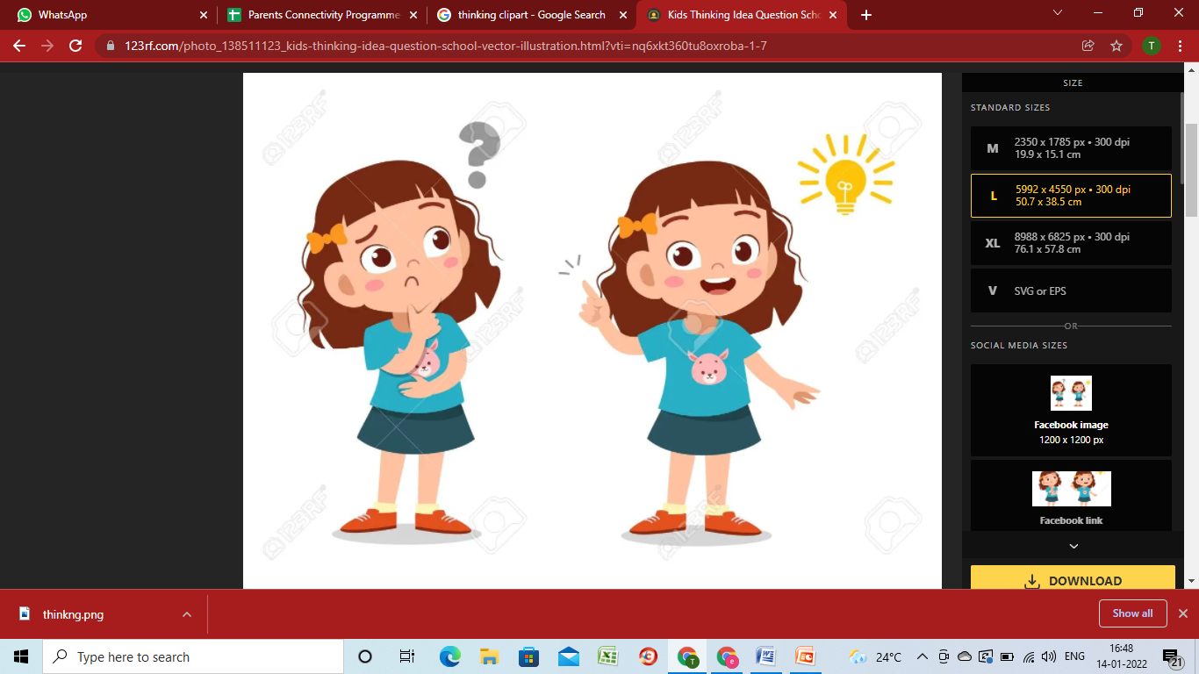
LEARNING OBJECTIVE
Students will be able to-

Slide 3
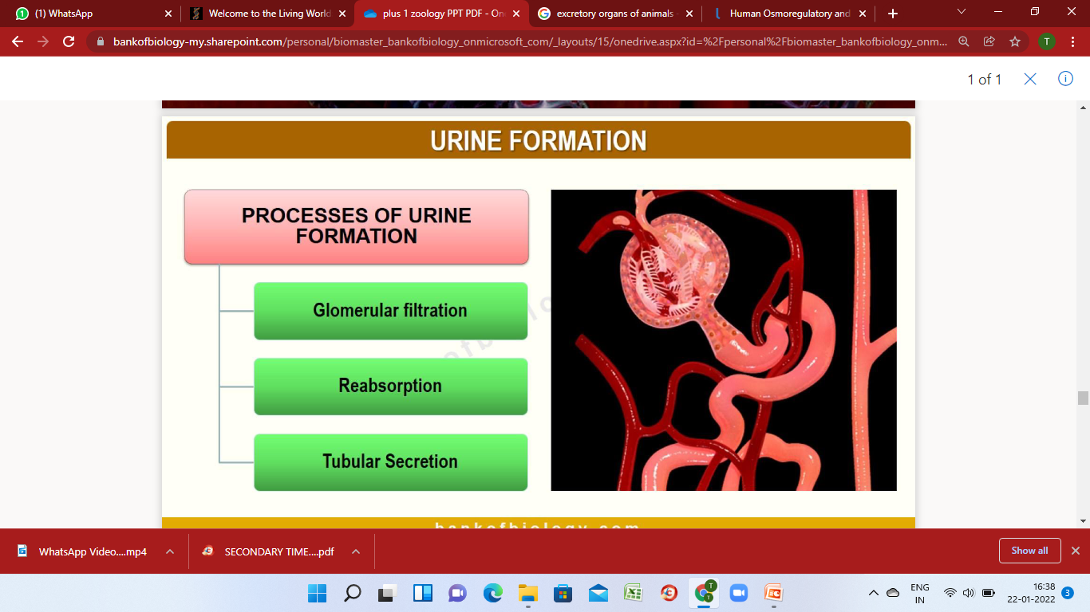
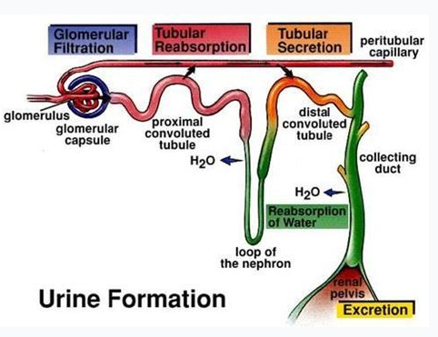
URINE FORMATION

Slide 4
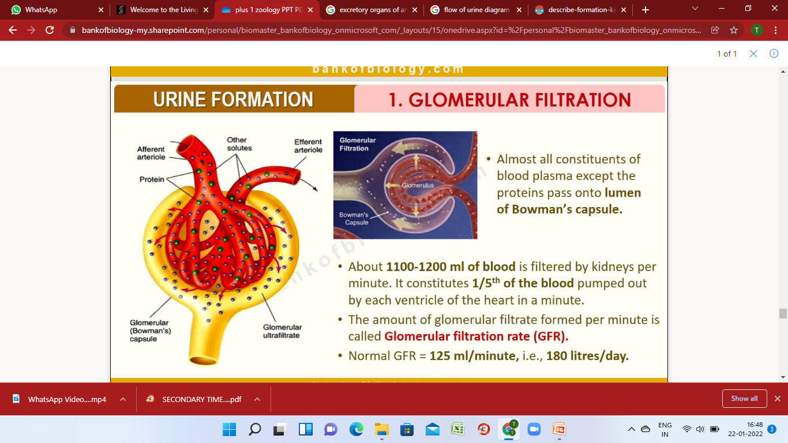
URINE FORMATION- 1. GLOMERULAR FILTRATION

Slide 5
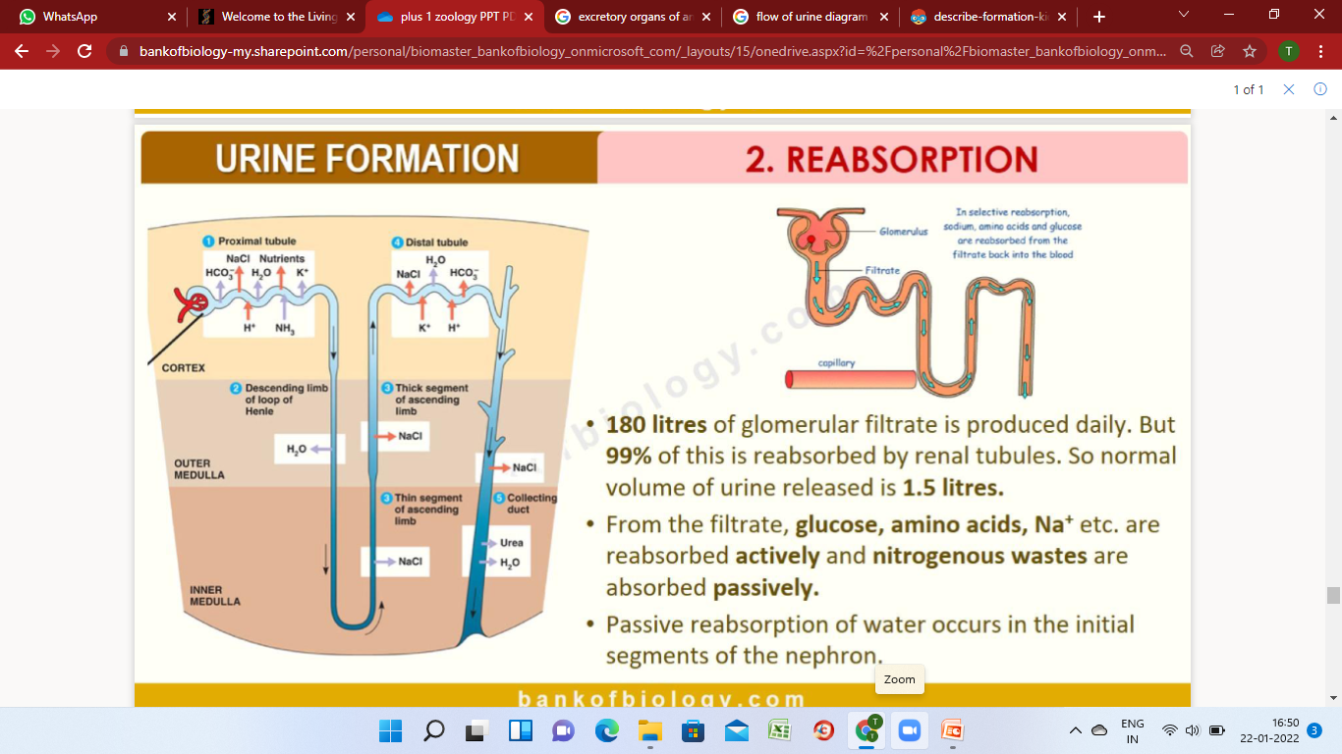
URINE FORMATION- 2. SELECTIVE REABSORPTION

Slide 6
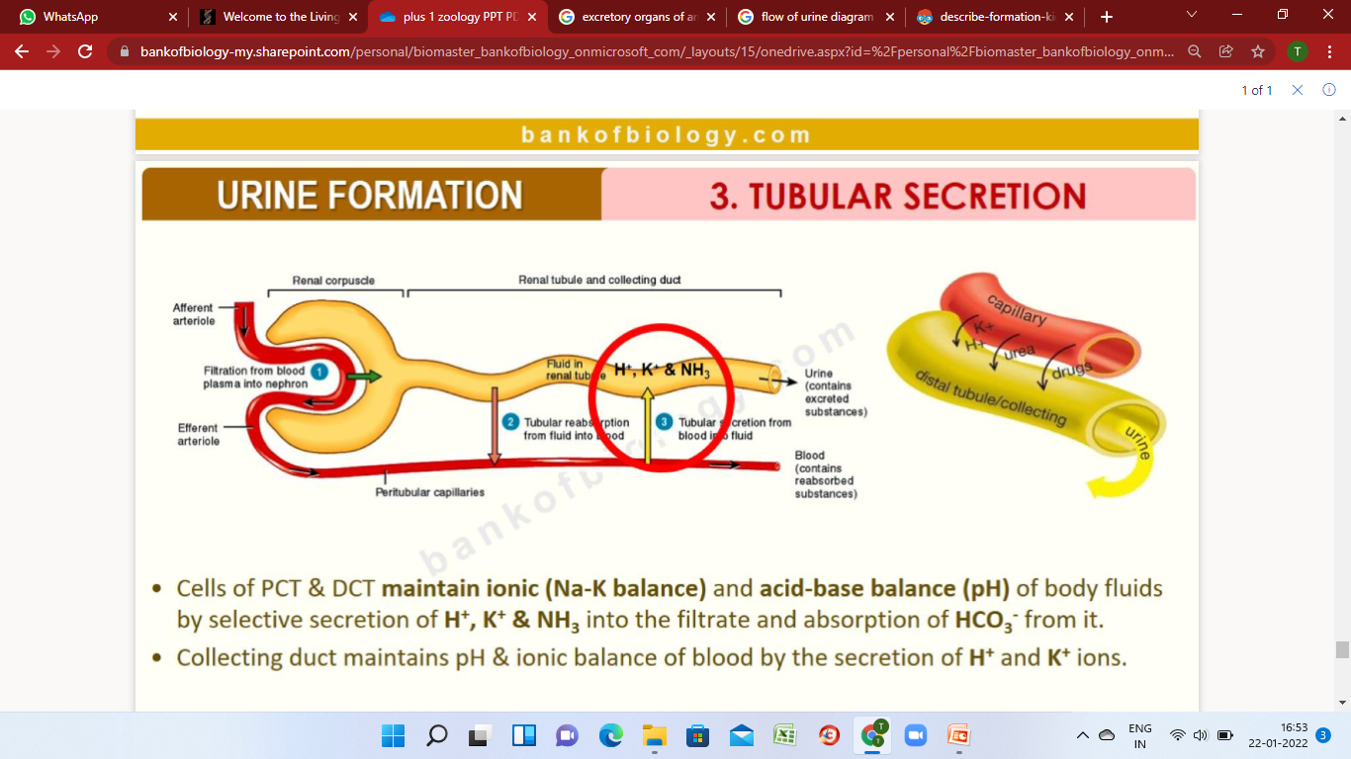
URINE FORMATION- 3. TUBULAR SECRETION

Slide 7
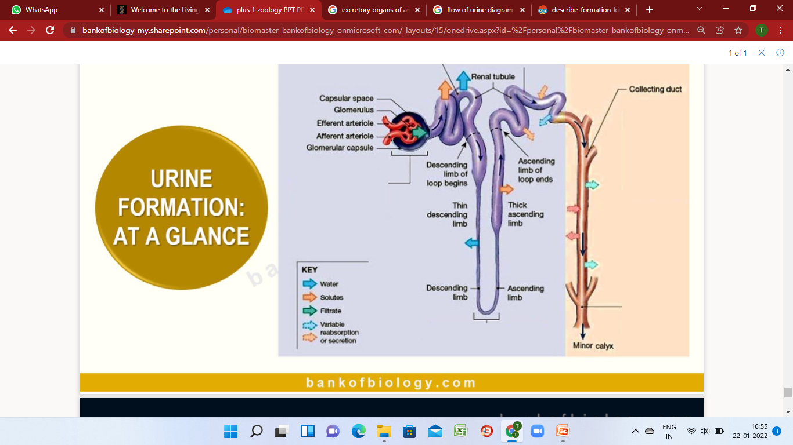


Slide 8
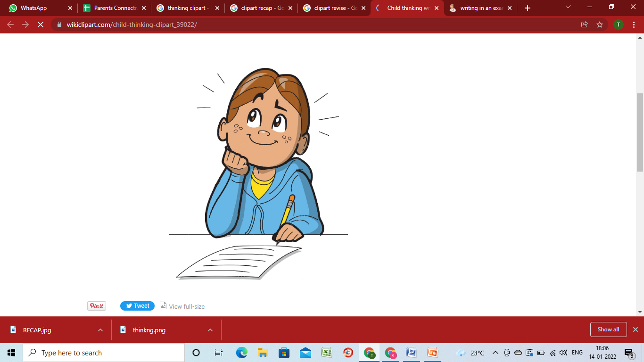
RECAPITULATION

Slide 9
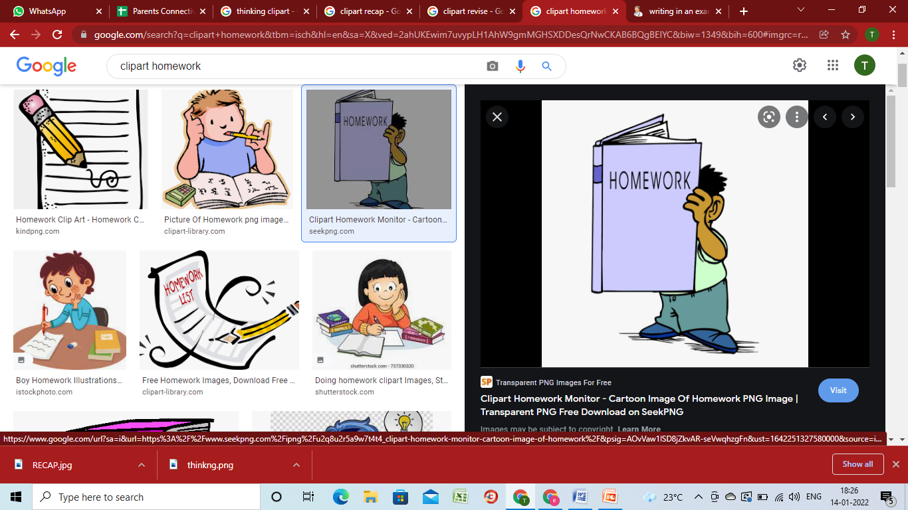
HOME ASSIGNMENT

Slide 10

THANKING YOU
ODM EDUCATIONAL GROUP

