Slide 1

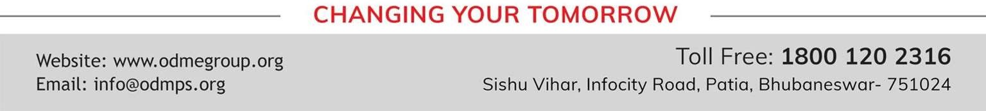
TOPIC- Structure of Nephron PERIOD- 3
CHAPTER NUMBER- 05
CHAPTER: Excretion in Humans
CLASS: VII
SUBJECT: BIOLOGY

Slide 2

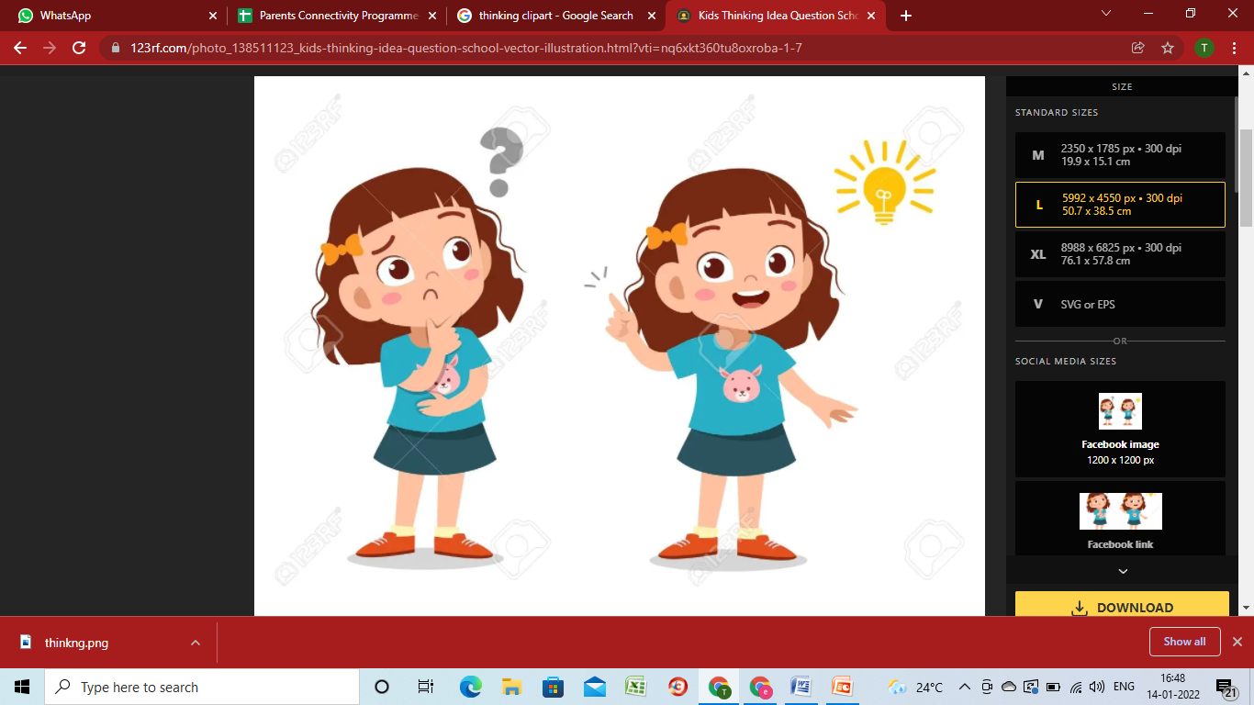
LEARNING OBJECTIVE
Students will be able to-

Slide 3
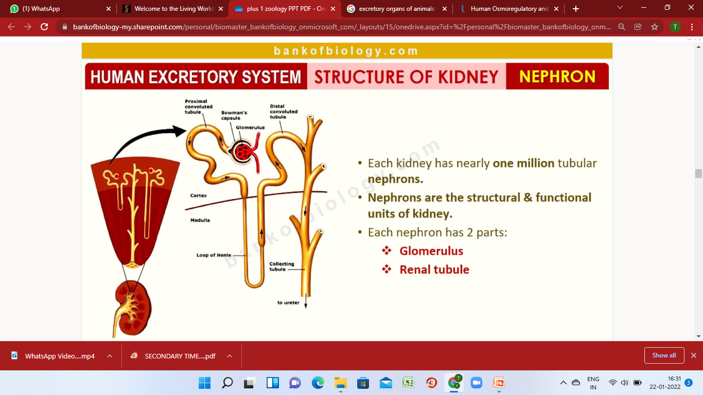
STRUCTURE OF NEPHRON- THE FUNCTIONAL UNIT OF KIDNEY

Slide 4
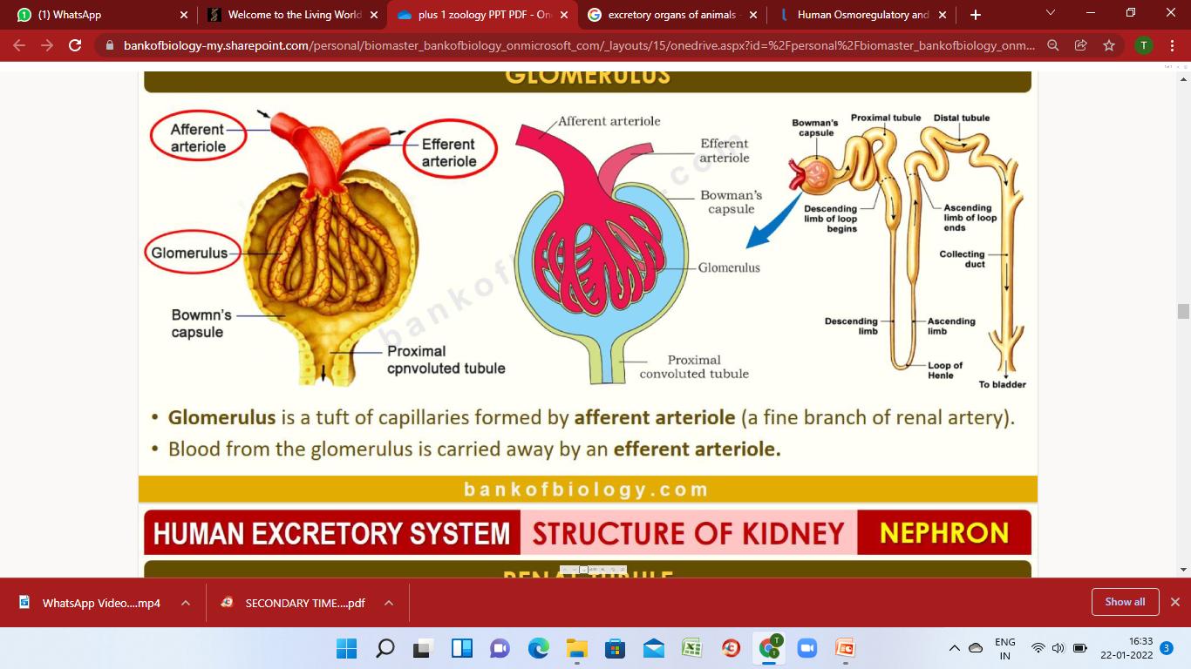
GLOMERULUS

Slide 5
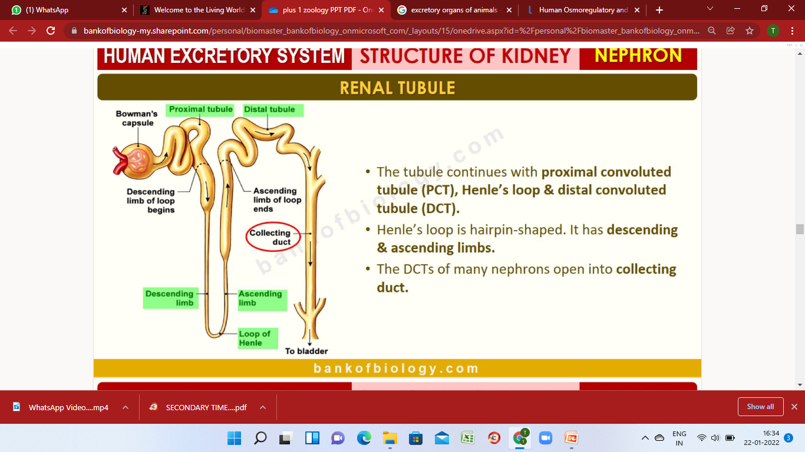
RENAL TUBULES

Slide 6


Slide 7
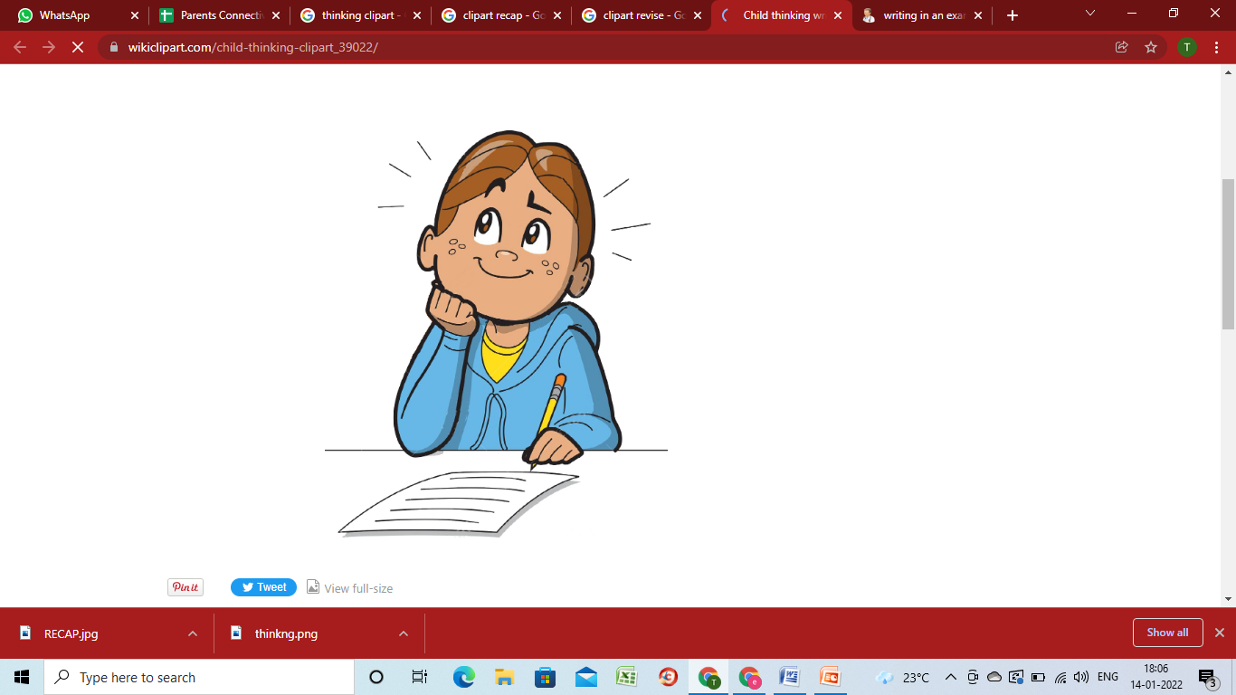
RECAPITULATION

Slide 8
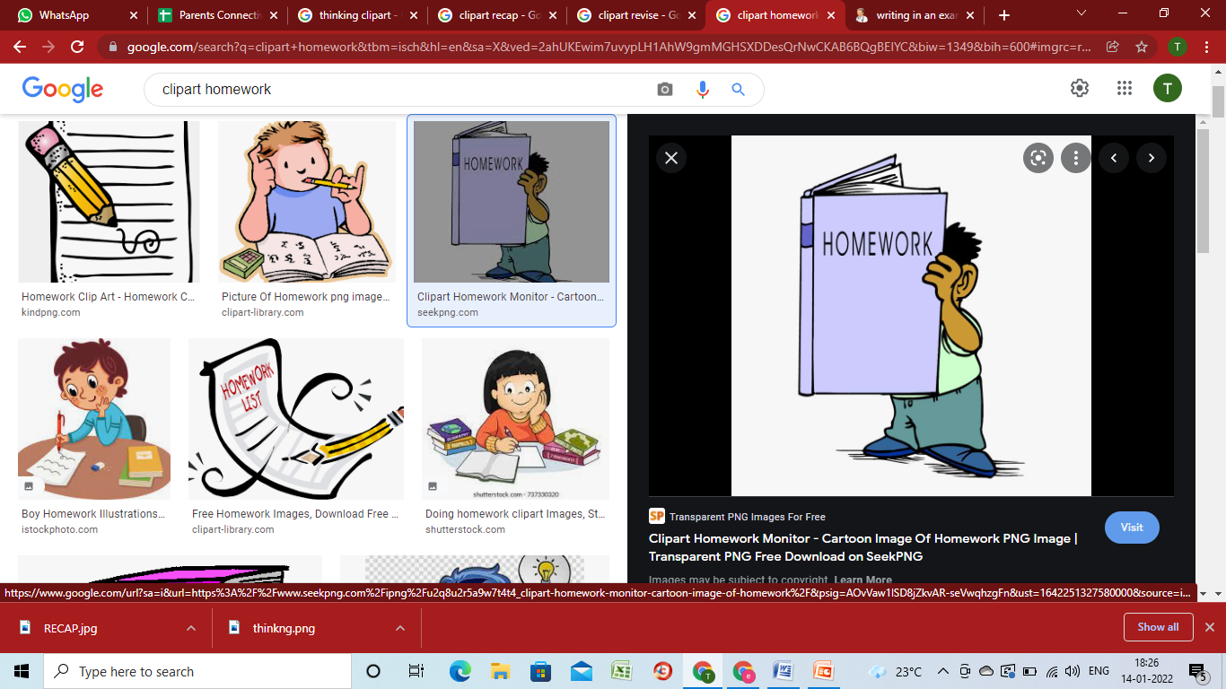
HOME ASSIGNMENT
When do we say that work is done?
Write an expression for the work done when a force is acting on an object in the direction of its displacement.
Define 1 J of work.

Slide 9

THANKING YOU
ODM EDUCATIONAL GROUP

