Slide 1

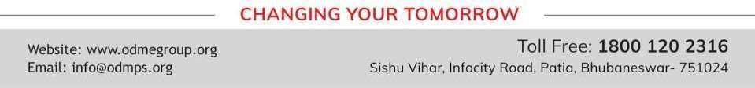
PROFIT, LOSS AND DISCOUNT
PERIOD 8
SUBJECT : MATHEMATICS
CHAPTER NUMBER: 8
CHAPTER NAME : PROFIT, LOSS AND DISCOUNT

Slide 2

Learning outcome
Students will be able to able to review the profit and loss.
The children will be able calculate S.P , C.P and Gain or Loss.
The children will be able calculate discount and its percentage
The children will be able calculate tax and its percentage
Students will be able to know about GST.

Slide 3
Recapitulation:
Question 1.
A shopkeeper buys an article for ₹ 8,000 and sells it for ₹ 10,000. If the rate of tax under
VAT is 10%, find :
tax paid by the shopkeeper
tax charged by the shopkeeper
VAT paid by the shopkeeper

Slide 4
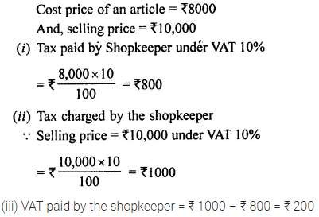
Solution:

Slide 5
Question 2.
Find the cost price, if :
S.P. = Rs. 1,680 and profit = 12%
S.P. = Rs. 1,128 and loss = 6%
Question 3.
A stationer buys pens at 5 for Rs.28 and sells them at a profit of 25 %. How
much should a customer pay; if he buys
only one pen ;
three pens

Slide 6
An article is marked for Rs. 1,300 and is sold for Rs. 1,144 ; find the discount
percent.
Rajat purchases a wrist-watch costing Rs. 540. The rate of Sales Tax is 8%. Find the
total amount paid by Rajat for the watch.

Slide 7
Home Assignment
Chapter 8

Slide 8
THANKING YOU
ODM EDUCATIONAL GROUP

