Slide 1

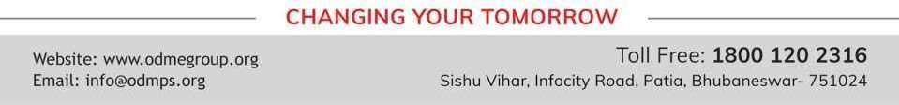
PROFIT, LOSS AND DISCOUNT
PERIOD 7
SUBJECT : MATHEMATICS
CHAPTER NUMBER: 8
CHAPTER NAME : PROFIT, LOSS AND DISCOUNT

Slide 2

Learning outcome
Students will be able to know about GST.

Slide 3
Previous knowledge
Question 1.
Rajat purchases a wrist-watch costing Rs. 540. The rate of Sales Tax is 8%. Find the
total amount paid by Rajat for the watch
Question 2.
The price of a washing machine, inclusive of sales tax is ₹ 13,530/-. If the Sales Tax
is 10%, find its basic (cost) price.

Slide 4
Exercise- 8(F)
Question 1.
A shopkeeper buys an article for ₹ 8,000 and sells it for ₹ 10,000. If the rate of tax under
VAT is 10%, find :
tax paid by the shopkeeper
tax charged by the shopkeeper
VAT paid by the shopkeeper

Slide 5
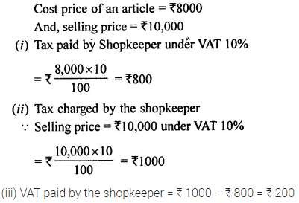
Solution:

Slide 6
Exercise- 8(F)
Question 2.
A trader buys some goods for ₹ 12,000 and sells them for ₹ 15,000. If the
rate of tax under VAT is 12%, find the VAT paid by the trader?

Slide 7
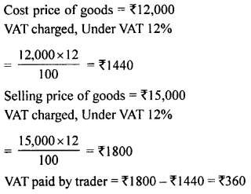
Solution:

Slide 8
Exercise- 8(F)
Question 3.
The marked price of an article is ₹ 7,000 and is available at 20% discount. Manoj buys this article and then sold it at its marked price. If the rate of tax at each state is 10%, find the VAT paid by Manoj.

Slide 9
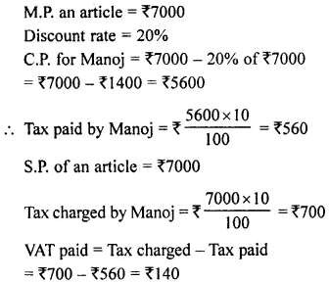
Solution:

Slide 10
Exercise- 8(F)
Question 5.
A buys an article for ₹ 8,000 and sold it to B at 20% profit. If the rate of tax
under VAT is 8%, find :
tax paid by A
tax charged by A
VAT paid by A

Slide 11
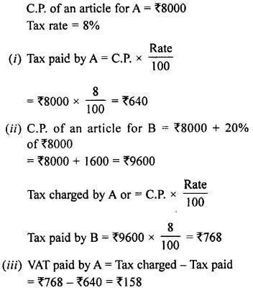
Solution:

Slide 12
Exercise- 8(F)
Question 6.
A shopkeeper purchases an article for ₹ 12,400 and sells it to a customer for ₹ 17,000. If the tax under VAT is 8%, find the VAT paid by the shopkeeper.

Slide 13
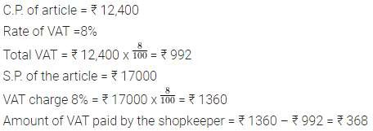
Solution:

Slide 14
Home Assignment
Exercise 8(F)

Slide 15
THANKING YOU
ODM EDUCATIONAL GROUP

