Slide 1

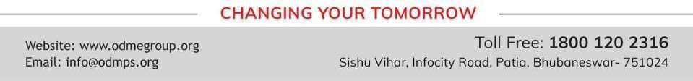
PROFIT, LOSS AND DISCOUNT
PERIOD 4
SUBJECT : MATHEMATICS
CHAPTER NUMBER: 8
CHAPTER NAME : PROFIT, LOSS AND DISCOUNT

Slide 2

Learning outcome
The children will be able calculate profit and loss problems (HOTS).

Slide 3
Previous knowledge:
By selling a sofa-set for Rs.2,500; the shopkeeper loses 20%. Find his loss
percent or profit percent ; if he sells the same sofa-set for Rs.3150.
A tape-recorder is sold for Rs. 2,760 at a gain of 15% and a C.D. player is sold
for Rs. 3,240 at a loss of 10% Find :
the C.P. of the tape-recorder
the C.P. of the C.D. player.
the total C.P. of both.
the total S.P. of both
the gain % or the loss % on the whole

Slide 4
Exercise- 8(C)
Question 1.
A stationer buys pens at 5 for Rs.28 and sells them at a profit of 25 %. How much should a
customer pay; if he buys
only one pen ;
three pens ?

Slide 5
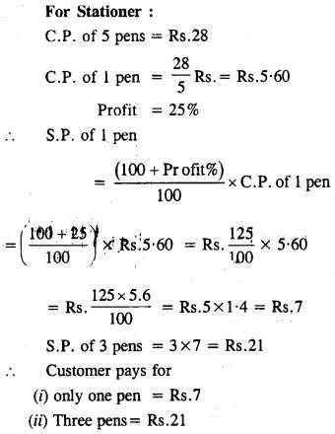
Solution:

Slide 6
Exercise- 8(C)
Question 2.
A fruit-seller sells 4 oranges for Rs. 3, gaining 50%. Find :
C.P. of 4 oranges,
C.P. of one orange.
S.P. of one orange.
profit made by selling one orange.
number of oranges brought and sold in order to gain Rs. 24.

Slide 7
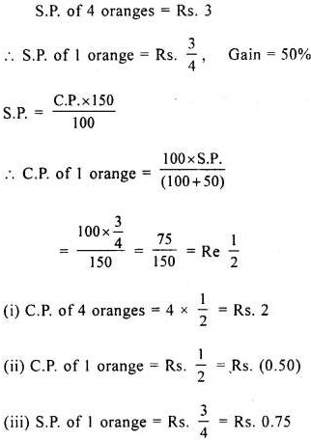
Solution:

Slide 8
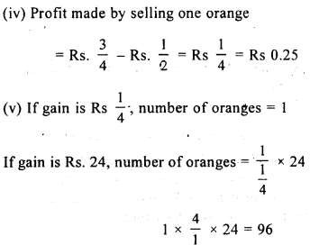
Solution:

Slide 9
Exercise- 8(C)
Question 4.
The cost price of 20 articles is same as the selling price of 16 articles. Find the
gain percent

Slide 10
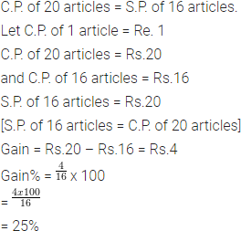
Solution:

Slide 11
Exercise- 8(C)
Question 5.
The selling price of 15 articles is equal to the cost price of 12 articles.
Find the gain or loss as percent

Slide 12
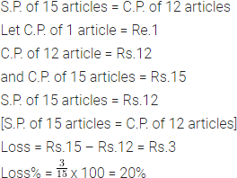
Solution:

Slide 13
Home Assignment
Exercise 8(C) - 1 to 5

Slide 14
THANKING YOU
ODM EDUCATIONAL GROUP

