Slide 1

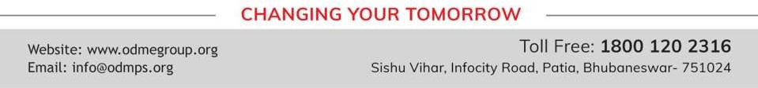
ALGEBRAIC EXPRESSION
PERIOD 1
SUBJECT : MATHEMATICS
CHAPTER NUMBER: 11
CHAPTER NAME : ALGEBRAIC EXPRESSION

Slide 2

Learning outcome
Students will be able to understand the concept of algebraic expression

Slide 3


Question 1.
Separate the constants and variables from the following

Slide 4
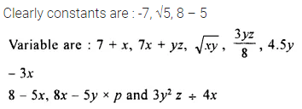
Solution:

Slide 5
Question 5.
Write the coefficient of :
(i) ab in 7abx ,
(ii) 7a in 7abx ;
(iii) 5x2 in 5x2 – 5x ;
(iv) 8 in a2 – 8ax + a ;
(v) 4xy in x2 – 4xy + y2.

Slide 6
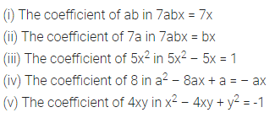
Solution:

Slide 7
Home assignment
Exercise 11(A)

Slide 8
THANKING YOU
ODM EDUCATIONAL GROUP

