Slide 1

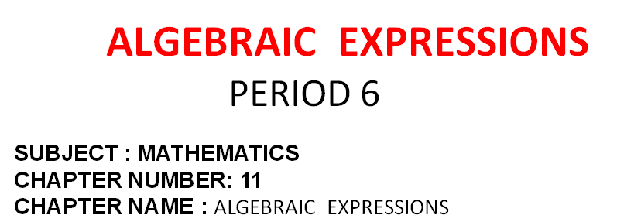
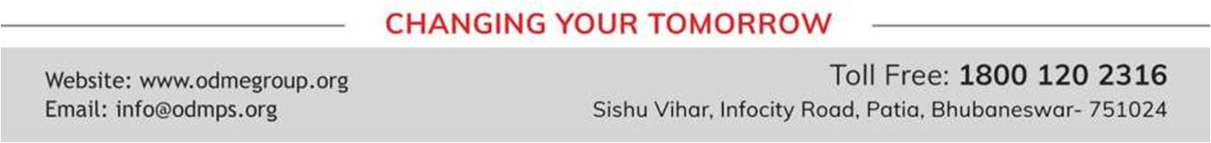

Slide 2
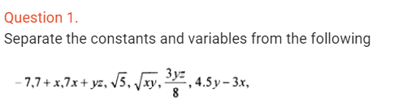
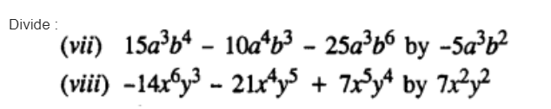
Recapitulation of the chapter
Question 2. The adjacent sides of a rectangle are x² – 4xy + 7y² and x³ – 5xy². Find its area.

Slide 3
Home assignment
Chapters -11

Slide 4


