Slide 1

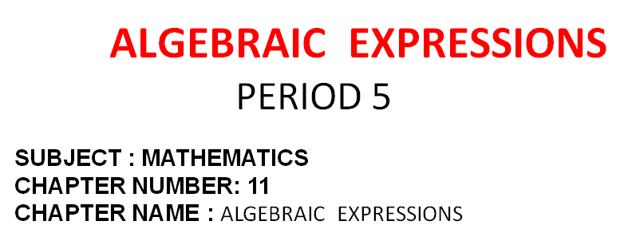


Slide 2




EXERCISE- 11 E

Slide 3
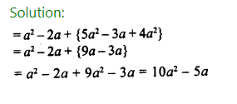
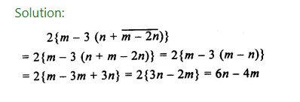

Slide 4



Slide 5
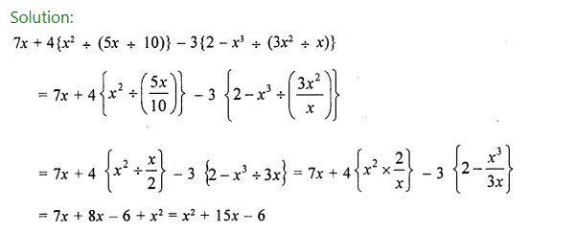

Slide 6
Home assignment
Ex 11(E) - 1 to 5

Slide 7


