Slide 1

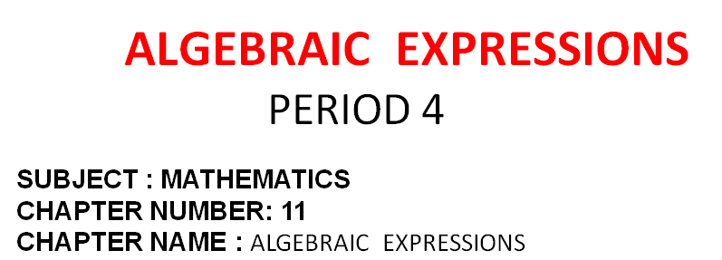
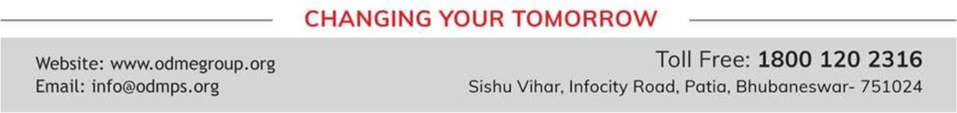

Slide 2

EXERCISE- 11 D
Question 1.
Divide :

Slide 3
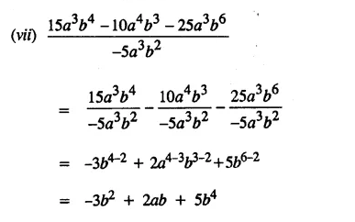

Slide 4
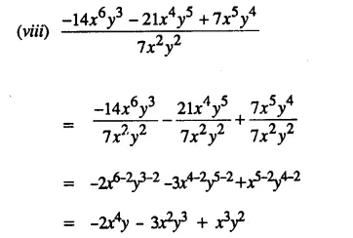

Slide 5

Question 4.
The product of two numbers is 16x4 – 1. If one number is 2x – 1, find the other Question 5.
Divide x6 – y6 by the product of x2 + xy + y2 and x – y..

Slide 6
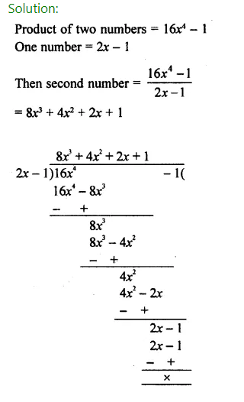

Slide 7
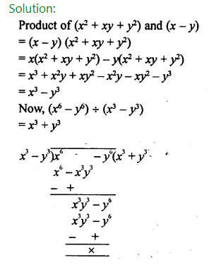

Slide 8
Home assignment
Exercise 11(D) - 2,3

Slide 9


