Slide 1

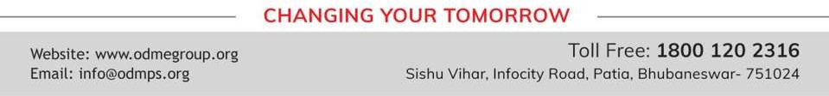
ALGEBRAIC EXPRESSIONS
PERIOD 3
SUBJECT : MATHEMATICS
CHAPTER NUMBER: 11
CHAPTER NAME : ALGEBRAIC EXPRESSIONS

Slide 2

EXERCISE- 11 C
Question 4. The adjacent sides of a rectangle are x² – 4xy + 7y² and x³ – 5xy². Find its area.
Question 5. The base and the altitude of a triangle are (3x – 4y) and (6x + 5y) respectively. Find its area.
Question 8. Evaluate (3x⁴y²) (2x²y³) for x = 1 and y = 2.

Slide 3
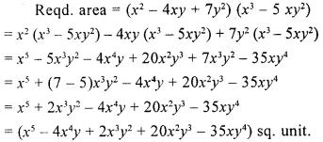
Solution:

Slide 4

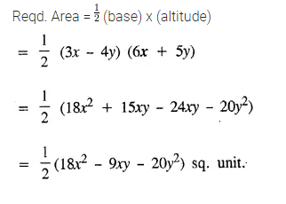

Slide 5
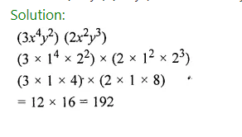
Solution:
Solution:

Slide 6
Home assignment
Exercise 11(C) - 1,2,13,14,15

Slide 7
THANKING YOU
ODM EDUCATIONAL GROUP

