Slide 1

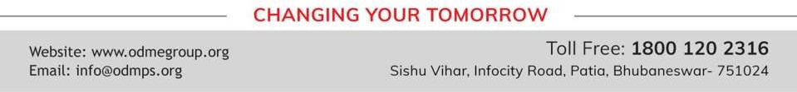
ALGEBRAIC EXPRESSIONS
PERIOD 2
SUBJECT : MATHEMATICS
CHAPTER NUMBER: 11
CHAPTER NAME : ALGEBRAIC EXPRESSIONS

Slide 2

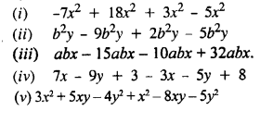
Evaluate:
EXERCISE- 11 B

Slide 3
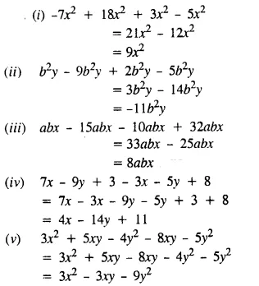
Solution:
Solution:
Solution:

Slide 4
Question 10.
The sides of a triangle are x² – 3xy + 8, 4x² + 5xy – 3 and 6 – 3x² + 4xy. Find its perimeter.
Question 13.
What must be subtracted from 19x⁴ + 2x³ + 30x – 37 to get 8x⁴ + 22x³ – 7x – 60 ?
Question 15.
How much bigger is 15x²y² – 18xy² – 10x²y than -5x² + 6x²y – 7xy ?

Slide 5
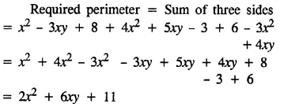
Solution:
Solution:

Slide 6
Home assignment
Exercise 11(B) - 1 to 5

Slide 7
THANKING YOU
ODM EDUCATIONAL GROUP

