Slide 1

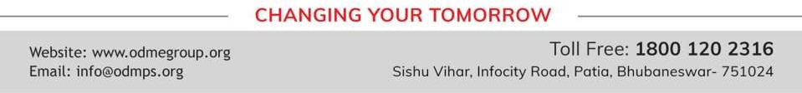
FACTORISATION
PERIOD 4
SUBJECT : MATHEMATICS
CHAPTER NUMBER: 13
CHAPTER NAME : FACTORISATION

Slide 2

Learning outcome
Students will be able to understand the concept of factorization
Understand the different method of factorization
.

Slide 3





Exercise -13 D

Slide 4
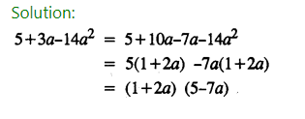
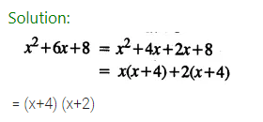
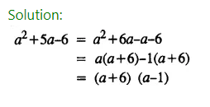
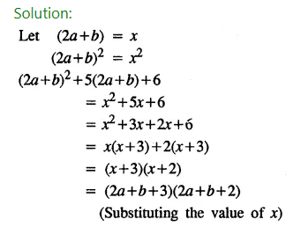

Slide 5
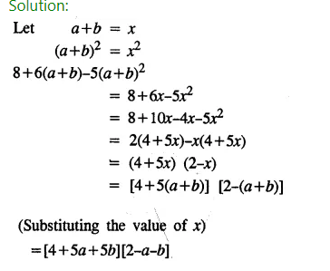

Slide 6
Home assignment
Exercise 13(D)

Slide 7
THANKING YOU
ODM EDUCATIONAL GROUP

