Slide 1

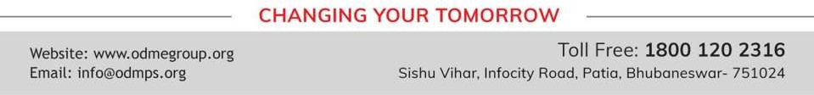
FACTORISATION
PERIOD 2
SUBJECT : MATHEMATICS
CHAPTER NUMBER: 13
CHAPTER NAME : FACTORISATION

Slide 2

Learning outcome
Students will be able to understand the concept of factorization
Understand the different method of factorization
.

Slide 3





Exercise -13 B

Slide 4
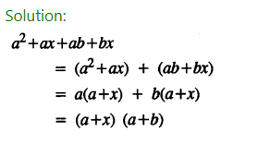
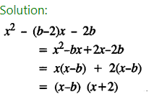
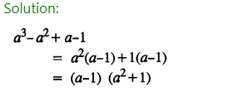
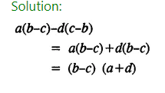
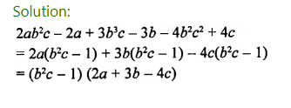

Slide 5
Home assignment
Exercise 13(B)

Slide 6
THANKING YOU
ODM EDUCATIONAL GROUP

