Slide 1


CLASS- VIII
INDUSTRIES
SUBJECT : GEOGRAPHY
CHAPTER NUMBER: 06
CHAPTER NAME : INDUSTRIES

Slide 2


Slide 3
CONTENT:-
Industry
Manufacturing
Importance of Industries
Classification of Industries (On the basis of ownership, raw materials used and size)

Slide 4
INDUSTRY
THE ORGANISED PRODUCTION OF GOODS OR SERVICES IS CALLED INDUSTRY.
TYPES: MANUFACTURING INDUSTRY AND SERVICE INDUCTRY
INDUSTRY: Any economic activity concerned with the processing of raw materials into finished goods with the help of machines in factories in organised manner.
MANUFACTURING : Process of converting the raw material into a finished good is called manufacturing. This adds value to the good and it becomes of greater use to humans.

Slide 5
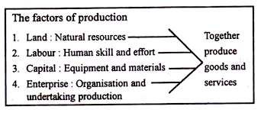

Slide 6
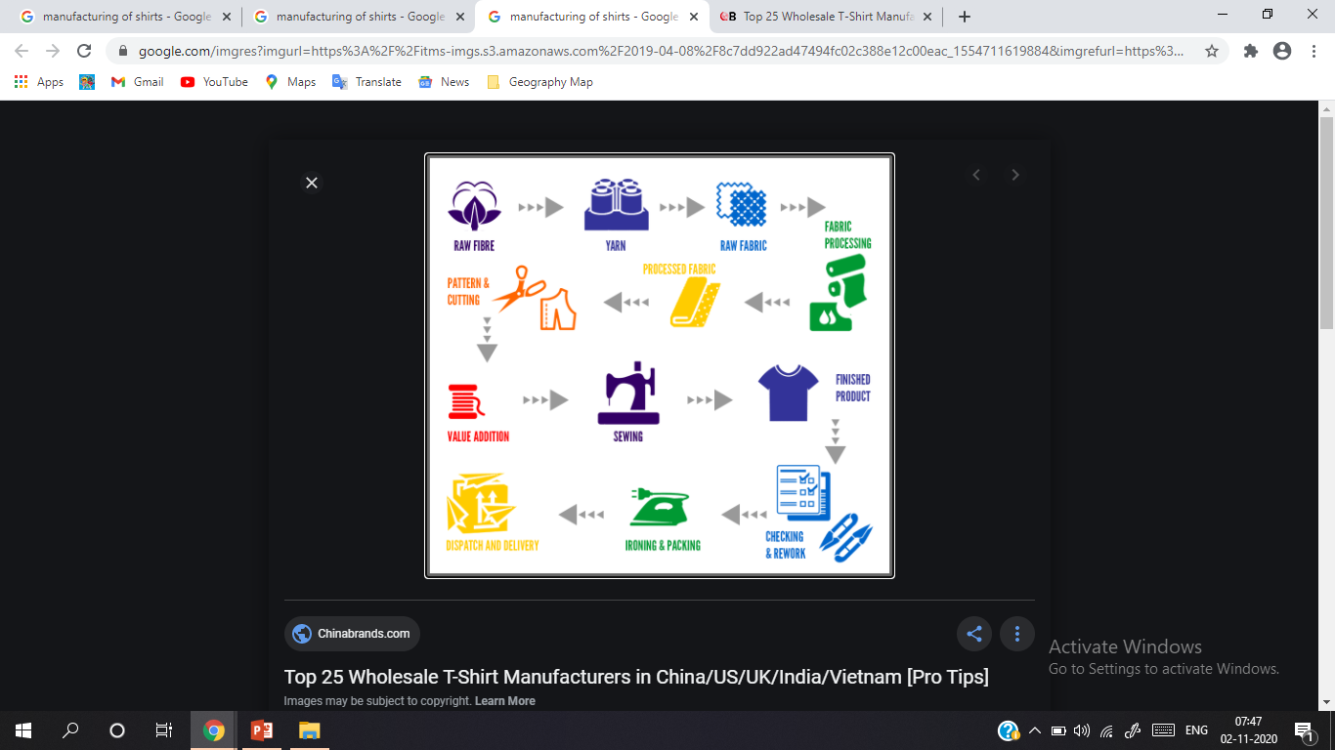

Slide 7
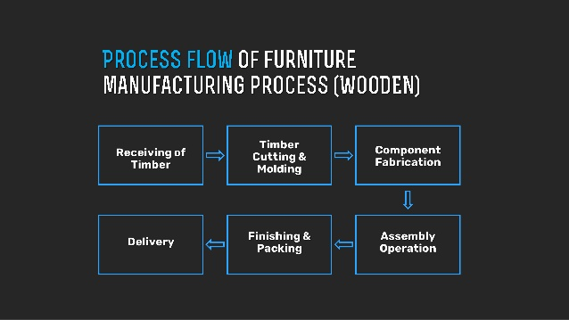

Slide 8
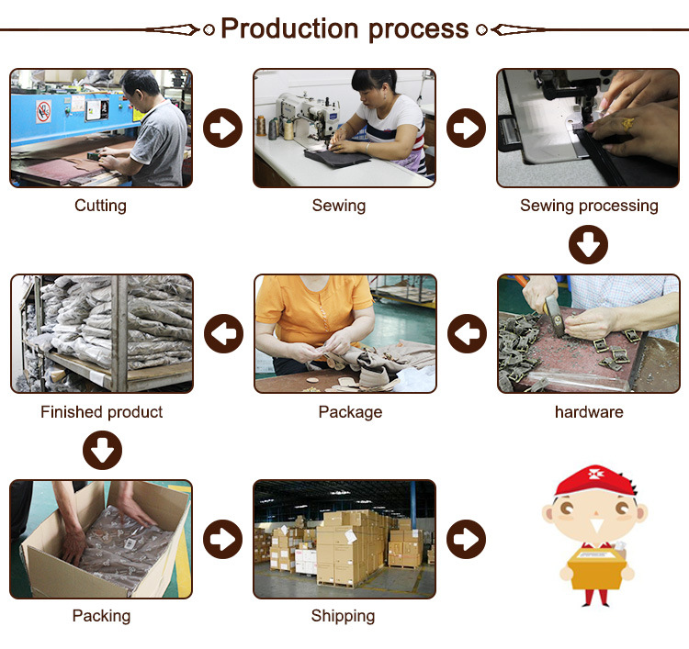

Slide 9
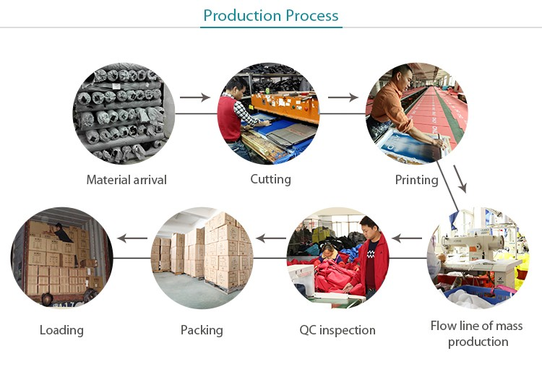

Slide 10
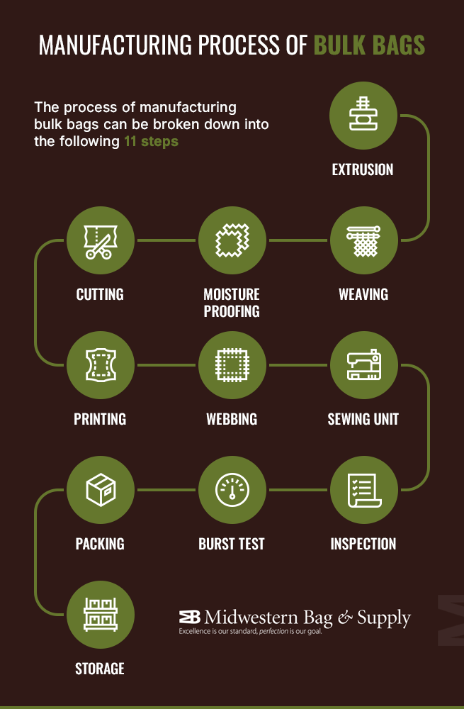

Slide 11
INDUSTRY
Industrial activities are divided in three sectors – Primary sector, Secondary sector and tertiary sector.
Secondary activities are those activities which change raw materials into products of more value.
Industry refers to an economic activity that is concerned with production of goods, extraction of minerals or the provision of services.
Industries are divided on the basis of raw material, size, and ownership.

Slide 12
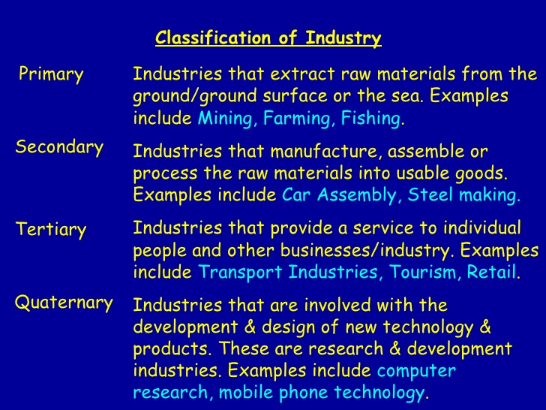

Slide 13
Industry is a group concept while manufacturing is an unit. Manufacturing may be from handicrafts to high tech. It involves converting raw materials to finished products.
Industrial activity can be classified into :-
primary (extraction),
secondary (manufacturing),
tertiary (services),
quaternary (knowledge)
quinary (culture and research).

Slide 14
IMPORTANCE OF INDUSTRIES :
1. Industries help in modernizing agriculture which forms the backbone of our economy. 2. Industry also reduces the heavy dependence of people on agricultural income by providing them jobs in secondary and tertiary sector. 3. Industrial Development helps in removal of unemployment and poverty. 4. It also aims at bringing down regional differences by establishing industry in backward areas. 5. Export of manufactured goods expand trade and Commerce.

Slide 15
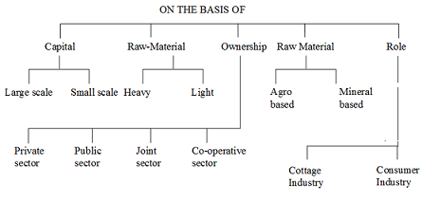
CLASSIFICATION OF INDUSTRIES

Slide 16
THANKING YOU
ODM EDUCATIONAL GROUP

Slide 18
CLASSIFICATION OF INDUSTRIES

Slide 19
CONTENT
Classification of Industries
On the basis of OWNERSHIP
On the basis of RAW MATERIALS
On the basis of SIZE

Slide 20
On the basis of ownership
Ownership: On the basis of ownership, industries can be classified into the following sectors:
Public sector industries are owned and operated by the government. For example, Hindustan Aeronautics Limited and Steel Authority of India Limited.
Private Sector Industries are owned and operated by individuals or a group of individuals. For example, Bharat Heavy Electrical Ltd., Indian Oil Cooperation.
Joint Sector Industries are owned and operated by the state and individuals or a group of individuals. For example Maruti Udyog Limited.

Slide 21
Cooperative Sector Industries: These industries are owned and operated by the producers or suppliers of raw materials, workers or both. For example AMUL (Anand Milk Union Limited, Cooperative Producers), KRIBHCO (Krishak Bharati Cooperative Limited), Sudha Dairy and West Bengal State Co-operative Bank Ltd. They process the raw material to add value and earn more profit. Aims community welfare.
Multinational Firms are big companies that operate from several countries. They operate with a desire to be globally competitive and to get maximum profits. Ex- Infosys, NIIT, Tata Steel, Samsung and Coca-Cola.

Slide 22


Slide 23
On the basis of Raw Materials:
Raw materials are basic material used in any industry and industry can be classified on the basis of raw materials used in the industry.
Industries under this are-
Agro-based(depends of agriculture products) – The cotton textile, Jute, Vegetable Oil, Food Processing etc.
Mineral-based (based on mines)- Iron and Steel, Locomotive, Automobile, Cement, Aluminium
Marine-based(water-sea, ocean)- Sea food, Pearls, Oil

Slide 24
Pastoral-based (animal based like sheep, goats and cattle)- Wool, Hide, Meat, Milk (Woollen, Dairy, Leather)
Forest-based (shrubs, herbs, grasses, trees based)- Wood or wood pulp (paper), Cardboard, Rayons, Pharmaceuticals, Furniture, Fittings, Timber, Rubber etc.

Slide 25
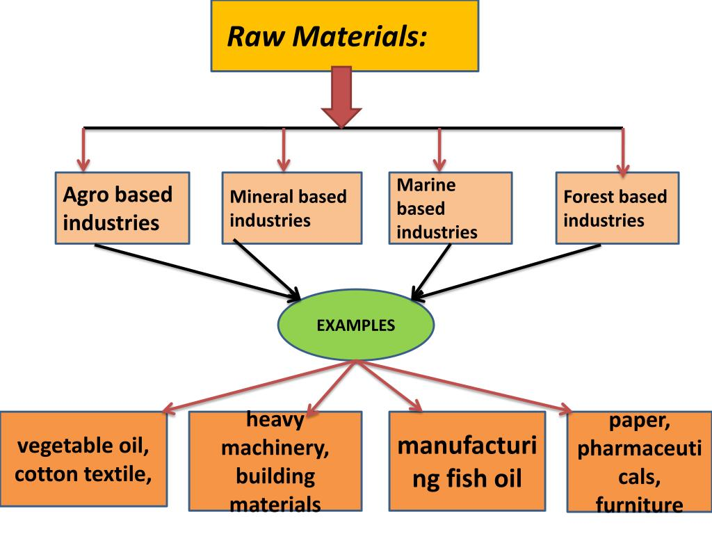

Slide 26
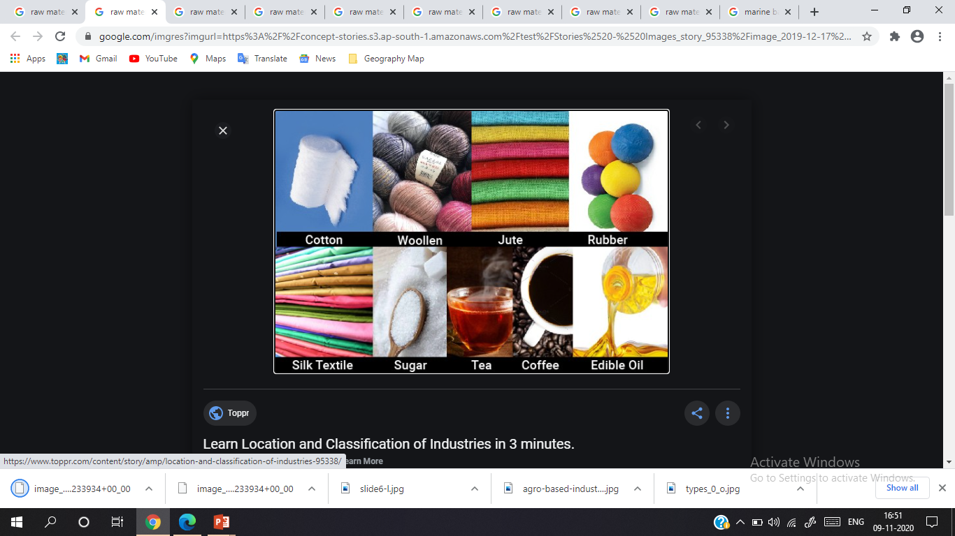

Slide 27


Slide 28
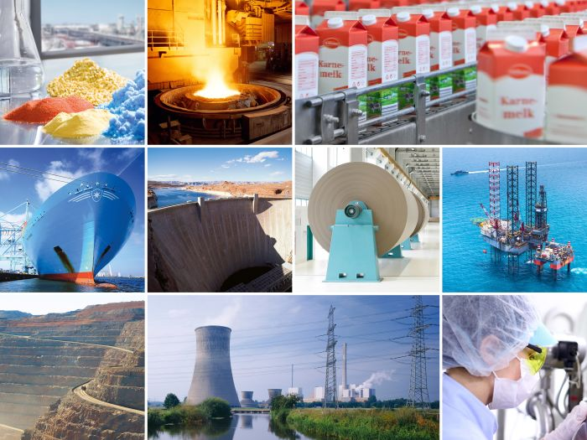

Slide 29
Size of Industries: Size refers to the amount of capital invested, number of people employed and the volume of production. Industries based on size are classified into cottage industries, small scale and large scale industries.
Cottage Industries:
Also known as VILLAGE or HOUSEHOLD Industry.
Few people get together, use simple tools and make things for sale.
Work from home
Do not use machines.
Local raw-materials forms finished product for local consumption.
Encouraged to enable village-based artisans to earn a living by following traditional means of occupation.
Example- Toy-Making, Weaving, Pottery, Shoemaking, Jewellery Making

Slide 30
Small Scale Industries:
These industries use lesser amount of capital and technology.
They hire skilled labour.
Use machines
Obtain raw material from outside.
Produce more in terms of volume
Sell through traders in markets.
Works under private sector.
Ex- Silk-weaving, Garments production, food-leather units, chemical manufacturing, furniture-fittings, Automobile components etc.

Slide 31
Large Scale Industries:
Large scale industries produce large volumes of products.
The investment of capital is higher.
Technology is superior.
Employ huge number of workers.
Production is on a mass scale and in voluminous.
For example: Iron-Steel, Petrochemicals, Textile, Production of automobiles- aircraft, railway coach, ship building, cement and heavy machinery etc.
After independence, India gave emphasis to this sector for development.

Slide 32
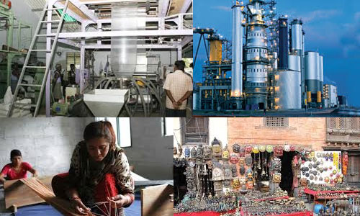
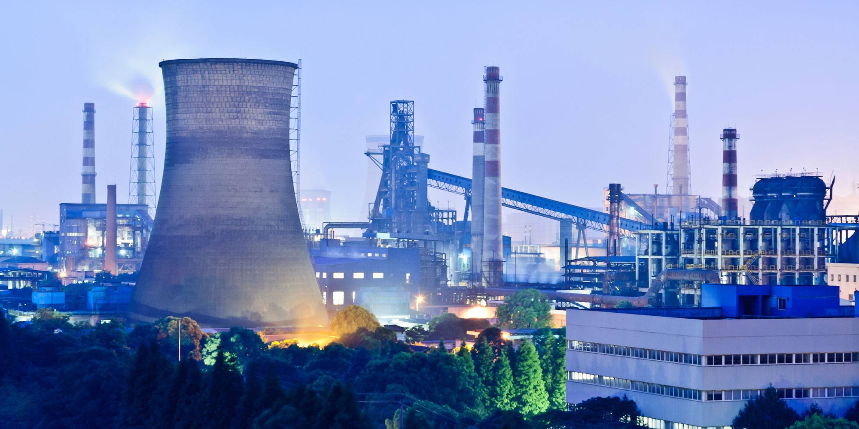
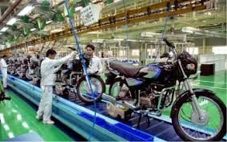

Slide 33
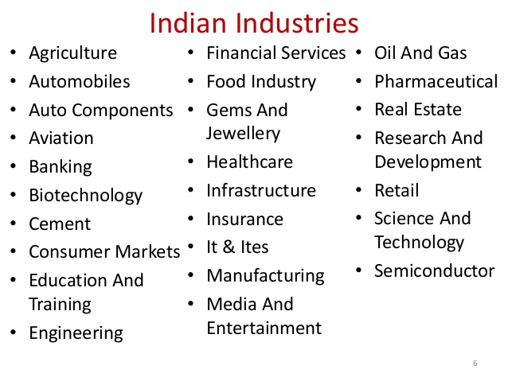

Slide 34
THANKING YOU
ODM EDUCATIONAL GROUP

Slide 36
CONTENT
Factors Affecting Location Of Industries
Raw Materials
Availability of power resources
Labour
Capital
Means of transport
Proximity to markets
Government policy

Slide 37
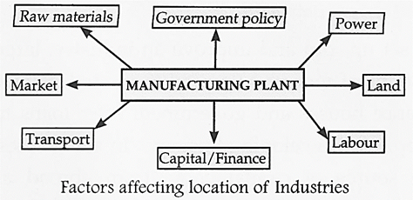

Slide 38
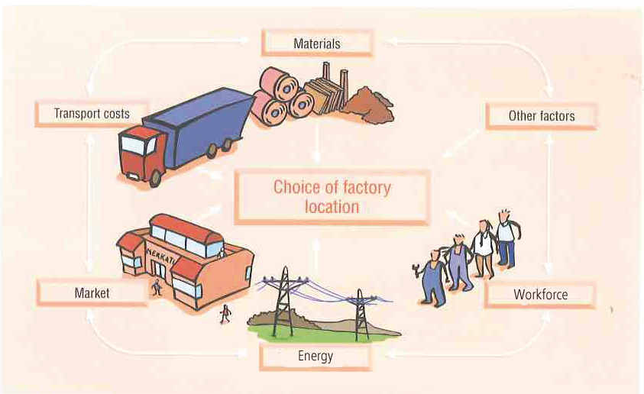
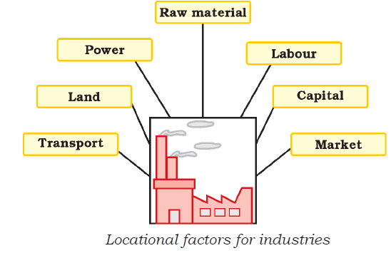

Slide 39
RAW MATERIALS & AVAILABILITY OF POWER RESOURCES
Raw material is easily available.
Important for heavy and bulky industries ex-Iron and Steel or if Raw material is perishable in nature ex-sugarcane, flower.
Industry should be near the source of raw material.
Adequate and steady supply of power at low rates.
Coal, Mineral Oil, Hydroelectric Power, Biogas
Iron-Steel Industry, metal industry are located near thermal or hydroelectric power plants.

Slide 40
LABOUR & CAPITAL
Variety of labour or workers for varied works efficiently.
Skilled, Semi-skilled and Unskilled Labourers.
Managers, Technicians, Engineers
Labour intensive industries- textile industry
Huge capital investment is required as per size of the industry.
Working Capital for day-today operations as well as fixed capital which refers to long term investment in fixed assets like factory, land, builging and machinery.

Slide 41
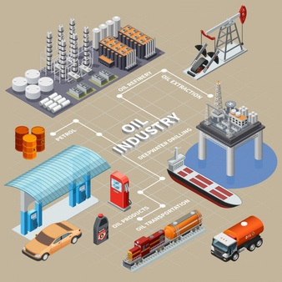
MEANS OF TRANSPORT
To move raw material to the industries and finished products to the markets.
Network of roadways, railways, waterways and airways is important.
Helps in distribution of products to markets.

Slide 42
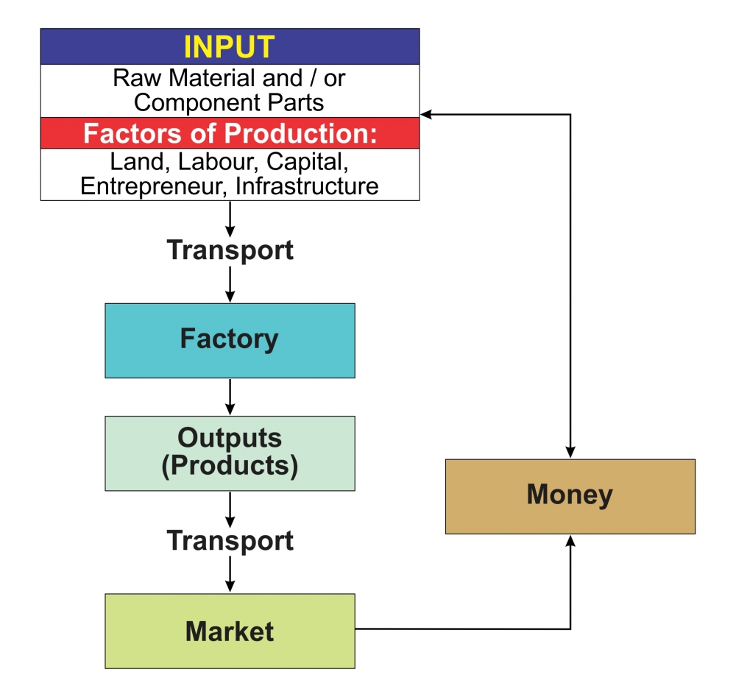
PROXIMITY TO MARKETS
The finished products from the industries are sent to the market and sold to different people who require them.
Quick sale of goods.
If market is near it saves cost of transportation on products.

Slide 43




GOVERNMENT POLICY
The government develops industrial estates to encourage industries.
Government gives subsidies.
Supportive policies of the government influence industrial location.

Slide 44
THANKING YOU
ODM EDUCATIONAL GROUP

Slide 46
CONTENT
Industrial System
Industrial Regions

Slide 47
Industrial System
An industrial system consists of inputs, processes and outputs.
Raw materials, labor and costs of land, transport, power and other infrastructure are the inputs.
The processes include a wide range of activities that convert the raw materials into finished products.
The result or the outputs are the end of product and income earned from it.
Industrial set ups also depends on the political will.

Slide 48
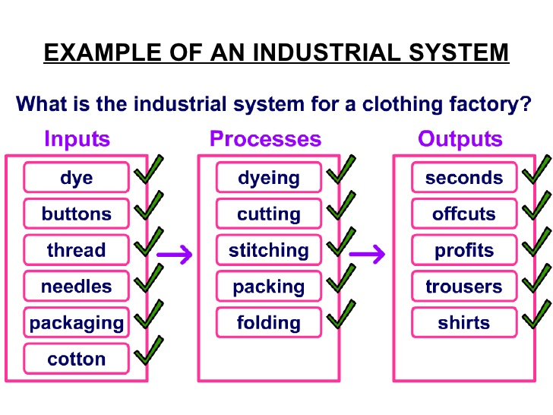

Slide 49
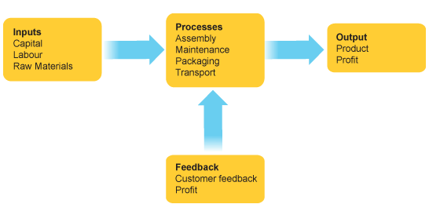

Slide 50
Industrial Regions:
Industrial regions emerge when a number of industries locate close to each other and share the benefits of their closeness.
Major industrial regions tend to be located in the temperate areas, near sea ports and especially near coal-fields.
Major industrial regions of the world are eastern North America, western and Central Europe, western and central Europe and eastern Asia (China, Japan). (Urbanised and densely populated)
In India the industrial regions are Mumbai-Pune cluster, Bangalore-Tamil Nadu region, Hugli region, Ahmadabad-Baroda region, etc.
Industrial regions depends on technological advancement of a country too.
Now industrial corridors are being set up by countries to utilize maximum potential. China-India economic corridor is one of the such examples.

Slide 51
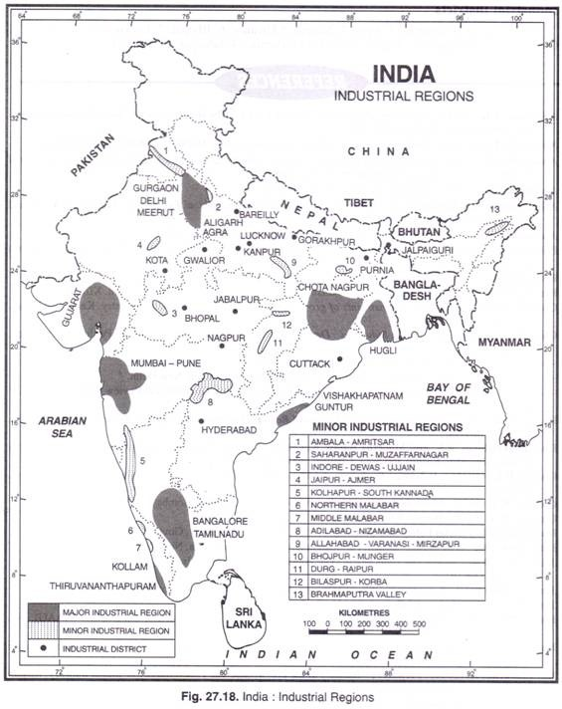
Industrial Regions
The Mumbai-Pune cluster
The Ahmadabad-Vadodara region
The Gurgaon-Delhi-Meerut region
The Bangalore-Coimbatore-Madurai cluster
The Jharkhand-West Bengal region

Slide 52
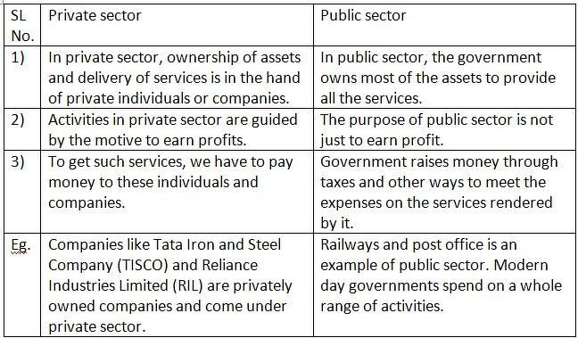
EXERCISE
Distinguish between:-
Public and Private Sector Industries

Slide 53
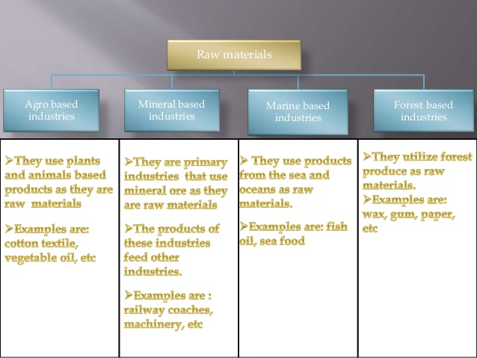

Slide 54
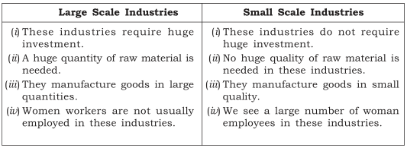
Large and Small Scale Industry

Slide 55
Give Reasons-
1.Several industrial cities are located along the coast.
Industrial cities are located near the coast because of availability of water in abundance for production process, export through cheap waterways and availability of hydroelectric power.
2.Industries provide value addition.
Yes, Industries provide value addition because when a raw material goes in a industry it goes in a process of processing and when it comes out it becomes a valuable product like- wood pulp=processing=paper

Slide 56


SQA
Q.1.What is foot loose industry?
Industries independent of factors.
Q.2.What are multinational firms?
Big companies that operate from several countries. Globally competitive and gives maximum profits. Ex-Infosys, Tata Steel, Nokia, Samsung etc.

Slide 57
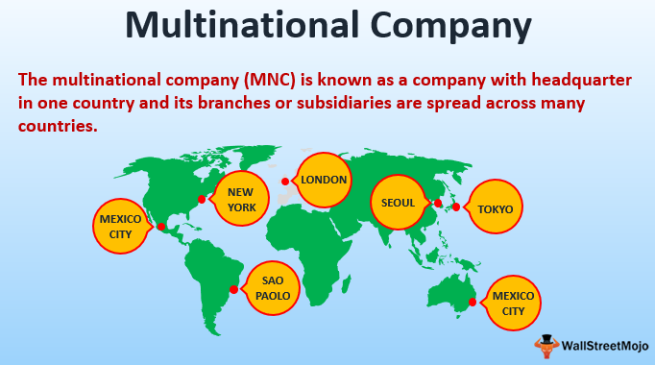

Slide 58
THANKING YOU
ODM EDUCATIONAL GROUP

