Slide 1
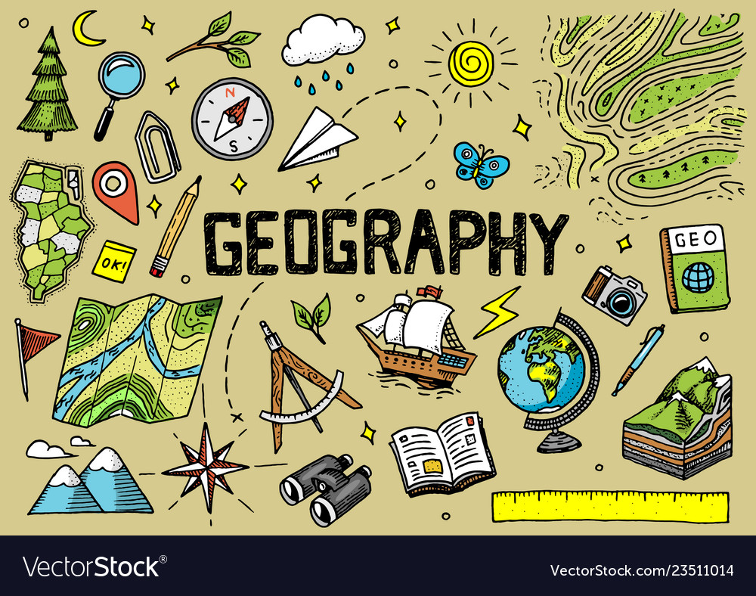
ODM LEARNING

Slide 2
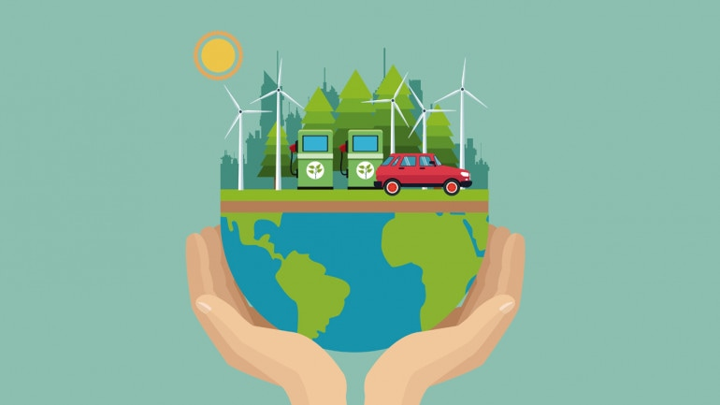


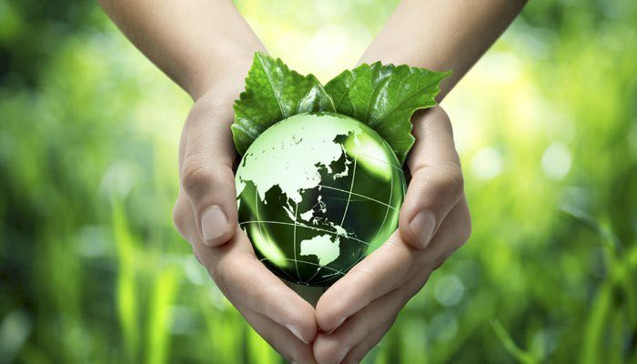

CLASS-VIII
LAND, SOIL AND WATER RESOURCES
SUBJECT : GEOGRAPHY
CHAPTER NUMBER: 02
CHAPTER NAME : LAND, SOIL AND WATER RESOURCES

Slide 3
Learning Outcomes:-
To be able to understand distribution of water.
To be able to understand the significance of water resources & types of water resources in India.
To know different ways of water conservation.

Slide 4
CONTENTS:-
Water Resources
Water Resources in India
Multi-Purpose River Projects
Water Pollution
Water Conservation

Slide 5
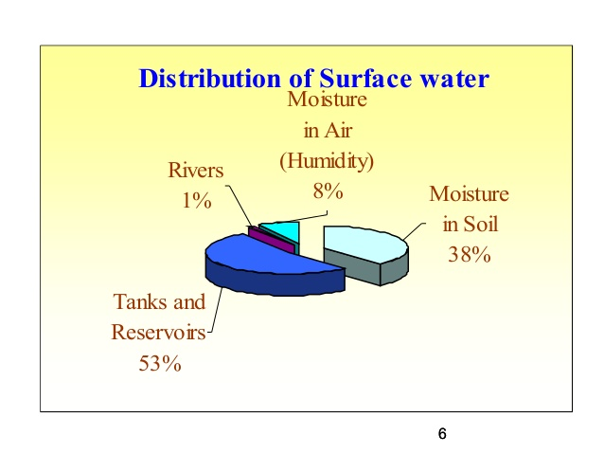
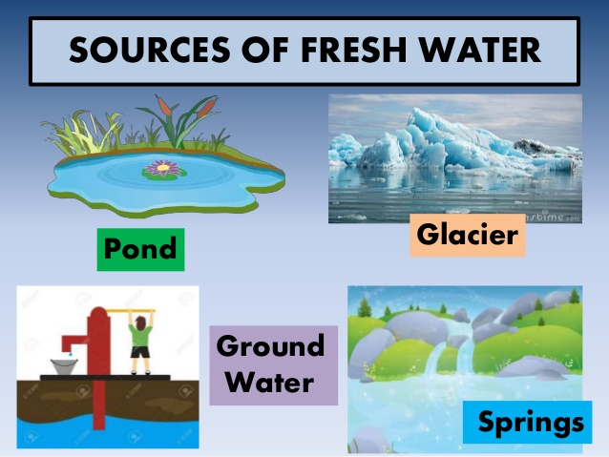
WATER

Slide 6
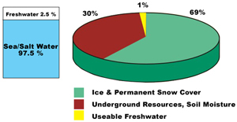
WATER DISTRIBUTION

Slide 7
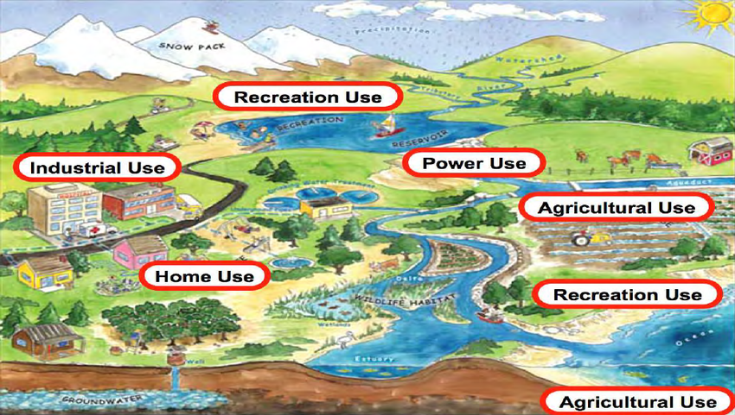
USES OF WATER

Slide 8
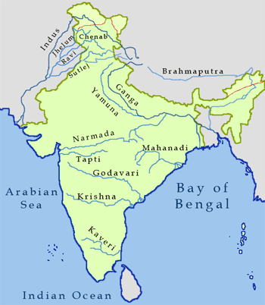
WATER RESOURCES OF INDIA (MAP)
India has abundant water resources.
Perennial Rivers
Seasonal Rivers
Irrigation

Slide 9
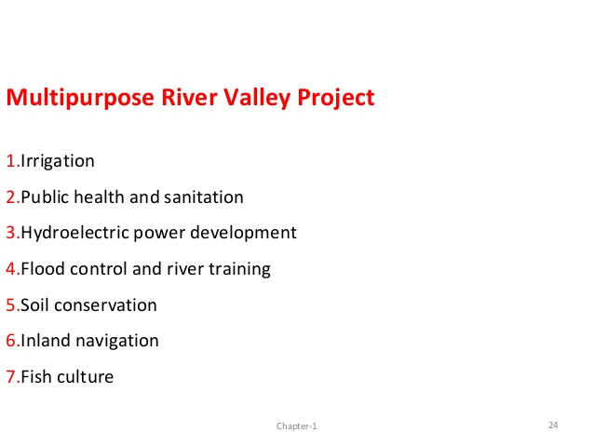
MULTIPURPOSE PROJECTS
Multi purpose project is a project which can do many works at a time.
OR
A project which serves more than one project is called multi purpose project. For example, water project is planned for various purpose like irrigation, hydropower generation, water supply for drinking, etc.

Slide 10
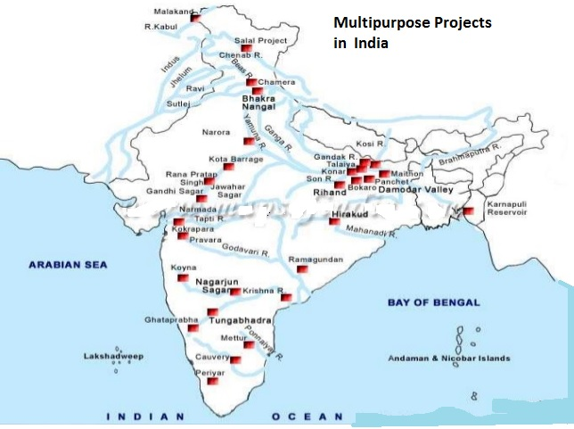
MULTIPURPOSE PROJECTS

Slide 11
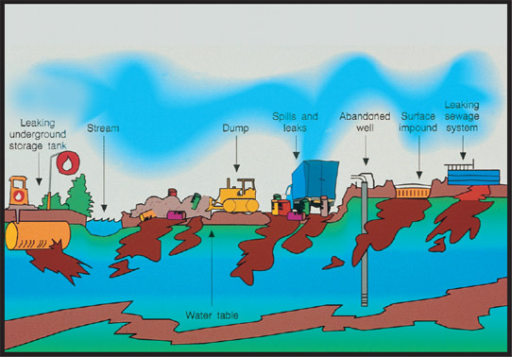
WATER POLLUTION

Slide 12
REASONS TO CONSERV WATER
Scarcity of water
Increase in population, increase in demand for water.
Drying up of water sources
Water pollution
Variation in seasonal and annual precipitation.
Over-exploitation
Wastage of water

Slide 13
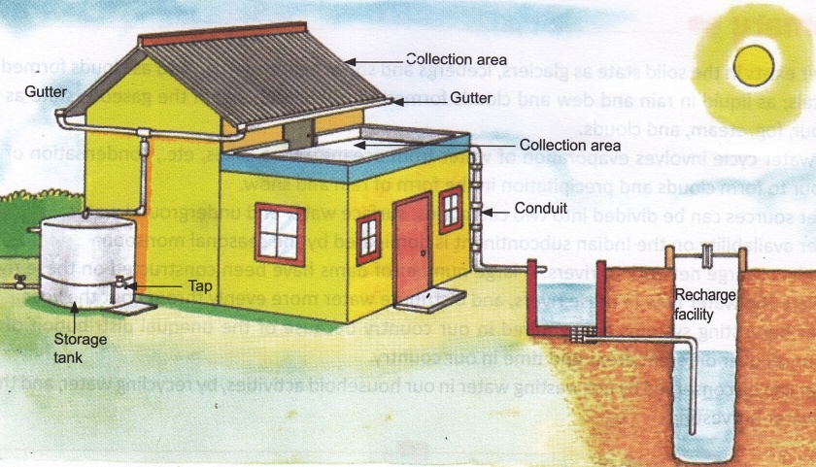
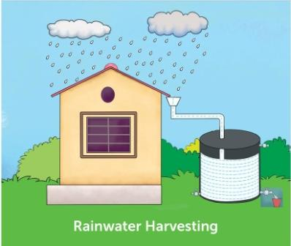
WAYS OF WATER CONSERVATION

Slide 14
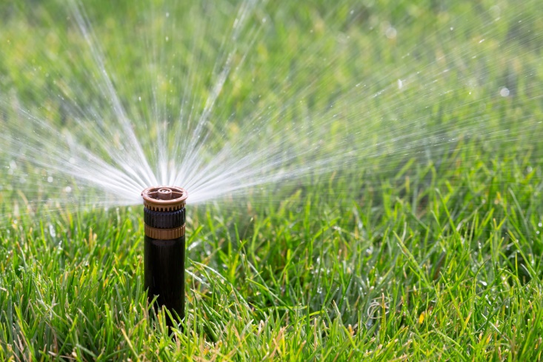
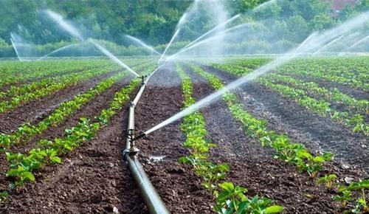
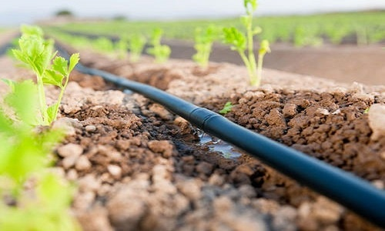
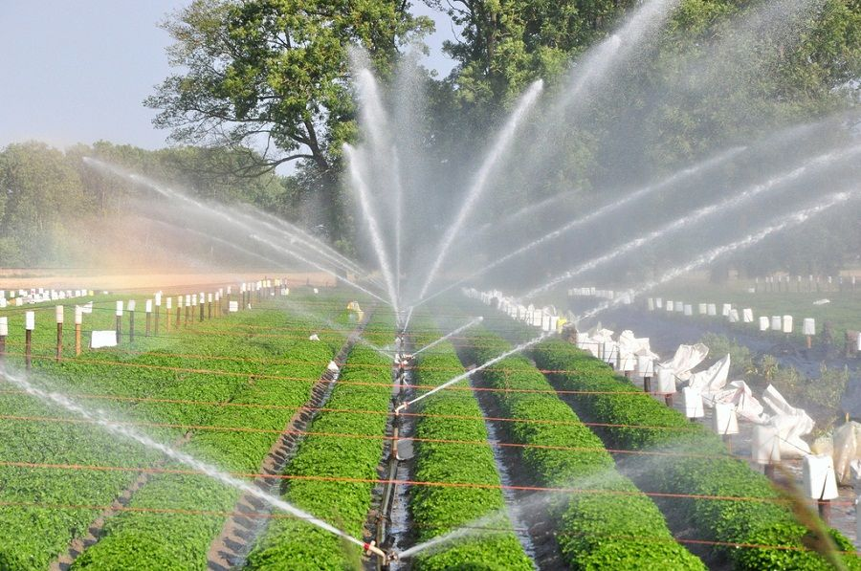

Slide 15


Slide 16
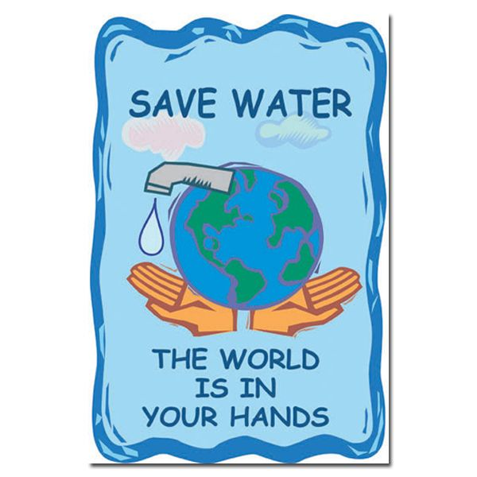

Slide 17
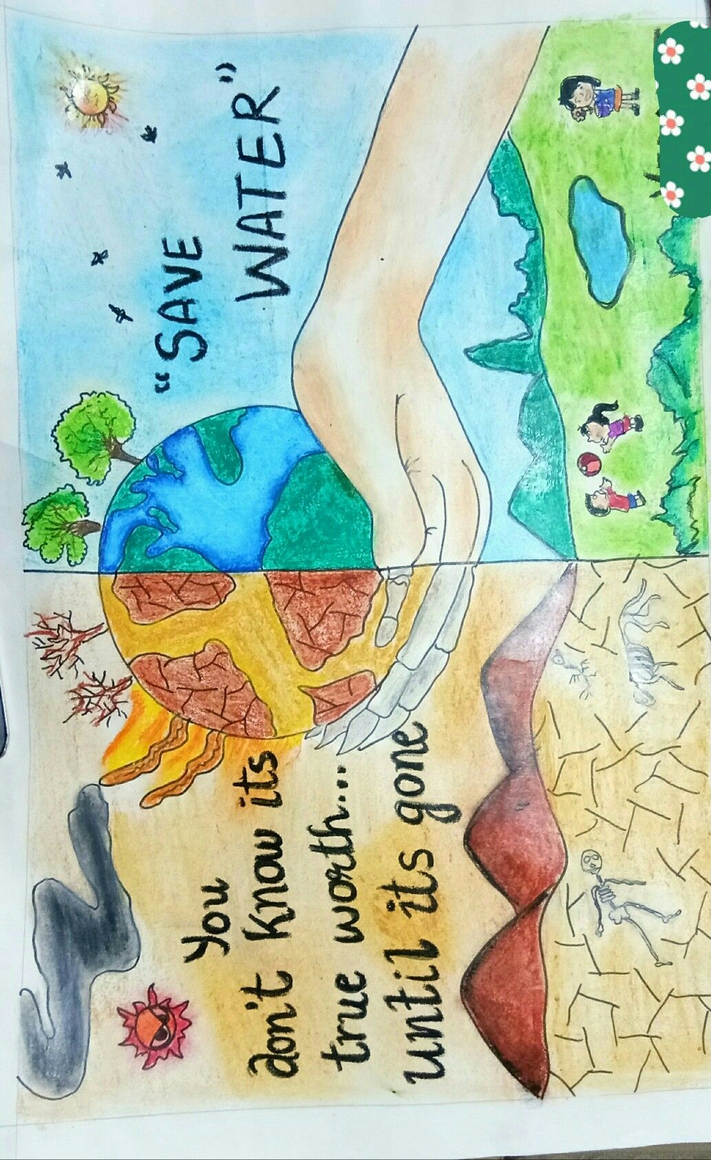
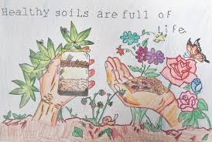
ACTIVITY
DRAW A POSTER ON ANY OF THE FOLLOWING TOPIC:-
SOIL CONSERVATION
WATER CONSERVATION

Slide 18
Home Assignment
Differentiate between perennial and season rivers of India.
2. Mention uses of water.
3. What are different ways of water conservation?

Slide 19
THANKING YOU
ODM EDUCATIONAL GROUP

