Slide 1
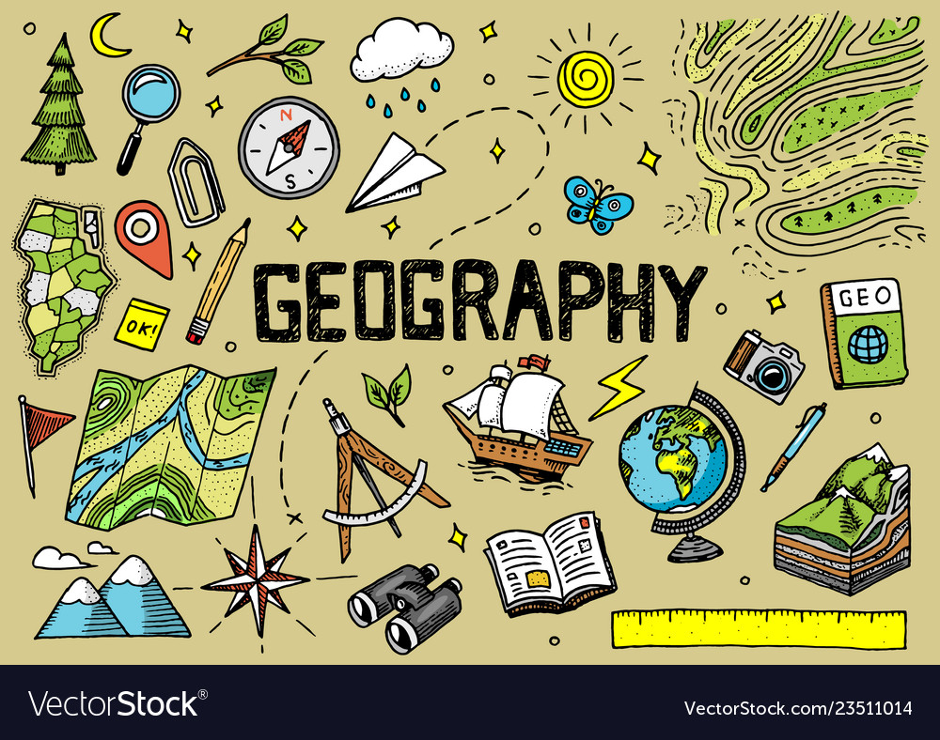
ODM LEARNING

Slide 2
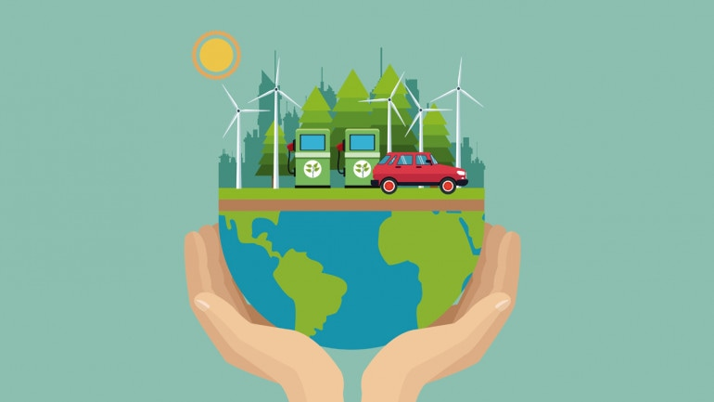

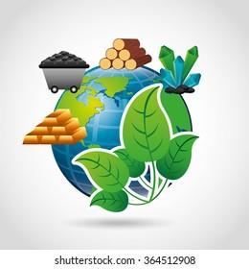


CLASS-VIII
LAND, SOIL AND WATER RESOURCES
SUBJECT : GEOGRAPHY
CHAPTER NUMBER: 02
CHAPTER NAME : LAND, SOIL AND WATER RESOURCES

Slide 3
Learning Outcomes:-
To be able to know consequence of soil erosion.
To be able to understand the significance of methods of soil conservation.

Slide 4
CONTENTS:-
Soil Erosion
Methods of Soil Conservation

Slide 5
SOIL EROSION
Soil erosion is the removal of top soil.
SOIL DEGRADATION : Depletion of soil.
It is a vital resource which is responsible for the sustenance of all plants, animals and human beings.
https://www.youtube.com/watch?v=qNTOq1uEObc SOIL EROSION

Slide 6
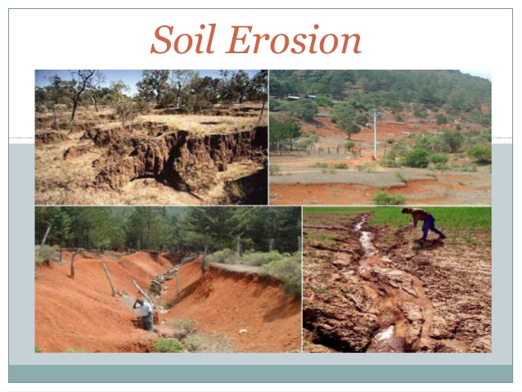
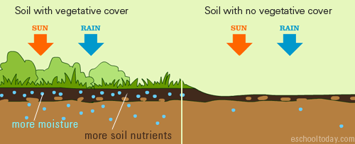
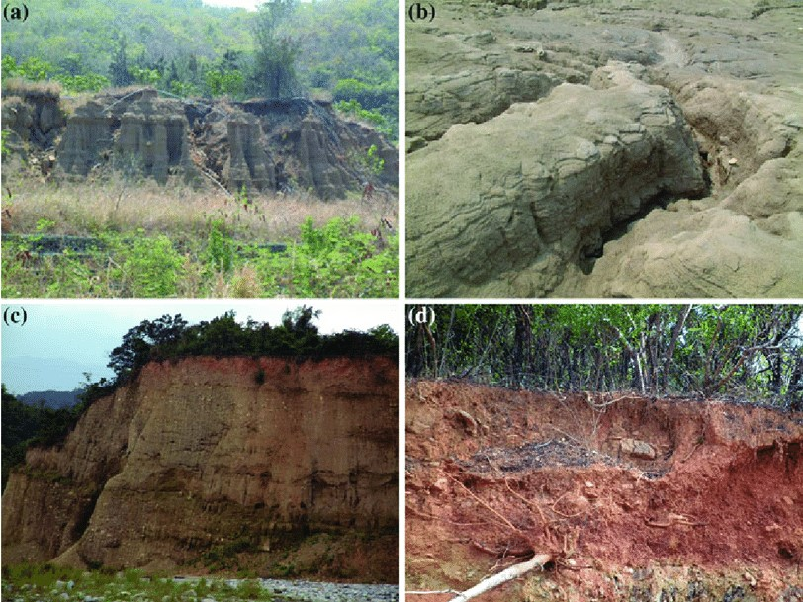

Slide 7
SOIL CONSERVATION
1. Ploughing along the contour lines decelerate the flow of water down the slopes. This is called contour ploughing.
2. Terrace cultivation restricts erosion. This type of agriculture practice is done in western and central Himalayas.
3. When a large field is divided into strips and strips of grass are left to grow between the crops. Then, this breaks up the force of the wind. This method is known as strip cropping.
4. Planting lines of trees to create shelter helps in the stabilization of sand dunes and in stabilizing the desert in western India. Rows of such trees are called shelter belts.
https://www.youtube.com/watch?v=uo_ntewAemw

Slide 8
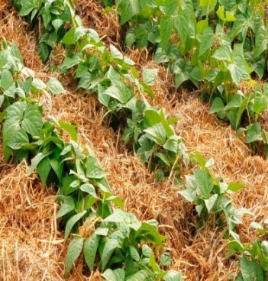
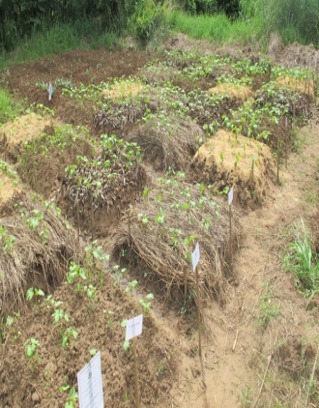
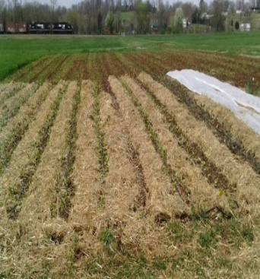
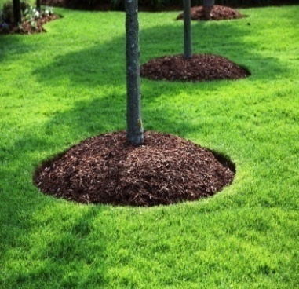
MULCHING

Slide 9
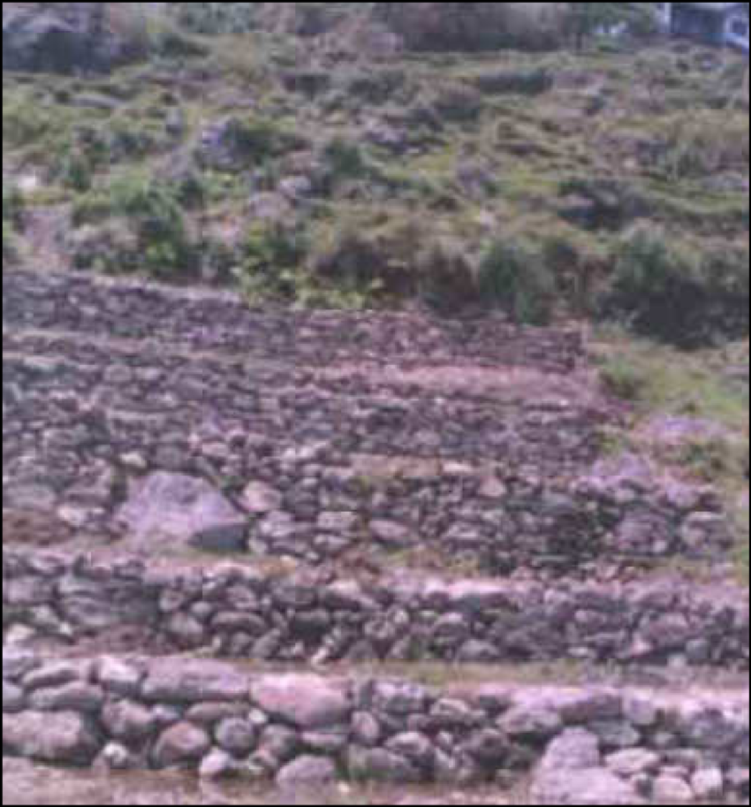
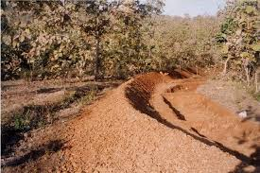
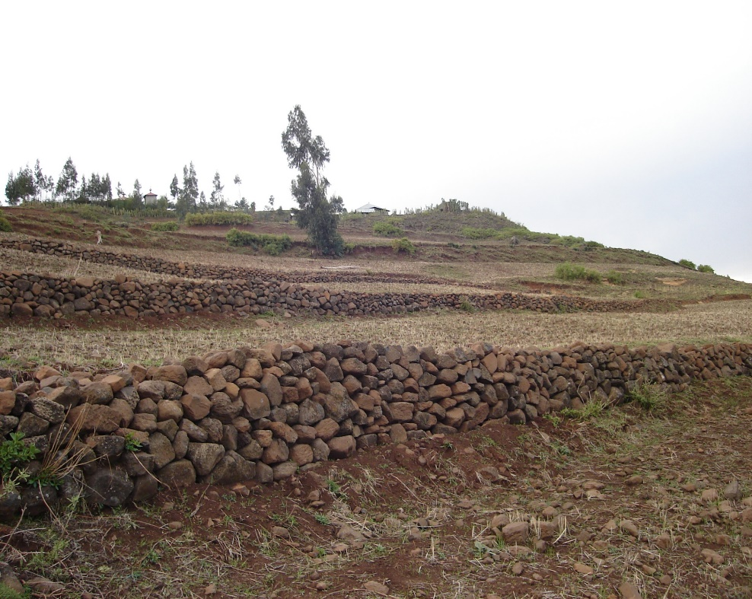
COUNTOUR BUNDING

Slide 10
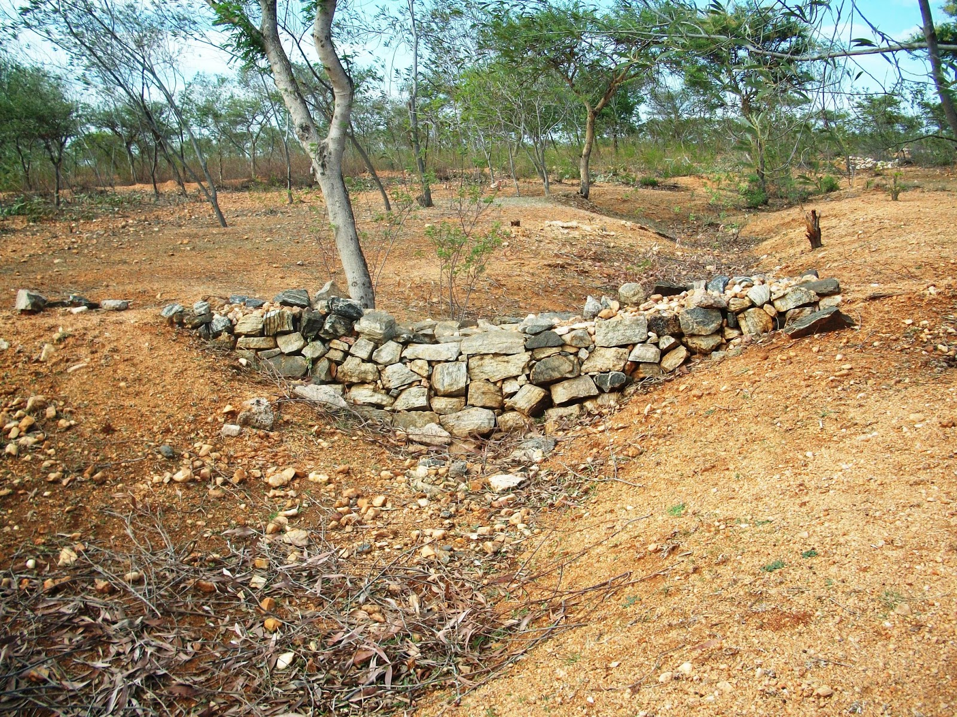
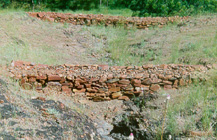
PLUGGING

Slide 11
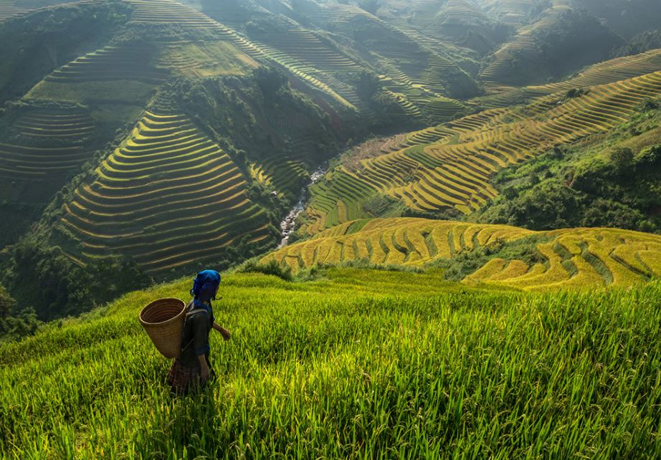
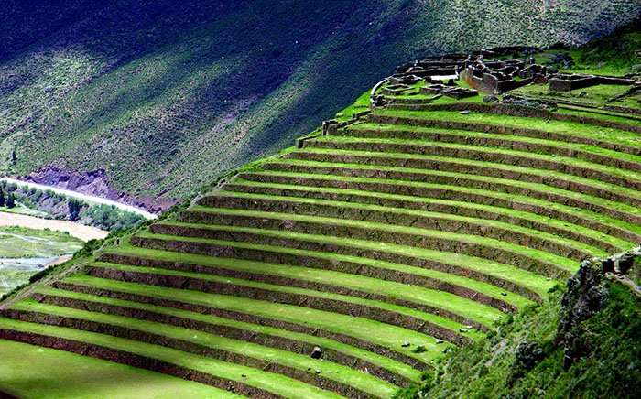
TERRACE FARMING

Slide 12
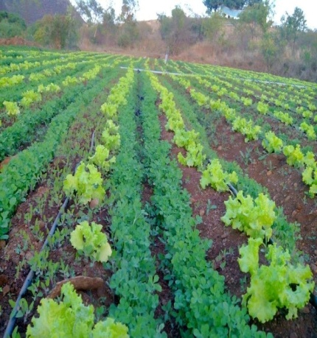
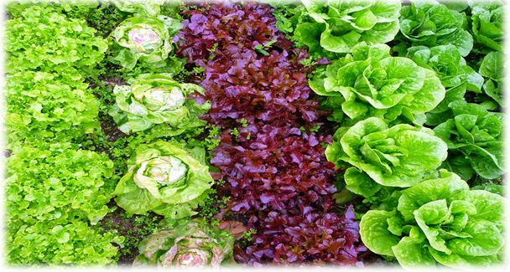
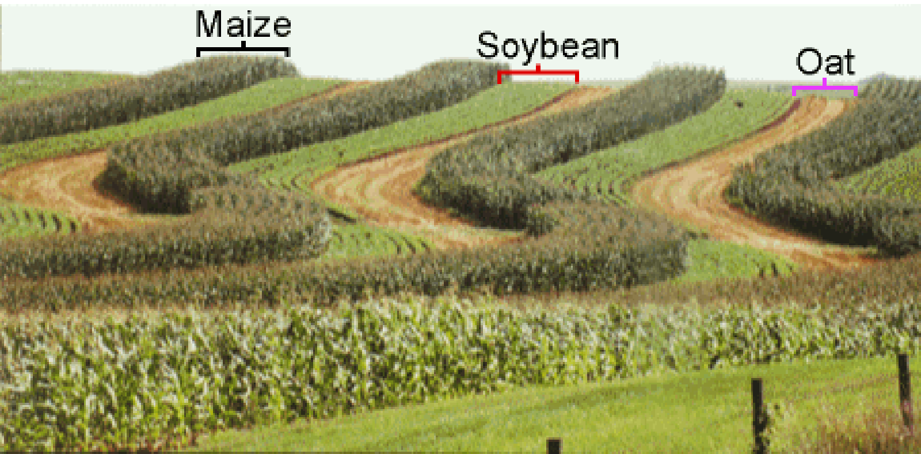
INTERCROPPING

Slide 13
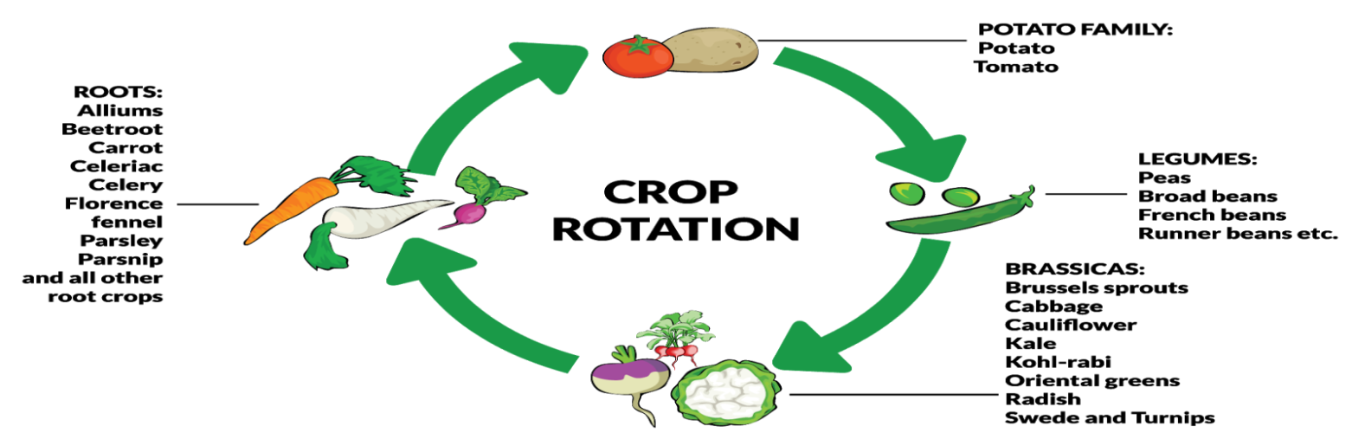
CROP ROTATION

Slide 14
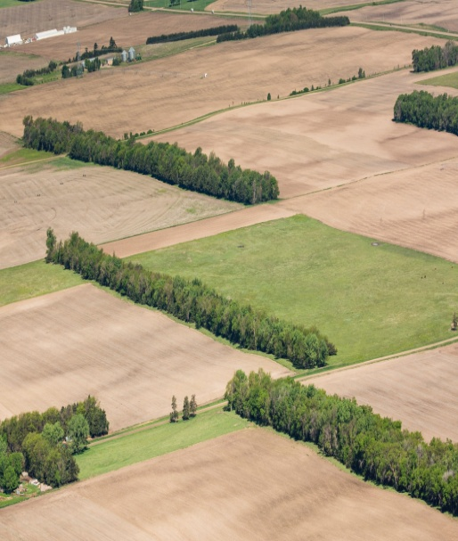
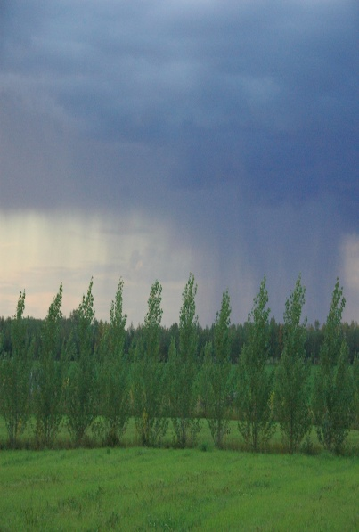
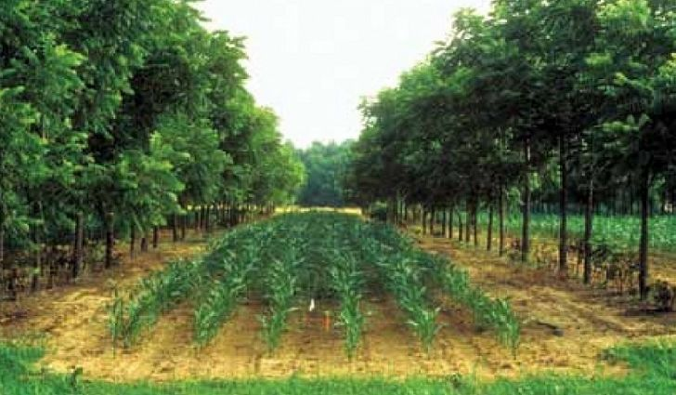
SHELTER BELTS

Slide 15
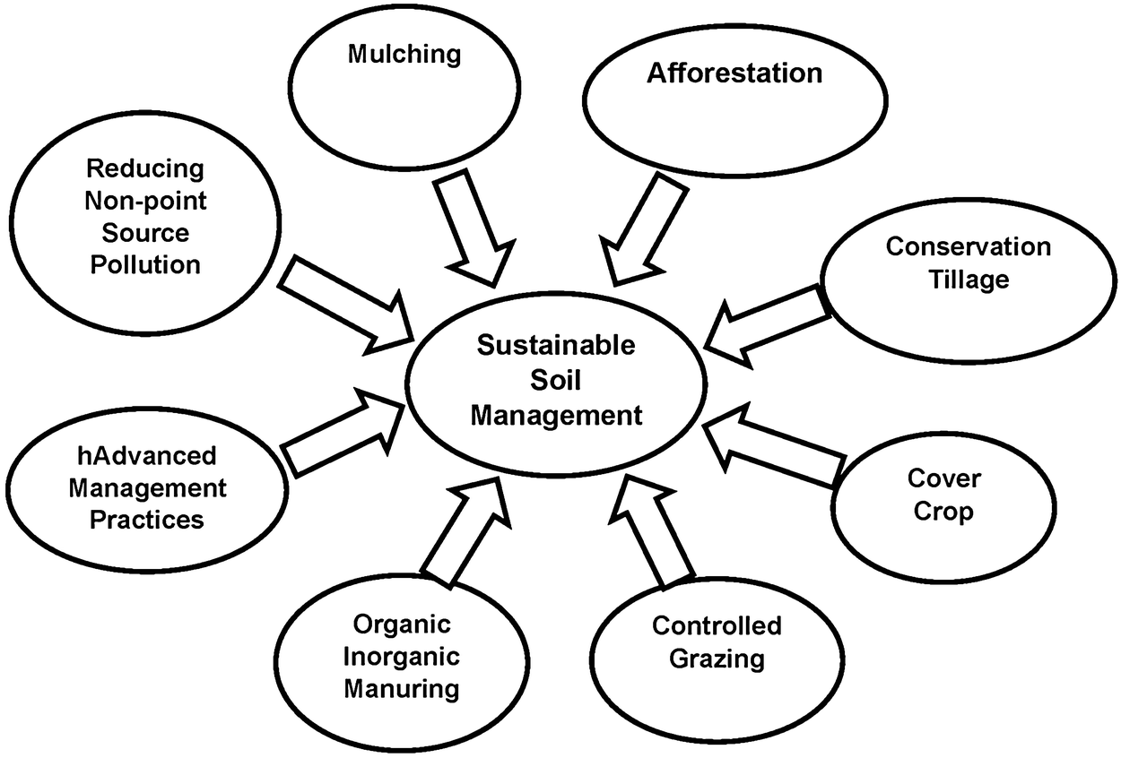

Slide 16
Home Assignment
1. What is soil erosion?
2. Mention methods to conserve soil in the hilly regions.
3. What can be done to conserve soil in the coastal regions?

Slide 17
THANKING YOU
ODM EDUCATIONAL GROUP

