Slide 1

ODM LEARNING

Slide 2





CLASS-VIII
LAND, SOIL AND WATER RESOURCES
SUBJECT : GEOGRAPHY
CHAPTER NUMBER: 02
CHAPTER NAME : LAND, SOIL AND WATER RESOURCES

Slide 3
Learning Outcomes:-
To be able to know the location and distribution of soil in India.
To be able to understand the significance of soil and its impact on agriculture/vegetation of various location.

Slide 4
CONTENTS:-
SOILS OF INDIA
Alluvial Soil
Black Soil
Laterite Soil
Arid Soil
Mountain Soil
Red/Yellow Soil

Slide 5
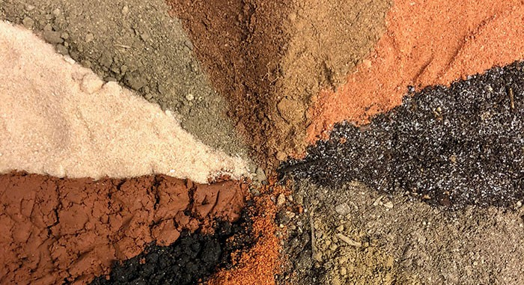
SOILS OF INDIA
The soils of India are classified into eight different types according to The Indian Council of Agricultural Research (ICAR).

Slide 6
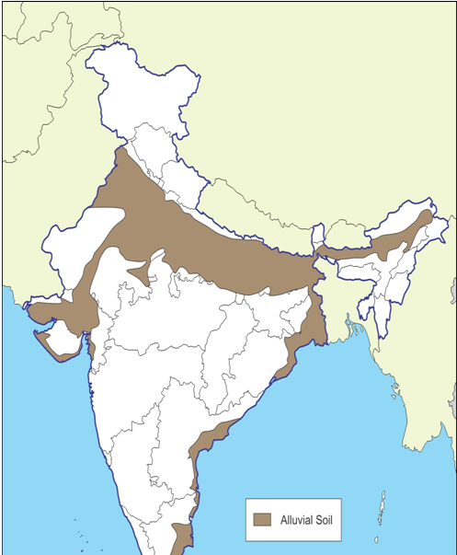
ALLUVIAL SOILS

Slide 7
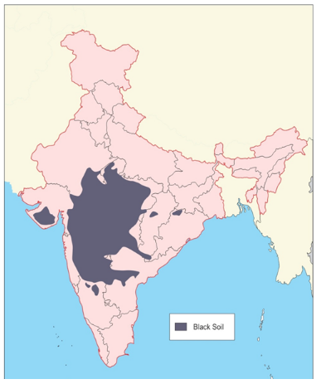
BLACK SOIL

Slide 8
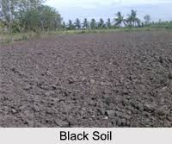
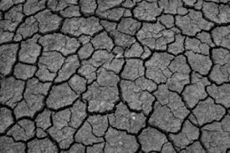

Slide 9
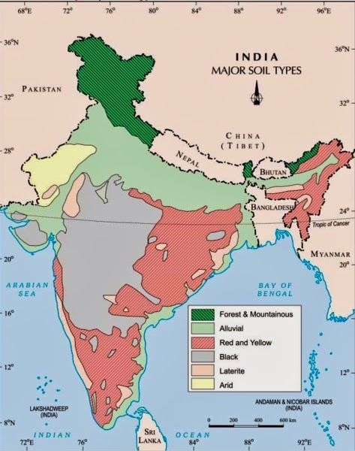
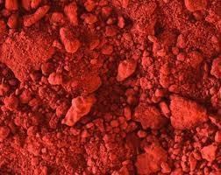
RED SOILS

Slide 10
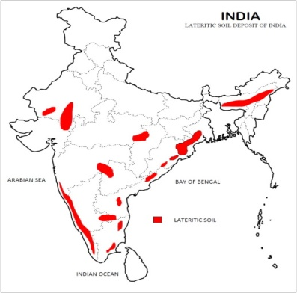
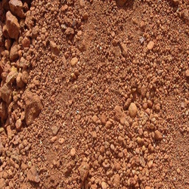
LATERITE SOIL

Slide 11
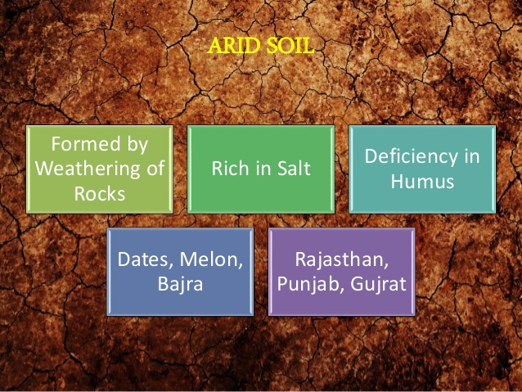

ARID SOILS

Slide 12
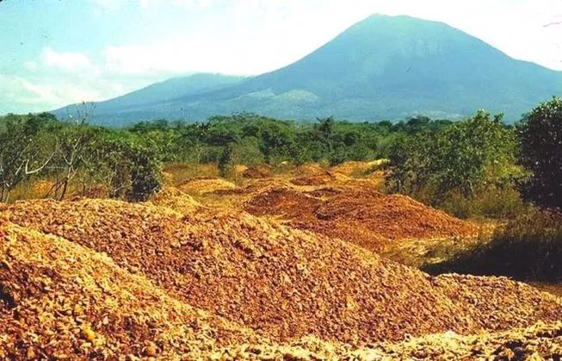
FOREST SOILS

Slide 13
TYPES OF INDIAN SOIL :-
SOIL | FORMATION | FEATURE | AREAS
ALUVIAL SOIL | DEPOSITIONAL ACTION OF RIVERS | MOST FERTILE SUPPORT CULTIVATION | INDO-GANGETIC PLAINS, DELTAIC PLAINS
BLACK SOIL (REGUR/COTTON) | SOLIDIFICATION OF LAVA | SWELLS WHEN WET. DEVELOPES CRACKS WHEN DRY GOOD FOR CEREALS, PULSES, OIL SEEDS, CITRUS FRUITS, VEGETABLES | DECCAN PLATEAU
RED SOIL | DIFFUSION OF METAMORPHIC ROCKS | SANDY, RED IN COLOUR (PRESENCE OF IRON-OXIDES) LESS FERTILE IN UPLANDS | ODISHA, MP, TN, TELANGANA, AP, KERALA
LATERITE SOIL | INTENSE LEACHING (WATER WASHES OUT SOIL NUTRIENTS) | NEED FERTILISERS FOR CULTIVATION USED FOR BRICK MAKING, JUTE, MILLETS, FODDER CROP | MAHARASTRA, KARNATAKA, KERALA, ODISHA, TN, WB
ARID/ SANDY SOIL | DRY REGION, LACK MOISTURE | LOW MOISTURE, LACK VEGETATION COVER, IRRIGATION HELPS IN CULTIVATION | WESTERN RAJASTHAN
PEATY/FOREST SOIL | NATURAL OCCURING FOREST AND REGIONS OF DENSE VEGETATION | RICH IN HUMUS, ORGANIC MATTER, | UTTARANCHAL, J&K, JHARKHAND, BIHAR, N-E States

Slide 14
Home Assignment
Mention various soil found in India?
Give three features of alluvial soil.
Write the distribution of laterite soil in India?
Which soil is also known as Regur Soil? Mention features of the same.

Slide 15
THANKING YOU
ODM EDUCATIONAL GROUP

