Slide 1

ODM LEARNING

Slide 2





CLASS-VIII
LAND, SOIL AND WATER RESOURCES
SUBJECT : GEOGRAPHY
CHAPTER NUMBER: 02
CHAPTER NAME : LAND, SOIL AND WATER RESOURCES

Slide 3
Learning Outcomes:-
To be able to know the meaning of resources, their variety, location and distribution.
To be able to understand the significance of resources & types of land resources, their distribution and utility.

Slide 4
CONTENTS:-
LAND RESOURCES
CLASSIFICATION OF LAND
LAND USE
LAND DEGRADATION
CONSERVATION OF LAND RESOURCES

Slide 5
Land is one of the most important Natural resources although it covers only 30% of the total area of the earth's surface.
Water is the most important natural resource for all life, but only 1% of water is directly useful to humans.
The growth of vegetation depends mainly on temperature and moisture.
Soil is closely linked to land, and it's formation an use depend on many local factors.
All plants and animals, big or small, are important to maintain balance in the ecosystem.

Slide 6
Land as a Resource. Land is a very valuable resource. It provides food, fiber, wood, medicine and other biological materials needed for food. Land is used for constructing buildings and industries.
Classification of Land
RELIEF
(Plains, Plateau, Moumtains)
SOIL FERTILITY
(Fertile and Barren Land)
Development of Area
(Rural and Urban)
OWNERSHIP
(Private, Community or Government)
USE
(Arable, Pasture, Forests, Fallow, Cultivable waste, Non-argricultural)

Slide 7
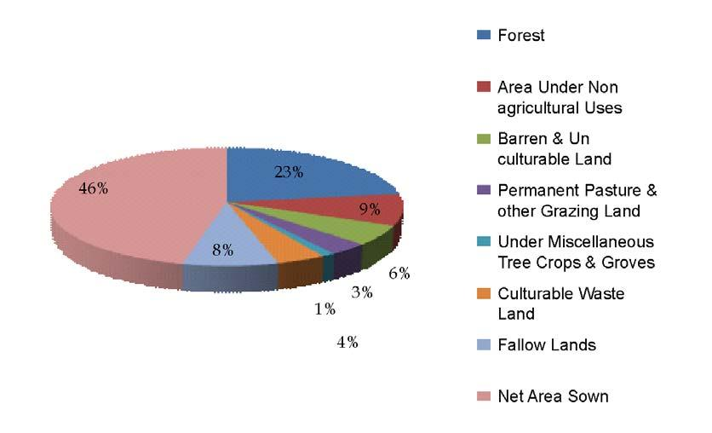
LAND USES :-

Slide 8
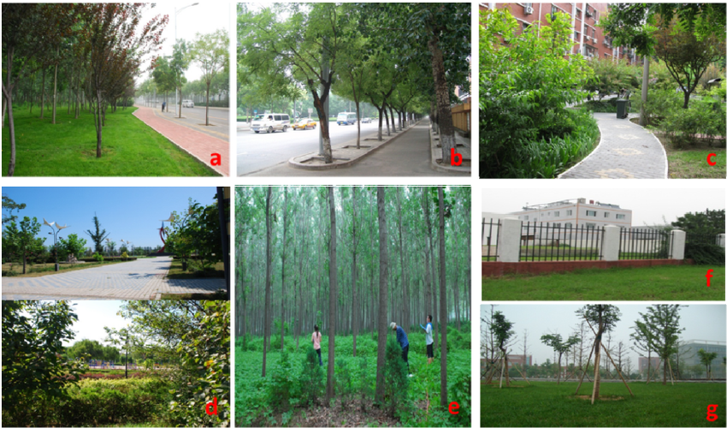
We use LAND in different ways :

Slide 9
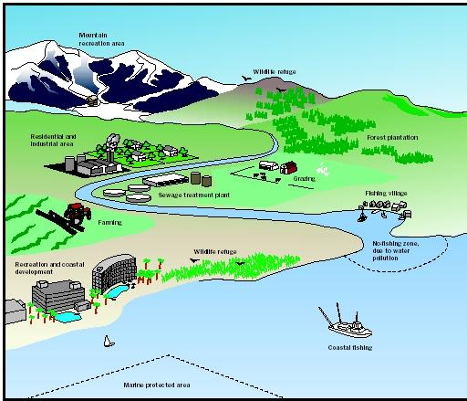
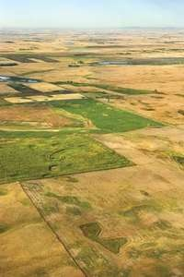
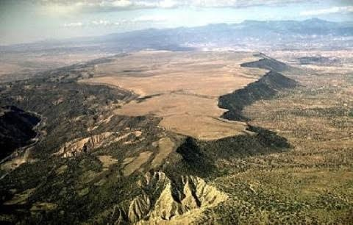
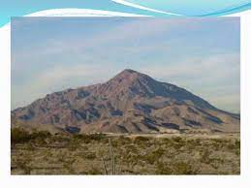
In India 43% plain land area provides facilities for agriculture and industry, 30% Mountains area of the country and ensure perennial flow of some rivers, provide facilities for tourism and ecological aspects, 27% plateau region are rich reserves of minerals, fossil fuels and forests.

Slide 10
Land resources are used for the following purposes:
Net Sown Area: 46.6%
Forested Land: 22.6%
Permanent Pasture: 3.6%
Cultivable Wasteland: 4.5%
Land not available for cultivation: 13.5% (non-agricultural uses)

Slide 11
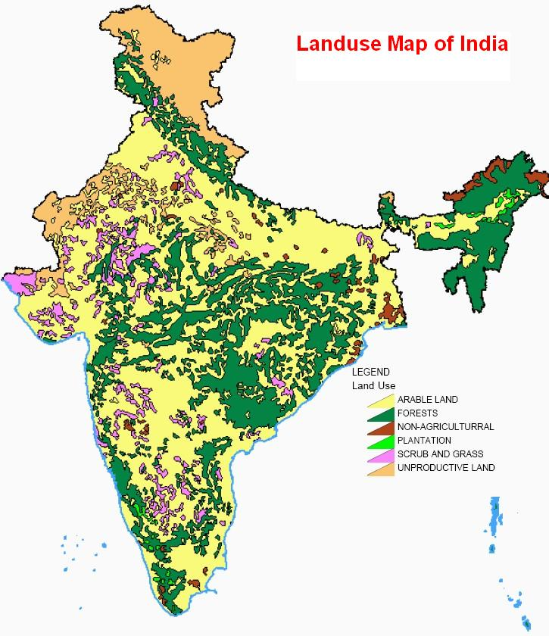
Land Use Pattern of India

Slide 12
Home Assignment
What do you mean by land as resource?
Mention different land use.
Differentiate between land classification on the basis of ownership.

Slide 13
THANKING YOU
ODM EDUCATIONAL GROUP

